Slide 1
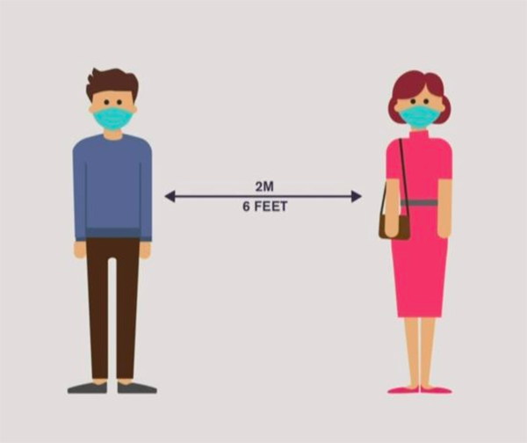

C.V. RAMAN GLOBAL UNIVERSITY, bhubaneswar
SOCIAL DISTANCE MONITORING
AND FACE MASK DETECTION

Slide 2
GROUP : CSE-2 SUB GROUP : 5
Manashi priyadarshani 1801227263
Sidharth K. Mohanty 1801227500
Shaikh Adnan 1801227463
Satyajit Mahunta 1801227446
GUIDED BY-
Dr. Sukant Kishoro Bisoy

Slide 3
CONTENTS:
Introduction
Objective
Technology and concepts
Social distance monitoring(flow chart)
Face mask detection(flow chart)
Experimental setup(algorithm)
Conclusion
References

Slide 4

INTRODUCTION:
Social distancing, also called “physical distancing,” means keeping a safe space between yourself and other people who are not from your household. To practice social or physical distancing, stay at least 6 feet (about 2 arms' length) from other people who are not from your household in both indoor and outdoor spaces.This way of living has been forced upon us by the fastest growing pandemic the world has ever seen – COVID-19.

Slide 5
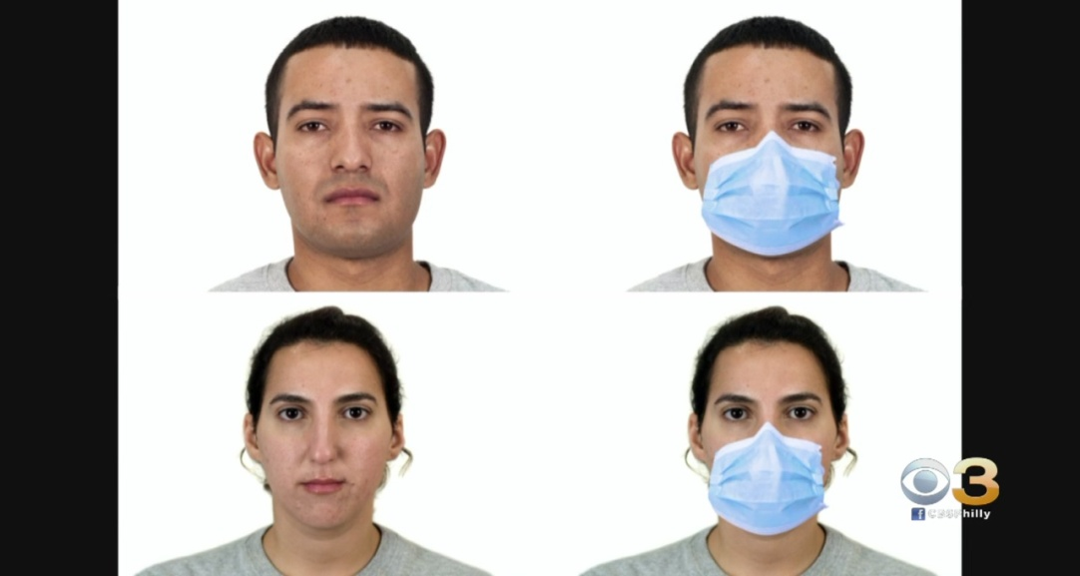
Cont………
Face detection has emerged as a very interesting problem in image processing and computer vision.
It has a range of applications from facial motion capture to face recognition which at the start needs the face to be detected with a very good accuracy.
High accuracy image classification is possible now with the advancements of Convolution networks. Pixel level information is often required after face detection which most face detection methods .
Using CNN face mask detection process is carried out.

Slide 6
OBJECTIVE:
To ensure COVID protocols in public places and workplace, We have developed social distancing & face mask detection tool that can monitor if people are keeping a safe distance from each other by analyzing real time video streams from the camera.

Slide 7
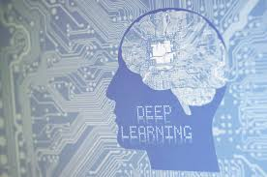
TECHNOLOGY USED:
Deep Learning
Deep learning is a type of Machine learning (ML) and artificial intelligence (AI) that imitates the way humans gain certain types of knowledge. Deep learning is an important element of data science, which includes statistics and predictive modeling. It is extremely beneficial to data scientists who are tasked with collecting, analyzing and interpreting large amounts of data; deep learning makes this process faster and easier.
At its simplest, deep learning can be thought of as a way to automate predictive analytics. While traditional machine learning algorithms are linear, deep learning algorithms are stacked in a hierarchy of increasing complexity and abstraction.

Slide 8
Cont……
Convolutional Neural Network
The convolutional neural network is a type of neural network model designed for working with 2D image data and they can be used with one-dimensional and 3D data.CNN is the convolutional which gives the network its name. That layer performs an operation called as “convolution“..
YOLO V3
YOLO is a advance convolutional neural network for doing image detection in live video stream. These bounding boxes are weighted by the predicted probabilities.YOLO is popular because it achieves high accuracy while also being able to run in real-time. The algorithm “only looks once” at the image in the sense that it requires only one forward propagation pass through the neural network to make predictions. YOLO V3 is an improvement over previous YOLO detection networks.

Slide 9
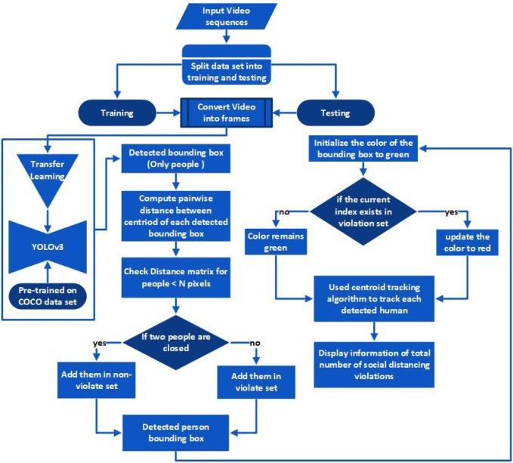
SOCIAL DISTANCE DETECTION:

Slide 10
EXPERIMENTAL SETUP:
Algorithm
To calibrate the camera, Let us assume that a person is at a distance D (assuming distance of person from the camera is 400cm) from camera and the person's actual height is H (assuming the average height of humans is 165cm). Using the object detection model we identify the pixel height P of the person using the bounding box coordinates. Using these values, the focal length of the camera can be calculated using: F = ( P * D ) / H
After adjusting the focal length of the camera, as we continue to move camera both closer and farther away from the object, we can apply the triangle similarity to determine the distance of the object to the camera using the actual height H of the person, pixel height P of the person and focal length F of camera using formula : D’ = ( H * F ) / P
We have the x, y (anchor box centroid) and z (distance of the person from camera) coordinates for every person. The Euclidean distance between every person detected is calculated between the mid-point of the bounding boxes of all the people detected using the (x, y, z) coordinates.
These pixel values are converted into cm using: ( Pixel * Distance ) / Focal Length
If the distance between two people is less than 2 meters or 200 centimeters, a red bounding box is displayed around them indicating that they are not maintaining social distance.

Slide 11
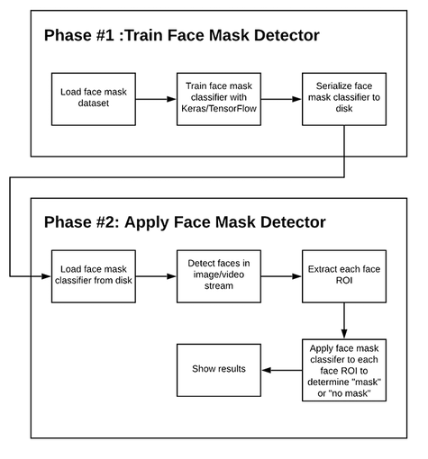
FACE MASK DETECTION

Slide 12
CONCLUSION:
Here we have practiced different deep learning technique and different models for data training attempting to discover a representation of social distance monitoring that allow their effective recognition are people maintain social distance or not and monitor for using face mask to achieve the highest accuracy of identifying .

Slide 13
REFERENCES:
The Visual Social Distancing Problem (MARCO CRISTANI1 (Member, IEEE), ALESSIO DEL BUE2 (Member, IEEE), VITTORIO MURINO3 (Senior Member, IEEE), FRANCESCO SETTI4 (Member, IEEE), AND ALESSANDRO VINCIARELLI5 (Member, IEEE) 1M. Cristani is within the Department of Computer Science, University of Verona, Italy, and Humatics S.r.l. (www.humatics.it) (e-mail: marco.cristani@univr.it) 2A. Del Bue is within Pattern Analysis and Computer Vision (PAVIS), Istituto Italiano di Tecnologia (IIT) (e-mail: alessio.delbue@iit.it) 3V. Murino is within the Department of Computer Science, University of Verona, Italy, and the Ireland Research Centre, Huawei Technologies Co., Ltd., Dublin 4 F. Setti is within the Department of Computer Science, University of Verona, Italy. 5A. Vinciarelli is within the School of Computing Science, University of Glasgow, Scotland. Corresponding author: A. Del Bue (e-mail: alessio.delbue@iit.it))
]S. A. Abbas and A. Zisserman. A geometric approach to obtain a bird’s eye view from an image. In IEEE International Conference on Computer Vision Workshop (ICCVW). IEEE, 2019. [2]
P. Ball. Critical Mass. Arrow Books, 2004.
C. Bartneck, D. Kulic, E. Croft, and S. Zoghbi. Measurement instruments ´ for the anthropomorphism, animacy, likeability, perceived intelligence, and perceived safety of robots. International Journal of Social Robotics, 1(1):71–81, 2009.
J.-C. Bazin and M. Pollefeys. 3-line ransac for orthogonal vanishing point detection. In IEEE/RSJ International Conference on Intelligent Robots and Systems (IROS). IEEE, 2012. [
J.-C. Bazin, Y. Seo, C. Demonceaux, P. Vasseur, K. Ikeuchi, I. Kweon, and M. Pollefeys. Globally optimal line clustering and vanishing point estimation in manhattan world. In IEEE Conference on Computer Vision and Pattern Recognition (CVPR). IEEE, 2012.
L. Bazzani, M. Cristani, D. Tosato, M. Farenzena, G. Paggetti, G. Menegaz, and V. Murino. Social interactions by visual focus of attention in a three-dimensional environment. Expert Systems, 30(2):115– 127, 2013.
A. N. Belbachir. Smart cameras, volume 2. Springer, 2010.
C. BenAbdelkader and Y. Yacoob. Statistical body height estimation from a single image. In IEEE International Conference on Automatic Face & Gesture Recognition (FG). IEEE, 2008
Google.com(for pictorial representation)

Slide 14
THANK YOU

