Slide 1

Ride sharing Company UBER
Instructed By: Dr.V.Bhaskar
-Mansi shah(19526)

Slide 2
Agenda
.
What is the business model of uber?
Why ER model?
Components of ER model
Relationship cardinalities
Participation Constraints
Specialization & Generalization
Category and Union
Entities and their Constraints
ER diagram of UBER
ER diagram Notations

Slide 3
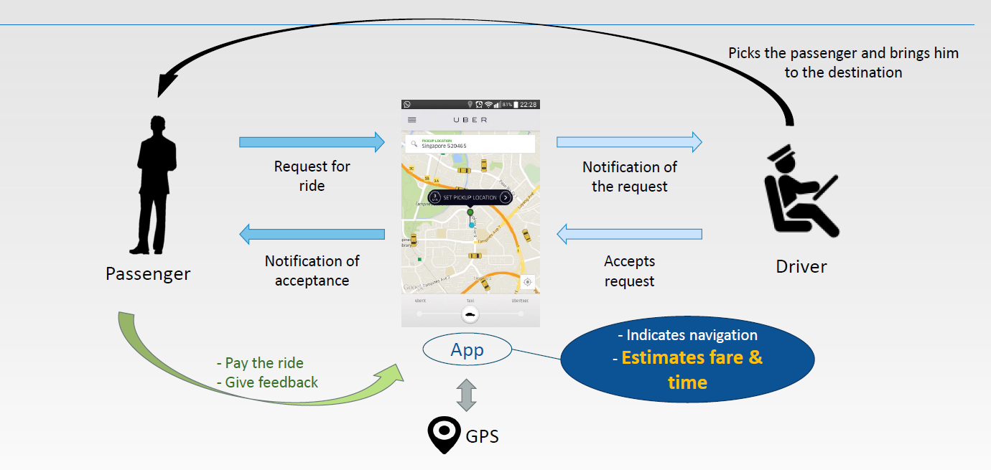
Business Model

Slide 4
Why we choose ER-model
It is concise description of data requirements of the user.
It does not include implementation details
It is easier to understand and to communicate with NonTechnical user.
It helps in actual implementation of database by logical mapping.

Slide 5
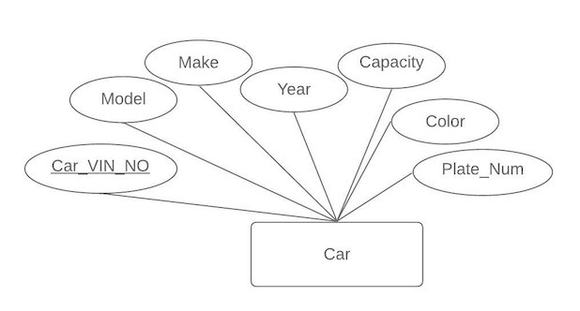
Components of ER model
Entity: Entity has its own identity that distinguishes it from other entities.
Attributes: Attributes are properties of entities. Attributes is a property or characteristic of an entity that is of interest to the organization.
Relationships are associations between one or more entity types. They are the “glue” that holds together components of an E-R model.

Slide 6
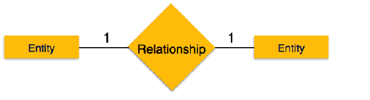
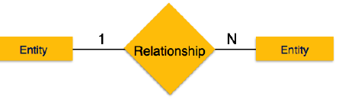
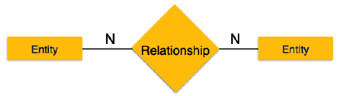
Relationship
One to one
One-to-many
Many to many
When only one instance of entity is associated with the relationship.
When more than one instance of entity is associated with the relationship.
one instance of entity on the left and more than one instance of entity on the right can be associated with the relationship.

Slide 7
Participation Constrains
Total Participation: Each entity in the entity is involved in the relationship. Total participation is represented by double lines.
Partial participation: Not all entities are involved in the relation ship. Partial participation is represented by single line.

Slide 8
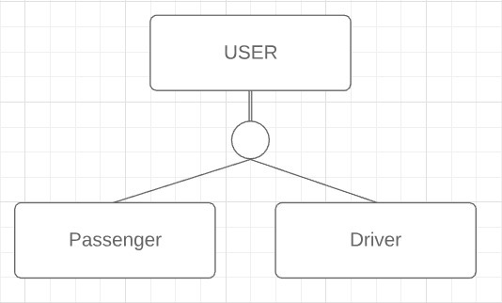
Specialization & Generalization
Specialization and generalization: Specialization used for categorizing a class of object into subclasses.
Generalization is the quite opposite of the specialization and it is used combined several class into a higher -level class.
Example: User can be Passenger or Driver.

Slide 9
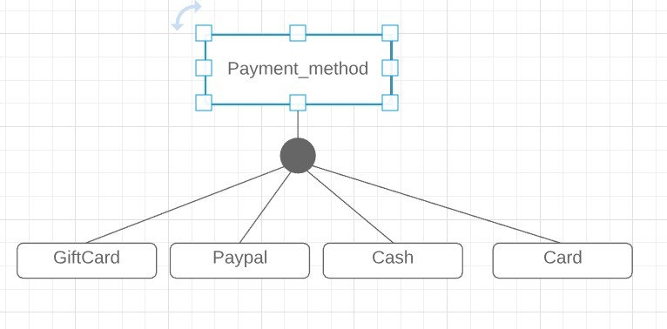
Category & Union
Category - a subclass that represents a collection of entities from different entity types.
Example: In Payment method inherits the attributes from Gift card, Card (Debit/Credit), Paypal account depending on the superclass to which Payment method user selects.

Slide 10
Passenger Entity:
USER_ID | F_NAME | L_NAME | GENDER | EMAIL-ID | MOBILE_NO | Password | RATING
Constraints for Passenger table
Primary Key: USER_ID
All attributes are not NULL
OVERALL_RATING:
Range between 0 to 5.
Default value : 5.0
Mobile_NO: Cannot be greater than 10 digits
Password: Minimum 8 Character and Maximum 20 Character.

Slide 11
Driver Entity
Driver_id | Firstname | Lastname | Gender | Email_id | Mobileno | Avg_Rating | Password | DL_Num
Constraint for Driver table
Primary Key : DRIVER_ID & DRIVER_LIC_NO
Mobile_No: Must be 10 digit Number.
Overall_Rating:
Ranges between 0.0 and 5.0
Default value is 5.0
Password: Min. 8 Char & Max 20 Char
DL_Num: Must be 8 Character.

Slide 12
Car Entity
Car_Vinno | Model | Make | Year | Capacity | Color | Plate_num
Constraints for Car table
Primary Key: CAR_VIN_NUM (Uniquely identifies car)
Year: No car older than 2010 year
Capacity: Min. 2 and max 8

Slide 13
Request Entity
Req_ID | User_ID | surge | Date&time | Ride_type | Pickup_loc | Dropoff_loc | EST_FARE | Seats
Constraints for Request Table
Primary Key: Req_ID
Foreign Key: User_ID
Ride_type: Pool, Express Pool, Uber X & Uber XL
Num_of_seat: Min 1 and Max 8.

Slide 14
Trip Entity
Trip_Id | Req_Id | Driver_id | Start_time | Duration | Fare | Tip | D_Rating | P_Rating | Comment
Constraints for trip table
Primary Key : Trip ID
Foreign Key : Req_ID & Driver_ID
D_Rating, P_Rating: Ranges between 0 and 5

Slide 15
Payment Method
Gift card
Paypal
Card
Expirydate | Card_num | Amount
Paypal_ID
Card_num | Name | Expiry | Type
Constraints
Card_num: primary key
Expiry: Date should be greater than current month
Type: Credit or Debit.
Constraints
P K: Card_num
Expiry_Date: date greater than current month
P k:Paypal _ID

Slide 16
Cancel Request
REQ_ID | USER_ID | DRIVER_ID | Penalty | Cancel_time | Cancelled_BY | Reason
Constraints for Cancel table
Primary Key : REQ_ID, USER_ID, DRIVER_ID
Foreign Key : REQ_ID, USER_ID, DRIVER_ID
Canceled BY: has to be USER_ID or DRIVER_ID.

Slide 17
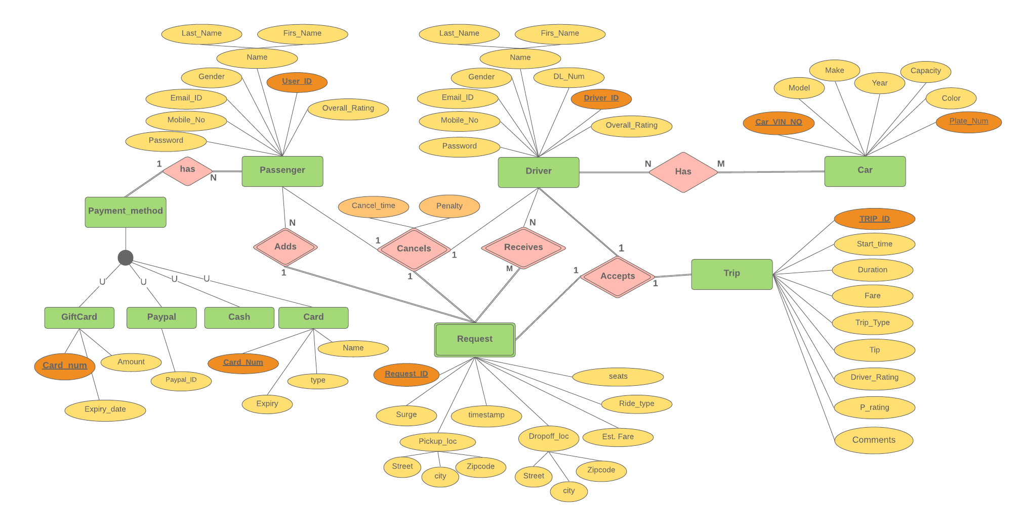
ER Diagram for UBER

Slide 18
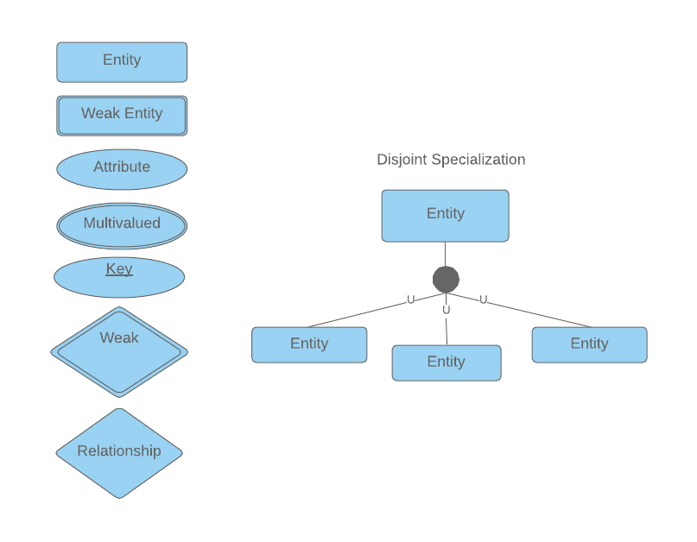
ER Diagram Notations

Slide 19
Thank You
Question?

