Slide 1


GIT - VCS
2nd March 2024

Slide 2
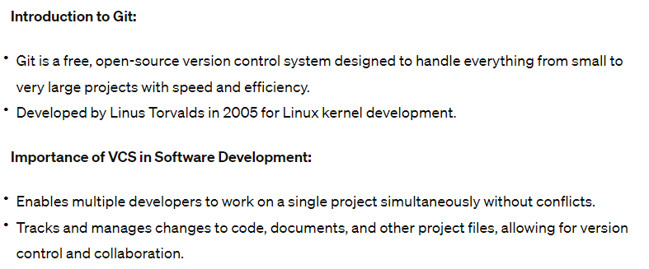
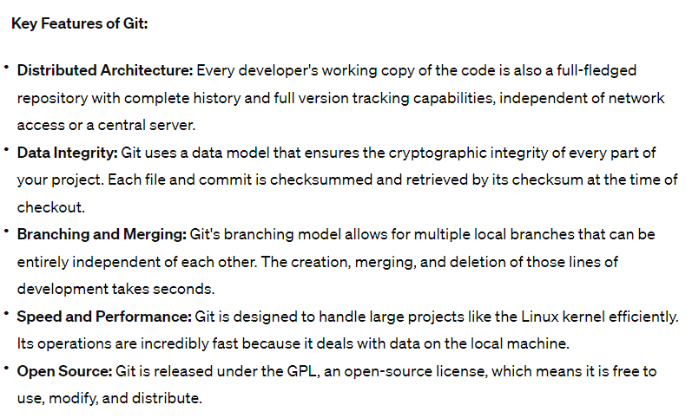
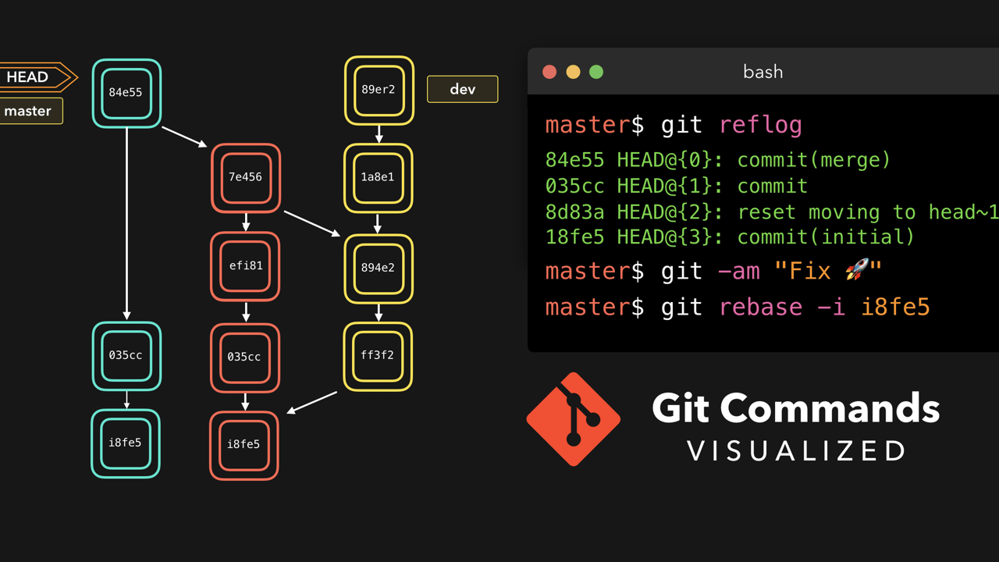
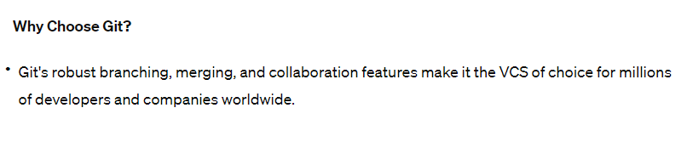
GIT VCS

Slide 3
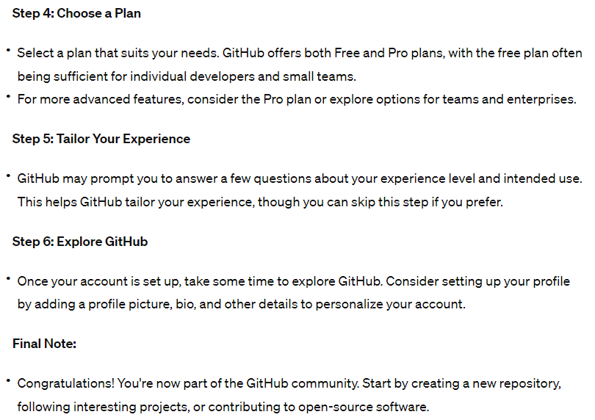
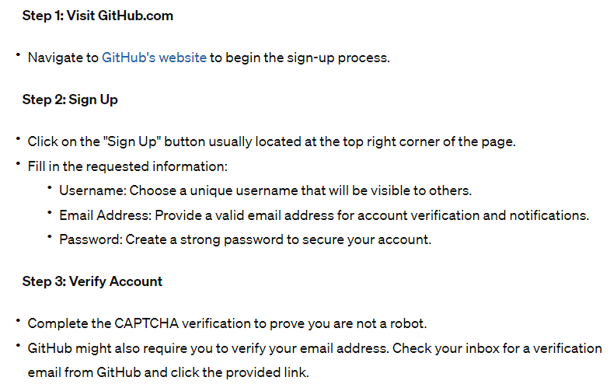
Create your account

Slide 4
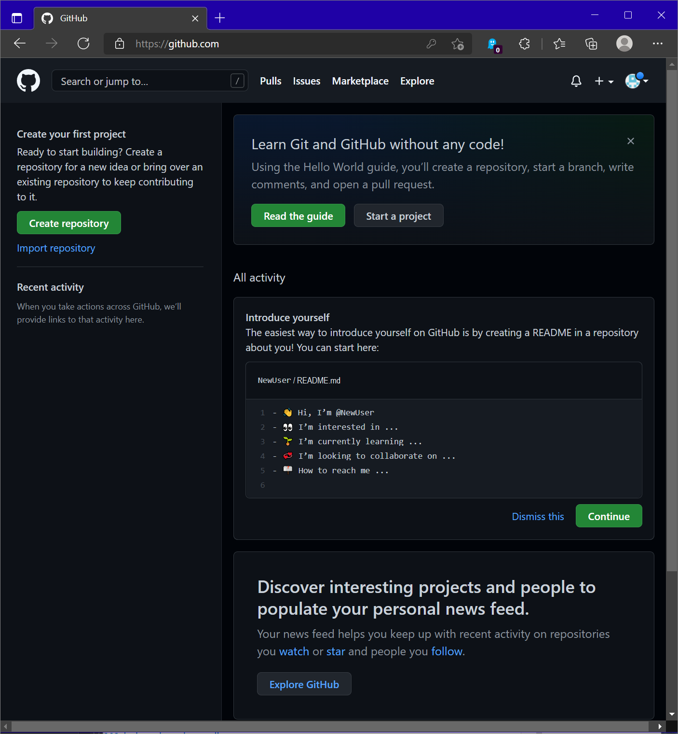
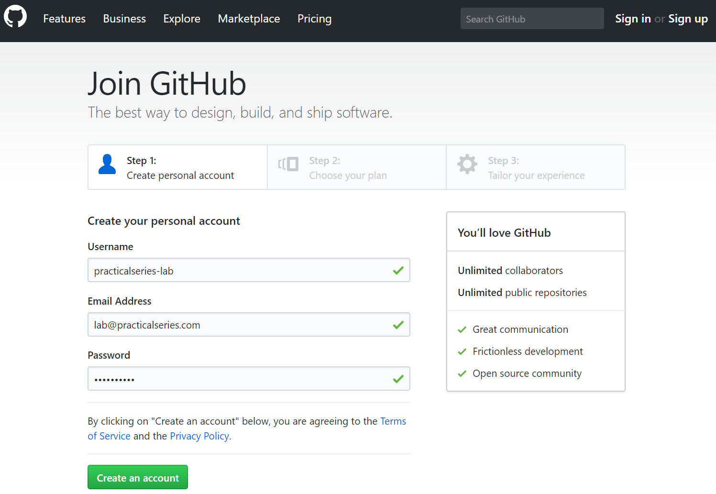
Thanks

Slide 5
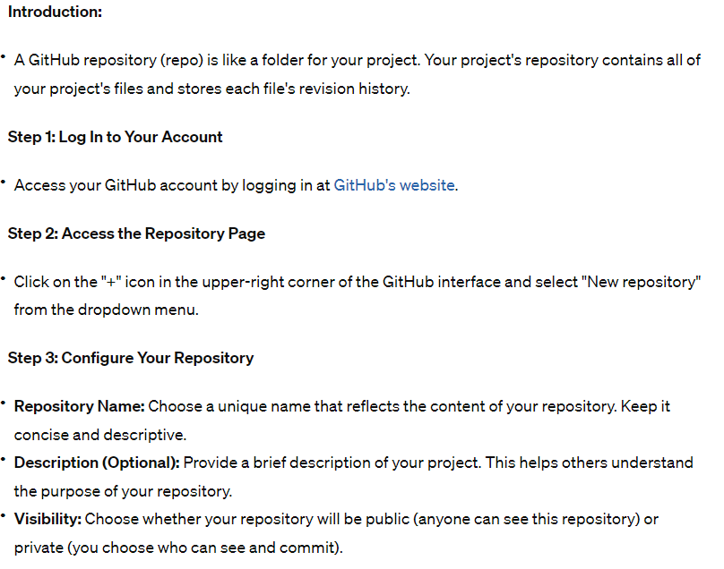
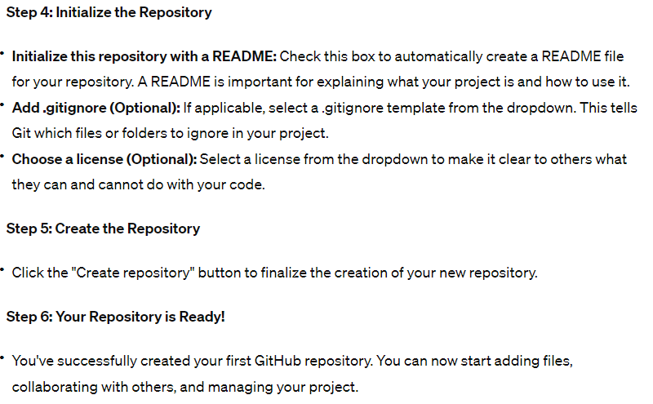
Create your 1st Repo

Slide 6
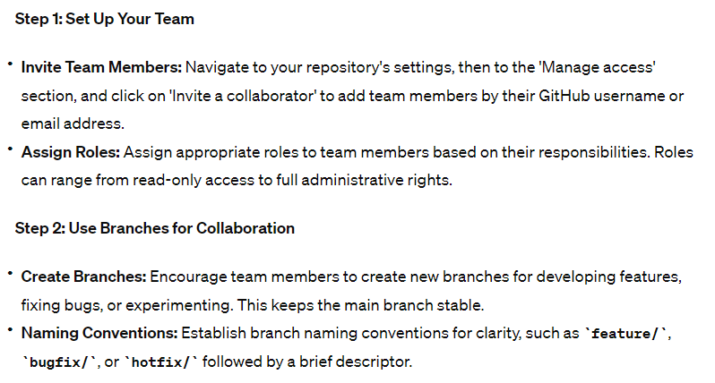
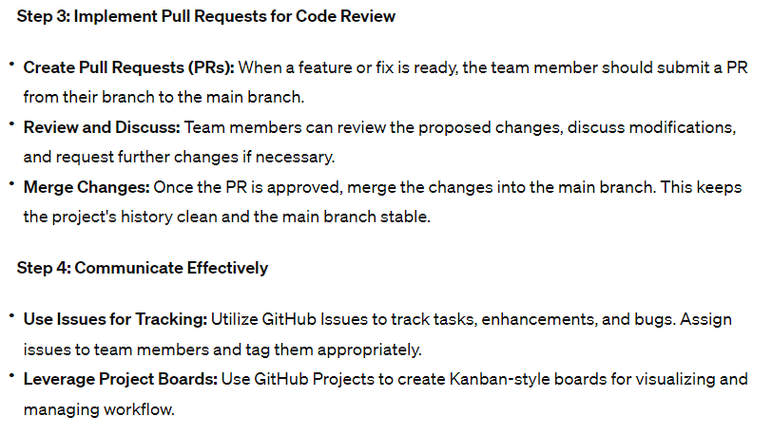
Collab with your Team

Slide 7
Push you Code to the created repo

Slide 8
Thanks

Slide 9
Thanks

Slide 10
Thanks

Slide 11
Thanks

Slide 12
Thanks

Slide 13
Thanks

Slide 14
Thanks

Slide 15
Thanks

Slide 16
Thanks

