Slide 1

SMART INDIA HACKATHON 2026
• Problem Statement ID: 26175
• Problem Statement Title: DepthWizard: Single-View Height Estimation & 3D Tactical Digital Twin for Rapid Reconnaissance
• Theme: Disaster Management
• PS Category: Software (AI/ML + WebGPU GIS Digital Twin)
• Team ID: [Insert Registered Team ID]
• Team Name: Control X

Slide 2

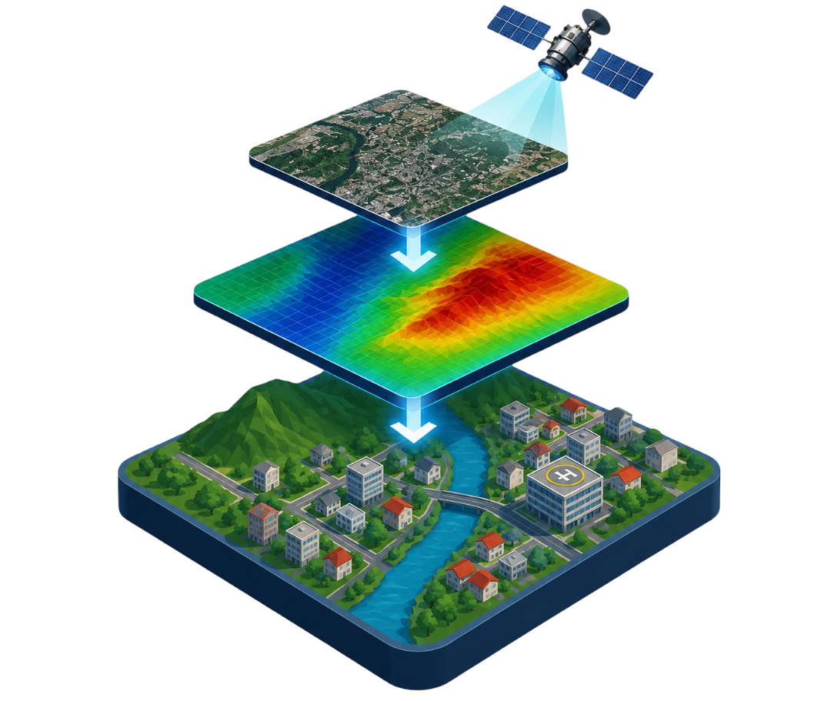


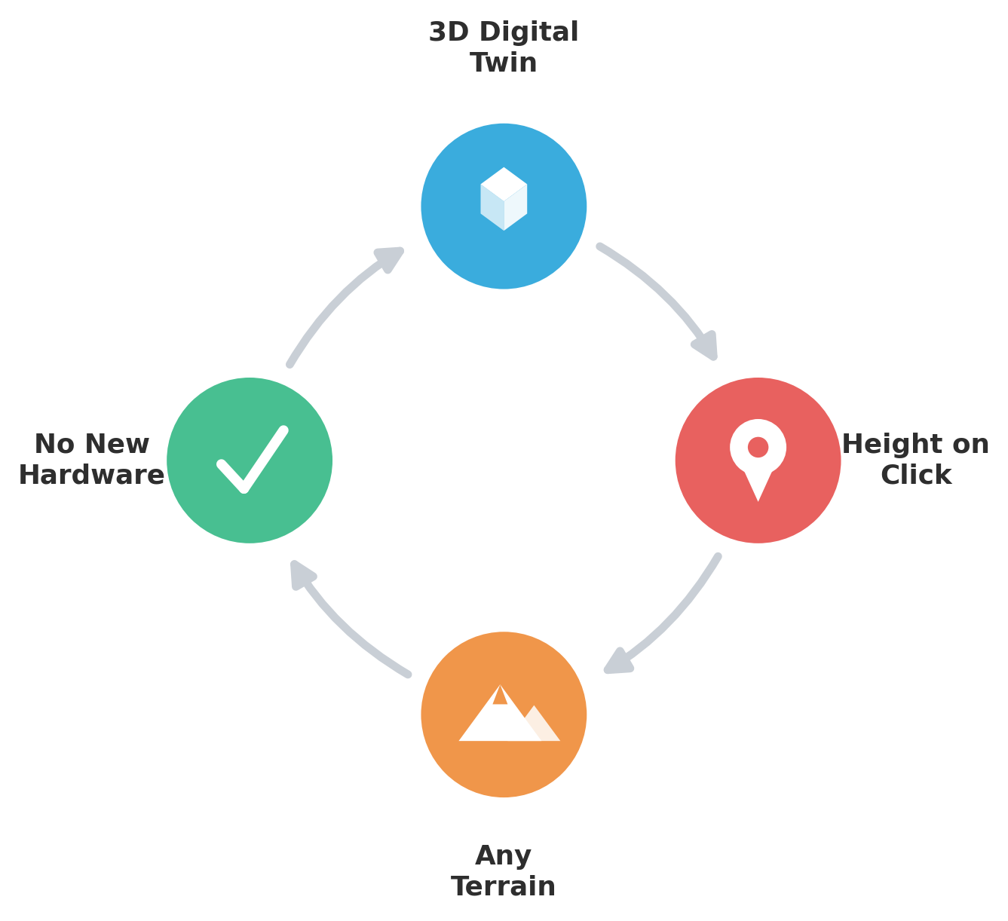
DepthWizard: Single-View Height Estimation and 3D Flythrough
Control X
OUR SOLUTION
DepthWizard automates 3D digital twins via 3 Real-Time Ingestion Streams:
• 🔍 Locality Search: Direct geocoding of cities & landmarks worldwide.
• 📍 Precise Coordinates: Lat/Long decimal targeting for remote grids.
• 🛰️ Frontline Live GPS: 1-click automated satellite acquisition.
Monocular Depth AI yields metric DSM, flood sim & safe escape routes in < 5s.
🌐 Live Prototype Portal:
https://blank-gods-prayers-reduced.trycloudflare.com
THE PROBLEM
Standard elevation mapping (stereo, LiDAR, InSAR) is expensive, complex, and often too slow for urgent needs like defence, urban planning, and disaster response.
WHY IT MATTERS?
Standard monocular depth models estimate relative depth for ground-level photos, but fail on satellite imagery due to domain shift and lack of absolute scale and solving this is our core goal.

Slide 3
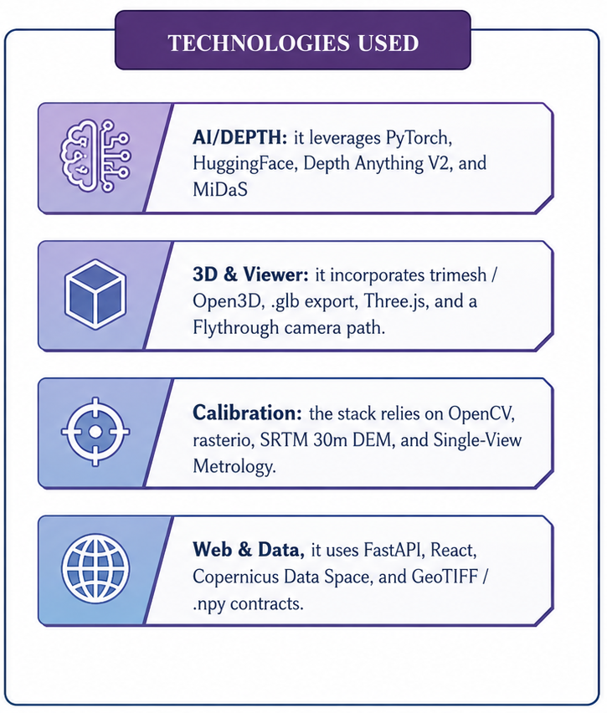
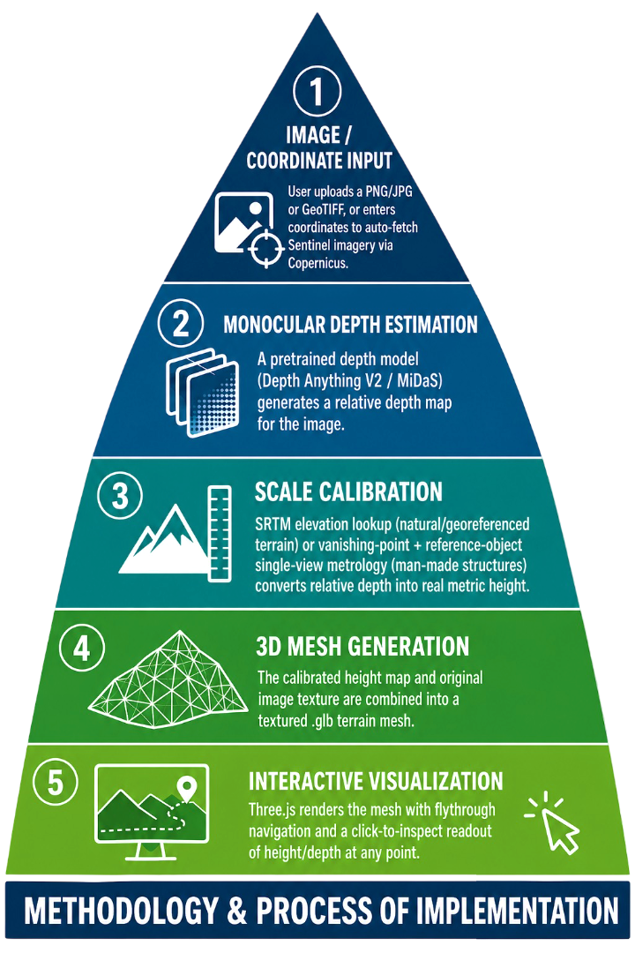

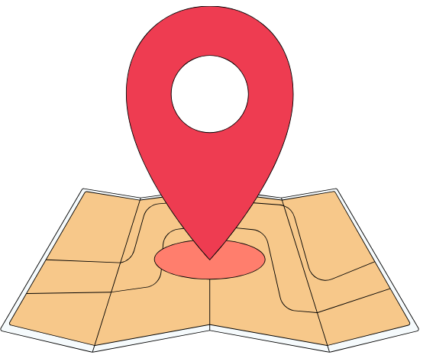
TECHNICAL APPROACH
Control X
CORE 4-STAGE PIPELINE
• 1. Multi-Stream Ingestion (Search/Coords/GPS)
• 2. Neural Depth-to-DSM Transformer
• 3. LOD-1 3D Building Extrusion in WebGPU
• 4. Tactical Recon: Flood Sim, Triage & Helipads

Slide 4
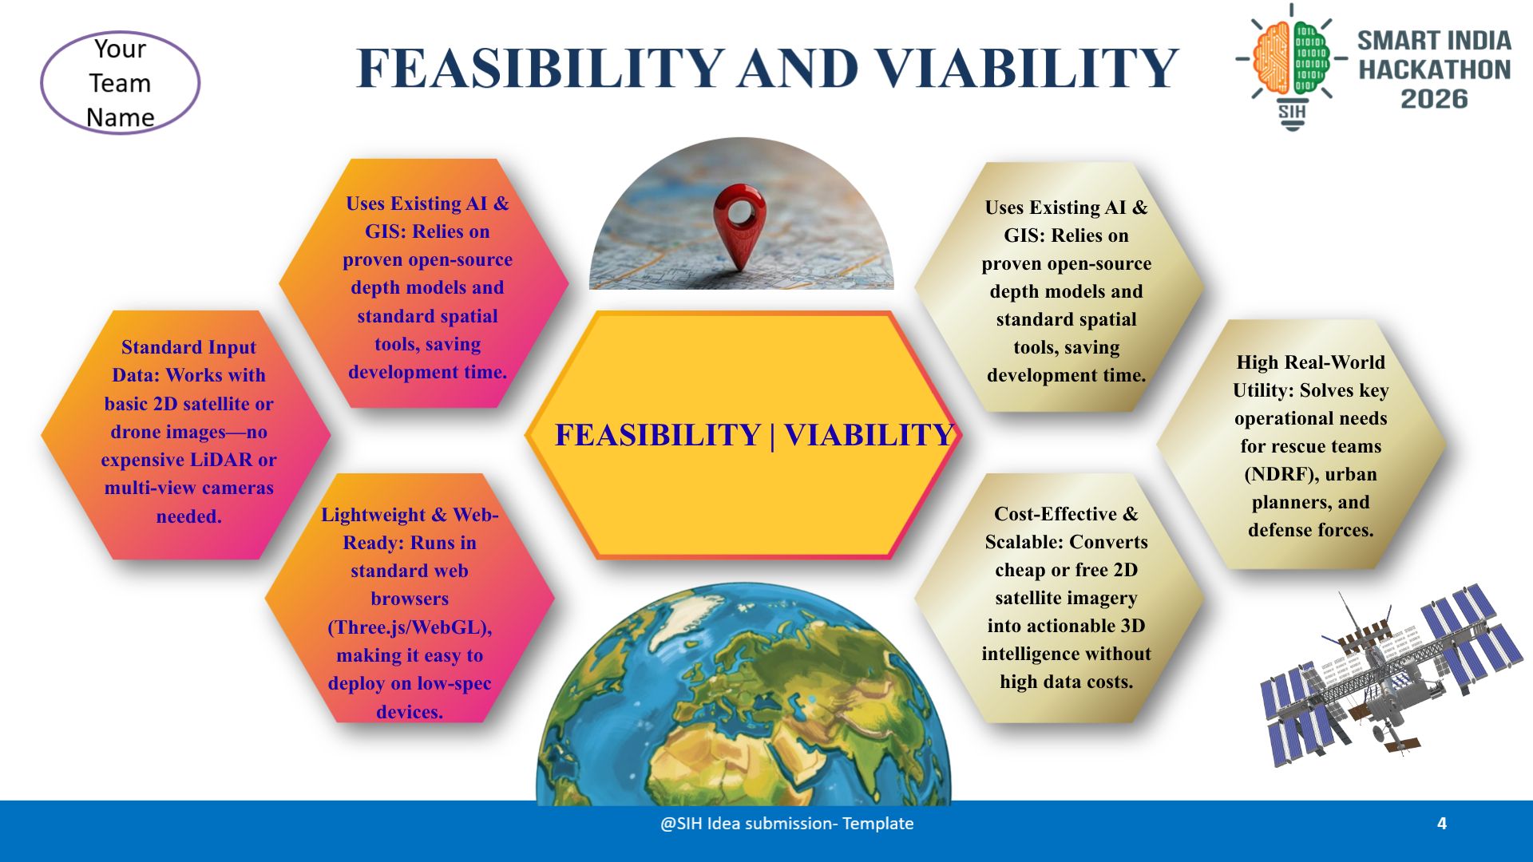
FEASIBILITY AND VIABILITY
Control X
Control X

Slide 5
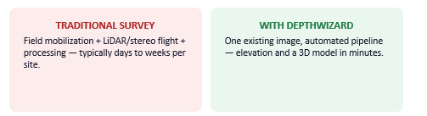
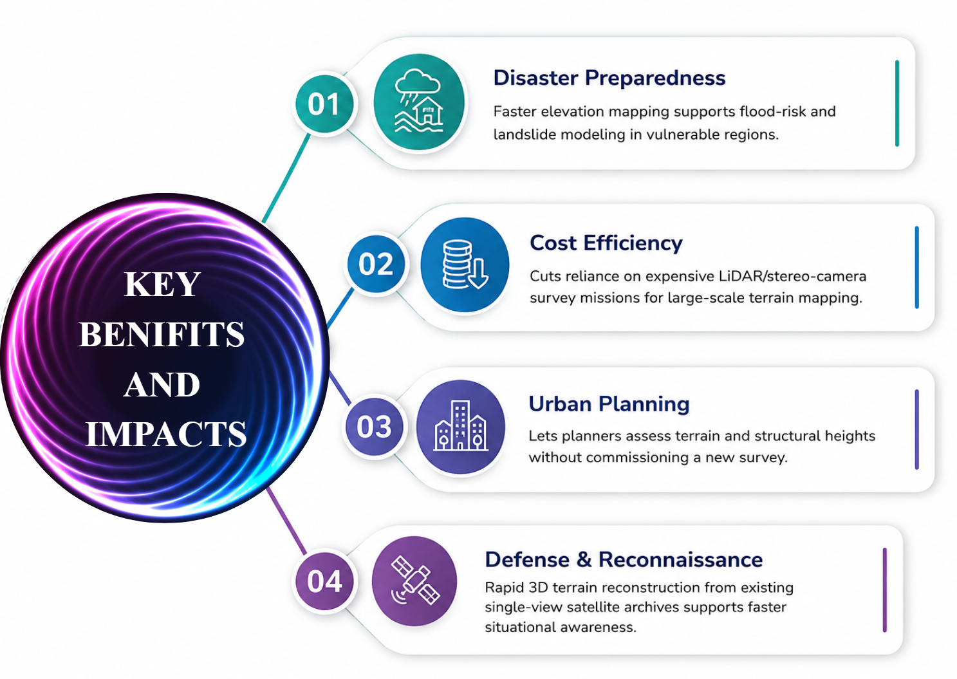
IMPACT AND BENEFITS
Control X
SCALABILITY &
QUANTIFIED ROI
• ₹0 Sensor Cost: Replaces ₹15–50L aerial LiDAR flights with existing satellite archives (98% cost reduction).
• Golden Hour Speed: Turnaround slashed from 72h to < 5s for urgent response.
• Automated Evacuation: Identifies safe havens & 3D ground escape routes.
• Aerial Heli Extraction: AI rooftop landing viability for IAF ALH Dhruv.
• National Scale: Instant deployment across NDMA, SDRF & district DEOCs.

Slide 6
RESEARCH AND REFERENCES
Control X
GOVERNMENT & DEFENSE REGULATORY FRAMEWORKS
1. NDMA National Guidelines (2023): Management of Landslides & Avalanches — High-Resolution Elevation Modeling.
2. ISRO Bhuvan / Cartosat Framework: Digital Elevation Models (DEM) Specifications for Disaster Monitoring.
3. ICAO & DGCA Annex 14 Standard: Urban Rooftop Heliport Approach Clearance Gradient (< 3° roof slope).
4. NITI Aayog Geospatial Report (2022): Enabling Resilient Infrastructure through Open Spatial Digital Twins.
5. IEEE Remote Sensing (2024): Foundation Transformers for Monocular Metric Depth Estimation in Satellite Imagery.
6. OpenStreetMap Overpass Consortium: LOD-1 3D Vector Building Extraction & Volumetric Footprint Standards.
LIVE EVALUATION PLATFORM & REPRODUCIBILITY LINKS
• 🌐 Live Interactive Cloud Portal: https://blank-gods-prayers-reduced.trycloudflare.com
• 💻 Official Open-Source GitHub Repository: https://github.com/sidharthunni/depthwizard
• 📍 Offline / Local Jury Evaluation Port: http://localhost:8080/

