Slide 1


APPLICATION OF ANN IN FAULT DETECTION OF 3 PHASE INDUCTION MOTOR
Group 11
Juan Thomas Mathew – MDL20EE033
Riya Elsa Sunny – MDL20EE047
Sidharth P – MDL20EE054
Smriti Srinivas – MDL20EE055
Project Guide : Dr Bindu CJ

Slide 2
CONTENT
Introduction
Relevance
Literature Survey
Implementation and Working
Conclusion
References

Slide 3

Introduction
The project uses Artificial Neural Networks to detect fault in 3 phase Induction motor
The project's goal is to show how artificial intelligence (AI) may be used to detect faults in electrical systems and extend their lifespan, which can save monetary resources and boost operational effectiveness
Machine learning is a method of data analysis that automates analytical model building. It is a branch of artificial intelligence based on the idea that systems can learn from data, identify patterns and make decisions with minimal human intervention.

Slide 4
Relevance
Preventive maintenance
Cost Savings
Improved reliability
Enhanced Safety
Improved energy efficiency

Slide 5
LITERATURE SURVEY

Slide 6

Standard Tools

Slide 7
Artificial Intelligence
Refers to the simulation of human intelligence in computer systems
AI often involves machine learning, where computers learn from data and improve their performance on specific tasks over time.
Accurate, fast, can handle complexities

Slide 8


Slide 9

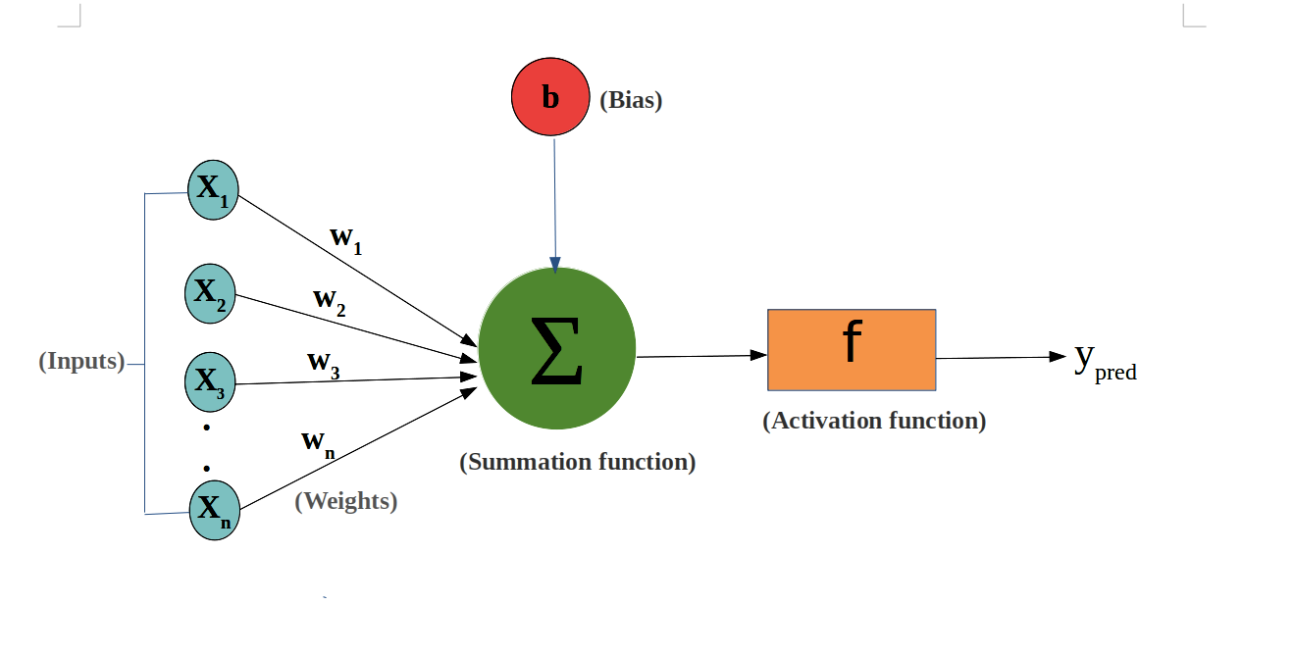
Neural Networks
Weights: Strength of a connection
Bias: Additional parameter to shift the output of a neuron
We adjust the weights and biases to get the desired output from the obtained output
Activation functions: Activation functions introduce non-linearity into the neural network, allowing it to model and approximate complex, non-linear relationships in data.
Threshold functions: To ensure output stays within a limit

Slide 10
The number of neurons in the input layer is equal to the number of input features in your data.
Hidden layer contains set of neurons that transform and process the data
Neurons in the output layer determine the result
Connections have strengths associated with them called weights which are adjusted in the process of optimization
Loss function gives the difference between the predicted value and the actual value. Usually Mean Square Error method is used
ANN comes with different Architecture variants like CNN, RNN and different optimization algorithms for training like Gradient descent. We need to choose them based on our application

Slide 11
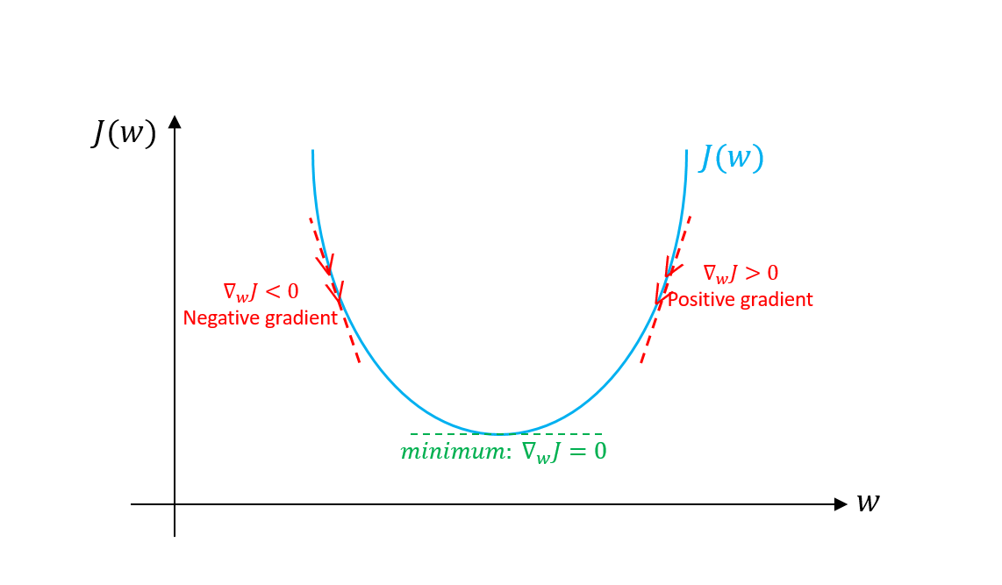
Gradient Descent Algorithm
An optimization algorithm used to minimize a loss or cost function in machine learning and deep learning ( minimize error )
Versatile, simple and efficient

Slide 12
Backpropagation
Backpropagation, short for "backward propagation of errors," is a key algorithm used for training artificial neural networks, including feedforward neural networks, by updating the model's parameters to minimize a chosen loss function
Steps:
Forward pass: Start with an initial set of parameters for weights and biases. Compute the output
Calculate loss: Using a loss function like Mean Square Error
Backward pass: Starting with the output layer, calculate the gradient of the loss function with respect to output layer parameters
Backpropagation: Backpropagate to hidden layers
Update the parameters
Repeat

Slide 13
Types of Faults
Faults in induction motors can be categorized as follows:
Electrical-related faults: Faults under this classification are single phasing, undervoltage and overvoltage, phase reversal and crawling.
Mechanical-related faults: Faults under this classification are broken rotor bar, mass unbalance, air gap eccentricity, bearing damage, rotor winding failure, and stator winding failure.

Slide 14
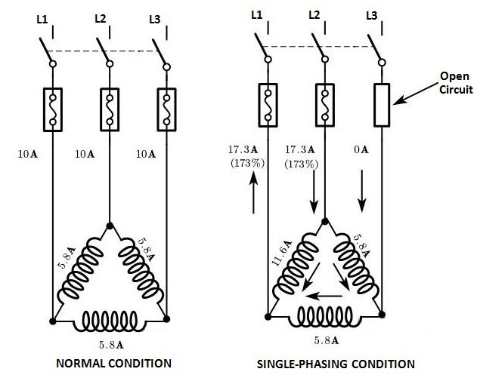
Single Phasing Fault
This is a power supply-related electrical fault in case of an induction motor. For a three-phase motor when one of the phases gets lost then the condition is known as single phasing.
If any one phase of the supply voltage is lost/open the motor might burn or heat up.
The motor must not carry the load not more than 0.5 times the rated load
Single Phasing fault is detected using analysis of acoustic sound signals in time and frequency domain.
The phase angle difference between currents of two healthy phases (R and Y) shifts from 120°to 180° and is observed. During single phasing, magnitude of line currents of healthy phases increase by√3 times .

Slide 15
Overvoltage
Overvoltage conditions in a three-phase induction motor refer to situations where the motor is exposed to voltage levels higher than its rated or designed voltage.
If any one of the line voltage is greater than 110% of rated value, overvoltage fault occurs.
In both cases, the electrical insulation system inside the motor or equipment can be degraded reducing life and potentially causing damage.

Slide 16
Phase Reversal Faults
A phase reversal fault condition in an induction motor occurs when the sequence of the three phases of the power supply is altered. In a balanced three-phase system, the phase sequence is typically designated as RYB or 1-2-3.
A phase reversal fault condition changes this sequence, causing one or more phases to be in the wrong order.

Slide 17
Other faults
Under voltage fault
Under voltage fault is reducing the supply voltage on the three phases by specific percentage, which makes the motor from attaining rated speed in specified time, increases the current and overheats the machine.
Crawling
It is an electromechanical fault of an induction motor. When an induction motor, though the full-load supply is provided, does not accelerate but runs at a speed nearly one-seventh of its synchronous speed, the phenomenon is known as crawling of the motor

Slide 18

Causes and Effects of various faults

Slide 19


Slide 20
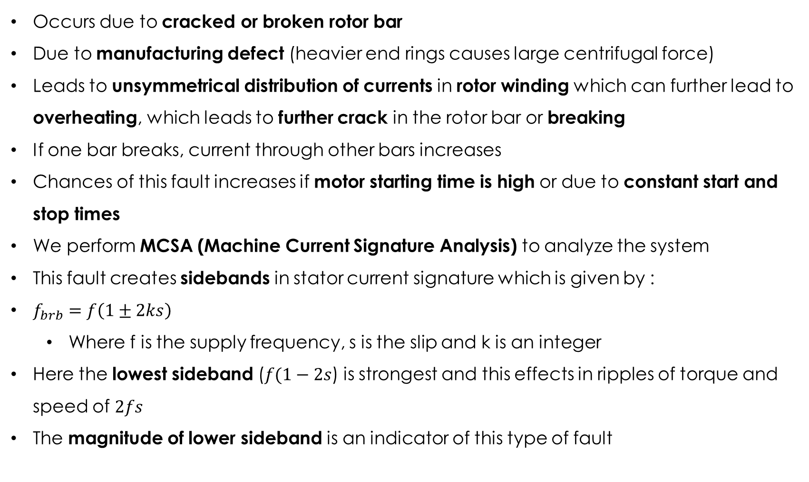
Broken Rotor Bar Fault
Occurs due to cracked or broken rotor bar
Due to manufacturing defect (heavier end rings causes large centrifugal force)
Leads to unsymmetrical distribution of currents in rotor winding which can further lead to overheating, which leads to further crack in the rotor bar or breaking
If one bar breaks, current through other bars increases
Chances of this fault increases if motor starting time is high or due to constant start and stop times
We perform MCSA (Machine Current Signature Analysis) to analyze the system
This fault creates sidebands in stator current signature which is given by :
$f_{brb}=f\left(1±2ks\right)$
Where f is the supply frequency, s is the slip and k is an integer
Here the lowest sideband ($f(1−2s$) is strongest and this effects in ripples of torque and speed of $2fs$
The magnitude of lower sideband is an indicator of this type of fault

Slide 21
Rotor Mass Unbalance Fault
The axis of rotor rotation should be aligned with geometrical axis of stator for a uniform air gap.
Otherwise it creates non uniform airgap, which creates non uniform electromagnetic pull
Rotor moves towards the direction of greater pull, I.e. where there is minimum airgap
Worst case scenario is when rotor starts rubbing with the stator
Usual indications are noises and vibrations
This fault occurs due to manufacturing defect or due to prolonged use of the machine
Caused by
Manufacturing defect
Internal misalignment or shaft bending
Accumulation of mass on rotor after prolonged use

Slide 22
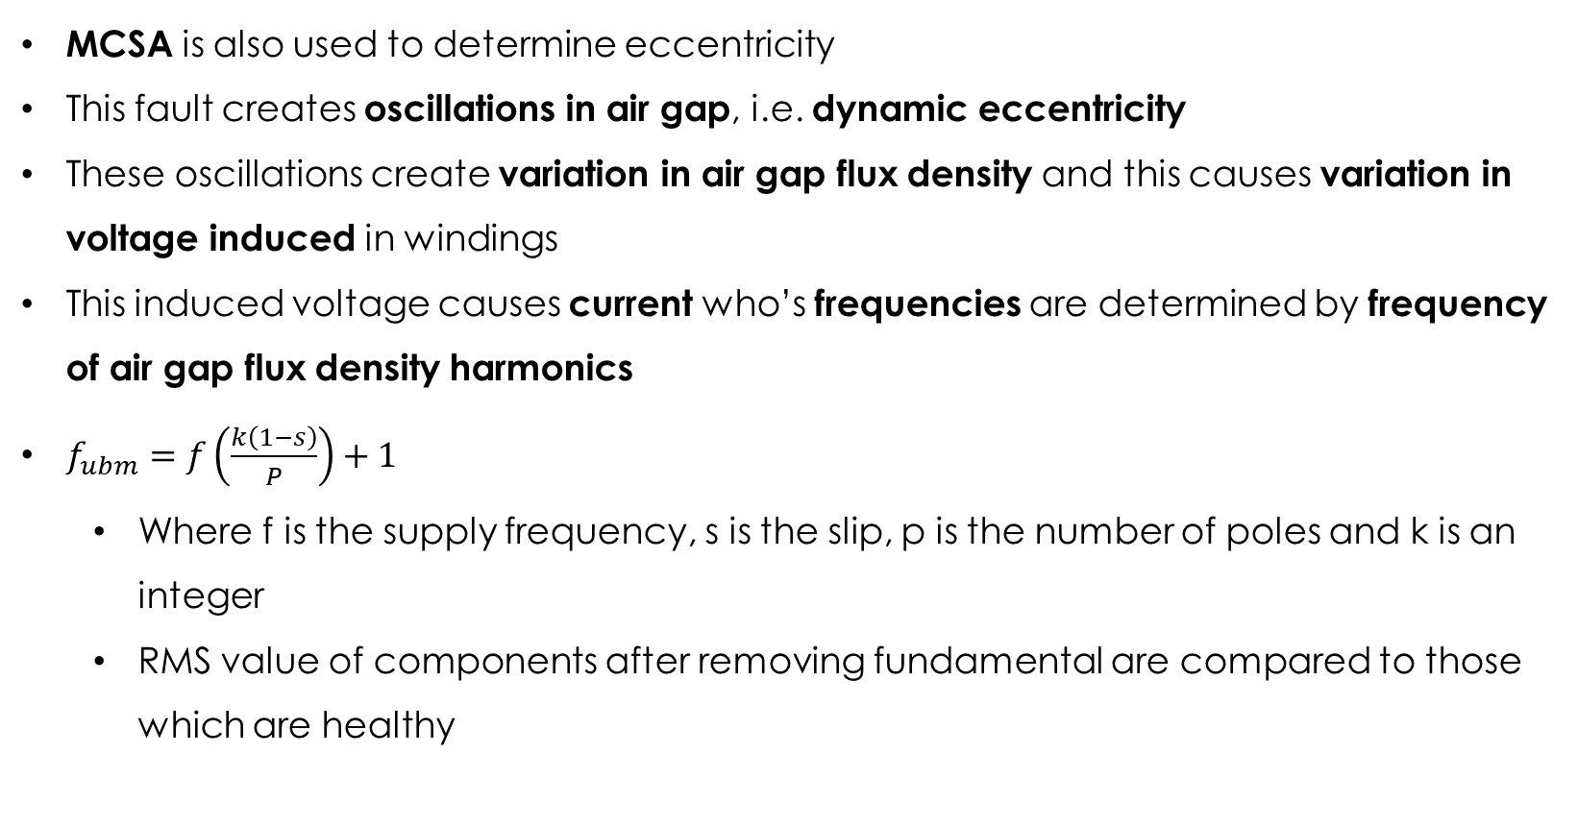
MCSA is also used to determine eccentricity
This fault creates oscillations in air gap, i.e. dynamic eccentricity
These oscillations create variation in air gap flux density and this causes variation in voltage induced in windings
This induced voltage causes current who’s frequencies are determined by frequency of air gap flux density harmonics
$f_{ubm}=f\left(\frac{k\left(1−s\right)}{P}\right)+1$
Where f is the supply frequency, s is the slip, p is the number of poles and k is an integer
RMS value of components after removing fundamental are compared to those which are healthy

Slide 23
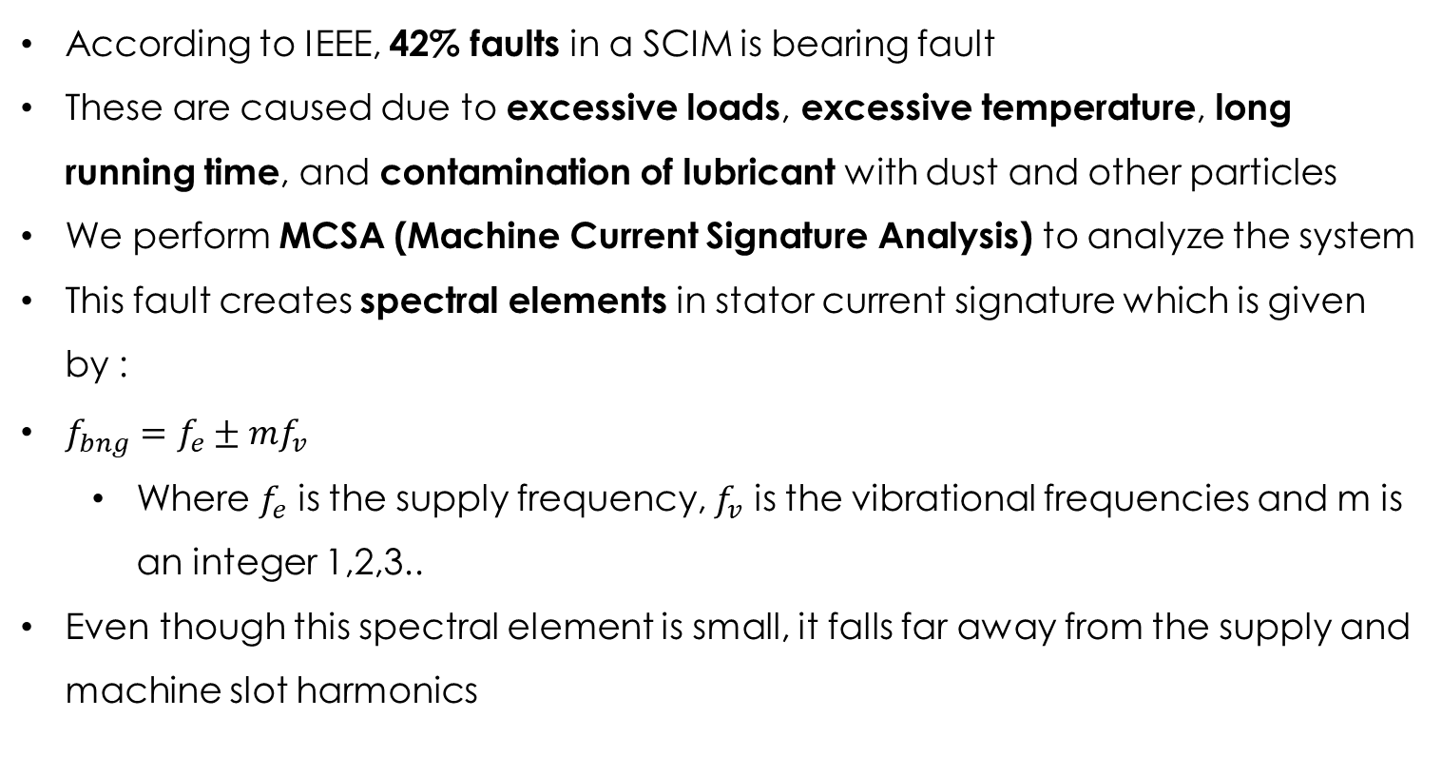
Bearing Fault
According to IEEE, 42% faults in a SCIM is bearing fault
These are caused due to excessive loads, excessive temperature, long running time, and contamination of lubricant with dust and other particles
We perform MCSA (Machine Current Signature Analysis) to analyze the system
This fault creates spectral elements in stator current signature which is given by :
$f_{bng}=f_{e}±mf_{v}$
Where $f_{e}$ is the supply frequency, $f_{v}$ is the vibrational frequencies and m is an integer 1,2,3..
Even though this spectral element is small, it falls far away from the supply and machine slot harmonics

Slide 24
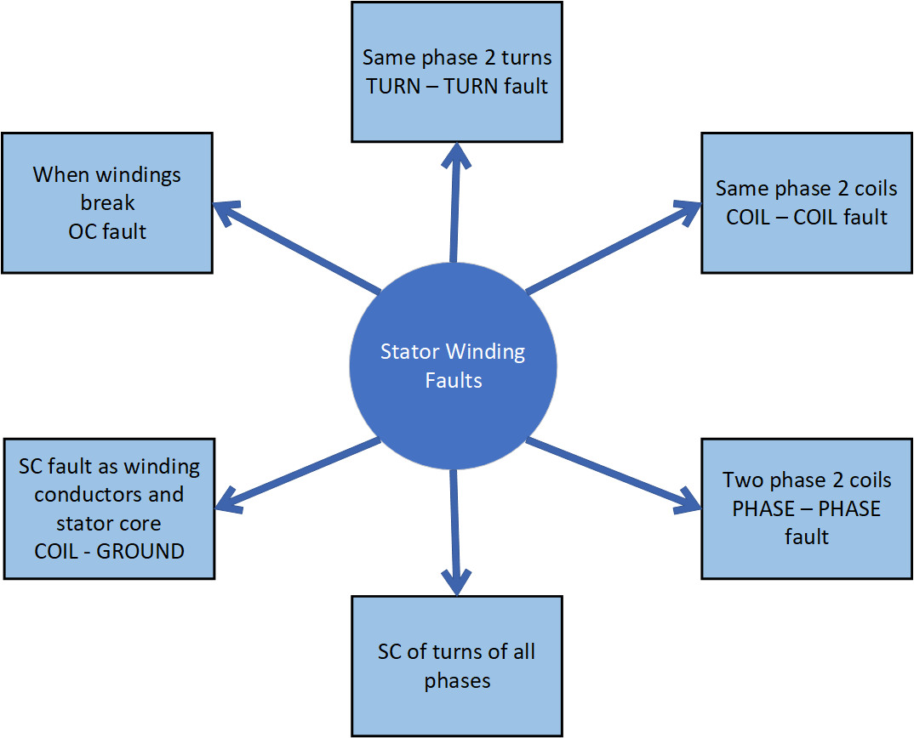
Stator Winding Faults
A common fault
Caused by failure of lamination due to various factors described in coming pages
Further classified as followed in the right figure
Most common is fault between phase windings or phase windings and ground
Undetected turn to turn faults grow up into bigger problems

Slide 25
Causes of Stator Winding fault
Mechanical stress: Rubbing of stator and rotor, Coil movement due to stator current, Rotor to stator misalignment, Shaft deflection, Bearing failure
Electrical stress: Line to Line, Line to Ground,3 phase to Ground
Thermal stress: Overloading, improper ventilation, unbalanced supply voltage, high ambient temperature
Diagnosis of Stator winding fault
The supply current negative-sequence component at a frequency of (-f) could be used to diagnose stator winding faults.
An increase in the motor phase current leading to shifts in both positive and negative sequence currents is an indicator of fault

Slide 26
IMPLEMENTATION AND WORKING

Slide 27
Implementation
A 37Kw 50Hp 4 pole 1500rpm 415V 3 Phase Induction Motor is chosen.
Afterwards normal and fault conditions are simulated in MATLAB. Faults included are :
Stator Winding fault
Eccentricity fault
Rotor Broken bar fault
Bearing damage fault
Feed forward network is chosen as the ANN architecture
Inputs to network are supply voltage, rotor current, air gap flux and shaft vibration
The activation function used is ReLU
The training is done using Gradient Descent Algorithm and Back propagation
Output layer would be normal condition, eccentricity fault, stator winding fault, broken rotor fault and bearing fault

Slide 28
PLANNING AND WORK DISTRUBUTION
Link to Gantt Chart

Slide 29
CONCLUSION
Induction Machines take up 50% of electric power produced globally. They are the backbone of various industries. Faults in Induction Machine can lead to down time which impacts productivity and output.
It’s important that we diagnose the faults before machine reaches a point where it’s unable to be operated.
Artificial Neural Networks could effectively detect faults in Electrical machines in a way that we can diagnose before heavy damages to the machine occur.
This helps in reducing downtime and expenses.

Slide 30
REFERENCES
Mohamed A. Awadallah, Medhat M. Morcos, “Application of AI Tools in Fault Diagnosis of Electrical Machines and Drives—An Overview”, IEEE TRANSACTIONS ON ENERGY CONVERSION, VOL. 18, NO. 2, JUNE 2003
Fiorenzo Filippetti, Giovanni Franceschini, Carla TassoniI, Peter Vas, “Recent Developments of Induction Motor Drives Fault Diagnosis Using AI Techniques”, IEEE TRANSACTIONS ON INDUSTRIAL ELECTRONICS, VOL. 47, NO. 5, OCTOBER 2000
NPTEL LECTURES, Prof. S Sengupta, IIT Kharagpur, “Neural Networks and Applications”
Subrata Karmakar Surajit Chattopadhyay Madhuchhanda Mitra Samarjit Sengupta, “Induction Motor Fault Diagnosis”

