Slide 2
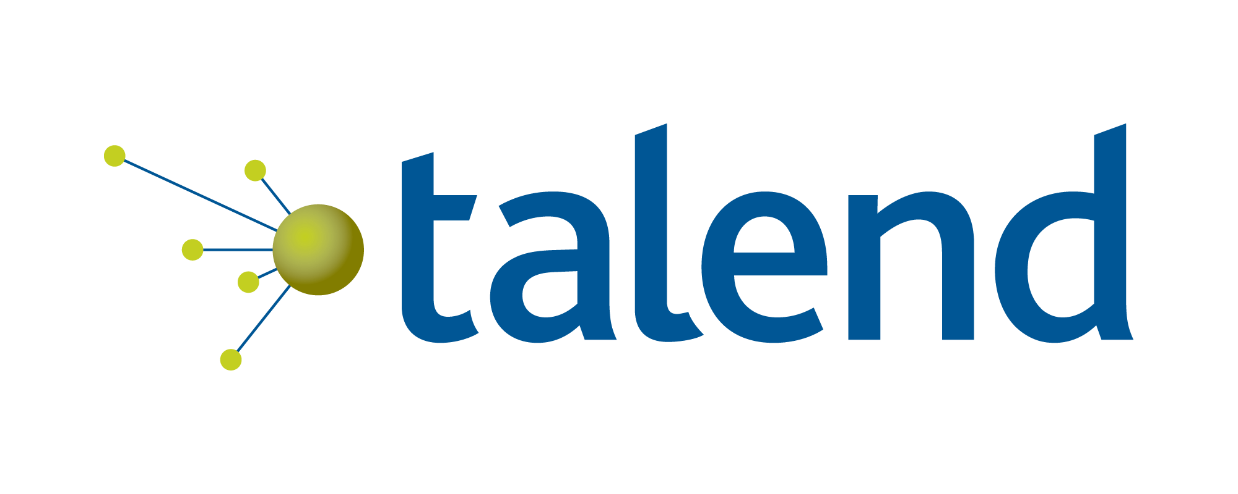
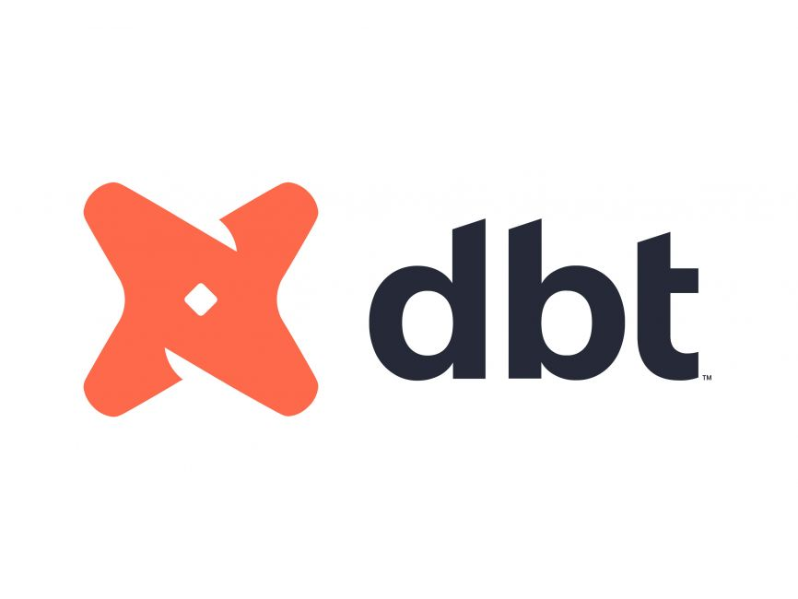
or
Choose the right transformation tool

Slide 3
Objective
In today’s data-driven landscape, organizations require scalable, efficient, and robust solutions to manage their data integration and transformation processes. This comparison between Talend and DBT (Data Build Tool) highlights two leading tools tailored for modern enterprise data engineering needs.
Talend is an all-encompassing ETL platform offering a comprehensive suite of tools for extracting, transforming, and loading data across a wide variety of sources and destinations. With its intuitive visual interface, Talend is well-suited for enterprises with complex, multi-source data workflows, supporting both on-premise and cloud environments. It excels in scenarios where data integration, data quality, and governance are critical.
DBT, on the other hand, focuses on the ELT process within cloud-native data warehouses, leveraging SQL and Jinja templating to transform data post-load. DBT is optimized for enterprises that use modern cloud data platforms (e.g., Snowflake, BigQuery, Redshift) and prefer a code-first, collaborative approach with strong version control and automation.
This document provides insights into how each tool aligns with enterprise requirements for data processing, scalability, and team collaboration, enabling you to make an informed decision on the best solution for your organization's data strategy.

Slide 4
Talend Programming Constructs
In Talend, various programming constructs and components are used to build ETL (Extract, Transform, Load) workflows. These constructs enable users to manipulate and manage data as it flows through the Talend platform. Here’s a list of the key programming constructs in Talend:
Database and External Integration - tDBInput / tDBOutput / tRestClient / tRestOutput / tFileInputDelimited / tFileOutputDelimited
Error Handling - tDie / tWarn / tLogCatcher / tRetry
Job Design - Subjobs / Flow / Iterate / tParallelise
Routines and Custom Logic - tJava / tJavaFlex
Flow Control and Data Processing - tFlowToIterate / tIterate / tLoop / tSkip
Conditional Logic - tMap / tIf / tElse
Metadata and Schema Management - tSchemaComplianceCheck
Transformations and Aggregations - tAggregateRow / tDenormalize / tSortRow

Slide 5
DBT Programming Constructs
In DBT (Data Build Tool), the programming constructs revolve around the use of SQL for data transformations, along with a set of tools and functionalities that enable version control, testing, and documentation. The programming constructs of DBT are designed to help data engineers and analysts model, test, and document data transformations efficiently within modern cloud data warehouses like Snowflake, BigQuery, Redshift, and Databricks. Below are the main programming constructs of DBT:
Models: SQL-based transformations -> select * FROM {{ ref('raw_sales') }}
Jinja Templating: Dynamic SQL generation -> select * FROM {{ ref('raw_sales') }} where amount > {{threshold}}
Macros: Reusable SQL functions -> {% macro custom_transformation(input_column) %} .... {% endmacro %}
Documentation: Auto-generated metadata and documentation
Seeds: Static data loaded into the warehouse (Redshift, Snowflake, S3, ADLS, etc. any datastore available in DBT) -> in data/seed_file.csv
Materializations: Different strategies for creating models in the database -> {{ config( materialized='incremental', unique_key='id' ) }}
DBT Commands: Orchestration of transformations, testing, and documentation. -> dbt run / dbt build / dbt snapshot

Slide 6
Comparison
Feature | Talend Open Studio | DBT
Primary Use Case | ETL workflows, data integration, and transformation in a GUI-based environment | Data transformation and modeling inside a data warehouse using SQL
Data Source Integration | Supports a wide range of data sources (databases, files, cloud APIs) | Primarily works with data warehouses (Snowflake, BigQuery, Redshift)
Transformation Language | Java, Python, or Talend's own ETL language | SQL-based transformations
User Interface | GUI-based (drag and drop) | CLI-based (SQL scripts), but also has a web-based dashboard for DBT Cloud
Deployment Model | On-premise, cloud integration through Talend Cloud | Cloud-based, primarily for cloud data warehouses
Version Control | Not built-in, but can integrate with Git | Built-in Git version control for models and collaboration
Collaboration | Limited collaboration capabilities, though can use Talend Cloud | Built-in collaboration features (Git-based version control, cloud sharing)
Data Quality / Governance | Strong data quality, cleansing, and profiling tools | Basic data quality testing using custom SQL tests
ETL vs ELT | Primarily ETL (Extract, Transform, Load) | Primary Transformation Tool
Tech Stack Integration | Hadoop, Spark, SQL databases, cloud services, APIs, file systems | Cloud data warehouses (Snowflake, BigQuery, Redshift, Databricks)
Learning Curve | Steeper due to GUI and complex workflows | Easier for data engineers familiar with SQL
Cost | Free (open source), but cloud and enterprise versions are paid | Free (open source) or subscription-based for DBT Cloud

Slide 7
Example 1: input
Talend tDBInput:
Purpose: The tDBInput component is used in Talend to extract data from relational databases (SQL Server, MySQL, PostgreSQL, etc.).
Function: Executes SQL queries to read data from source databases.
In DBT, data extraction is typically done by creating Source Models using SQL queries. DBT does not extract data directly, but instead, it assumes that the data is already loaded into a data warehouse (such as Snowflake, BigQuery, or Redshift).
-- models/source_orders.sql
WITH source_orders AS (
SELECT *
FROM {{ source('raw', 'orders') }}
)
SELECT * FROM source_orders;

Slide 8
Example 2: Output
Talend tDBOutput
Purpose: Writes the results of transformations or data loads into a database.
In DBT, the final transformation output is written back into the data warehouse as a table or view using DBT models.
-- models/transformed_orders.sql
SELECT
customer_id,
COUNT(order_id) AS total_orders,
SUM(order_amount) AS total_spent
FROM {{ ref('source_orders') }}
GROUP BY customer_id;

Slide 9
Example 3: Transformation
Talend tMap
Purpose: tMap is used to perform complex transformations, such as joins, filters, and lookups, by visually mapping input data to output data.
In DBT, all transformations are written in SQL scripts. Complex transformations (joins, filtering, aggregations) can be handled within the models directly.
-- models/order_summary.sql
WITH order_details AS (
SELECT
....... FROM {{ ref('orders') }} o
JOIN {{ ref('order_items') }} oi ON o.order_id = oi.order_id
JOIN {{ ref('products') }} p ON oi.product_id = p.product_id
)
SELECT * FROM order_details
GROUP BY customer_id;

Slide 10
Example 4: Command
Talend tCommand:
Purpose: Executes system commands (e.g., running shell commands or scripts) during the ETL process.
In DBT, you can use Hooks and macros for custom commands or scripts. However, if you want to run a custom SQL command (such as clearing a table before running a model), you would use the on-run-start or on-run-end hooks
# dbt_project.yml
on-run-start:
- "DROP TABLE IF EXISTS {{ ref('old_data') }};"

Slide 11
Example 5: Connection Handling
Talend tDBConnection:
Purpose: Configures database connections for the ETL process.
DBT does not require explicit connection configuration within models. Instead, the connection settings are defined in the profiles.yml file, which configures the connection to your data warehouse.
# profiles.yml
my_project:
target: dev
outputs:
dev:
type: snowflake
account: "your_account"
user: "your_user"
password: "your_password"

Slide 12
Example 5: Looping
Talend tFlowToIterate:
Purpose: This component iterates over a flow of data and passes it to other components or processes.
DBT does not support native iterative data flow like Talend, but you can achieve similar behavior by using macros or orchestration tools like Airflow to handle iterative processing.
-- macros/dynamic_model.sql
{% macro dynamic_model(table_name) %}
SELECT * FROM {{ ref(table_name) }}
{% endmacro %}
This macro can be called with different table names dynamically across models. However, full iteration-based data flow would be handled better in an orchestration tool like Airflow.

Slide 13
Thank you

