Slide 1

B. Tech. Project Mid-Semester Evaluation
Explainable Deep Learning Framework for Automated ECG Arrhythmia Detection and Classification
Presented by
Sidhesh Mahesh Tavare (2314037)
Nikhil Kumar Singh (2314055)
Supervisor
Dr. Arnab Nandi
Department of Electronics and Communication Engineering
National Institute of Technology Silchar
Notes:
Good morning respected panel members. We are Bhoomi Singhal (2314168) and Archita Roy (2314165), working under the supervision of Dr. Koushik Guha.
Our project is "Design of an Energy-Efficient EEG Seizure Detection System using Approximate Computing".
In one line: we detect epileptic seizures from EEG signals with a machine-learning classifier (SVM), and we plan to build its hardware with APPROXIMATE adders and multipliers so that it consumes much less power - making it suitable for wearable, battery-powered seizure monitors.

Slide 2
Introduction
Electrocardiogram (ECG)
Why automate?
An ECG records the heart's electrical activity. Each beat shows a P wave, a QRS complex and a T wave; their shape and timing reveal rhythm problems.
Arrhythmias can be life-threatening, but checking a long Holter recording beat by beat by hand is slow and error-prone.
What the framework must deliver
Accurate classification
Explanation
Robustness
per-class F1 on N, S, V, F
why a beat was flagged
behaviour on noisy ECG
The project builds a deep learning model that classifies ECG beats and shows, as a heatmap on the waveform, which part of the beat drove each decision.

Slide 3
ECG Beats & Arrhythmia Classes
P, QRS and T waves
RR interval
P wave = atrial depolarisation, QRS complex = ventricular depolarisation, T wave = ventricular repolarisation. One beat lasts roughly 0.6–1 s.
Time between two successive R peaks. A premature beat arrives early (short previous RR, longer next RR), so timing carries as much information as shape.
N – Normal
S – Supraventricular ectopic
Normal and bundle-branch-block beats. The vast majority of beats, which makes the data strongly imbalanced.
Early beats starting in the atria. The QRS looks almost normal, so these are recognised mainly from the RR timing and the P wave.
V – Ventricular ectopic
F – Fusion
Beats starting in the ventricles: wide, abnormal QRS complex, usually with no P wave in front of it.
A mix of a normal and a ventricular beat. The rarest class and the hardest one to classify.
Classes follow the AAMI EC57 standard, so our results can be compared fairly with other MIT-BIH studies.

Slide 4
Literature Review & Research Gap
37 papers (2020–2026) on deep learning and XAI for ECG arrhythmia classification were reviewed.
Area
Existing direction
Deep learning models
1D CNN, CNN-LSTM and transformer models report 98–99% accuracy on MIT-BIH [2], [7]
Evaluation protocol
Only ~30% use the inter-patient split; F1 falls 95.5% → 83.9% on unseen patients [4], [5]
Explainability
SHAP / Grad-CAM shown as example heatmaps; < 10% of studies validate them [2], [3], [6]
Research gap
Our project position
Explanations are rarely checked (do they point at the right waves? are they faithful?) and almost never tested on noisy ECG.
Build a CNN / CNN-LSTM beat classifier, explain it with Grad-CAM and SHAP, and measure whether those explanations make sense.

Slide 5
Problem Statement & Motivation
Develop an explainable deep learning framework that classifies single ECG beats into the AAMI classes N, S, V and F and shows which part of the waveform drove each prediction.
Black-box models
Class imbalance
Patient leakage
Noisy signals
High accuracy, but no reason is given for a decision, so clinicians find it hard to trust.
Normal beats dominate; rare S and F beats get poor recall.
Same patient in train and test sets inflates the reported scores.
Real ECGs contain muscle and motion artefacts; most models are tested on clean data only.
Core pipeline: preprocess → classify → explain → validate
Motivation
• Screening long ECG recordings for arrhythmias needs automation.
• A model that shows why it flagged a beat is easier to verify and trust.

Slide 6
Project Objectives
01
Preprocess MIT-BIH
Filter the signal, cut beats around R peaks, add RR-interval features and map labels to N, S, V, F.
Baseline & proposed
Train a 1D CNN baseline and a CNN-LSTM + RR model, with class-weighted loss for imbalance.
02
03
Fair evaluation
Intra-patient (random 80/20) and inter-patient (DS1/DS2) splits; per-class precision, recall, F1.
04
Explain predictions
Grad-CAM and SHAP heatmaps; check importance on P/QRS/T and run a deletion test.
05
Robustness and demo
Add real muscle noise (NSTDB) at 18, 6, 0 dB SNR; small Streamlit demo of prediction + heatmap.

Slide 7
Dataset: MIT-BIH Arrhythmia Database
MIT-BIH Arrhythmia Database (PhysioNet)
Moody & Mark [1] • 48 half-hour two-lead recordings • 47 subjects • 360 Hz
Data used
Two evaluation splits
Lead MLII only. The 4 paced records (102, 104, 107, 217) are removed. Every beat has a cardiologist label and R-peak position.
Intra-patient: random 80/20 split of beats. Inter-patient: DS1 (22 records) to train, DS2 (22 records) to test, so no patient appears in both [8].
Noise data: MIT-BIH Noise Stress Test Database (NSTDB)
Real muscle-artefact noise from NSTDB will be added to the test beats at controlled SNRs to check how accuracy and explanations hold up.

Slide 8
Methodology
1
2
3
4
5
6
7
Raw ECG
→
Filter
→
Segment
→
RR
→
Classify
→
Predict
→
Explain
MLII, 360 Hz
0.5–40 Hz
252-sample beats
features
CNN / CNN-LSTM
N, S, V, F
Grad-CAM, SHAP
Steps 1–4 turn the raw record into fixed-length beats plus timing features; steps 5–7 classify each beat and explain the decision.
Preprocessing
Imbalance & metrics
Band-pass filter (0.5–40 Hz) removes baseline wander and power-line noise. A 252-sample (0.7 s) window around each R peak, z-score normalised.
Class-weighted cross-entropy loss. Results reported as confusion matrix, per-class precision / recall / F1 and macro-F1, since accuracy alone hides rare classes.

Slide 9
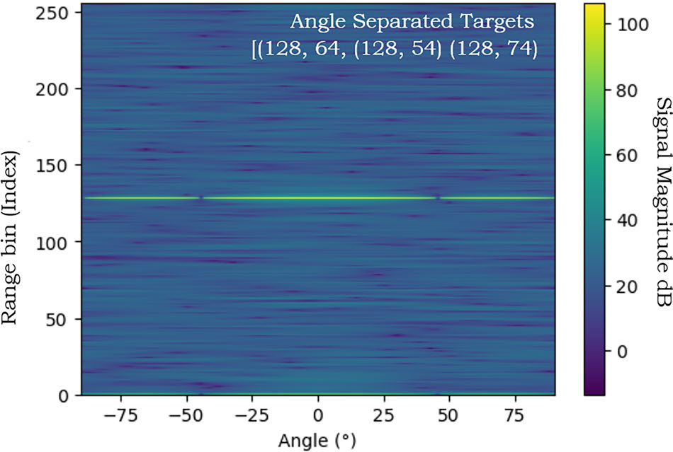
Models & Explainability
ECG beat (252 samples)
Baseline: 1D CNN
• Conv → BatchNorm → ReLU → MaxPool blocks
• Global pooling → dense → softmax (4 classes)
• Learns the local shape of the QRS, P and T waves
Conv1D blocks ×3
Heatmap
Grad-CAM / SHAP
LSTM (proposed only)
Proposed: CNN-LSTM + RR
CNN extracts wave shape, the LSTM models the order P → QRS → T, and the previous / next RR intervals are added before the classifier (helps S beats).
Concat → Dense → Softmax
RR features
N / S / V / F
Explainability (Captum)
Grad-CAM: last conv layer, gradient-weighted
Gradient SHAP: contribution of each sample
Checks: % importance on P / QRS / T, deletion test
Expected: V beats → heatmap on the wide QRS; S beats → more weight on P wave and RR timing.

Slide 10
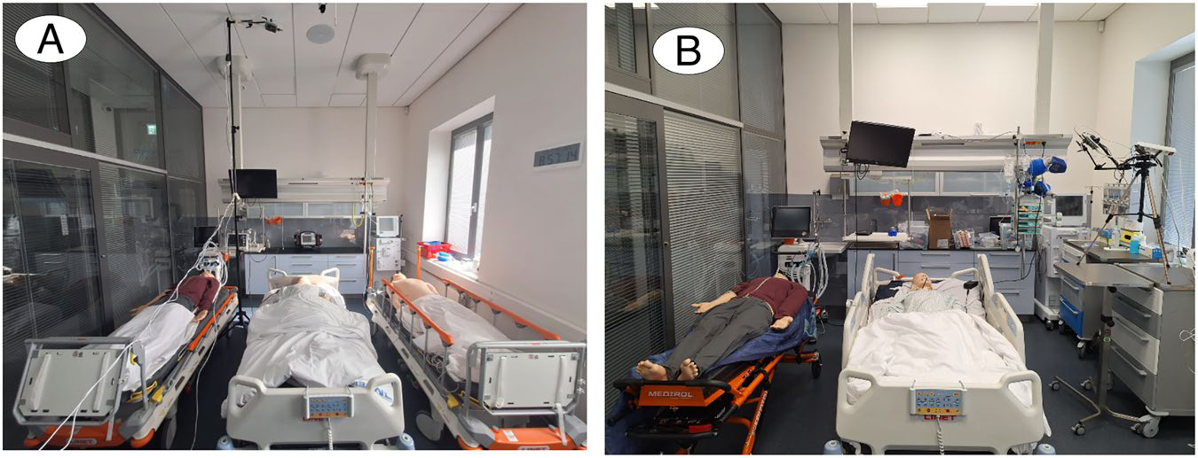
Current Work: Baseline CNN
Baseline CNN results
Confusion matrix and per-class precision / recall / F1
(to be attached after training)
Completed
• Literature review of 37 papers
• Framework and pipeline design
• Dataset, classes and splits fixed
In progress: baseline 1D CNN
• Input: 252-sample MIT-BIH beats
• 4 classes: N, S, V, F
• Intra-patient 80/20 split
• Class-weighted cross-entropy
• Output: confusion matrix + per-class F1
The baseline gives the reference scores that the CNN-LSTM + RR model must beat.

Slide 11
Conclusion And Future Scope
Key takeaways
• Deep learning reaches high accuracy on MIT-BIH, but explanations are rarely validated.
• Inter-patient testing is needed for honest results.
• Our framework joins classification, explanation and checks of the explanation.
Next steps
Baseline CNN → CNN-LSTM + RR → DS1/DS2 evaluation → Grad-CAM / SHAP with region and deletion checks → noise robustness → demo.
Future scope
External test on another database (INCART), automatic R-peak detection (Pan-Tompkins), uncertainty estimation and clinician review of explanations.

Slide 12
References
[1] G. B. Moody and R. G. Mark, “The impact of the MIT-BIH Arrhythmia Database,” IEEE Eng. Med. Biol. Mag., vol. 20, no. 3, pp. 45–50, 2001.
[2] N. Alamatsaz et al., “A lightweight hybrid CNN-LSTM explainable model for ECG-based arrhythmia detection,” Biomed. Signal Process. Control, vol. 90, 2024.
[3] D. Tenepalli and T. M. Navamani, “Design of an explainable deep learning framework for ECG-based arrhythmia prediction,” IEEE Access, vol. 13, 2025.
[4] Q. Xiao et al., “Deep learning-based ECG arrhythmia classification: A systematic review,” Applied Sciences, vol. 13, 4964, 2023.
[5] G. A. L. Silva et al., “A systematic review of ECG arrhythmia classification: Adherence to standards, fair evaluation, and embedded feasibility,” arXiv:2503.07276, 2025.
[6] N. N. Kulkarni et al., “Recent advances in deep learning based arrhythmia classification using ECG and PPG signals: a systematic review,” Discover Computing, vol. 29, 2026.
[7] P. Pramkeaw et al., “Deep learning-based ECG arrhythmia detection system: A comparative study of CNN, RNN, and LSTM architectures,” IEEE ICCI, 2026.
[8] P. de Chazal, M. O’Dwyer and R. B. Reilly, “Automatic classification of heartbeats using ECG morphology and heartbeat interval features,” IEEE Trans. Biomed. Eng., vol. 51, no. 7, 2004.

