Slide 1

B. Tech. Project Mid-Semester Evaluation
Explainable Deep Learning Framework for Automated ECG Arrhythmia Detection and Classification
Presented by
Sidhesh Mahesh Tavare (2314037)
Nikhil Kumar Singh (2314055)
Supervisor
Dr. Arnab Nandi
Department of Electronics and Communication Engineering
National Institute of Technology Silchar
Notes:
Good morning respected panel members. We are Bhoomi Singhal (2314168) and Archita Roy (2314165), working under the supervision of Dr. Koushik Guha.
Our project is "Design of an Energy-Efficient EEG Seizure Detection System using Approximate Computing".
In one line: we detect epileptic seizures from EEG signals with a machine-learning classifier (SVM), and we plan to build its hardware with APPROXIMATE adders and multipliers so that it consumes much less power - making it suitable for wearable, battery-powered seizure monitors.

Slide 2
Introduction
Electrocardiogram (ECG)
Why automate?
Skin electrodes record the heart's electrical activity. Each beat shows a P wave, QRS complex and T wave; arrhythmias alter their morphology (shape) or rhythm (timing).
A 24 h Holter recording at ~70 bpm holds ≈ 100,000 beats. Manual beat-by-beat review is slow and error-prone, so automatic beat classification is needed.
What the framework must deliver
Accurate classification
Explanation
Robustness
per-class F1 on N, S, V, F
sample-level heatmap per beat
stable under real ECG noise
Deep models reach high accuracy but act as black boxes. This project pairs a CNN / CNN-LSTM classifier with Grad-CAM and SHAP, and quantitatively checks whether the explanations point at the clinically relevant waves.

Slide 3
ECG Beats & Arrhythmia Classes
P, QRS and T waves
RR interval
P = atrial depolarisation; QRS = ventricular depolarisation (normal width < 120 ms); T = ventricular repolarisation. Normal PR interval 120–200 ms.
Time between successive R peaks; heart rate = 60 / RR (s). A premature beat has a short previous RR and a long next RR (compensatory pause).
N – Normal {N, L, R, e, j}
S – Supraventricular {A, a, J, S}
Normal, bundle-branch-block and escape beats. ≈ 90% of all beats, so the data are heavily imbalanced.
Premature beats from the atria / AV junction. QRS is near-normal, so detection relies on the RR timing and an abnormal or hidden P wave.
V – Ventricular {V, E}
F – Fusion {F}
Ectopic focus in the ventricles: wide (≥ 120 ms), bizarre QRS, no preceding P wave, often an opposite-polarity T wave.
Normal and ventricular activation meet, giving an intermediate shape. Rarest class (< 1% of beats) and hardest to classify.
Labels are grouped into AAMI EC57 classes [12]; paced / unclassifiable beats (Q) are excluded, as in most MIT-BIH studies.

Slide 4
Literature Review & Research Gap
37 papers (2020–2026) on deep learning and XAI for ECG arrhythmia classification were reviewed.
Area
Existing direction & reported evidence
Deep learning models
CNN 96.8% vs CNN-LSTM 98.5% accuracy in a direct comparison [7]; lightweight CNN-LSTM with SHAP reports 98.24% over 9 rhythm classes [2]
Evaluation protocol
Only 30.3% of 122 studies use an inter-patient split [5]; where both are reported, F1 falls from 95.52% to 83.89% on unseen patients [4]
Explainability
Grad-CAM / SHAP mostly shown as example plots [2], [3]; < 10% of studies validate maps against P / QRS / T structures [6]
Research gap
Our project position
Explanations are rarely quantified: do they fall on the right wave, are they faithful to the model, and do they stay stable when the ECG is noisy?
Compare CNN vs CNN-LSTM + RR under intra- and inter-patient splits, then score Grad-CAM / SHAP with wave-region, deletion and noise-stability metrics.

Slide 5
Problem Statement & Motivation
Given a beat x ∈ ℝ²⁵² and its RR features r, learn a classifier f(x, r) → ŷ ∈ {N, S, V, F} together with an attribution map A(x) ∈ ℝ²⁵² that shows how much each sample drove the decision.
Black-box models
Class imbalance
Patient leakage
Noisy signals
Thousands of learned weights and no stated reason; a clinician cannot verify the decision.
N ≈ 90%, S ≈ 2%, F < 1% of beats: high accuracy can hide near-zero S / F recall.
Beats of one patient look alike; random splits place them in both train and test sets.
Muscle (EMG) and motion artefacts overlap the QRS band; most models are tested only on clean ECG.
Core pipeline: preprocess → classify → explain → validate
Motivation
• Long-term ECG screening needs automatic, beat-level arrhythmia detection.
• A heatmap a clinician can check (e.g. "wide QRS → V") builds trust in the prediction.
• Inter-patient and noise tests show how the model would behave on new, real recordings.

Slide 6
Project Objectives
01
Preprocess MIT-BIH
Band-pass filter, segment 252-sample beats around R peaks, compute normalised RR features, map labels to AAMI N / S / V / F.
Baseline & proposed
Train a 1D CNN baseline and a CNN-LSTM + RR model with class-weighted cross-entropy to handle the ≈ 45:1 N:S imbalance.
02
03
Fair evaluation
Intra-patient (stratified 80/20) and inter-patient DS1 → DS2 splits; confusion matrix, per-class precision, recall, F1, macro-F1.
04
Explain & validate
Grad-CAM and Gradient SHAP maps; measure importance share on P / QRS / T and faithfulness with a deletion test.
05
Robustness & demo
Add NSTDB muscle noise at 18 / 6 / 0 dB SNR: F1 vs SNR and heatmap stability; Streamlit demo of prediction + heatmap.

Slide 7
Dataset: MIT-BIH Arrhythmia Database
MIT-BIH Arrhythmia Database (PhysioNet)
Moody & Mark [1] • 48 records × 30 min • 47 subjects • 2 leads • 360 Hz, 11-bit • ≈ 110,000 annotated beats
Data used
Two evaluation splits
Lead MLII. Paced records 102, 104, 107, 217 removed → 44 records. Cardiologist beat labels and R-peak positions are used directly.
Intra-patient: stratified random 80/20 split of beats. Inter-patient [8]: train on DS1 (22 records), test on DS2 (22 other records).
Split | N | S | V | F | Total
DS1 (train) | 45,866 | 944 | 3,788 | 415 | 51,013
DS2 (test) | 44,259 | 1,837 | 3,221 | 388 | 49,705
AAMI beat counts per split [8]: S and F together are < 3% of beats, so per-class F1 matters more than accuracy.
Noise data: MIT-BIH Noise Stress Test Database (NSTDB) [11]
The 'ma' (muscle artefact) recording is scaled and added to test beats at SNR = 18, 6 and 0 dB, where SNR = 10·log₁₀(P_signal / P_noise).

Slide 8
Methodology
1
2
3
4
5
6
7
Raw ECG
→
Filter
→
Segment
→
RR
→
Classify
→
Predict
→
Explain
MLII, 360 Hz
BP 0.5–40 Hz
−0.25 / +0.45 s
prev, next
CNN / CNN-LSTM
N, S, V, F
Grad-CAM, SHAP
Steps 1–4 turn each record into fixed-length beats plus timing features; steps 5–7 classify each beat and produce a sample-level explanation.
Preprocessing
Features & training
• 4th-order zero-phase Butterworth band-pass, 0.5–40 Hz: removes baseline wander and 60 Hz mains
• Window: 90 samples before + 161 after the R peak = 252 samples (0.7 s)
• Per-beat z-score: x′ = (x − μ) / σ
• RR_prev, RR_next divided by the record's mean RR (removes patient heart-rate differences)
• Class-weighted cross-entropy, w_c = N / (K · n_c)
• Adam (lr 10⁻³), batch 128, early stopping on validation macro-F1

Slide 9
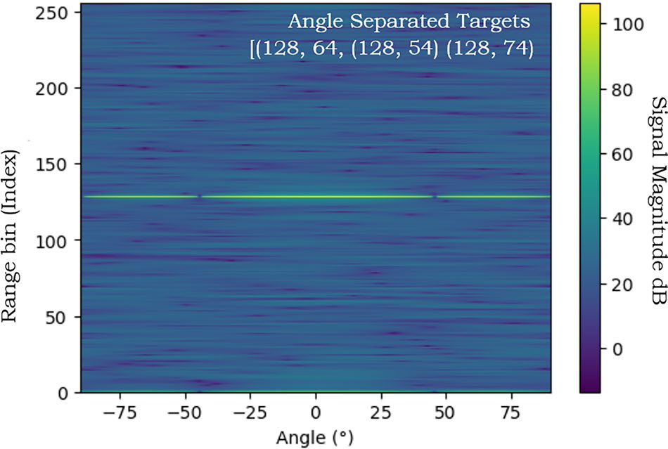
Models & Explainability
Beat x: 252 × 1
Baseline: 1D CNN (≈ 44 k parameters)
• Conv1D 32 (k=7) → 64 (k=5) → 128 (k=3)
• Each: BatchNorm → ReLU → MaxPool(2): 252 → 31 steps
• Global avg. pool → Dense 64 → Softmax 4
Conv1D ×3
32 → 64 → 128 ch
Heatmap
A(x) ∈ ℝ²⁵²
Grad-CAM / SHAP
Proposed: CNN-LSTM + RR
LSTM(64) (proposed only)
The 31 × 128 conv feature sequence feeds an LSTM(64) that models the P → QRS → T order; its last hidden state is concatenated with the 2 RR features before Dense 64 → Softmax 4.
Concat → Dense 64 → Softmax
RR prev, next
Explainability (Captum)
N / S / V / F
Grad-CAM [9]: α_k = (1/T) Σ_t ∂y_c / ∂A_k(t), L = ReLU(Σ_k α_k A_k), upsampled 31 → 252
Gradient SHAP [10]: averages gradient × (x − x′) over random baselines x′; Σ φ_i ≈ f(x) − E[f(x′)]
Expected: V beats → heatmap on the wide QRS; S beats → more weight on the P wave and RR inputs.

Slide 10
Evaluation & Explanation Metrics
Classification (per class)
Confusion matrix
Precision = TP / (TP + FP), Recall = TP / (TP + FN), F1 = 2PR / (P + R). Macro-F1 = mean F1 over N, S, V, F, so rare classes count equally.
4 × 4 table of true vs predicted class. Shows the typical errors: S beats called N (similar shape) and F beats called N or V.
Region share (are maps clinical?)
Deletion test (are maps faithful?)
R_w = Σ_{t∈w} |A(t)| / Σ_t |A(t)| for w ∈ {P, QRS, T}. Windows relative to R: P [−250, −80] ms, QRS [−50, +50] ms, T [+100, +400] ms.
Zero the 10% highest-importance samples: Δp = p_c(x) − p_c(x_del). Compare with 10% random samples; a faithful map gives a much larger drop.
Noise robustness
Explanation stability
Add NSTDB muscle noise at SNR ∈ {18, 6, 0} dB and plot macro-F1 vs SNR for both models.
ρ = Pearson correlation of A(x_clean) and A(x_noisy); ρ → 1 means the explanation does not change with noise.
All metrics are reported for both the intra-patient and inter-patient (DS1 → DS2) splits.

Slide 11
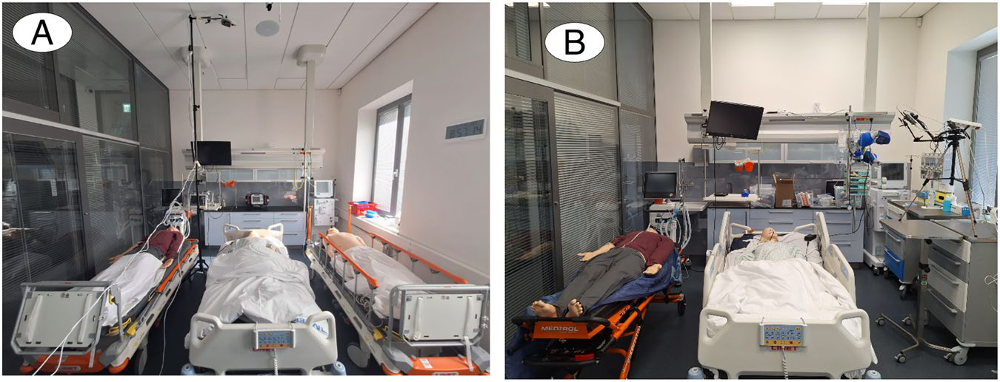
Current Work: Baseline CNN
Baseline CNN results
Confusion matrix and per-class precision / recall / F1
(to be attached after training)
Completed
• Literature review of 37 papers
• Framework, metrics and splits defined
• AAMI mapping and DS1 / DS2 records fixed
In progress: baseline 1D CNN
• Replicating a public reference 1D CNN
• Retrained on our 252-sample, 4-class beats
• Stratified 80/20 split, class-weighted loss
• Output: confusion matrix, per-class P / R / F1, macro-F1
These scores become the reference the CNN-LSTM + RR model must beat, especially on S and F recall.

Slide 12
Conclusion And Future Scope
Key takeaways
• Published accuracies (98–99%) are mostly intra-patient; inter-patient F1 is far lower.
• Explanations are common, but rarely validated quantitatively.
• Our framework adds region, deletion and noise-stability scores to standard classification metrics.
Next steps
Baseline CNN → CNN-LSTM + RR → DS1 / DS2 evaluation → Grad-CAM / SHAP with region and deletion checks → NSTDB noise tests → Streamlit demo.
Future scope
External test on INCART, automatic R-peak detection (Pan-Tompkins), MC-dropout uncertainty, full P/QRS/T delineation and clinician review of explanations.

Slide 13
References
[1] G. B. Moody and R. G. Mark, “The impact of the MIT-BIH Arrhythmia Database,” IEEE Eng. Med. Biol. Mag., vol. 20, no. 3, pp. 45–50, 2001.
[2] N. Alamatsaz et al., “A lightweight hybrid CNN-LSTM explainable model for ECG-based arrhythmia detection,” Biomed. Signal Process. Control, vol. 90, 2024.
[3] D. Tenepalli and T. M. Navamani, “Design of an explainable deep learning framework for ECG-based arrhythmia prediction,” IEEE Access, vol. 13, 2025.
[4] Q. Xiao et al., “Deep learning-based ECG arrhythmia classification: A systematic review,” Applied Sciences, vol. 13, 4964, 2023.
[5] G. A. L. Silva et al., “A systematic review of ECG arrhythmia classification: Adherence to standards, fair evaluation, and embedded feasibility,” arXiv:2503.07276, 2025.
[6] N. N. Kulkarni et al., “Recent advances in deep learning based arrhythmia classification using ECG and PPG signals: a systematic review,” Discover Computing, vol. 29, 2026.
[7] P. Pramkeaw et al., “Deep learning-based ECG arrhythmia detection system: A comparative study of CNN, RNN, and LSTM architectures,” IEEE ICCI, 2026.
[8] P. de Chazal, M. O’Dwyer and R. B. Reilly, “Automatic classification of heartbeats using ECG morphology and heartbeat interval features,” IEEE Trans. Biomed. Eng., vol. 51, no. 7, 2004.
[9] R. R. Selvaraju et al., “Grad-CAM: Visual explanations from deep networks via gradient-based localization,” Proc. IEEE ICCV, 2017.
[10] S. M. Lundberg and S.-I. Lee, “A unified approach to interpreting model predictions,” Proc. NeurIPS, 2017.
[11] G. B. Moody, W. Muldrow and R. G. Mark, “A noise stress test for arrhythmia detectors,” Computers in Cardiology, vol. 11, 1984.
[12] ANSI/AAMI EC57, “Testing and reporting performance results of cardiac rhythm and ST segment measurement algorithms,” AAMI, 2012.

