Slide 1

B. Tech. Project Mid-Semester Evaluation
Explainable Deep Learning Framework for Automated ECG Arrhythmia Detection and Classification
Presented by
Sidhesh Mahesh Tavare (2314037)
Nikhil Kumar Singh (2314055)
Supervisor
Dr. Arnab Nandi
Department of Electronics and Communication Engineering
National Institute of Technology Silchar
Notes:
Good morning respected panel members. We are Bhoomi Singhal (2314168) and Archita Roy (2314165), working under the supervision of Dr. Koushik Guha.
Our project is "Design of an Energy-Efficient EEG Seizure Detection System using Approximate Computing".
In one line: we detect epileptic seizures from EEG signals with a machine-learning classifier (SVM), and we plan to build its hardware with APPROXIMATE adders and multipliers so that it consumes much less power - making it suitable for wearable, battery-powered seizure monitors.

Slide 2
Introduction
Background and Motivation
The ECG is a widely used non-invasive tool for detecting cardiac arrhythmias, and automating its interpretation is an active research area.
• CNNs are used in 58.7% of 368 studies reviewed by Xiao et al. [1] and in 62% of 119 studies reviewed by Kulkarni et al. [2].
• Hybrid CNN-recurrent and Transformer-based models are increasingly common [1], [2].
Significance of the Problem: three issues limit clinical usefulness
Evaluation protocol
Black-box models
Narrow robustness tests
F1 fell from 95.52% (intra-patient) to 83.89% (inter-patient) [1]; only 30.3% of 122 reviewed articles followed the inter-patient paradigm [4].
SHAP and saliency methods are increasingly used, but fewer than 10% of studies validated explanation maps against clinically meaningful ECG structures [2].
Robustness to realistic noise is tested narrowly, often with additive white Gaussian noise only [5].

Slide 3
Problem Statement & Objectives
There is a need for an ECG arrhythmia classification framework whose performance is measured on unseen patients, whose explanations are checked for consistency and clinical plausibility, and whose predictions and explanations are evaluated for robustness under realistic noise.
01
Objective 1: Patient-independent baseline
Develop a hybrid deep learning arrhythmia classifier evaluated under a strict inter-patient protocol (MIT-BIH DS1/DS2) with external testing on a second database, reporting per-class and macro F1 alongside accuracy.
02
Objective 2: Validated explanations
Apply post-hoc XAI methods (e.g. SHAP and Grad-CAM) to the patient-independent model and measure the within-class consistency of explanations and their agreement with recognised ECG features (P wave, QRS complex, RR interval).
03
Objective 3: Robustness of predictions and explanations
Assess how classification performance and explanation stability degrade under realistic NSTDB noise (baseline wander, muscle artefact, electrode motion) at graded SNRs, using uncertainty estimates to flag unreliable predictions.

Slide 4
Literature Review
A literature survey of 36 papers (5 reviews and 31 original studies) on deep learning and explainable AI for ECG arrhythmia classification, grouped into four themes.
Architectures
Explainable AI methods
• CNNs remain dominant [1], [2]; hybrids pair a CNN front end with a recurrent or attention module (CNN-LSTM [8], CNN-BiLSTM [11]).
• Attention/Transformer models gain 0.845% over 1D-CNNs, at higher cost beyond ~1 M parameters [2].
• Lightweight designs stay competitive: a 0.16 MB CNN-LSTM ran at 5.127 ms per rhythm on a Raspberry Pi [8].
• SHAP is the most widely used method [8], [3]; then Grad-CAM and class activation maps.
• Explanations for APB and PVC beats were inconsistent within a class and not validated by medical professionals [3].
• Fewer than 10% of studies validated maps against clinical ECG structures [2].
Datasets and evaluation
Robustness
• MIT-BIH dominates: used in 61% [1] and 78.7% [4] of reviewed studies.
• One study: 99.00% accuracy beat-wise but 91.69% patient-wise, with Fusion recall 0.021 [11].
• External validation in only 18.5% of studies, with a mean accuracy drop of 8.7% [2].
• Often only AWGN tested: F1 fell to 32.46% at 5 dB [5].
• Uncertainty-aware fusion was more robust under NSTDB noise from 15 to 0 dB [30].
• Rejecting high-uncertainty predictions raised macro F1 from 0.6635 to 0.8688 [33].

Slide 5
Comparison of Key Studies
Surveyed papers most relevant to this project (report Table 1).
Ref. | Dataset(s) | Model | XAI | Split | Key result
[8] | MIT-BIH + LTAF | Lightweight CNN-LSTM | SHAP | Not stated (85/15) | Acc 98.24%, Se 86.1%; 0.16 MB
[3] | MIT-BIH + 12-lead (Zheng et al.) | 1D CNN | 4 SHAP variants | Not stated (80/20) | Val acc 98.30%; 73.45% on combined data
[29] | MIT-BIH; Chapman-Shaoxing | Adversarial SE-ResNet | Not stated | Inter-patient | AFib F1 77.9% vs 61.0%
[5] | MIT-BIH; INCART, SVDB, PTB | CNN-BiLSTM + CapsNet fusion | Branch weights | Inter-patient | Acc 99.55%; F1 32.46% at 5 dB AWGN
[11] | MIT-BIH | CNN-BiLSTM + cGAN | Not stated | Both | 99.00% beat-wise vs 91.69% patient-wise
[30] | MIT-BIH; INCART; NSTDB | BiLSTM + ViT, D-S fusion | Not stated | Not stated (80/20) | Acc 98.8%; robust 15–0 dB noise
Pattern: XAI studies often do not describe patient separation in their splits [8], [3], while strong inter-patient studies often include no XAI [29], [11].

Slide 6
Research Gaps
Gap 1 – Explanations rarely validated
Gap 2 – XAI seldom patient-independent
SHAP and Grad-CAM are widely applied, but fewer than 10% of studies validated maps against clinical ECG structures [2], and explanations were inconsistent within a class [3].
Several XAI studies do not describe patient separation, although inter-patient evaluation substantially lowers performance [1], [11] and is used by only 30.3% of studies [4].
Gap 3 – Narrow noise tests, not linked to XAI
Gap 4 – Weak minority classes and generalisation
Noise tests are limited to AWGN [5] or absent; NSTDB-based work [30] has no explanation analysis; no surveyed paper tests whether explanations stay stable under noise [33].
Patient-wise Fusion and S recall were only 0.021 and 0.209 [11]; only 18.5% of studies validate externally, with a mean accuracy drop of 8.7% [2].

Slide 7
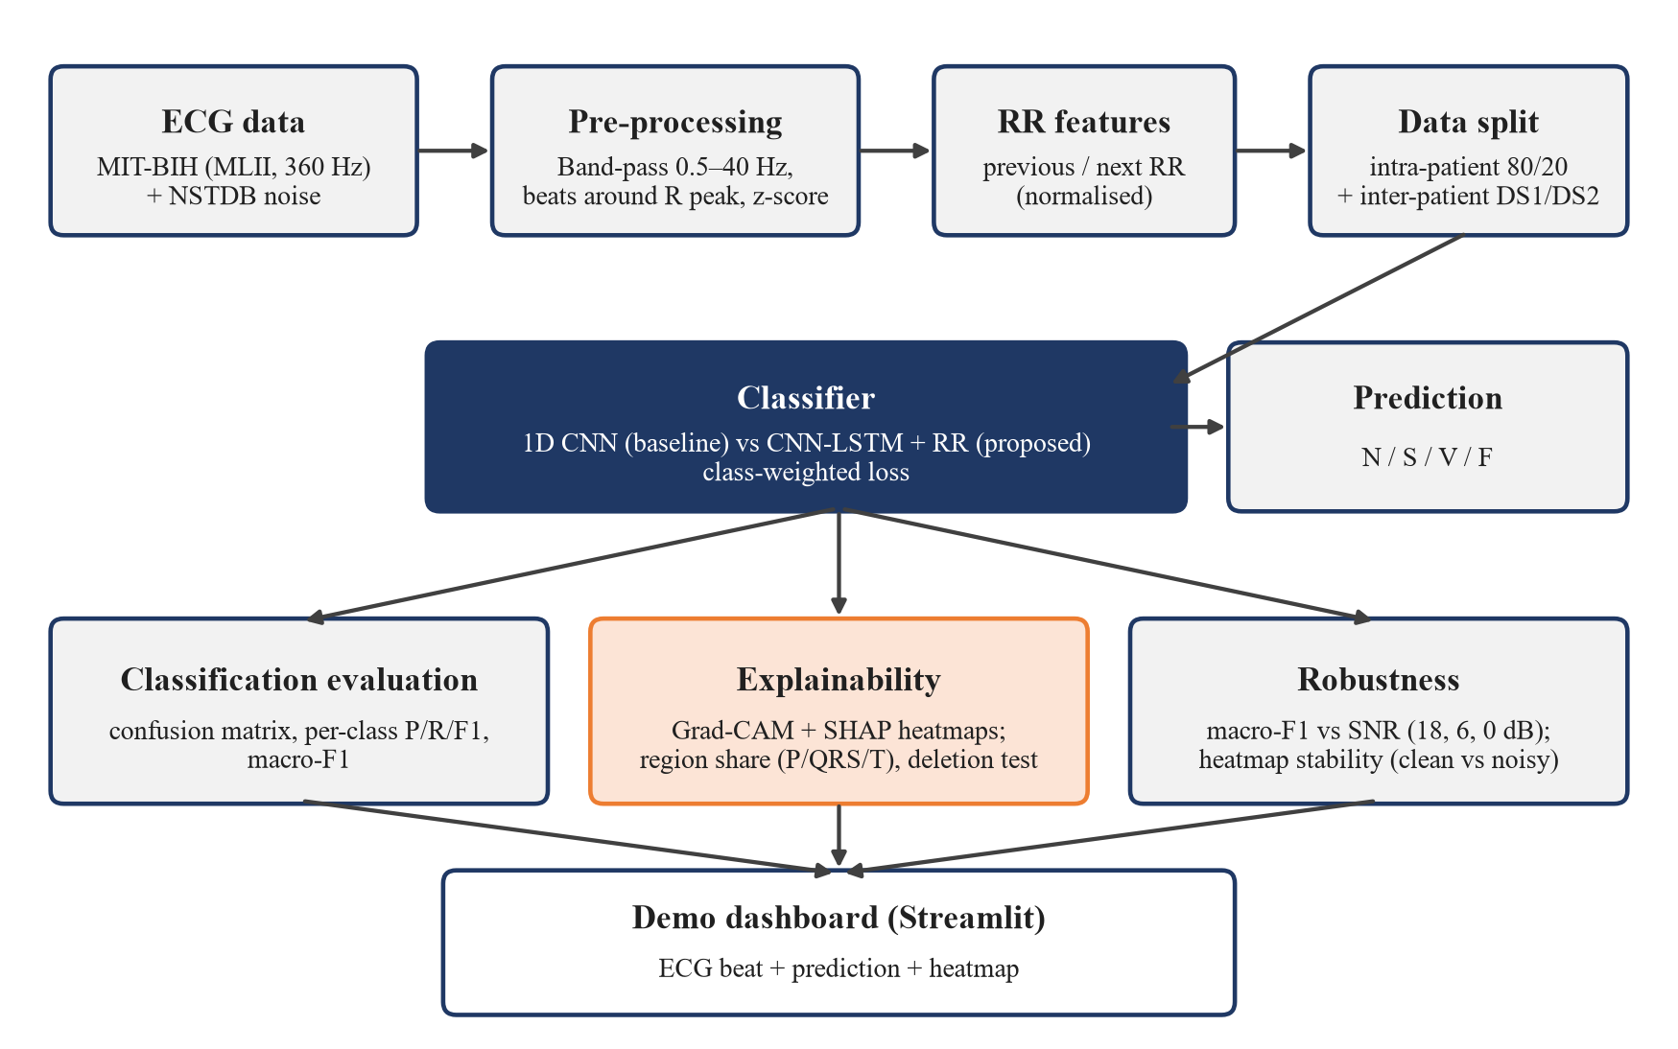
Methodology: Proposed Framework
Block diagram of the proposed framework (report Figure 1)
Datasets
• MIT-BIH Arrhythmia Database with AAMI classes N, S, V, F, Q and the inter-patient DS1/DS2 split (Objective 1).
• External database for cross-database testing (INCART preferred: beat-level annotations like MIT-BIH); a stretch goal, otherwise future work.
• MIT-BIH Noise Stress Test Database (baseline wander, muscle artefact, electrode motion) for robustness tests (Objective 3), as used in [30].

Slide 8
Classification Model & Training
A hybrid model: convolutional front end + recurrent or attention module for temporal context, a design family a recent review judged the most clinically translatable [2].
Baseline: 1D CNN
Proposed: CNN-LSTM + RR
Three conv blocks (32, 64, 128 filters; kernels 7, 5, 3; each with batch normalisation, ReLU and max-pooling), global average pooling, Dense 64 and softmax (about 44,700 parameters). Already implemented and trained.
Same conv front end → LSTM (64 units); its last hidden state is concatenated with the previous and next RR intervals (each divided by the record's mean RR) → Dense 64 → softmax over N, S, V, F. A residual CNN is kept as an extra comparison model.
Class imbalance
Training
Class-weighted cross-entropy on the training partition only. Balanced weights (F:N 113:1) caused many false Fusion predictions; square-root weights (10.6:1) gave the best results and are used.
Adam, batch size 128, at most 30 epochs; best epoch chosen on validation macro F1 rather than validation loss (this alone raised test macro F1 from 76.29% to 83.96%). Learning rate tuned on validation.
Tools: Python 3, TensorFlow 2.20 / Keras, NumPy, pandas, scikit-learn, Matplotlib, seaborn, wfdb, SHAP, Streamlit; Kaggle notebooks with an NVIDIA Tesla T4 GPU.

Slide 9
Explainability, Robustness & Metrics
Explainability: Grad-CAM [37] (already implemented) and Gradient SHAP [38], evaluated for within-class consistency and agreement with the P wave, QRS complex and RR interval. Three measures:
Region share
Deletion test
Stability
Share of total absolute attribution in fixed windows around the R peak: P [−250, −80] ms, QRS [−50, +50] ms, T [+100, +400] ms; averaged per class.
Zero the 10% highest-attribution samples; compare the drop in predicted-class probability with removing 10% at random. A faithful map gives a much larger drop.
Pearson correlation between the attribution map of a clean beat and of the same beat with noise added (used in the robustness study).
Robustness and uncertainty
Evaluation metrics
• NSTDB muscle-artefact ('ma') record scaled and added to test beats at SNR = 18, 6 and 0 dB, SNR = 10·log10(P_signal / P_noise).
• Macro F1 plotted against SNR for both models.
• Monte Carlo dropout [33] to flag unreliable predictions if time permits; otherwise future work.
• Accuracy, per-class precision, recall and F1, and macro F1.
• Overall accuracy alone can hide poor minority-class performance [1], so macro F1 is the main metric.

Slide 10
Work Done Till Mid-Semester
Completed Tasks
Dataset used in the preliminary experiments
• Literature survey and identification of the research gaps.
• Framework design: AAMI class mapping, intra- and inter-patient (DS1/DS2) protocols, explanation metrics and noise test settings.
• V1: baseline 1D CNN with class-weighted loss, full test-set evaluation and Grad-CAM for each class.
• V2: five controlled experiments (E1–E5) + threshold tuning: test macro F1 76.29% → 91.10%, then Grad-CAM on the final model.
Pre-segmented MIT-BIH heartbeat dataset of Kachuee et al. [35]: 187-sample beats (1.5 s at 125 Hz), scaled to [0, 1], zero-padded, five AAMI classes (N, S, V, F, Q).
Used to develop and debug the pipeline before building our own pre-processing.
Class | Training file | % | Test file | %
N – Normal | 72,471 | 82.77 | 18,118 | 82.76
S – Supraventricular ectopic | 2,223 | 2.54 | 556 | 2.54
V – Ventricular ectopic | 5,788 | 6.61 | 1,448 | 6.61
F – Fusion | 641 | 0.73 | 162 | 0.74
Q – Unknown / paced | 6,431 | 7.35 | 1,608 | 7.35
Total | 87,554 | 100 | 21,892 | 100
A model that always predicts N would already exceed 80% accuracy, so macro F1 is the main metric. The split is by beat, so all preliminary results are intra-patient.

Slide 11
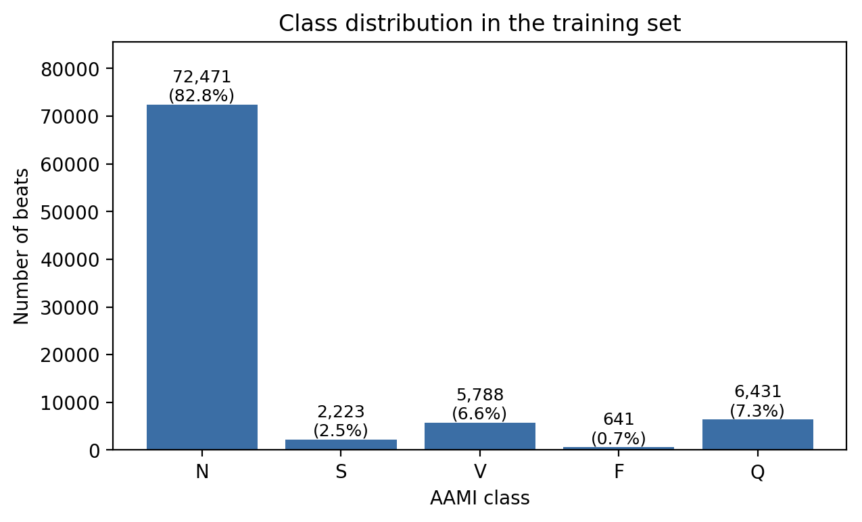
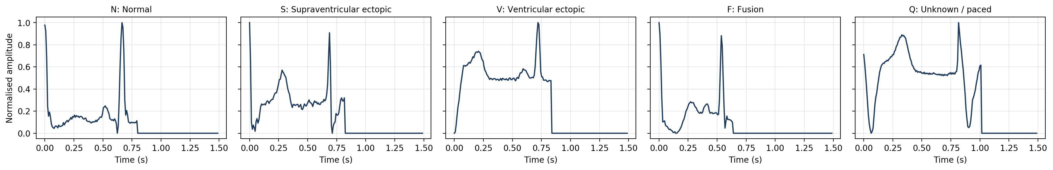
Preliminary Data: Split and Example Beats
Set | Beats | Input shape | Source | Used for
Training | 70,043 | (187, 1) | 80% of training file (stratified, seed 42) | Fitting the weights
Validation | 17,511 | (187, 1) | 20% of training file | Epoch, model and threshold selection
Test | 21,892 | (187, 1) | Provided test file | Final evaluation only
• Training portion after the split: 57,977 N, 1,778 S, 4,630 V, 513 F and 5,145 Q beats.
• Every beat starts at its R peak, contains a second large peak (most likely the next R peak) and is then zero-padded to 187 samples.
• The notebooks perform no filtering or segmentation of their own; this was done by the dataset authors [35].
Class distribution of the training file
One example beat of each class (187 samples, 125 Hz, zero-padded)

Slide 12
V1: Baseline 1D CNN – Architecture & Training
Layer | Output shape | Parameters
Input (one beat) | (187, 1) | 0
Conv1D 32, k = 7 → BN → ReLU → MaxPool 2 | (93, 32) | 256 + 128
Conv1D 64, k = 5 → BN → ReLU → MaxPool 2 | (46, 64) | 10,304 + 256
Conv1D 128, k = 3 → BN → ReLU (Grad-CAM layer) → MaxPool 2 | (23, 128) | 24,704 + 512
Global average pooling | (128) | 0
Dense 64, ReLU → Dropout 0.3 | (64) | 8,256
Dense 5, softmax | (5) | 325
Total (trainable / non-trainable) |  | 44,741 (44,293 / 448)
Setting | Value
Optimiser / learning rate | Adam, 10⁻³
Loss | Sparse categorical cross-entropy with balanced class weights
Class weights (N, S, V, F, Q) | 0.24, 7.88, 3.03, 27.31, 2.72 (F:N ≈ 113:1)
Batch size / maximum epochs | 128 / 30
Early stopping | Validation loss, patience 6, best weights restored
Learning-rate schedule | ReduceLROnPlateau on validation loss, factor 0.5, patience 3, min 10⁻⁵
Augmentation / random seed | None / 42 (Python, NumPy, TensorFlow)
Class weights w_c = N / (K·n_c). Training stopped after 17 epochs and the weights of epoch 11 were restored.

Slide 13
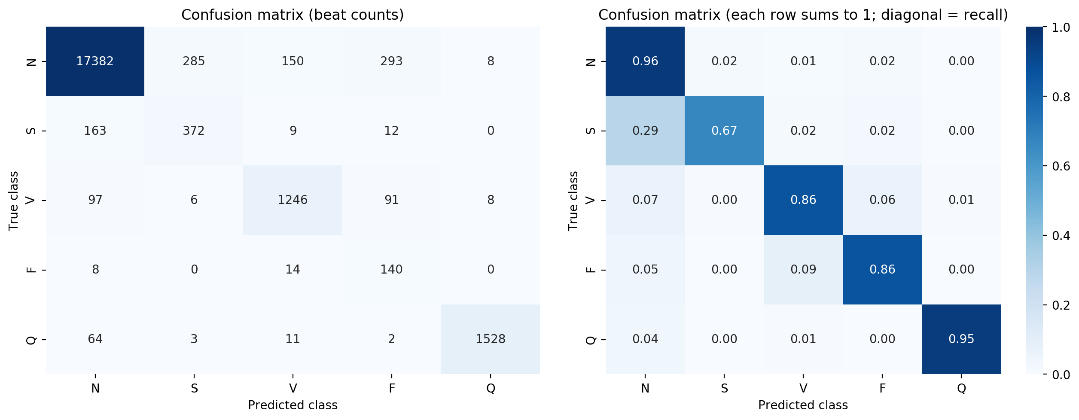
V1 Result: Baseline 1D CNN
Class | Precision | Recall | F1 | Beats
N | 0.9813 | 0.9594 | 0.9702 | 18,118
S | 0.5586 | 0.6691 | 0.6088 | 556
V | 0.8713 | 0.8605 | 0.8659 | 1,448
F | 0.2602 | 0.8642 | 0.4000 | 162
Q | 0.9896 | 0.9502 | 0.9695 | 1,608
Macro | 0.7322 | 0.8607 | 0.7629 | 21,892
Accuracy 94.41% | Macro F1 76.29%
• Class weighting gave high rare-class recall (F 86.4%) at the cost of precision.
• Of 538 beats predicted F, only 140 were truly F (293 were N): F precision 26.0%.
• Largest S error: S → N (163 of 556 S beats, 29%).
• Validation accuracy jumped between 14.5% and 95.1% from epoch to epoch.

Slide 14
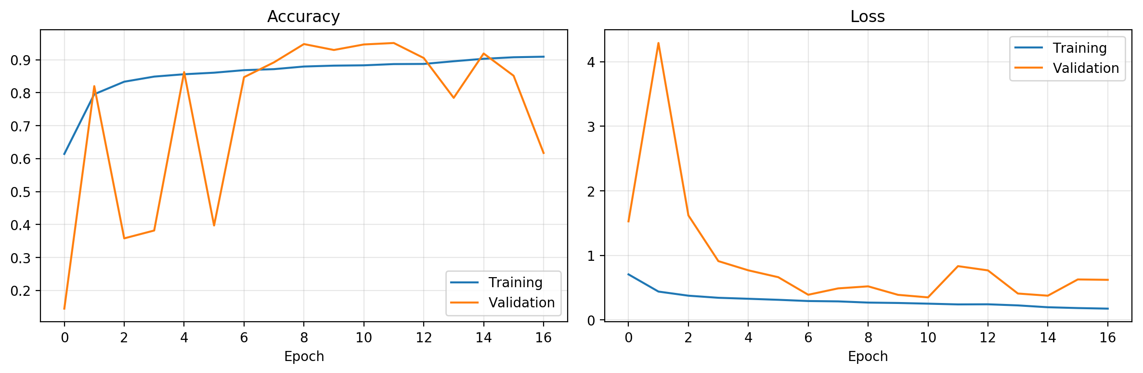
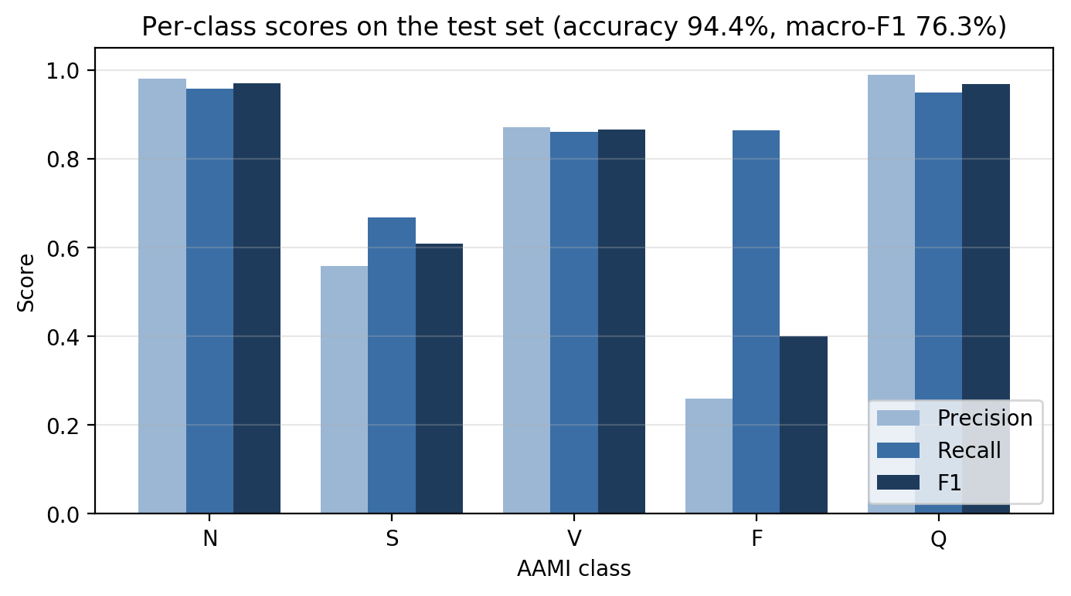
V1: Training Curves and Per-Class Scores
Training and validation accuracy and loss (17 epochs; best validation loss at epoch 11)
• Training loss fell smoothly 0.706 → 0.175; training accuracy still rising (90.93% at epoch 17).
• Validation loss ranged from 0.349 (epoch 11, restored) to 4.29 (epoch 2): a gap between training and inference behaviour, not overfitting – what V2 set out to fix.
• F and S precision bars are clearly below recall: the sign of over-weighting the rare classes.
• Weighted F1 94.98%; macro precision / recall 73.22% / 86.07%.

Slide 15
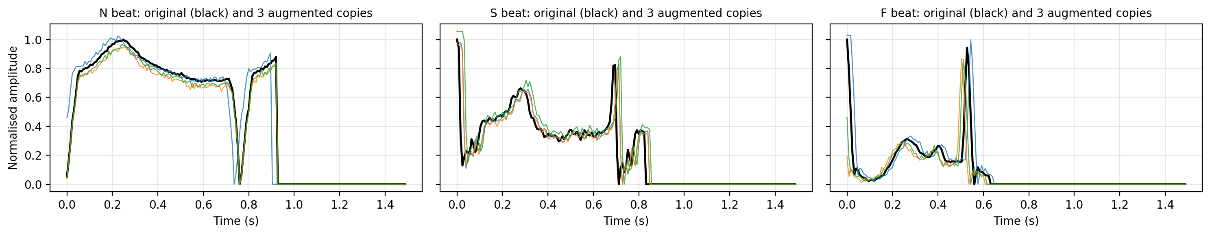
V2: Step-by-Step Experiment Setup
Class | Train beats | Balanced (B0–E2) | Sqrt (E3–E5)
N | 57,977 | 0.24 | 0.49
S | 1,778 | 7.88 | 2.81
V | 4,630 | 3.03 | 1.74
F | 513 | 27.31 | 5.23
Q | 5,145 | 2.72 | 1.65
F : N |  | 113 : 1 | 10.6 : 1
Same split and seed as V1; one change added per step. The test set was never used to choose an epoch, a model or a threshold.
Custom loop: best weights stored on validation macro F1; LR halved after 3 epochs without improvement (min 10⁻⁵); stop after 8.
ID | Network | Params | LR | Clip norm | BN mom. | Class weights | Augment.
E1 | CNN | 44,741 | 1×10⁻³ | – | 0.99 | Balanced | No
E2 | CNN | 44,741 | 5×10⁻⁴ | 1.0 | 0.9 | Balanced | No
E3 | CNN | 44,741 | 5×10⁻⁴ | 1.0 | 0.9 | Square-root | No
E4 | CNN | 44,741 | 5×10⁻⁴ | 1.0 | 0.9 | Square-root | Yes
E5 | Residual CNN [36] | 185,477 | 5×10⁻⁴ | 1.0 | 0.9 | Square-root | Yes
Augmentation (E4, E5): amplitude ×U(0.9, 1.1), Gaussian noise σ = 0.01 on the non-padded part, shift ±3 samples (±24 ms).
Residual CNN: Conv 32 (k 7) stem + 3 residual blocks (32, 64, 128), two Conv1D (k 5) + BN per block with a shortcut.
Original and three augmented copies of an N, S and F beat

Slide 16
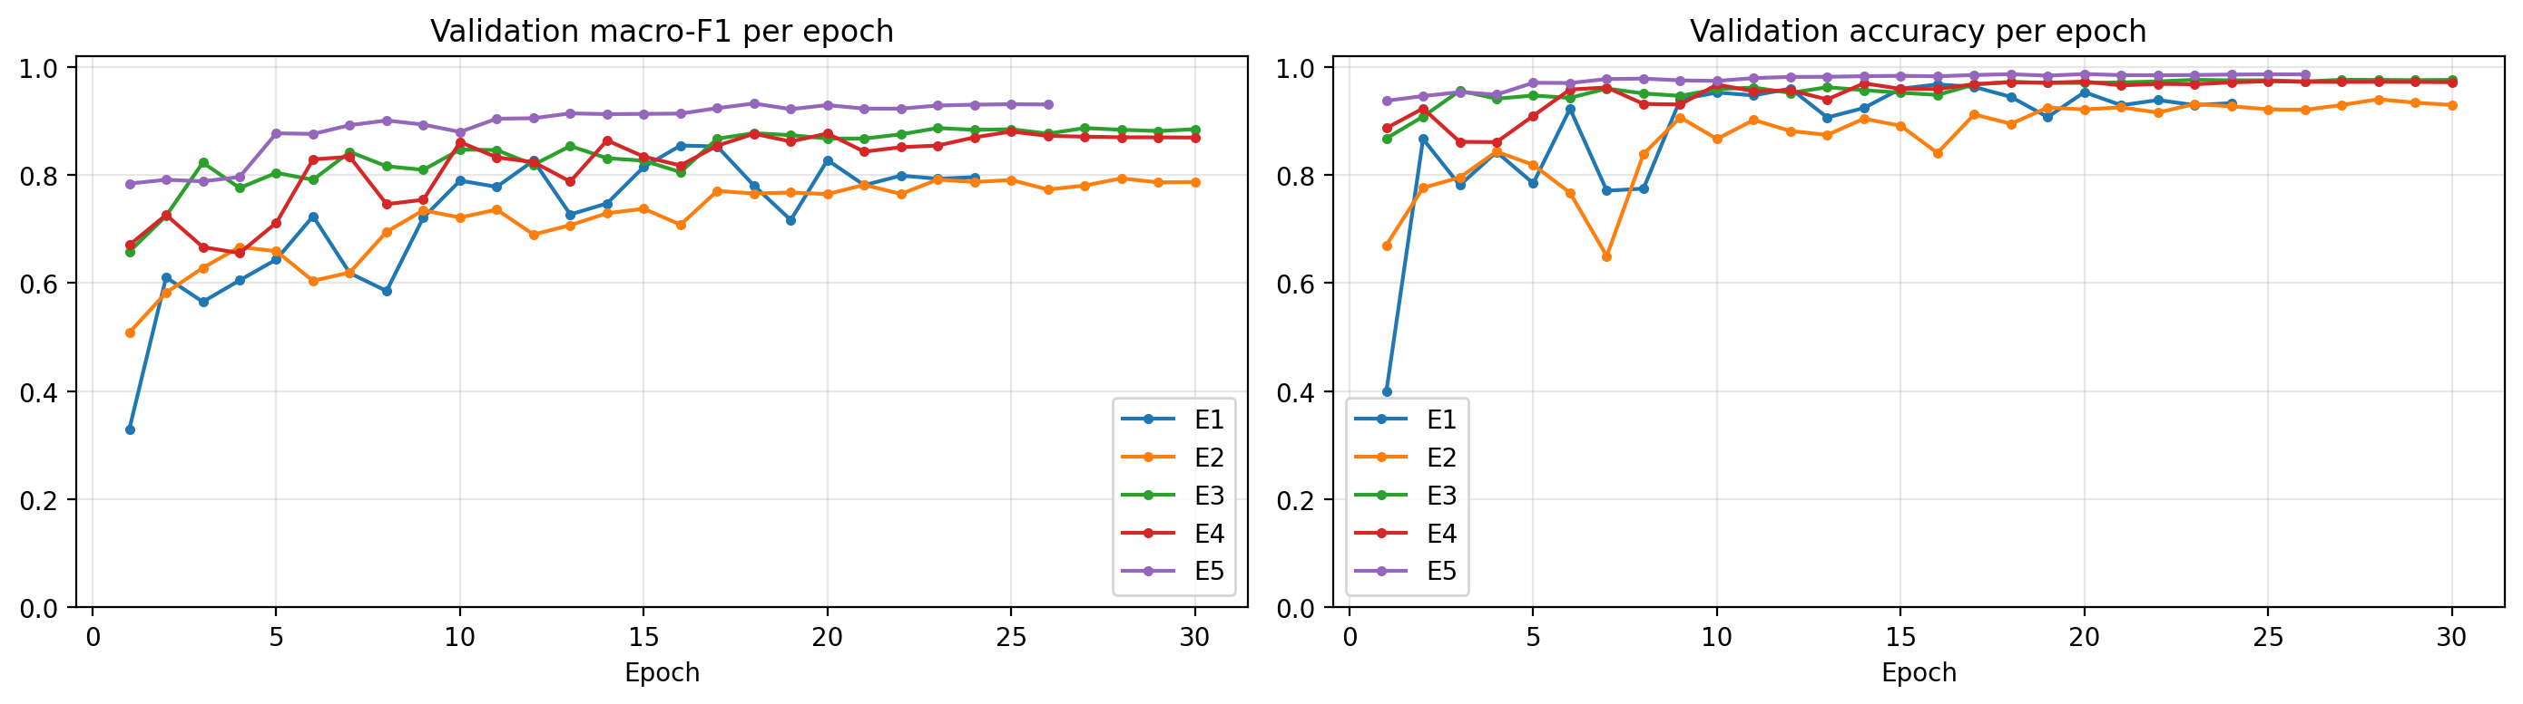
V2: Training Runs
ID | Best epoch / epochs run | Stopped early | Best val. macro F1 (%) | Δ test macro F1 | Time (s)
E1 | 16 / 24 | Yes | 85.43 | +7.67 (vs B0) | 70
E2 | 28 / 30 | No (cap) | 79.35 | −5.66 | 80
E3 | 23 / 30 | No (cap) | 88.65 | +9.28 | 80
E4 | 25 / 30 | No (cap) | 88.01 | −1.38 | 95
E5 | 18 / 26 | Yes | 93.19 | +4.57 | 158
Validation macro F1 and validation accuracy per epoch for E1–E5
• E5 trains highest and most smoothly (val. macro F1 0.78 after epoch 1; val. accuracy 0.94–0.99); E1 is the most jagged and E2 the lowest.
• E2, E3 and E4 reached the 30-epoch cap, so they may be slightly under-trained. All five runs took 8.1 min on a Tesla T4 GPU.

Slide 17
V2: Step-by-Step Results
ID | Change | Acc. | Macro F1 | S F1 | F F1 | Prec. F | Rec. F
B0 | V1 baseline | 94.41 | 76.29 | 60.90 | 40.00 | 26.02 | 86.42
E1 | Epoch chosen on val. macro F1 | 96.28 | 83.96 | 63.48 | 68.12 | 55.95 | 87.04
E2 | + lower LR, clipping, BN 0.9 | 93.58 | 78.30 | 49.13 | 58.49 | 43.73 | 88.27
E3 | + square-root class weights | 97.39 | 87.58 | 69.84 | 76.97 | 75.60 | 78.40
E4 | + light augmentation | 97.02 | 86.20 | 66.16 | 76.25 | 72.63 | 80.25
E5 | + residual network | 98.29 | 90.77 | 81.22 | 78.53 | 78.05 | 79.01
Final | E5 + tuned thresholds | 98.41 | 91.10 | 82.14 | 79.23 | 82.12 | 76.54
Test set, %. Final = E5 with per-class probability scale factors tuned on validation (only N × 3 changed).
What helped
What did not
• E1: selecting the epoch on validation macro F1: +7.67 macro F1.
• E3: square-root class weights: +9.28 over E2 (largest gain).
• E5: residual network: +4.57 over E4.
• E2 stability settings: −5.66; validation swings not visibly removed.
• E4 augmentation: −1.38.
• Threshold tuning: only +0.33; traded some S and F recall for precision.

Slide 18
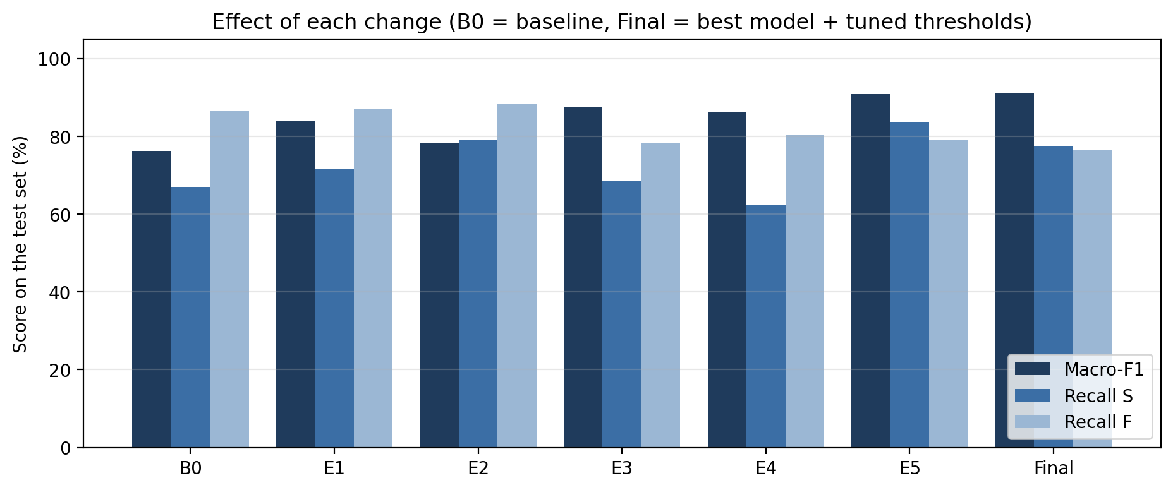
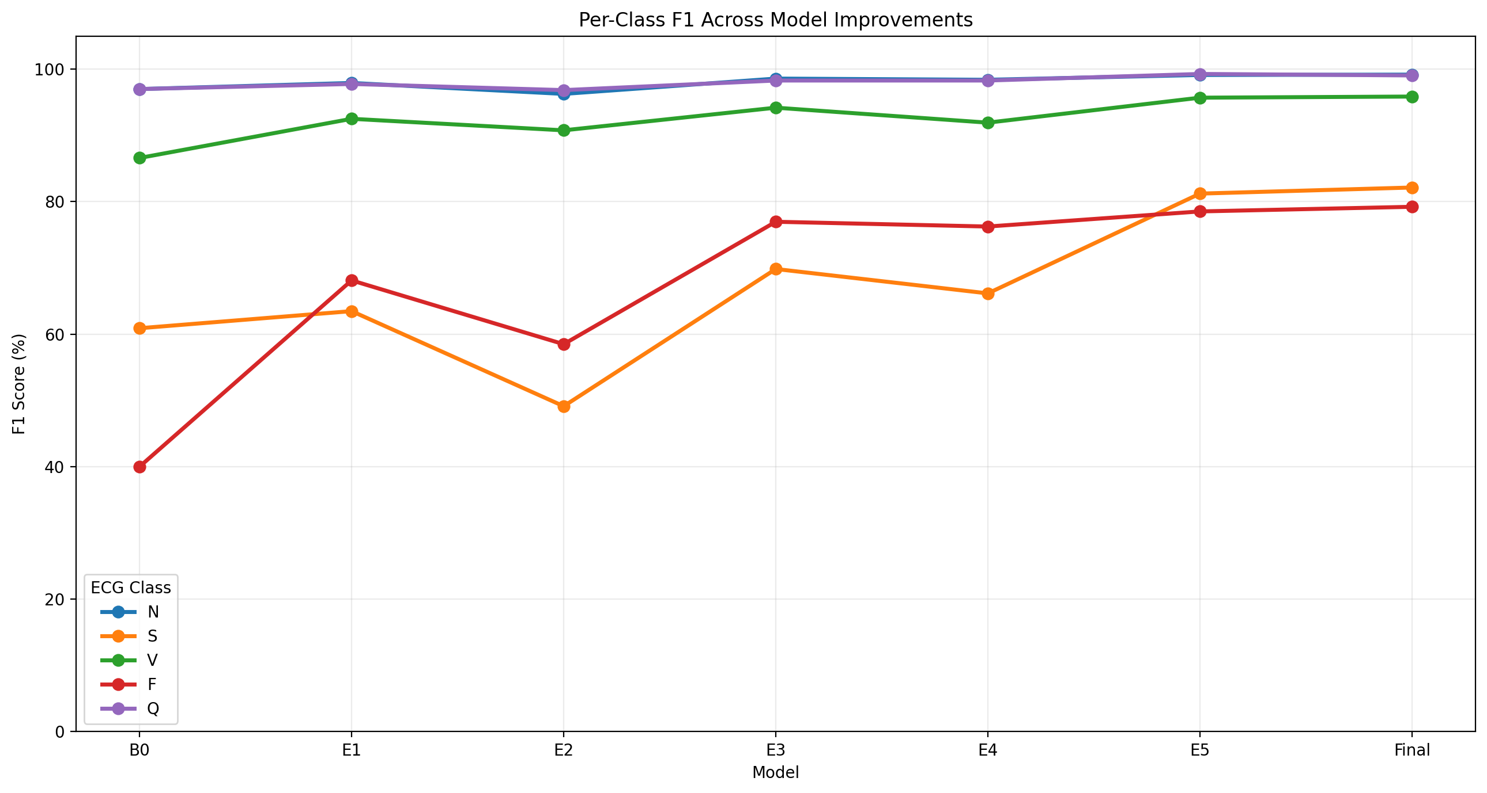
V2: Per-Class Progression
Test macro F1, S recall and F recall per step
Per-class F1 across the V2 experiments
Model | Acc. | Macro F1 | N | S | V | F | Q
B0 | 94.41 | 76.29 | 97.00 | 60.90 | 86.60 | 40.00 | 97.00
E1 | 96.28 | 83.96 | 97.92 | 63.48 | 92.51 | 68.12 | 97.77
E2 | 93.58 | 78.30 | 96.27 | 49.13 | 90.77 | 58.49 | 96.84
E3 | 97.39 | 87.58 | 98.58 | 69.84 | 94.19 | 76.97 | 98.29
E4 | 97.02 | 86.20 | 98.40 | 66.16 | 91.93 | 76.25 | 98.29
E5 | 98.29 | 90.77 | 99.13 | 81.22 | 95.70 | 78.53 | 99.28
Final | 98.41 | 91.10 | 99.18 | 82.14 | 95.87 | 79.23 | 99.06
Per-class test F1 (%) of every model.

Slide 19
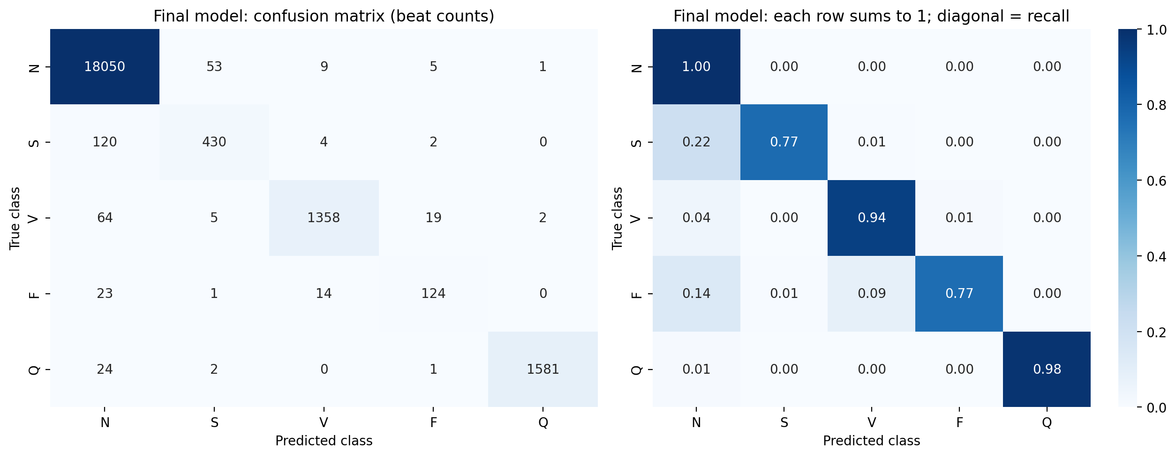
Final Model: Residual CNN + Tuned Thresholds
Class | Precision | Recall | F1 | Beats
N | 0.9874 | 0.9962 | 0.9918 | 18,118
S | 0.8758 | 0.7734 | 0.8214 | 556
V | 0.9805 | 0.9378 | 0.9587 | 1,448
F | 0.8212 | 0.7654 | 0.7923 | 162
Q | 0.9981 | 0.9832 | 0.9906 | 1,608
Macro | 0.9326 | 0.8912 | 0.9110 | 21,892
Accuracy 98.41% | Macro F1 91.10%
• Selected model: E5, highest validation macro F1 (93.19%).
• Tuned scale factors: N = 3.0, all others 1.0, so non-N predictions need more confidence.
• Tuning raised accuracy 98.29% → 98.41% and macro F1 90.77% → 91.10%.
• Weighted-average F1: 98.37%.

Slide 20
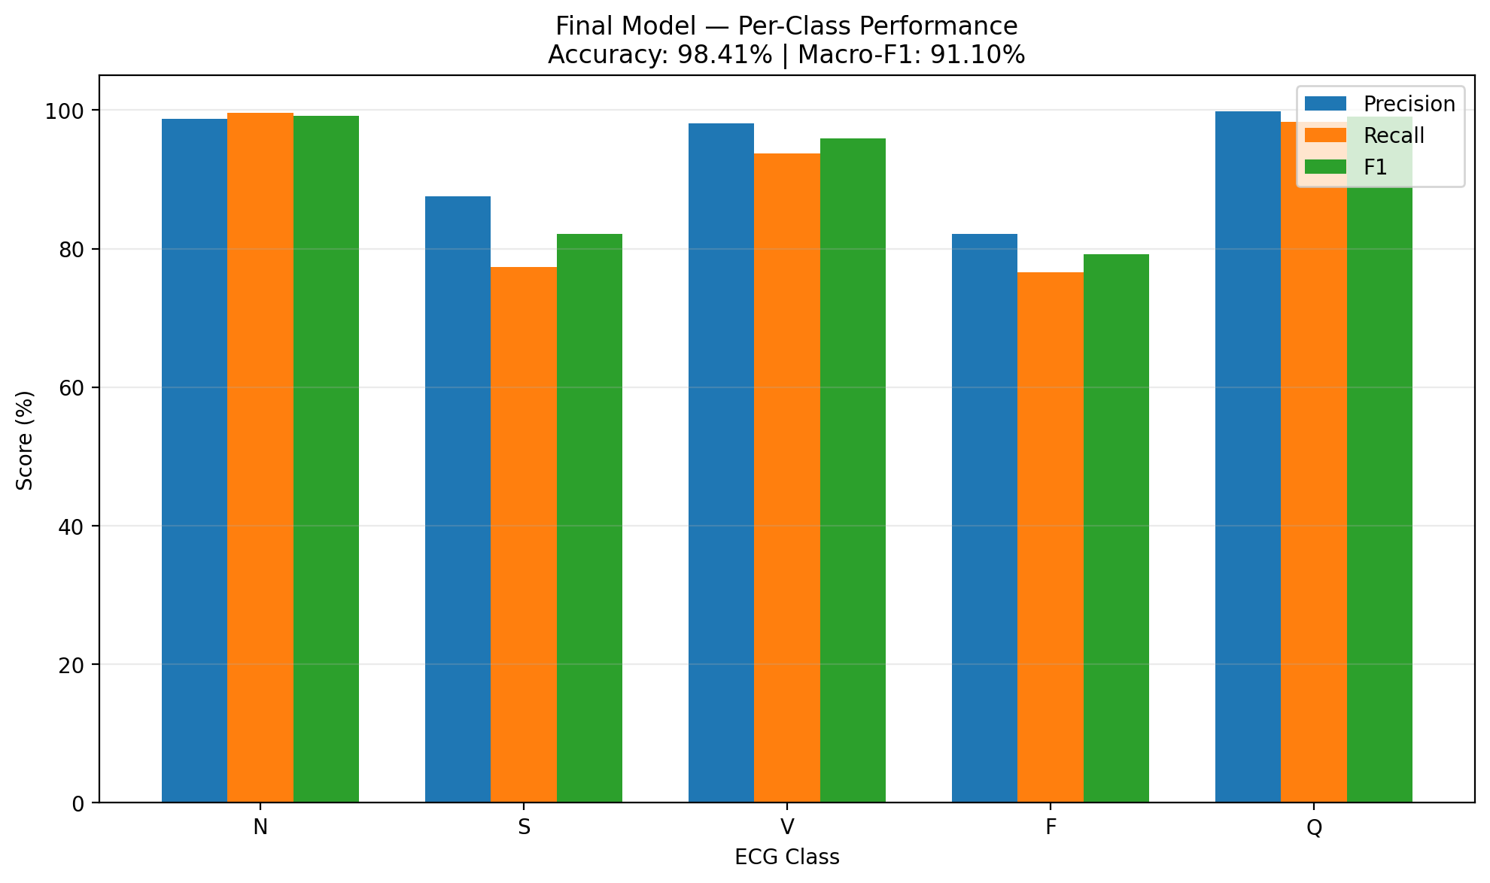
Baseline (V1) vs Final Model (V2)
Metric | B0 | Final | Change
Accuracy (%) | 94.41 | 98.41 | +4.00
Macro F1 (%) | 76.29 | 91.10 | +14.81
Weighted F1 (%) | 94.98 | 98.37 | +3.39
Precision / Recall S | 55.86 / 66.91 | 87.58 / 77.34 | +31.72 / +10.43
Precision / Recall F | 26.02 / 86.42 | 82.12 / 76.54 | +56.10 / −9.88
Wrongly predicted F | 398 | 27 | −371
Wrongly predicted S | 294 | 61 | −233
S predicted as N | 163 (29%) | 120 (22%) | −43
Parameters | 44,741 | 185,477 | ≈ 4×
Per-class P / R / F1 of the final model
• F1 improved for every class: S 60.9 → 82.1, V 86.6 → 95.9, F 40.0 → 79.2.
• Fusion recall is lower than the baseline's (76.5% vs 86.4%), because the baseline's high recall came from over-predicting F.
• Largest remaining error: S → N (120 of 556 S beats, 22%). S beats differ from N mainly in timing, which supports adding explicit RR-interval features in the proposed model.

Slide 21
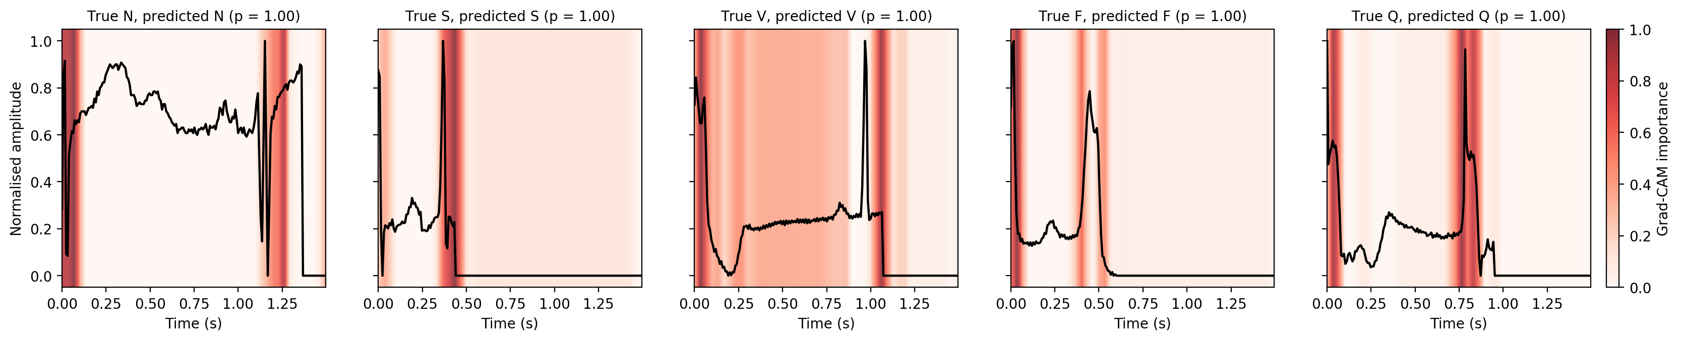
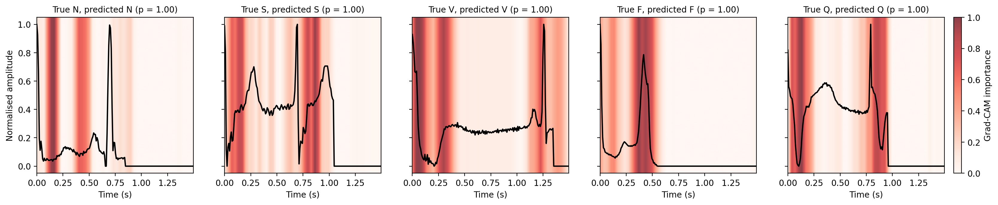
Grad-CAM Explanations
V1 baseline CNN
V2 final model (residual CNN)
• Grad-CAM [37] on the last convolutional activation (46 time steps, interpolated to 187 samples); the most confidently and correctly classified test beat of each class.
• Baseline: mostly the window start and the second large peak / end of signal. Final model: broader maps that more often cover bumps and troughs.

Slide 22
Grad-CAM: Where the Heat Is Concentrated
Class | V1 baseline CNN | Final model (residual CNN)
N | Window start (0–0.1 s) and 1.15–1.3 s around the second peak / start of padding | 0.12–0.2 s and 0.4–0.5 s, before the second R peak (P-wave-like bump); second peak itself low
S | 0.35–0.45 s over the second (sharp) peak and the drop into padding | Window start (0–0.2 s) and 0.75–0.9 s just after the second peak
V | Window start, broad 0.3–0.9 s region, strong band at 1.0–1.1 s where the signal ends | Window start, 0.27–0.35 s, and 1.15–1.3 s around the second peak / end of signal
F | Window start and two narrow bands either side of the second peak (~0.4 and ~0.53 s) | One strong broad band at 0.3–0.5 s centred on the second peak
Q | Window start and a strong band at 0.75–0.85 s over the second peak | ~0.1 s (deep trough) and 0.75–0.95 s around the second peak
Read from the heatmap figures; all beats predicted with p = 1.00.
• Each window starts at the current R peak, so the second peak is likely the next R peak: the models may partly use the timing of the next beat (an implicit RR cue) as well as beat shape.
• One Grad-CAM step ≈ 4 samples (≈ 32 ms); heat at the very first samples may partly be an edge effect of 'same' padding.
• Qualitative only: to be tested with the region-share and deletion measures.

Slide 23
Challenges Faced
Severe class imbalance
Unstable training
Fully balanced class weights made the baseline over-predict the rare classes (F precision 26.0%). Softer, square-root weights fixed most of this.
The baseline's validation accuracy swung between 14.5% and 95.1%, so early stopping on validation loss stopped training too early. Choosing the epoch on validation macro F1 and the residual network gave smoother, better results.
Not every improvement helped
Optimistic preliminary setting
The stability settings (E2) and augmentation (E4) lowered macro F1; because the experiments were cumulative, the best combination of changes is not yet known.
Pre-processed, intra-patient data including the Q class, so results are optimistic and not directly comparable with the planned four-class, inter-patient results. Each experiment was run once with one seed.

Slide 24
Work Plan for Next Phase
The following tasks follow from the project objectives and build on the pipeline developed so far.
1
Port the pipeline from the pre-segmented Kaggle beats to the raw MIT-BIH dataset.
2
Implement pre-processing and the inter-patient DS1/DS2 split of the MIT-BIH database.
3
Implement and train the hybrid classifier; report per-class and macro F1; test on the external database.
4
Apply XAI methods and evaluate explanation consistency.
5
Generate NSTDB noise at graded SNRs; evaluate classification, explanation stability and uncertainty.
6
Analyse results, prepare the final report and presentation.

Slide 25
Expected Outcomes
Deliverables
• A patient-independent ECG arrhythmia classifier with per-class and macro-averaged results under an inter-patient protocol and on an external database.
• A quantitative evaluation of explanation with two XAI methods.
• A robustness and uncertainty analysis of both predictions and explanations under realistic NSTDB noise.
• Final report and presentation.
Expected Results
• Intra-patient: macro F1 of about 90%, in line with the 91.10% already reached.
• Inter-patient (DS1/DS2): clearly lower, as reported in the literature [1], [11]; S and F remain the hardest classes; RR features expected to improve S recall in particular.
• Explanations: V beats should place a larger share of importance on the QRS region than N beats; deleting the most important samples should lower confidence much more than deleting random ones.
• Under NSTDB noise, macro F1 and explanation stability expected to fall as SNR decreases from 18 dB to 0 dB.

Slide 26
Summary
• Reported accuracies above 98% fall considerably on unseen patients, external databases or noisy signals, and explanations are rarely validated against clinical ECG knowledge [1], [2], [3].
• A working training, evaluation and Grad-CAM pipeline has been built and tested on the pre-segmented MIT-BIH dataset [35] (five AAMI classes, intra-patient split).
• Baseline 1D CNN: 94.41% accuracy, 76.29% macro F1 – very low precision on Fusion (26.0%) and S (55.9%).
• Epoch selection on validation macro F1, square-root class weights and a residual network gave the largest gains: 98.41% accuracy, 91.10% macro F1 on the same 21,892-beat test set.
• Grad-CAM heatmaps were produced for every class.
• These results are intra-patient and are treated as a development baseline for the patient-independent framework.

Slide 27
References
[1] Q. Xiao, K. Lee, S. A. Mokhtar, I. Ismail, A. L. bin Md Pauzi, Q. Zhang, and P. Y. Lim, "Deep learning-based ECG arrhythmia classification: A systematic review," Applied Sciences, vol. 13, Art. no. 4964, 2023.
[2] N. N. Kulkarni, Nagaraja G. S., B. G. Sudarshan, and Yeriswamy M. C., "Recent advances in deep learning based arrhythmia classification using ECG and PPG signals: A systematic review," Discover Computing, vol. 29, Art. no. 666, 2026.
[3] J. Beck and A. John, "Explainable AI (XAI) for arrhythmia detection from electrocardiograms," arXiv:2508.17294, 2025.
[4] G. A. L. Silva, P. H. L. Silva, G. J. P. Moreira, V. L. S. Freitas, J. C. Gertrudes, and E. J. S. Luz, "A systematic review of ECG arrhythmia classification: Adherence to standards, fair evaluation, and embedded feasibility," arXiv:2503.07276, 2025.
[5] B. A. Hassoon, S. Xiong, M. A. Hasson, R. Salahudeen, A. O. Abdulsalami, and T. Khan, "Dual-branch bidirectional attention fusion of temporal and hierarchical representations for robust ECG arrhythmia classification," Expert Systems with Applications, vol. 331, Art. no. 133409, 2026.
[8] N. Alamatsaz, L. Tabatabaei, M. Yazdchi, H. Payan, N. Alamatsaz, and F. Nasimi, "A lightweight hybrid CNN-LSTM explainable model for ECG-based arrhythmia detection," Biomedical Signal Processing and Control, vol. 90, Art. no. 105884, 2024.
[11] Sa. I. Ibrahim, "A hybrid deep learning algorithm for ECG-based heart disease classification," Scientific Reports, vol. 16, Art. no. 29911, 2026.

Slide 28
References (contd.)
[29] Y. Jeong, J. Lee, and M. Shin, "Enhancing inter-patient performance for arrhythmia classification with adversarial learning using beat-score maps," Applied Sciences, vol. 14, Art. no. 7227, 2024.
[30] M. Ashhad, S. Rahmani, M. Fayiz, A. Etemad, and J. Hashemi, "Uncertainty-aware multi-view arrhythmia classification from ECG," arXiv:2506.06342, 2025 (published at IJCNN 2024).
[33] W. Zhang, X. Di, G. Wei, S. Geng, Z. Fu, and S. Hong, "Cardiac arrhythmia classification with rejection of ECG recordings based on uncertainty estimation from deep neural networks," Neural Computing and Applications, vol. 36, pp. 4047–4058, 2024.
[35] M. Kachuee, S. Fazeli, and M. Sarrafzadeh, "ECG heartbeat classification: A deep transferable representation," in Proc. IEEE Int. Conf. Healthcare Informatics (ICHI), 2018, pp. 443–444.
[36] K. He, X. Zhang, S. Ren, and J. Sun, "Deep residual learning for image recognition," in Proc. IEEE Conf. Computer Vision and Pattern Recognition (CVPR), 2016, pp. 770–778.
[37] R. R. Selvaraju, M. Cogswell, A. Das, R. Vedantam, D. Parikh, and D. Batra, "Grad-CAM: Visual explanations from deep networks via gradient-based localization," in Proc. IEEE Int. Conf. Computer Vision (ICCV), 2017, pp. 618–626.
[38] S. M. Lundberg and S.-I. Lee, "A unified approach to interpreting model predictions," in Proc. Advances in Neural Information Processing Systems (NeurIPS), 2017, pp. 4765–4774.
Numbering follows the reference list of the mid-semester report.

