Slide 1

B. Tech. Project Mid-Semester Evaluation
Explainable Deep Learning Framework for Automated ECG Arrhythmia Detection and Classification
Presented by
Sidhesh Mahesh Tavare (2314037)
Nikhil Kumar Singh (2314055)
Supervisor
Dr. Arnab Nandi
Department of Electronics and Communication Engineering
National Institute of Technology Silchar
Notes:
Good morning respected panel members. We are Bhoomi Singhal (2314168) and Archita Roy (2314165), working under the supervision of Dr. Koushik Guha.
Our project is "Design of an Energy-Efficient EEG Seizure Detection System using Approximate Computing".
In one line: we detect epileptic seizures from EEG signals with a machine-learning classifier (SVM), and we plan to build its hardware with APPROXIMATE adders and multipliers so that it consumes much less power - making it suitable for wearable, battery-powered seizure monitors.

Slide 2
Introduction & Motivation
Background
• The ECG is a widely used non-invasive tool for detecting cardiac arrhythmias; automating its interpretation is an active research area.
• Deep learning dominates: CNNs are used in 58.7% of 368 studies [1] and 62% of 119 studies [2]; hybrid CNN-recurrent and Transformer models are increasingly common.
Motivation
Accuracy that does not transfer
Explanations that are not checked
Reported accuracies above 98% fall considerably on unseen patients, external databases or noisy signals [1], [2].
Explanations attached to such models are rarely validated against clinical ECG knowledge [3].
Clinical use needs a classifier that works on new patients, explains its decisions, and stays reliable on real, noisy recordings.

Slide 3
Problem Statement
There is a need for an ECG arrhythmia classification framework whose performance is measured on unseen patients, whose explanations are checked for consistency and clinical plausibility, and whose predictions and explanations are evaluated for robustness under realistic noise.
Existing limitations
Evaluation protocol
Black-box models
Narrow robustness tests
F1 fell from 95.52% (intra-patient) to 83.89% (inter-patient) in studies reporting both [1].
Fewer than 10% of studies validated explanation maps against clinically meaningful ECG structures [2].
Noise robustness is often tested with additive white Gaussian noise only [4].
Why it matters: a model that is only tested on familiar patients and clean signals, with unchecked explanations, cannot be trusted on new, real recordings.

Slide 4
Objectives
01
Objective 1: Patient-independent baseline
Develop a hybrid deep learning arrhythmia classifier evaluated under a strict inter-patient protocol (MIT-BIH DS1/DS2) with external testing on a second database; report per-class and macro F1 alongside accuracy.
02
Objective 2: Validated explanations
Apply post-hoc XAI methods (SHAP and Grad-CAM) and measure the within-class consistency of explanations and their agreement with ECG features (P wave, QRS complex, RR interval).
03
Objective 3: Robustness of predictions and explanations
Assess how classification performance and explanation stability degrade under realistic NSTDB noise at graded SNRs, using uncertainty estimates to flag unreliable predictions.

Slide 5
Literature Review
36 papers surveyed (5 reviews, 31 original studies). Most relevant studies:
Ref. | Dataset(s) | Model | XAI | Split | Key result
[5] | MIT-BIH + LTAF | Lightweight CNN-LSTM | SHAP | Not stated (85/15) | Acc 98.24%, Se 86.1%; 0.16 MB
[3] | MIT-BIH + 12-lead | 1D CNN | 4 SHAP variants | Not stated (80/20) | Val acc 98.30%; 73.45% on combined data
[4] | MIT-BIH; INCART, SVDB, PTB | CNN-BiLSTM + CapsNet fusion | Branch weights | Inter-patient | Acc 99.55%; F1 32.46% at 5 dB AWGN
[6] | MIT-BIH | CNN-BiLSTM + cGAN | Not stated | Both | 99.00% beat-wise vs 91.69% patient-wise
Key findings
• Architectures: CNNs dominate; hybrids add a recurrent or attention module (CNN-LSTM [5], CNN-BiLSTM [6]); Transformers gain 0.845% over 1D-CNNs at higher cost [2].
• XAI: SHAP is the most used method, then Grad-CAM; APB/PVC explanations were inconsistent within a class [3].
• Evaluation: MIT-BIH dominates (61% of studies [1]); external validation in only 18.5% of studies, with a mean accuracy drop of 8.7% [2].

Slide 6
Research Gap
Gap 1 – Explanations rarely validated
Gap 2 – XAI seldom patient-independent
< 10% of studies validate maps against ECG structures [2]; explanations inconsistent within a class [3].
→ Addressed by Objective 2: region-share and deletion checks
XAI studies often do not describe patient separation, though inter-patient evaluation lowers performance [1], [6].
→ Addressed by Objectives 1 + 2: XAI on a DS1/DS2 model
Gap 3 – Noise tests narrow, not linked to XAI
Gap 4 – Weak minority classes
Noise tests limited to AWGN [4] or absent; no surveyed paper tests whether explanations stay stable under noise.
→ Addressed by Objective 3: NSTDB noise + heatmap stability
Patient-wise Fusion and S recall only 0.021 and 0.209 [6]; little external validation [2].
→ Addressed by Objective 1: per-class / macro F1, external test

Slide 7
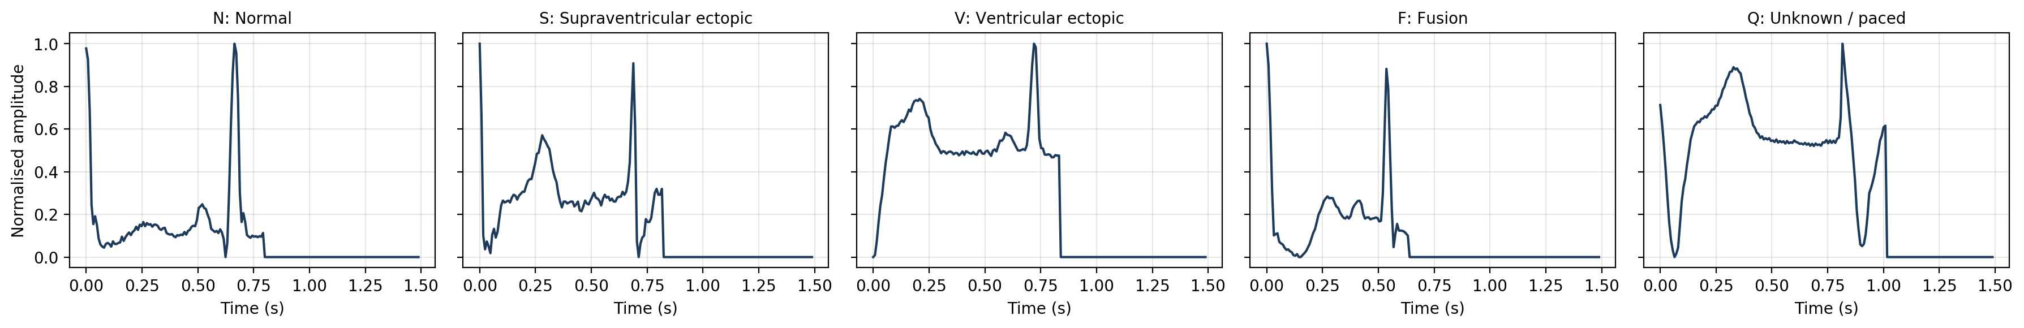
Dataset
Framework datasets
Used so far (preliminary)
• MIT-BIH Arrhythmia Database: AAMI classes, inter-patient DS1/DS2 split.
• External test: INCART (preferred; stretch goal).
• MIT-BIH NSTDB: baseline wander, muscle artefact, electrode motion noise.
• Pre-segmented MIT-BIH heartbeat dataset [7].
• 187-sample beats (1.5 s at 125 Hz), scaled to [0, 1], zero-padded.
• 5 AAMI classes: N, S, V, F, Q.
File | N | S | V | F | Q | Total
Train file | 72,471 (82.77%) | 2,223 (2.54%) | 5,788 (6.61%) | 641 (0.73%) | 6,431 (7.35%) | 87,554
Test file | 18,118 (82.76%) | 556 (2.54%) | 1,448 (6.61%) | 162 (0.74%) | 1,608 (7.35%) | 21,892
Split: train file 80/20 (stratified, seed 42) → 70,043 train / 17,511 validation; test file (21,892) used only for final evaluation. Split is by beat → intra-patient.
One example beat per class: starts at the R peak, second peak ≈ next R peak, then zero padding

Slide 8
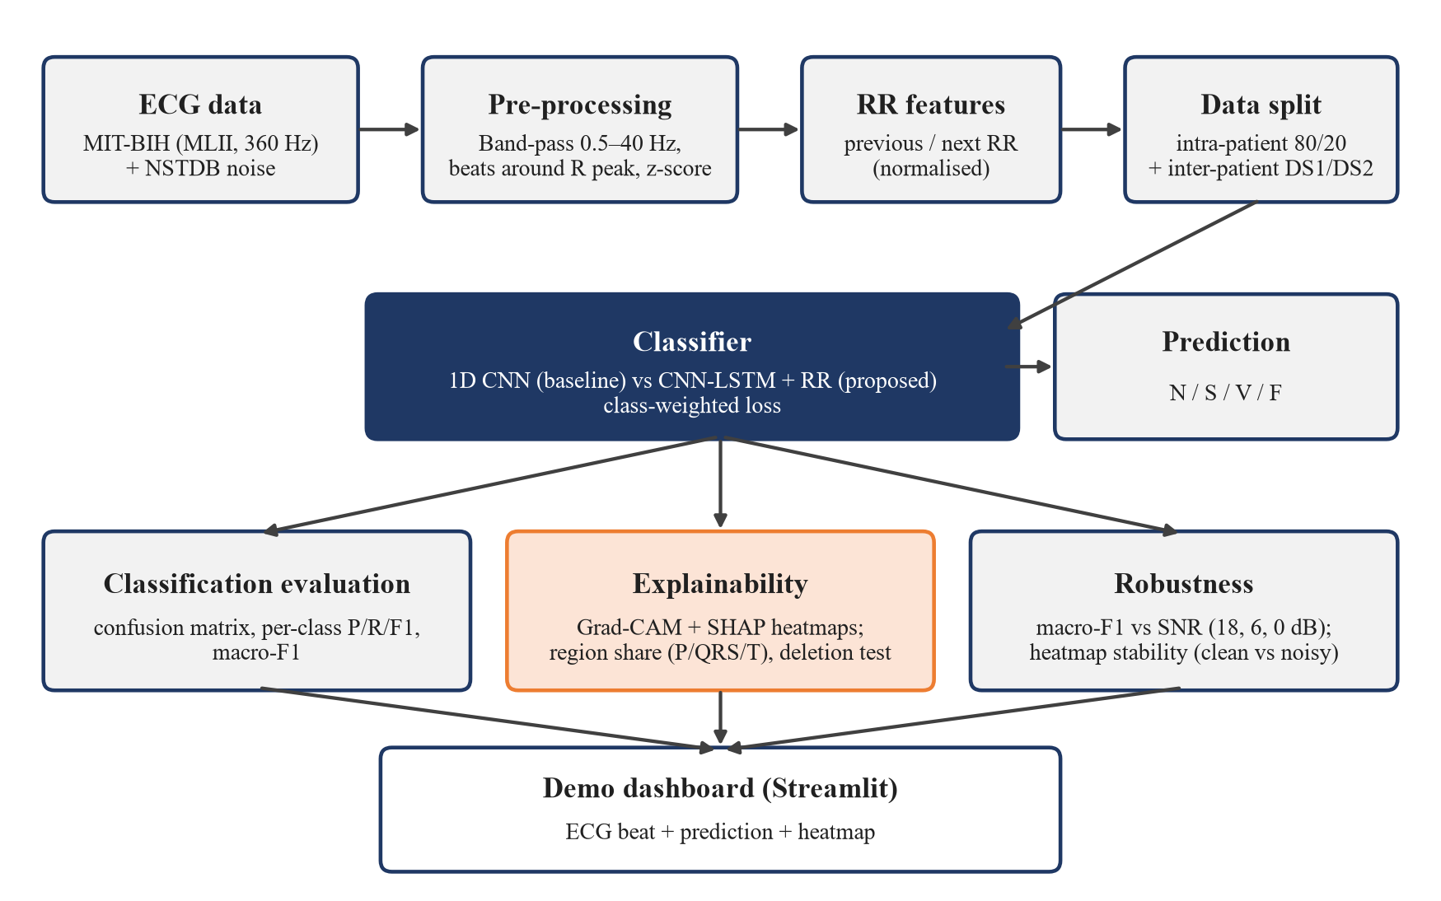
Proposed Methodology
Block diagram of the proposed framework
Pre-processing: filtering, R-peak-centred beats, normalisation, RR features.
Split: intra-patient 80/20 + inter-patient DS1/DS2.
Explain: Grad-CAM [8] + Gradient SHAP [9].
Robustness: NSTDB 'ma' noise at 18 / 6 / 0 dB SNR; macro F1 vs SNR.

Slide 9
Model & Algorithms
Baseline 1D CNN (implemented): input 187 × 1 beat → softmax over 5 classes
Layer | Output shape | Parameters
Conv1D 32, k = 7 → BN → ReLU → MaxPool 2 | (93, 32) | 256 + 128
Conv1D 64, k = 5 → BN → ReLU → MaxPool 2 | (46, 64) | 10,304 + 256
Conv1D 128, k = 3 → BN → ReLU (Grad-CAM layer) → MaxPool 2 | (23, 128) | 24,704 + 512
Global average pooling → Dense 64, ReLU → Dropout 0.3 → Dense 5, softmax | (5) | 8,256 + 325
Total |  | 44,741
Residual CNN (V2 final)
Proposed: CNN-LSTM + RR
Explainability
Conv 32 (k 7) stem + 3 residual blocks (32, 64, 128); each: two Conv1D (k 5) + BN with a shortcut (1×1 conv when channels change). 185,477 parameters.
Same conv front end → LSTM (64); last hidden state + previous / next RR (÷ record mean RR) → Dense 64 → softmax over N, S, V, F.
Grad-CAM [8] on the last conv activation (46 steps → 187 samples). Gradient SHAP [9] planned. Measures: region share, deletion test, stability.
Key design choices: square-root class weights (F:N 10.6:1 instead of 113:1); best epoch chosen on validation macro F1; per-class probability thresholds tuned on validation.

Slide 10
Experimental Setup
ID | Change added (cumulative) | Network | LR | Clip norm | BN mom. | Class weights | Augment.
E1 | Epoch chosen on val. macro F1 | CNN | 1×10⁻³ | – | 0.99 | Balanced | No
E2 | + lower LR, clipping, BN 0.9 | CNN | 5×10⁻⁴ | 1.0 | 0.9 | Balanced | No
E3 | + square-root class weights | CNN | 5×10⁻⁴ | 1.0 | 0.9 | Square-root | No
E4 | + light augmentation | CNN | 5×10⁻⁴ | 1.0 | 0.9 | Square-root | Yes
E5 | + residual network | Residual CNN | 5×10⁻⁴ | 1.0 | 0.9 | Square-root | Yes
B0 = V1 baseline (LR 10⁻³, balanced weights, early stopping on validation loss, patience 6). Final = E5 + thresholds tuned on validation (N × 3).
Training
Evaluation metrics
Tools & hardware
Adam, batch 128, ≤ 30 epochs
Best weights on val. macro F1; LR halved after 3 non-improving epochs (min 10⁻⁵); stop after 8
Augmentation: amplitude ±10%, noise σ 0.01, shift ±3 samples
Seed 42; test set never used for selection
Accuracy
Per-class precision, recall, F1
Macro F1 – main metric (N ≈ 83% of beats, so accuracy hides rare-class errors)
Confusion matrix
Python 3, TensorFlow 2.20 / Keras
NumPy, pandas, scikit-learn, Matplotlib, seaborn
wfdb, SHAP, Streamlit (next phase)
Kaggle notebooks, NVIDIA Tesla T4 GPU; 5 runs in 8.1 min

Slide 11
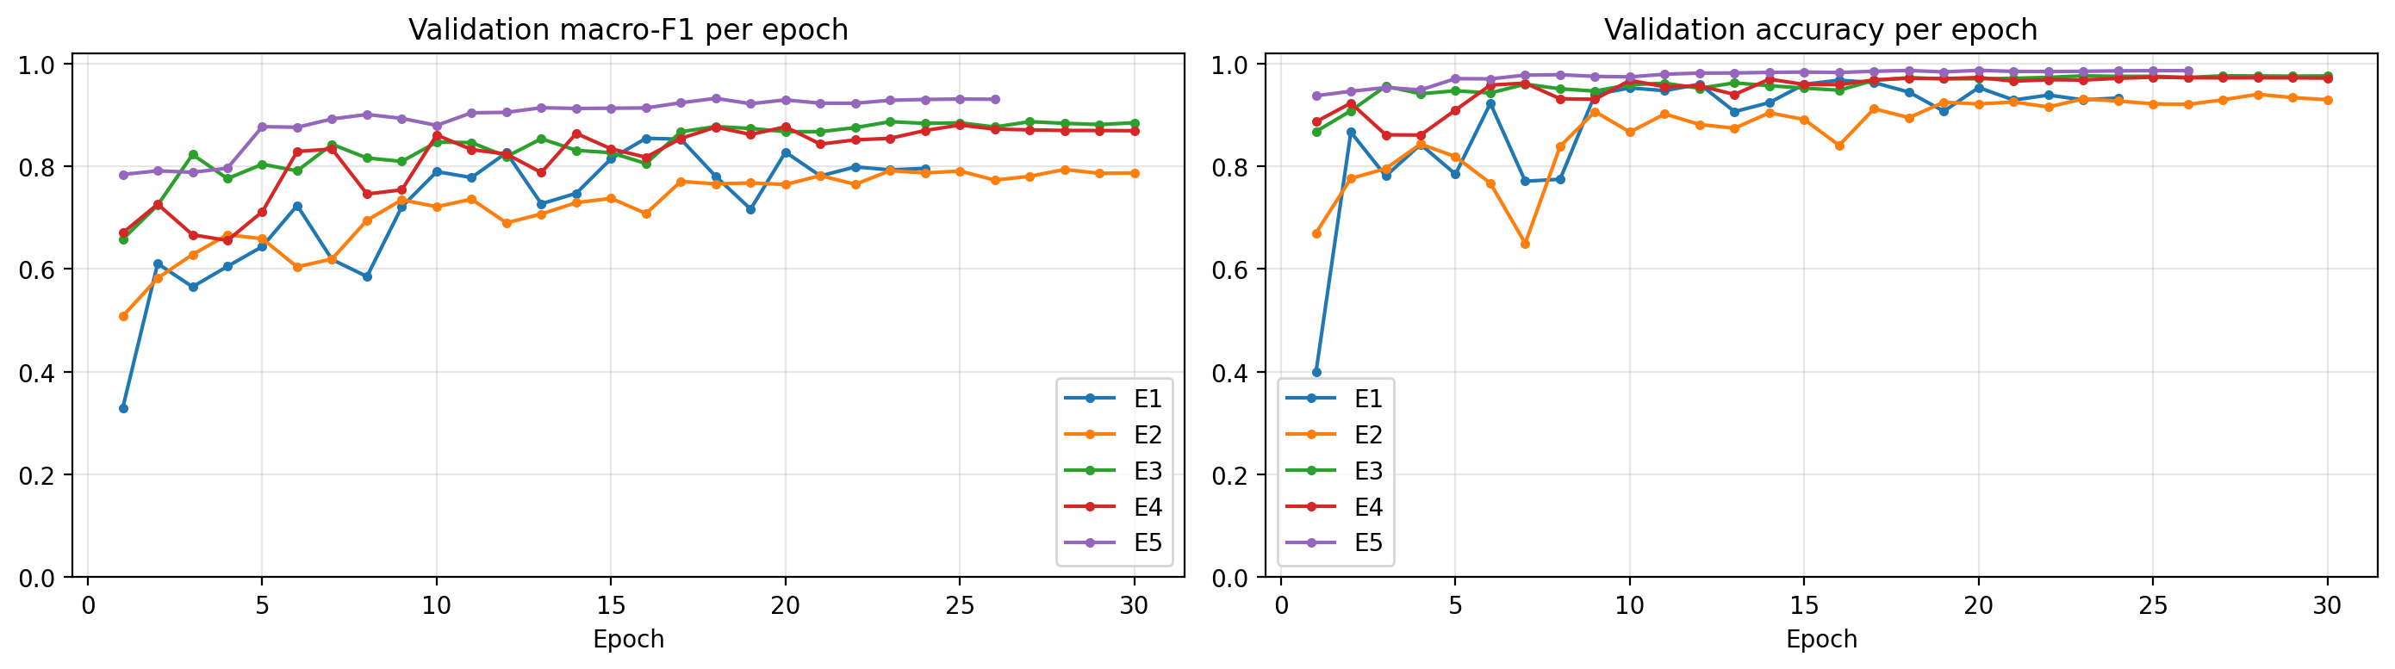
Work Done Till Now
Completed milestones
Experiments conducted (test set, %)
1
Literature survey of 36 papers; research gaps identified
ID | Change | Acc. | Macro F1
B0 | V1 baseline | 94.41 | 76.29
E1 | Epoch on val. macro F1 | 96.28 | 83.96
E2 | + LR, clipping, BN | 93.58 | 78.30
E3 | + sqrt class weights | 97.39 | 87.58
E4 | + augmentation | 97.02 | 86.20
E5 | + residual network | 98.29 | 90.77
Final | E5 + tuned thresholds | 98.41 | 91.10
2
Framework design: AAMI classes, DS1/DS2 protocol, XAI metrics, noise settings
3
Data preparation: stratified 80/20 split, class weights
4
V1: baseline 1D CNN trained, evaluated, Grad-CAM per class
Same data, split and seed for every step; one change added at a time.
5
V2: 5 controlled experiments (E1–E5) + threshold tuning
6
Final model evaluated; Grad-CAM on the final model
Validation macro F1 / accuracy per epoch, E1–E5

Slide 12
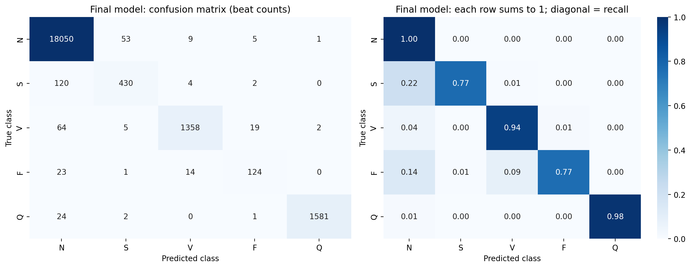
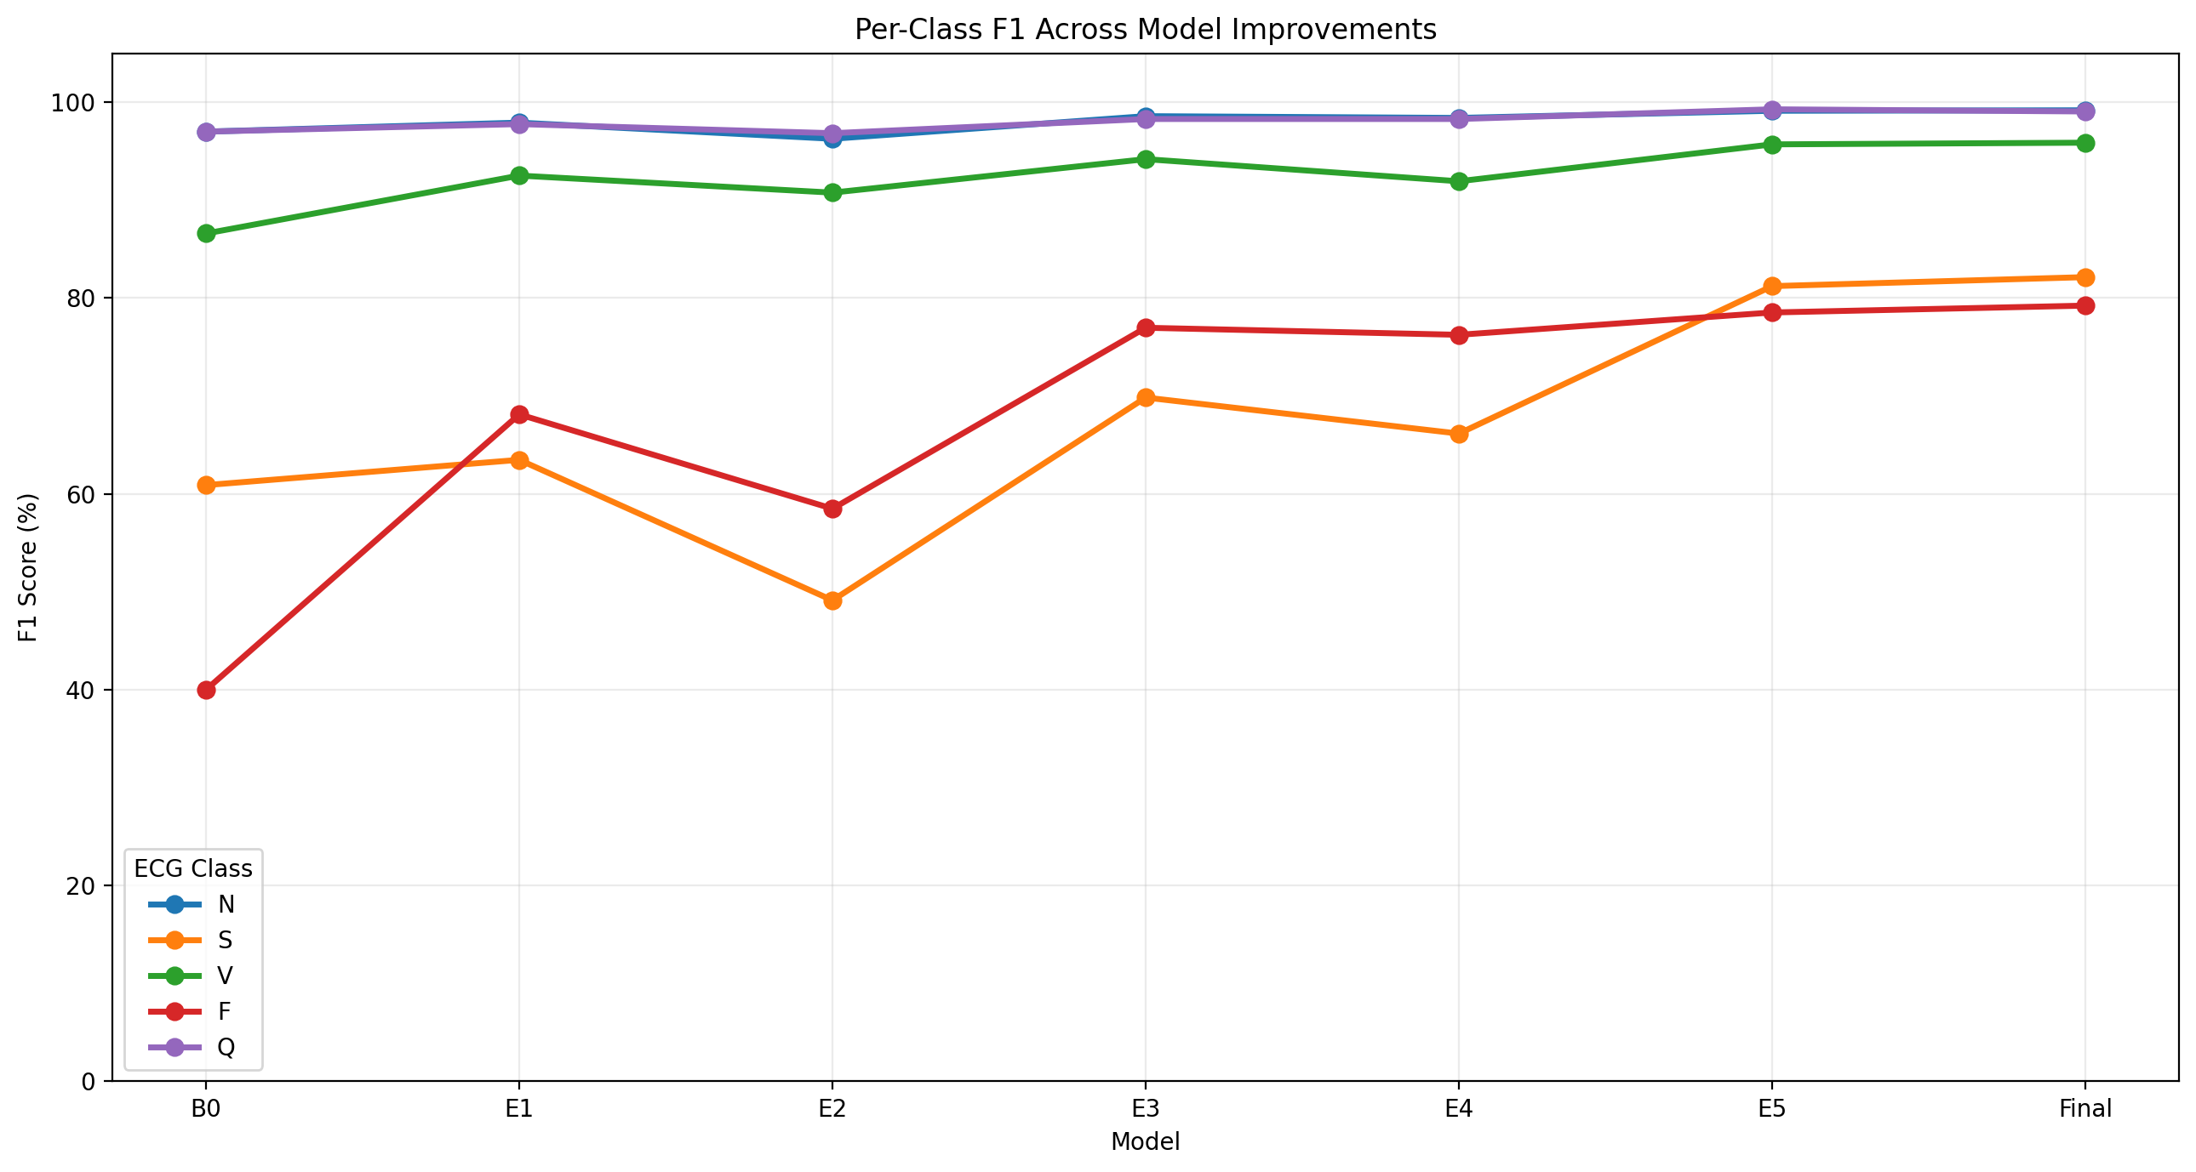
Preliminary Results
Accuracy 94.41% → 98.41% | Macro F1 76.29% → 91.10% (V1 baseline → V2 final)
Final model confusion matrix (counts; row-normalised)
Per-class F1, B0 → Final
Metric | V1 baseline | V2 final
Precision / Recall S (%) | 55.86 / 66.91 | 87.58 / 77.34
Precision / Recall F (%) | 26.02 / 86.42 | 82.12 / 76.54
Beats wrongly predicted as F | 398 | 27
Beats wrongly predicted as S | 294 | 61
S beats predicted as N | 163 (29%) | 120 (22%)
Parameters | 44,741 | 185,477
Class | Prec. | Rec. | F1
N | 0.987 | 0.996 | 0.992
S | 0.876 | 0.773 | 0.821
V | 0.981 | 0.938 | 0.959
F | 0.821 | 0.765 | 0.792
Q | 0.998 | 0.983 | 0.991
Macro | 0.933 | 0.891 | 0.911
Test set: 21,892 beats; intra-patient split. F1 improved for every class (S 60.9 → 82.1, V 86.6 → 95.9, F 40.0 → 79.2).

Slide 13
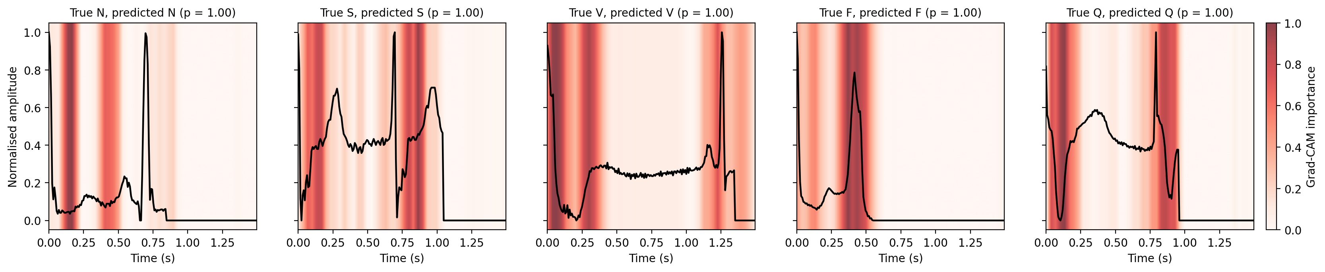
Challenges & Key Findings
Challenges faced
Key findings
• Class imbalance: balanced weights (F:N 113:1) gave F precision 26.0%.
• Unstable training: V1 validation accuracy swung 14.5% ↔ 95.1%.
• E2 stability settings (−5.66) and augmentation E4 (−1.38) hurt; steps cumulative.
• Optimistic setting: pre-processed, intra-patient, 5 classes, one seed per run.
• Biggest gains: square-root weights (E3, +9.28), epoch selection on macro F1 (E1, +7.67), residual network (E5, +4.57).
• F recall fell 86.4% → 76.5%: V1's high recall came from over-predicting F.
• Largest remaining error S → N (22%): S differs from N mainly in timing → RR features.
Explainability finding
Grad-CAM of the final model (most confident correct beat per class): heat often near the second R peak → possible implicit RR cue; qualitative only so far

Slide 14
Future Work & Expected Outcomes
Remaining tasks
Deliverables
1
Port pipeline to raw MIT-BIH; pre-processing + DS1/DS2 split
• Patient-independent classifier with per-class and macro results (inter-patient + external).
• Quantitative evaluation of explanations with two XAI methods.
• Robustness and uncertainty analysis under NSTDB noise.
• Final report and presentation.
2
Train hybrid CNN-LSTM + RR; per-class and macro F1; external test
3
Apply Grad-CAM + SHAP; region-share, deletion and consistency checks
4
Expected results
NSTDB noise at graded SNRs; explanation stability and uncertainty
• Intra-patient macro F1 ≈ 90%; DS1/DS2 clearly lower [1], [6]; RR features should raise S recall.
• V beats: larger QRS importance share than N; top-sample deletion ≫ random deletion.
• Macro F1 and explanation stability fall as SNR drops 18 → 0 dB.
5
Analyse results; final report and presentation
Anticipated challenges
• Inter-patient scores clearly lower; S and F remain hardest.
• External testing and MC dropout only if time permits.

Slide 15
Conclusion & References
Conclusion
• A working training, evaluation and Grad-CAM pipeline is in place.
• Macro F1 76.29% → 91.10% and accuracy 94.41% → 98.41% via epoch selection, square-root weights and a residual CNN.
• Results are intra-patient: a development baseline for the patient-independent framework.
• Next: raw MIT-BIH + DS1/DS2 → CNN-LSTM + RR → Grad-CAM / SHAP checks → NSTDB noise.
References
[1] Q. Xiao et al., "Deep learning-based ECG arrhythmia classification: A systematic review," Applied Sciences, vol. 13, Art. no. 4964, 2023.
[2] N. N. Kulkarni et al., "Recent advances in deep learning based arrhythmia classification using ECG and PPG signals: A systematic review," Discover Computing, vol. 29, Art. no. 666, 2026.
[3] J. Beck and A. John, "Explainable AI (XAI) for arrhythmia detection from electrocardiograms," arXiv:2508.17294, 2025.
[4] B. A. Hassoon et al., "Dual-branch bidirectional attention fusion of temporal and hierarchical representations for robust ECG arrhythmia classification," Expert Systems with Applications, vol. 331, Art. no. 133409, 2026.
[5] N. Alamatsaz et al., "A lightweight hybrid CNN-LSTM explainable model for ECG-based arrhythmia detection," Biomedical Signal Processing and Control, vol. 90, Art. no. 105884, 2024.
[6] Sa. I. Ibrahim, "A hybrid deep learning algorithm for ECG-based heart disease classification," Scientific Reports, vol. 16, Art. no. 29911, 2026.
[7] M. Kachuee, S. Fazeli, and M. Sarrafzadeh, "ECG heartbeat classification: A deep transferable representation," Proc. IEEE ICHI, 2018, pp. 443–444.
[8] R. R. Selvaraju et al., "Grad-CAM: Visual explanations from deep networks via gradient-based localization," Proc. IEEE ICCV, 2017, pp. 618–626.
[9] S. M. Lundberg and S.-I. Lee, "A unified approach to interpreting model predictions," Proc. NeurIPS, 2017, pp. 4765–4774.

