Slide 1

B. Tech. Project Mid-Semester Evaluation
Explainable Deep Learning Framework for Automated ECG Arrhythmia
Presented by
Sidhesh Mahesh Tavare (2314037)
Nikhil Kumar Singh (2314055)
Supervisor
Dr. Arnab Nandi
Department of Electronics and Communication Engineering
National Institute of Technology Silchar
Notes:
Good morning respected panel members. We are Bhoomi Singhal (2314168) and Archita Roy (2314165), working under the supervision of Dr. Koushik Guha.
Our project is "Design of an Energy-Efficient EEG Seizure Detection System using Approximate Computing".
In one line: we detect epileptic seizures from EEG signals with a machine-learning classifier (SVM), and we plan to build its hardware with APPROXIMATE adders and multipliers so that it consumes much less power - making it suitable for wearable, battery-powered seizure monitors.

Slide 2
Introduction
Non-contact vital-sign monitoring
Why radar?
Radar can sense tiny periodic movements of the chest caused by breathing and heartbeat without requiring electrodes, belts, or physical contact with the subject.
Radar operates without physical contact and can monitor a subject from a distance, making it suitable for comfortable and continuous monitoring.
Clinical quantities of interest
Heart Rate (HR)
Respiratory Rate (RR)
Multiple patients
beats per minute
breaths per minute
simultaneous monitoring
The project focuses on the signal-processing chain required to separate multiple radar returns and estimate HR/RR from the recovered phase information.

Slide 3
Radar System & Why FMCW mmWave
Primary radar
Chirp
Texas Instruments IWR6843AOP FMCW mmWave radar
77–81 GHz. It continuously transmits FMCW chirps and receives their reflections from the human body. Multiple receiving antennas help capture spatial information about the target.
A transmitted signal whose frequency changes continuously over a known time interval. The frequency sweeps from a lower frequency to a higher frequency during each chirp. Comparing the transmitted and received chirps produces a frequency difference called the beat frequency.
Data capture
Range information
DCA1000EVM for high-speed ADC capture; TI mmWave, The radar's analog received signal is converted into digital ADC samples, which are stored as raw data for offline processing.
The beat-frequency difference between transmitted and received signals is related to target distance. A farther target produces a larger propagation delay, which results in a different beat frequency. By estimating this frequency, the radar can determine how far the target is from the sensor.
Secondary radar
Vital-sign sensitivity
Infineon BGT60LTR11AIP around 60/61 GHz was used in selected measurements. It provides an independent radar sensing setup and allows measurements to be performed using a different mmWave frequency and hardware configuration.
Tiny chest movements modulate received phase, allowing periodic components related to respiration and heartbeat to be extracted.
Compared with a basic Doppler-only view, FMCW also provides range information, which is crucial for separating multiple subjects.

Slide 4
Literature Review & Research Gap
The paper positions SiViS primarily as a dataset + technical-validation contribution.
Area
Existing direction
Multi-person radar
Signal separation, localization and vital-sign estimation
FMCW vital signs
Range + phase information for non-contact monitoring
SiViS contribution
Public dataset with multiple patients, states
\
Gap addressed by SiViS
Our project position
A public dataset combines multiple simulated patients, physiological states, radar geometries and raw recordings.
Study and reproduce the paper’s processing pipeline as a foundation for later comparison with additional papers and methods.

Slide 5
Problem Statement & Motivation
Develop a non-contact signal-processing pipeline capable of separating multiple patient radar returns and estimating their heart and respiratory rates from FMCW mmWave radar data.
Overlapping returns
Clutter & multipath
Target separation
Clinical scenarios
Signals from different patients can occupy similar range/angle regions.
Reflections from beds, walls and equipment can interfere with weak vital-sign components.
The system must identify each subject before estimating an individual HR/RR.
The dataset includes different simulated physiological states rather than only healthy rest.
Core challenge: identify → isolate → extract → estimate
Motivation
• Contact sensors are not always convenient for continuous or multi-patient observation.
• SiViS provides controlled, repeatable multi-patient clinical simulations for algorithm development.

Slide 6
Project Objectives
01
Study the SiViS dataset
Understand its experimental setups, radar configurations and simulated physiological conditions.
Decode and preprocess
radar data
Convert raw IWR6843AOP recordings into usable complex I/Q data.
202
03
Separate multiple targets
Use range-angle information and MVDR beamforming to isolate individual subjects.
04
Extract HR and RR
Use phase-derived frequency information to estimate heart and respiratory rates.
05
Build and validate the
pipeline
Reproduce the base-paper processing flow; implementation/results remain in progress.

Slide 7
Paper: SiViS
SiViS: Simulated multi-patient physiological clinical states for advanced vital sign radar monitoring research
Scientific Data (2026) • Reyes et al.
Main contribution
Important interpretation
A publicly available dataset designed for simultaneous multi-patient vital-sign monitoring and a technical-validation pipeline for HR/RR extraction.
The paper does not claim a new HR/RR estimation algorithm as its primary novelty. Its emphasis is the dataset and validation of a processing pipeline.
Dataset availability: Harvard Dataverse (SiViS)
The project uses this paper as the primary technical reference. The implementation aims to reproduce its processing flow; project-specific results are not yet available.

Slide 8
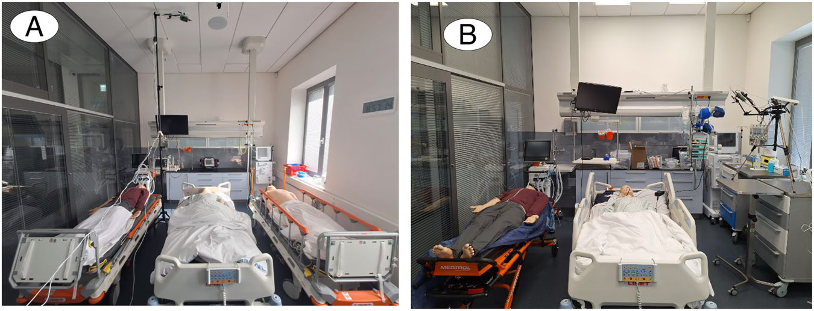
SiViS Dataset & Experimental Design
Experimental setups
• Area Set-up
• Mannequin Set-up
• Radar Set-up
Key dataset characteristics
• 2–3 SimMan 3G PLUS patient simulators
• 100+ uniquely configured sessions
• Radar positions: top, frontal and lateral
• Distances: 1–4 m; orientations: 0° and 45°
The controlled setups allow target separation and HR/RR extraction to be studied across different spatial configurations.

Slide 9
Methodology
1
2
3
4
5
6
7
Raw radar
→
Decode
→
Range-angle
→
Target
→
MVDR
→
Phase
→
HR / RR
ADC data
complex I/Q
processing
identification
beamforming
processing
estimation
The first five stages solve the multi-target separation problem; the final two stages convert the isolated target signal into physiological-rate estimates.
Data decoding & preprocessing
Recorded signal
Raw binary IWR6843AOP recordings are decoded into complex I/Q samples and organized according to the radar acquisition configuration.
The processing chain operates on captured radar data, not directly on HR/RR labels. CSV versions are also provided with the dataset.

Slide 10
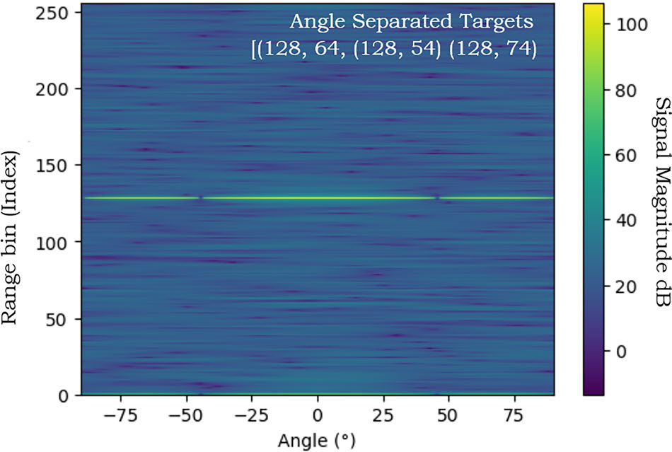
Target Separation & HR/RR Extraction
Range-angle maps
• Range indicates target distance.
• Angle indicates spatial direction.
• Candidate bins are selected using expected target locations and separation constraints.
MVDR beamforming
MVDR is used as a spatial filter: emphasize the selected direction while minimizing output power and suppressing interference/clutter.
Phase → HR / RR
Heart-rate band: 0.8–3.0 Hz.
Respiratory band: 0.1–0.6 Hz.
Frequency × 60 converts Hz to beats/min or breaths/min.
Goal: assign a spatial region to each mannequin before extracting its individual vital-sign signal.

Slide 11
Conclusion And Future Scope
Key takeaways
• SiViS provides a controlled multi-patient radar dataset.
• FMCW mmWave supplies spatial/range information and sensitivity to chest motion.
• Target separation is required before individual vital-sign extraction.
Current project focus
Reproduce the base-paper chain: decoding → range-angle processing → target selection → MVDR → phase-based HR/RR extraction.
Future scope
Compare ICA, MVDR and MUSIC; test robustness across radar configurations; investigate ML-based tracking; combine simulated and human datasets.

Slide 12
References
[1] K. M. Reyes et al., “SiViS: Simulated multi-patient physiological clinical states for advanced vital sign radar monitoring research,” Scientific Data, 2026.
[2] D.-M. Chian et al., “Signal Separation and Tracking Algorithm for Multi-Person Vital Signs by Using Doppler Radar,” IEEE TB-CAS, 2020.
[3] M. Mercuri et al., “Enabling Robust Radar-Based Localization and Vital Signs Monitoring in Multipath Propagation Environments,” IEEE TBME, 2021.
[4] Y. Eder and Y. C. Eldar, “Sparsity-Based Multi-Person Non-Contact Vital Signs Monitoring via FMCW Radar,” IEEE JBHI, 2023.
[5] SiViS dataset, Harvard Dataverse, DOI: 10.7910/DVN/S9SNAK.

