Slide 1
BIG MART SALES PREDICTION
Presented by-
Dheeraj-PES1201800
Anvesh-PES120180
Sidharth-PES1201800142
IDS Project Presentation under session
Aug 2019 - Dec 2019

Slide 2
AGENDA

Slide 3
INTRODUCTION

Slide 4
SCOPE AND MOTIVATION

Slide 5
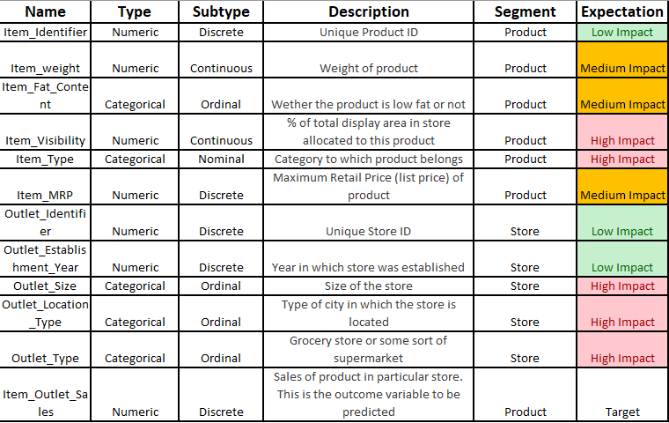
DETAILS OF DATASET
The dataset contains 8523 observations and 12 features.
From the 12 features, 5 are numerical and 7 categorical.
Details of all the features can be seen in the following table

Slide 6
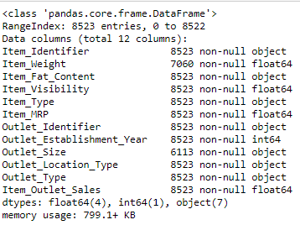
The target variable is Item_Outlet_Sales.
On first look, the variables which will have a high impact on the sales should be:
Item_type,Item_visibility,Outlet_type.
A summary of the parameters is given below-

Slide 7
TOOLS & TECHNOLOGY
The following libraries in Python have been used for visualisation and cleaning:
Pandas
Seaborn
Matplotlib
NumPy
R has been used to perform hypothesis testing and correlation with the help of:
Corrplot
PerformanceAnalytics

Slide 8
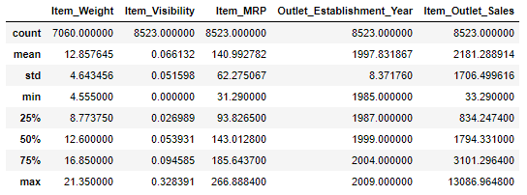
VISUALIZATION
After reading the dataset, we first provide few statistics of the numerical data:

Slide 9
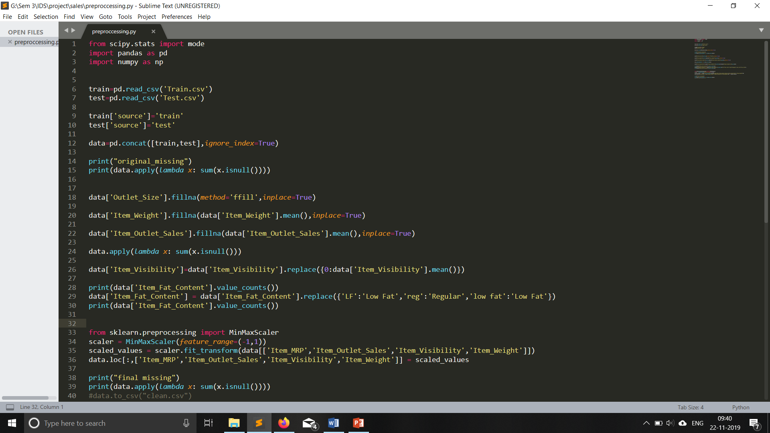
As it can be seen from the data on page 6, the dataset contains null values.
Also, certain parameters have the same values but with different names. Ex: “Low fat” and “LF” mean the same.
Thus, comes the need for data cleaning.
Following code snippet performs data cleaning:

Slide 10
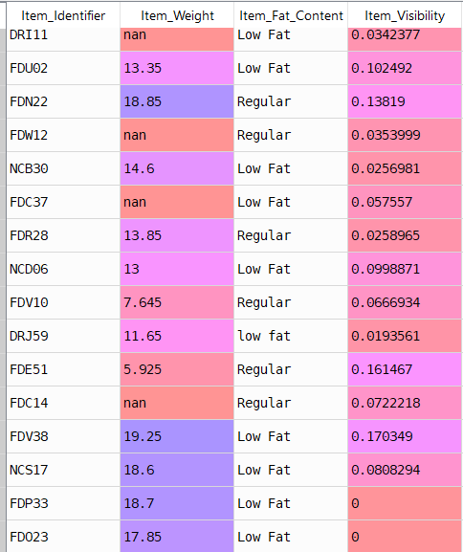
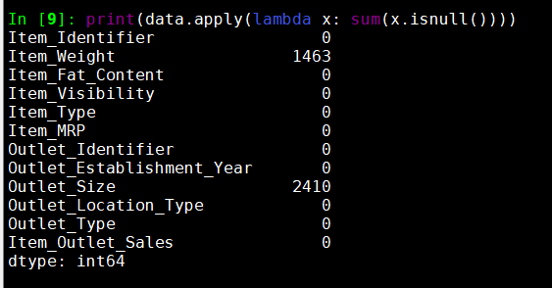
Dataset before cleaning:

Slide 11
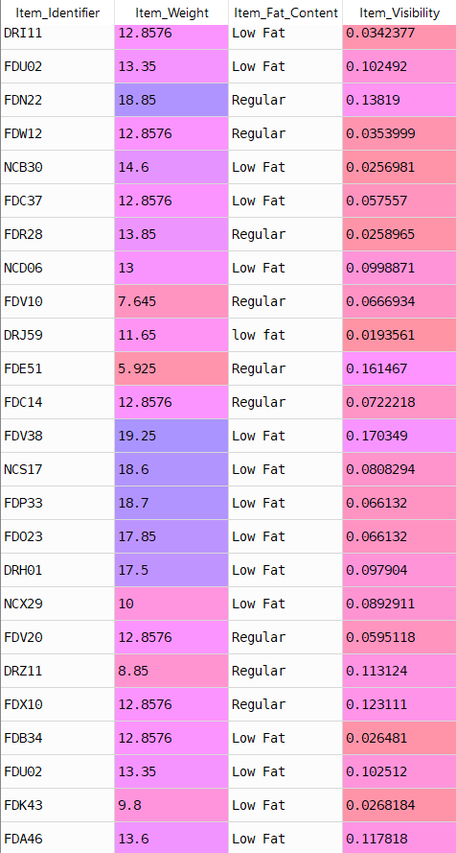
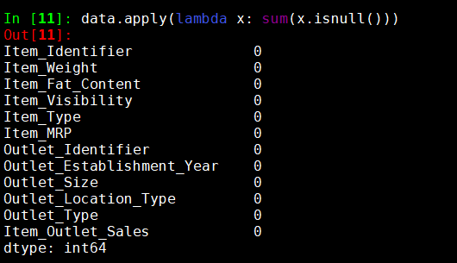
Dataset After cleaning:

Slide 12
Normalisation:
Performed on the numerical data
Values lying between -1 and 1
Mean=0, variance=1
Code for normalisation:

Slide 13
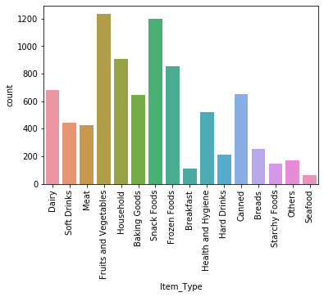
Distribution of the variable Item_Type:
Looking at the list of Item_Type we see there are sixteen different types. This is a high number of unique values for a categorical variable. Therefore we must try to think of a way to drastically reduce this number.

Slide 14
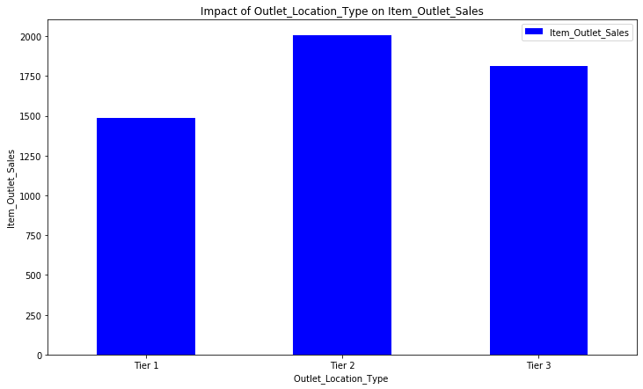
Impact of Outlet_Location_Type on Item_Outlet_Sales:
Do Tier 1 cities have higher sales? One would assume so for various reasons. However, if we look at our results we see that in fact it is stores from Tier 2 cities that present the highest results, followed by Tier 3 cities and with Tier 1 cities with the lowest results of the three type of locations.

Slide 15
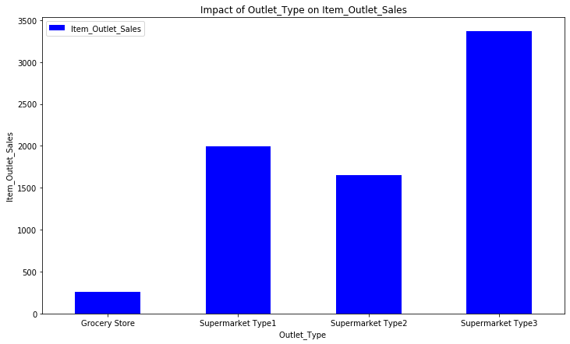
Impact of Outlet_Type on Item_Outlet_Sales:
From this analysis possibly it would be a good idea to create a new feature that shows the sales ratio according to the store size. It follows the general assumption that a larger store would have a higher sales.

Slide 16
Item_Visibility and Item_Outlet_Sales analysis:
Visibility in Store: The location of product in a store will impact sales. Ones which are right at entrance will catch the eye of customer first rather than the ones in back.
Therefore the products with higher visibility should have higher sales.
However, the plot chart indicates that the more visible a product is the less higher its sales will be. This might be due to the fact that a great number of daily use products, which do not need high visibility, control the top of the sales.
Furthermore, there is a concerning number of products with visibility zero.

Slide 17
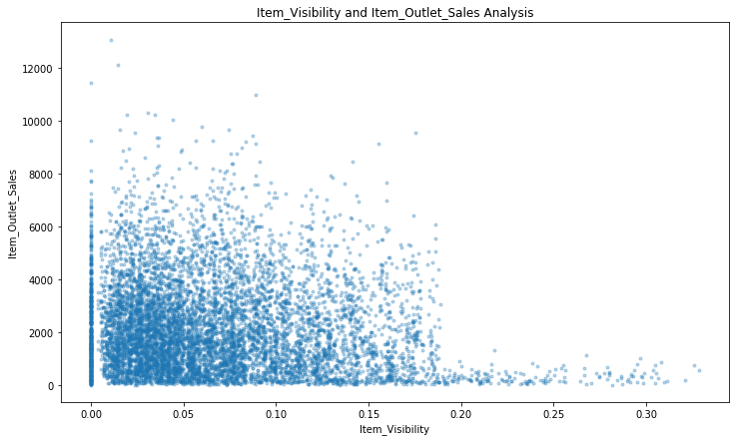

Slide 18
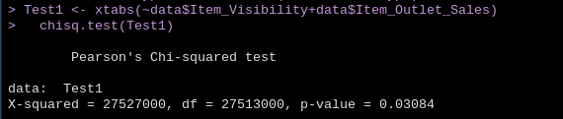
Hypothesis Testing:
H0: No correlation between the item_visibility and item_outlet_sales.
Ha: Correlation between the item_visibility and item_outlet_sales.
We use chi-squared test to prove the hypothesis.
From the above test , as P value is less than 0.05(significance level), we can reject
The null hypothesis.

Slide 19
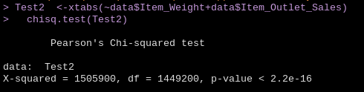
H0: No correlation between the item_weight and item_outlet_sales.
Ha: Correlation between the item_weight and item_outlet_sales.
We use chi-squared test to prove the hypothesis.
As P value is almost equal to 0, we can reject the null Hypothesis.
Therefore, there is Correlation between the item_weight and item_outlet_sales.

Slide 20
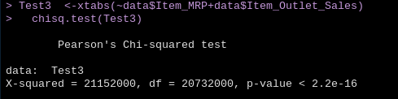
H0: No correlation between the item_MRP and item_outlet_sales.
Ha: Correlation between the item_MRP and item_outlet_sales.
We use chi-squared test to prove the hypothesis.
As P value is almost equal to 0, we can reject the null Hypothesis.
Therefore, there is Correlation between the item_MRP and item_outlet_sales.

Slide 21
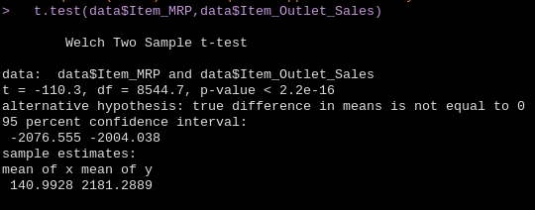
The previous hypotheses were also tested using a different test, the Student’s t
Distribution.
The same conclusion is also obtained in the t-test, i.e. there is correlation
Between item_MRP and item_outlet_sales.

Slide 22
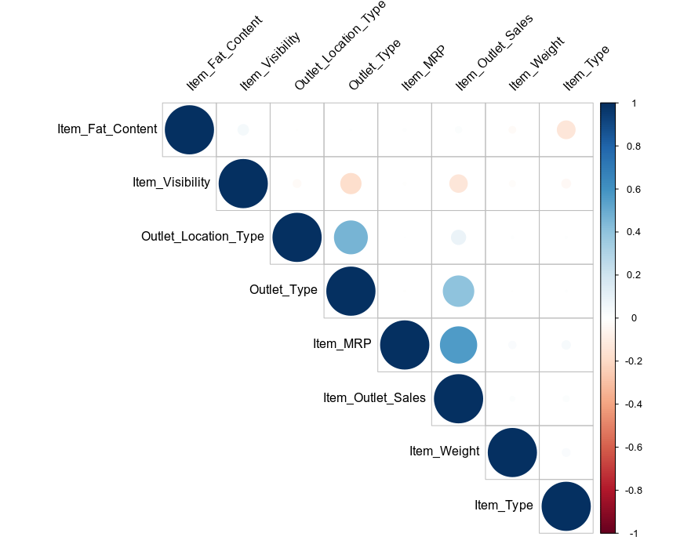
CORRELATION:
Here we have tried to find correlation between all the parameters present in
The dataset.

Slide 23
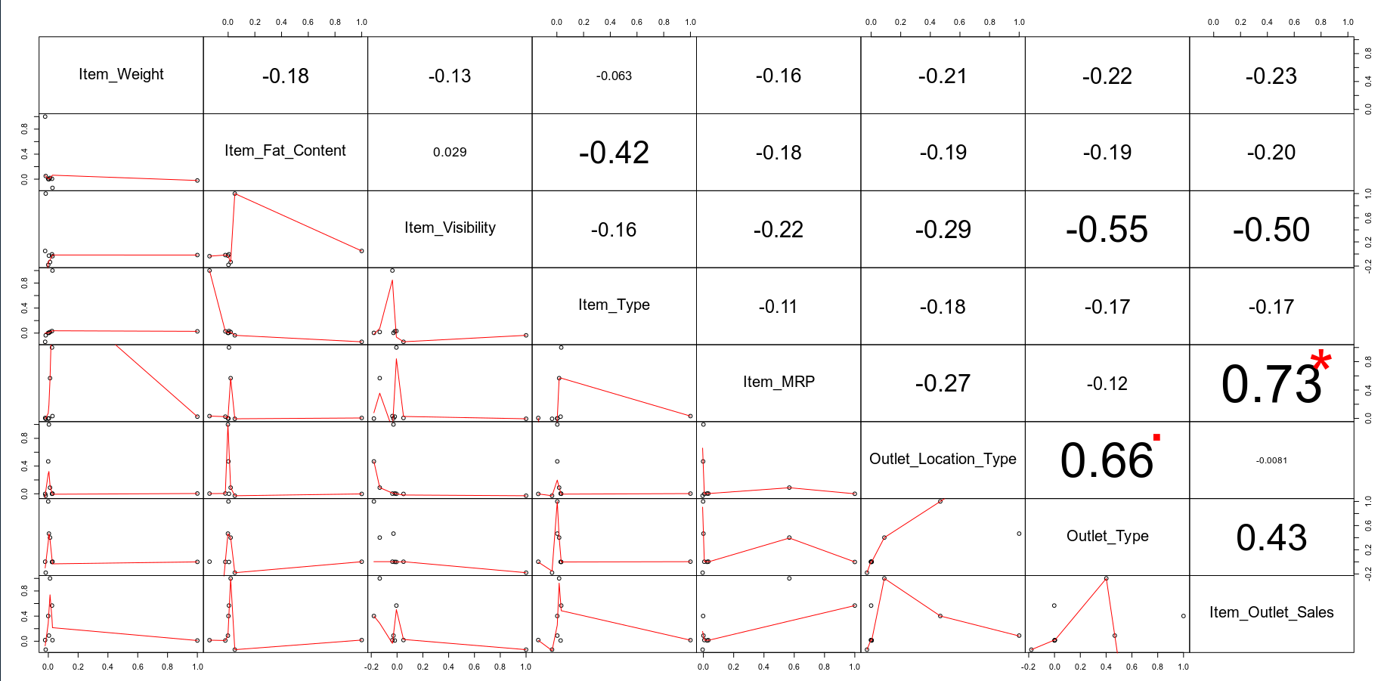

Slide 24
Insights:
There is positive correlation between Item_MRP and Item_Outlet_sales
There is negative correlation between Item_visibility and Item_Outlet_sales
As demonstrated on slide 15 by the scatterplot.
There is positive correlation between Outlet_Location_type and Outlet_type.
There is no correlation between Outlet_Location_type and Item_Outlet_sales

Slide 25
REFERANCES

