Slide 1
Formulary IQ
Implementation Plan
29 July 2026

Slide 2
Context, Current Landscape & the Vision
Coverage Intelligence is Fragmented and Hard to Act On
Formulary IQ consolidates payer coverage intelligence from multiple vendors and internal sources into a single AI-powered platform — eliminating duplication and enabling faster, evidence-based decisions.
Current Fragmentation & Pain Points
Vision for Formulary IQ
Scattered data sources: Coverage info spread across MMIT, Policy Reporter, FRM submissions, email threads, and manual spreadsheets.
Duplicate effort: Teams re-pull coverage data and re-field studies because past work is invisible across brands and regions.
No cross-brand visibility: Leaders lack a consolidated view - each brand team operates in its own silo without a shared source of truth.
Confidentiality risk: Sensitive payer data (pricing, rebates) lacks proper access controls in current SharePoint-based tools.
Manual uploads: No integration between source vendors and internal systems forces tedious copy-paste workflows.
Single intelligence hub: One workspace for all payer and brand coverage changes, with structured metadata and granular filters.
AI-powered search: Natural language queries across coverage updates, policy docs, and FRM submissions within user permissions.
Source comparison: Side-by-side view of what MMIT, Policy Reporter, and internal submissions say - with conflict and recency flags.
Role-based access: Confidential payer data protected by permission groups; executives see cross-brand insights without hunting sites.
Full traceability: Every AI summary and insight is traceable back to the source record or document that generated it.
Feature 1
Feature 4
Feature n
Feature 3
Feature 2
0
The Solution

Slide 3
Transforming Fragmented Coverage Data into Enterprise Intelligence
Phased delivery with 3 releases — MVP in Q3 2026
Formulary IQ creates one central place for all payer and brand coverage intelligence, delivered in 3 phases starting with a focused Q3 MVP for Tezspire and Tepezza (Medicare).
Release | Timeline | High-Priority Focus | Med Priority Add-Ons
Release 1 (Q3’26) | 12 Weeks | Home Dashboard, Payer & Brand Profiles (Tezspire, Tepezza - Mx), Coverage Update submission, basic search, RBAC | N/A
Release 2 (Q4’26) | 12 Weeks | Source comparison + AI summaries, PDF scrubbing, data pipeline, email notifications, confidential file handling | Geo filters, AI Q&A assistant, display optimisation
Release 3 (Q1’27) | 12 Weeks | Full Rx brand rollout, vendor upload portal, advanced AI Q&A with cross-source synthesis | Multi-modal insights, transcript storage, external group access
Release 1 is our top priority. An 12-week delivery unlocks immediate value across field and market access teams.
Release 1 | Key Deliverables
Formulary IQ App Live on Databricks: A fully functional React app deployed and accessible to all permitted users across the commercial organisation.
Payer & Brand Intelligence Pages: Dedicated profile pages for Tezspire and Tepezza (Medicare)
Centralised Coverage Data in Unity Catalog: All payer, brand, coverage, and submission data structured, governed, and queryable
Coverage Update Submission & Tracking: End-to-end workflow for submitting, reviewing, and publishing coverage updates

Slide 4
Detailed Feature Scope across 3 Releases
Each release is 8 weeks. React on Databricks Apps + Genie for AI-powered querying.
*To be scoped during the initial workshop
Release 1 delivers the core MVP. Release 2 activates Genie AI and source intelligence. Release 3 scales to the full Amgen commercial portfolio.
Release 1 | Weeks 1–12 | MVP
Release 2* | Weeks 13–24 | AI & Intelligence
Release 3* | Weeks 25–36 | Scale & Vendor
Home Dashboard: Live coverage update feed with filters for brand, payer, geography, source, and date range.
Genie AI Integration: Genie Spaces configured over Unity Catalog coverage tables with business context instructions, example prompts, and query guardrails.
Full Rx Brand Rollout: Coverage intelligence extended to all Amgen commercial Rx brands, with Unity Catalog schema extended and Genie Spaces updated with full brand context.
Coverage Update Submission: Structured intake form with document upload, routed to a reviewer before publication.
Source Comparison Engine: Side-by-side view of MMIT, Policy Reporter, and field submissions for any payer-brand pair, with conflict detection and recency flags.
Vendor Upload Portal: External vendor submission portal with validation workflows, internal review gate before publication, and configurable access tiers.
Payer & Brand Profiles: KPI cards, trend charts, lives maps, and source tables — scoped to Tezspire & Tepezza (Mx) for MVP.
PDF Scrubbing & Processing: Automated text extraction from policy PDFs with structured metadata tagging and linkage back to coverage update records.
Advanced Genie Q&A: Cross-source, cross-brand synthesis with multi-payer query support and automated briefing generation with source citations.
RBAC Security: Permission groups protecting confidential payer data aligned to commercial org roles.
Collaboration & Notifications: Comments on coverage updates, email alerts for tracked payers and brands, geo filters, and advanced table sorting.
Platform Maturity & Audit: Audit trail for all submission and publication events, full data lineage, load testing, and final documentation and handover pack.

Slide 5

Formulary IQ High-Level Architecture
Databricks-Native App with AI Layer for Secure, Semantic Coverage Intelligence
We utilize an approved framework from the Enterprise Architecture team for all AI product developments.
High-Level Architecture Diagram
NODE JS API
DATA SOURCES
DATABRICKS
JWT/IAM Auth
AI Orchestration
MMIT Searchlight
Policy Reporter
FRM & MA Submissions
Field Intake Forms
Raw Policy PDFs
UNITY CATALOG
UI Ready JSON
Clean & Version
RLS Ready
Summarization
Secure Query
JSON Conversion
Auto Loader Ingestion
Delta Bronze
Delta Silver
Delta Gold
Data Product
Enforce RLS
AI Job
RLS
Databricks SQL Warehouse
React Dashboard, hosted on Databricks Apps
OpenAI API
SES
Embedding Job
Vector Store
Trigger Alert
Alerts
Teams
Key Design Considerations
AI Search API
OpenAI API
Databricks Core: Unity Catalog as governed data layer for all structured coverage tables and document volumes.
RAG AI Layer: Closed-loop models for semantic search, source comparison, and conflict detection.
RBAC Security: Databricks/enterprise SSO with query-time row-level security enforced for sensitive payer data.
Integrations: Auto-ingest from vendor APIs; React frontend hosted natively on Databricks Apps.

Slide 6
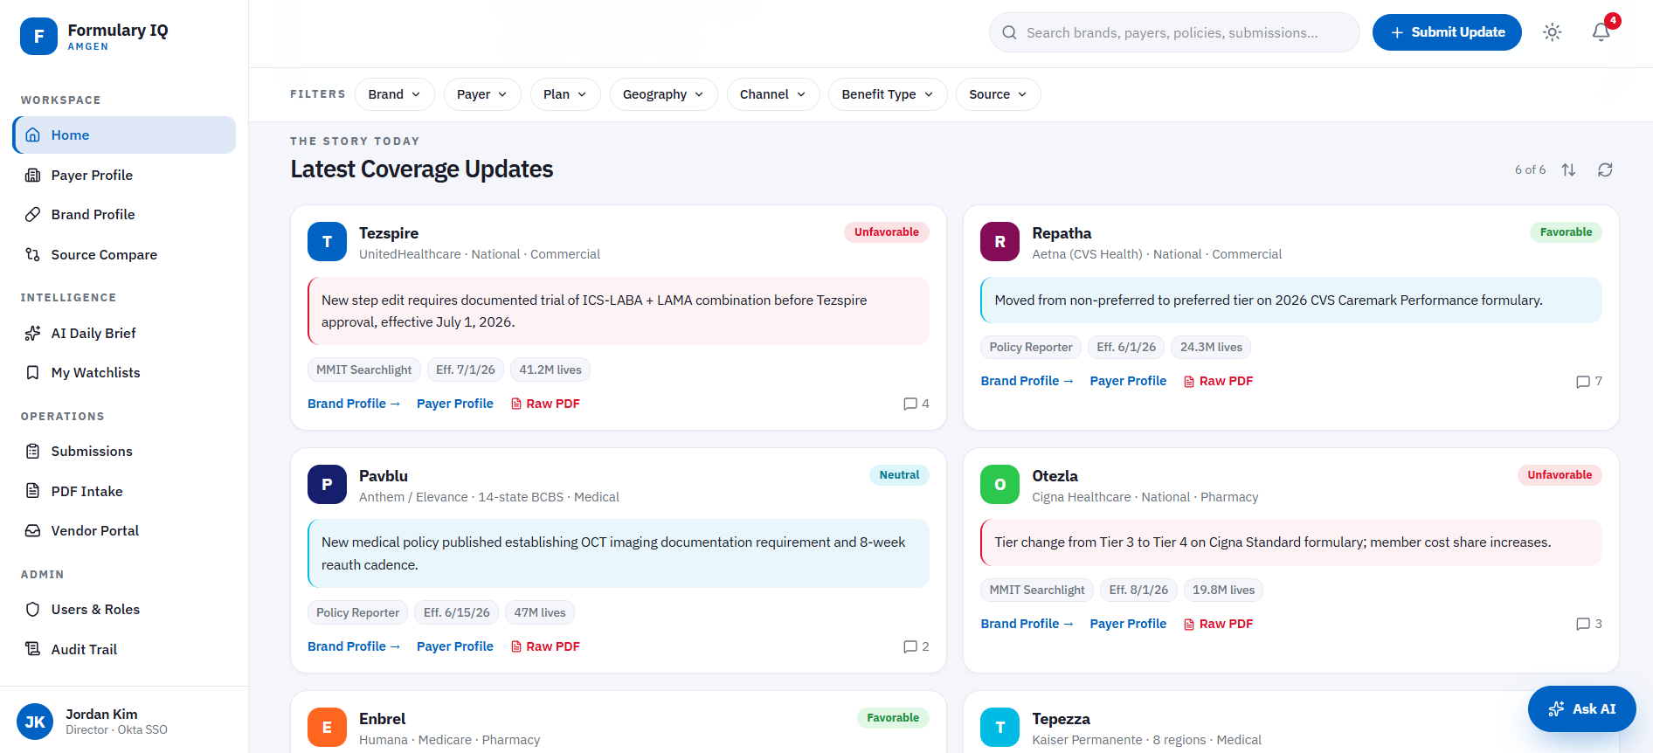
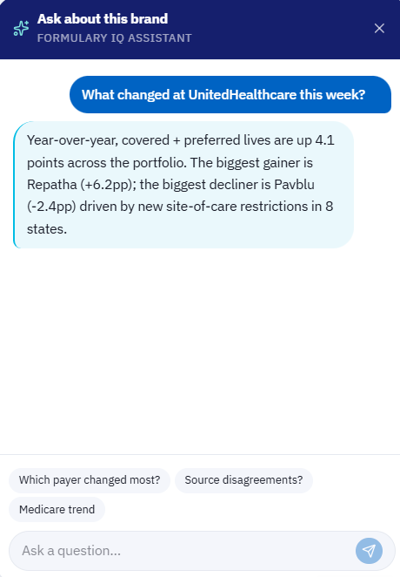
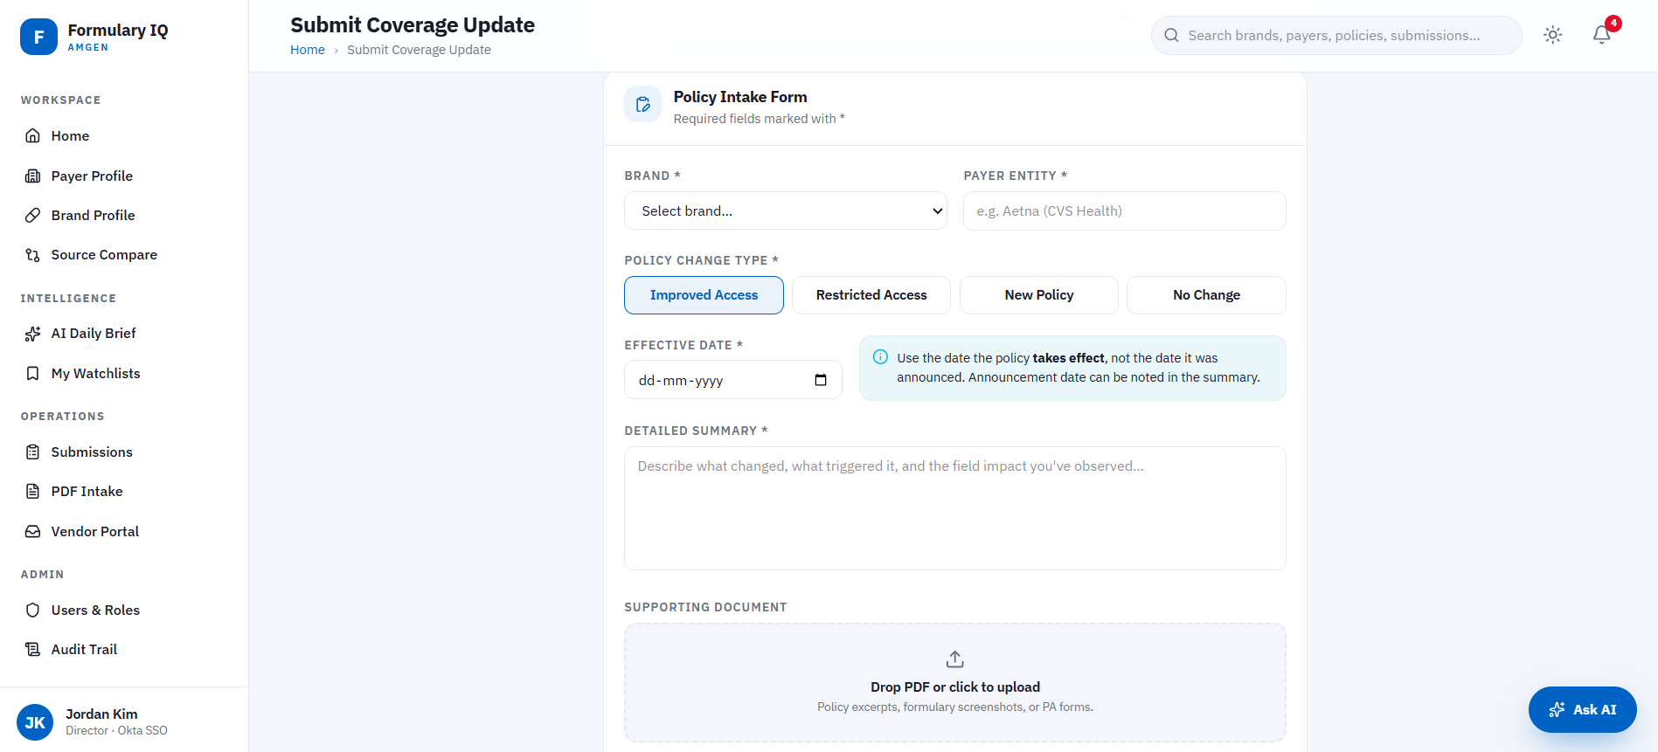
Sample Screens
Home, Policy intake page and AI Assistant

Slide 7
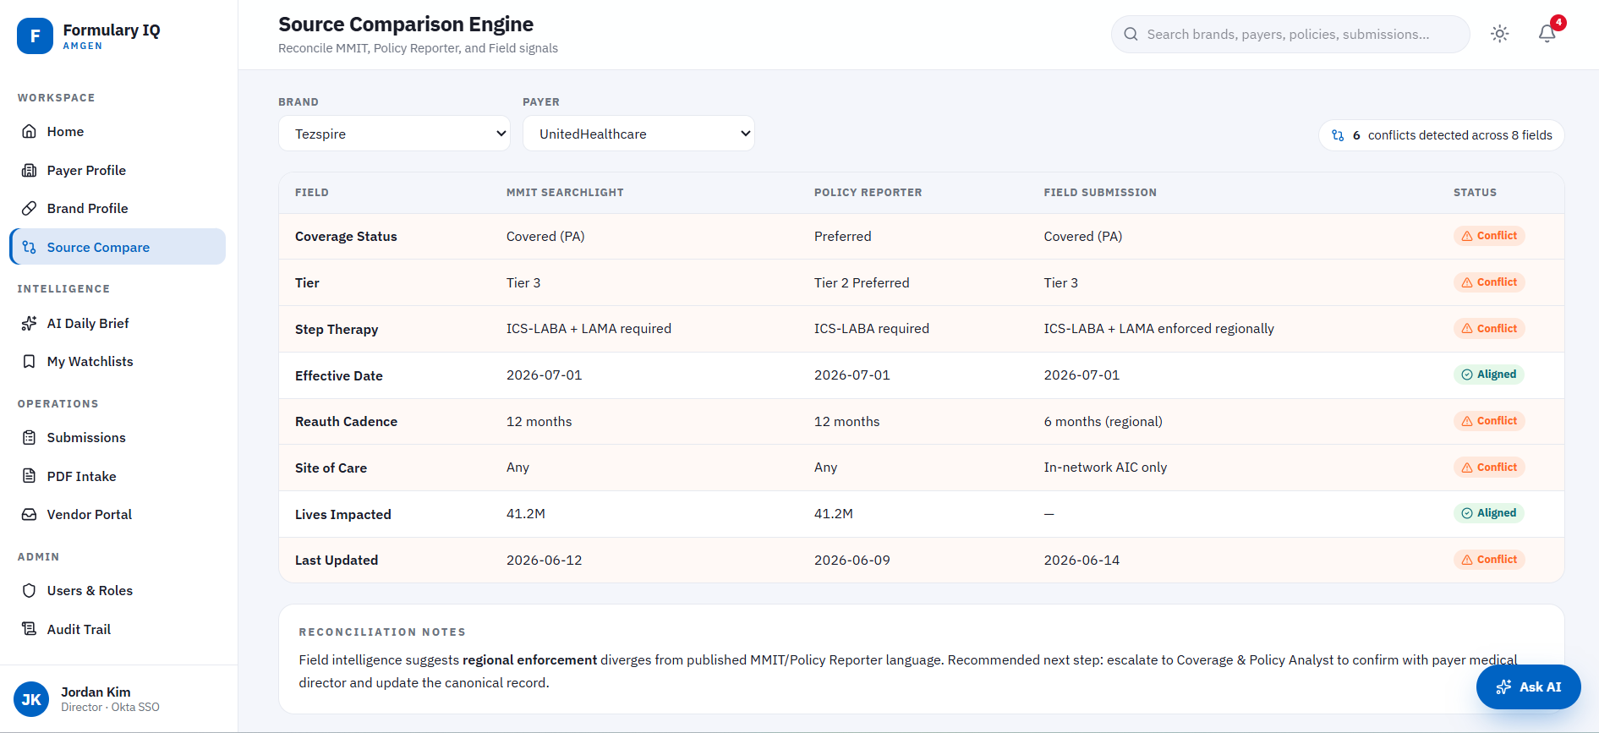
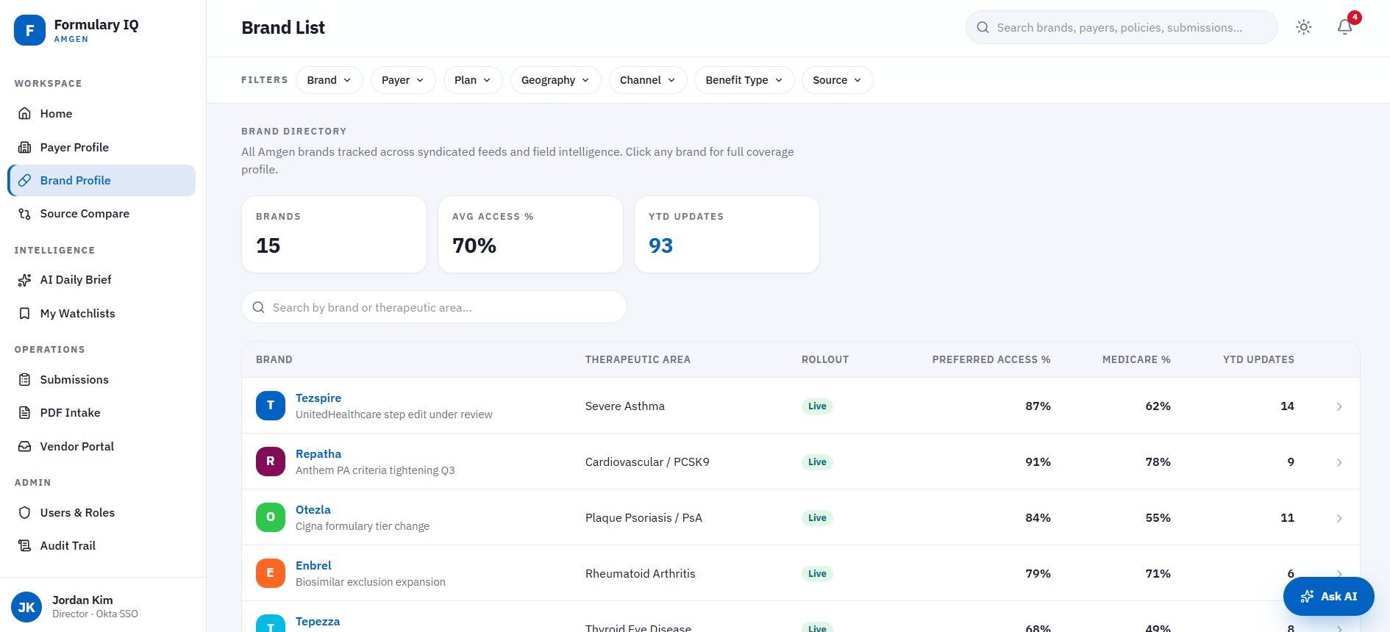
Sample Screens
Brand List and Source Comparison views

Slide 8
Formulary IQ: High Level Project Timeline
End-to-end delivery across 3 releases and 9 months, from MVP to full platform rollout
*Timelines are subject to change based on the initial scoping
Execution Timelines across the Releases
# | Activity | M1 | M2 | M3 | M4 | M5 | M6 | M7 | M8 | M9
Release 1: MVP
1 | Scoping, Discovery & Data Modelling
2 | React App, Flask API & RBAC Setup
3 | Dashboard, Payer & Brand Profile Pages
4 | Submission Workflow, UAT & R1 Go-Live
Release 2: AI & Intelligence
5 | Genie AI Setup & Tuning
6 | Source Comparison & PDF Scrubbing
7 | Collaboration, Notifications & UI Enhancements
8 | R2 UAT & Go-Live
Release 3 and beyond: Scale & Vendor
9 | Rx Brand Rollout & Schema Extension
10 | Vendor Portal & Advanced Genie Q&A
11 | Platform Audit, Load Testing & Documentation
The AI features would require more evaluation and would be done during the Release 1 development

Slide 9
Timelines*: Release 1 focus: High‑priority capabilities
AI features and full brand coverage to be integrated in Release 2 & 3
*Timelines are subject to change based on the initial scoping
Release 1: Execution Timelines
Sl | Task | W-1 | W0 | W1 | W2 | W3 | W4 | W5 | W6 | W7 | W8 | W9 | W10 | W11 | W12
1 | Scoping, Access & Backend Discovery Workshop
2 | Frontend App Setup (on Databricks Apps)
3 | Backend Setup (Initial Setup, Unity Catalog connection)
4 | Data Modelling & Schema Design
5 | Payer & Brand Profile Pages (Tezspire, Tepezza - Mx)
6 | Coverage Update Submission & Review Workflow
7 | RBAC Security, Search & Dashboard Build
8 | Release 1 Launch, UAT & Validation
Release 1 | Key Deliverables
Formulary IQ App Live on Databricks: A fully functional React app deployed and accessible to all permitted users across the commercial organisation.
Payer & Brand Intelligence Pages: Dedicated profile pages for Tezspire and Tepezza (Medicare)
Centralised Coverage Data in Unity Catalog: All payer, brand, coverage, and submission data structured, governed, and queryable
Coverage Update Submission & Tracking: End-to-end workflow for submitting, reviewing, and publishing coverage updates

Slide 10
Resourcing & Costing
# | Role | Release 1 | Release 2 | Release 3 | Cost/Hr
1 | Senior Full Stack Developer | 1 | 2 | 2 | $36
2 | React Developer | 1 | 2 | 2 | $34
3 | Senior Databricks Engineer | 2 | 3 | 3 | $36
4 | AI/ML Engineer | 1 | 2 | 2 | $38
5 | Project Manager | 1 | 1 | 1 | $38
6 | Sr. Business Analyst | 2 | 2 | 2 | $38
Total Headcount |  | 8 | 12 | 12

