Slide 1
Student Performance Tracker
Academic Web Application & Database Management System
Technology Stack: Python 3 | Flask Web Framework | SQLite Database | HTML5 & CSS3
Bachelor of Computer Applications (BCA) — Final Project Presentation

Slide 2
STUDENT PERFORMANCE TRACKER
Project Overview & Key Objectives
Project Objectives
• Digital Student Record Management: Store student profiles digitally.
• Subject-Wise Grade Entry: Maintain academic marks across multiple subjects.
• Automated Performance Analytics: Instant calculation of averages.
• Class-Wide Reporting: Comprehensive teacher summary table.
• Educational Integration: Demonstrate OOP and Relational DB concepts.
Core Value Proposition
• Eliminates Manual Errors: Automated mark accumulation and averaging.
• Instant Search: Query any student by Roll Number in milliseconds.
• Zero-Configuration DB: Built on SQLite3 requiring no setup.
• Clean Web Portal: User-friendly responsive HTML/CSS forms.
• Cloud Deployment: Ready to host on Render with Gunicorn.

Slide 3
STUDENT PERFORMANCE TRACKER
Problem Statement & Proposed Solution
Traditional Manual Method
• Paper-based grade registers are prone to physical loss and damage.
• Manual average percentage calculation is time-consuming and error-prone.
• Difficult to search specific student historical performance quickly.
• Lack of centralized data access for teachers across different departments.
Proposed Digital Solution
• Centralized SQLite Database: Immutable digital record storage.
• Automated Percentage Engine: Real-time grade summation & division.
• Instant Roll Search: Quick query with grade breakdown display.
• Web Accessibility: Standard browser portal accessible anywhere.

Slide 4
STUDENT PERFORMANCE TRACKER
Technology Stack & Layered Architecture
Backend Layer
• Python 3.x Engine
• Flask Web Framework
• OOP Domain Classes
• Virtual Environment
Database Layer
• SQLite3 Database
• students Table
• grades Table
• Foreign Key Linking
Frontend & Hosting
• HTML5 Semantic Forms
• Custom CSS3 Styling
• Jinja2 Templating
• Render Cloud Hosting

Slide 5
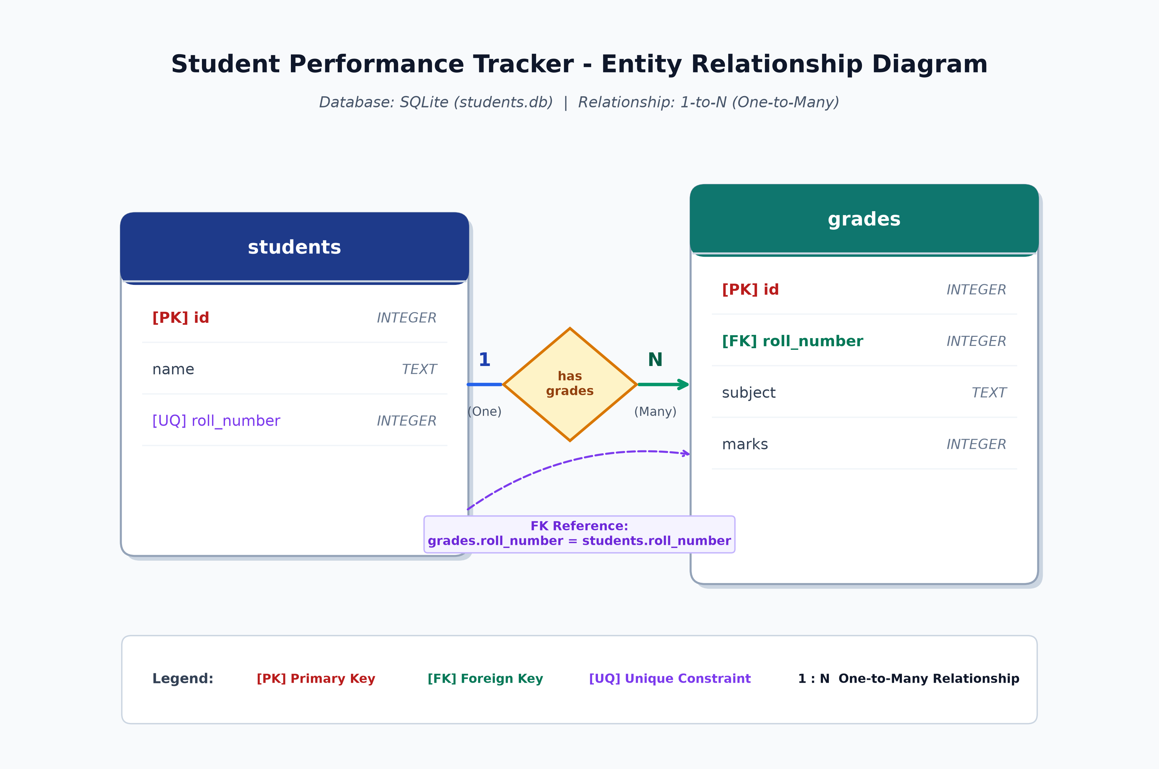
STUDENT PERFORMANCE TRACKER
Database Schema & Entity-Relationship Model
Relational Design Highlights
• 1-to-N Relationship: One student has multiple subject grades.
• students Table: Stores id, name, and unique roll_number.
• grades Table: Stores id, roll_number (FK), subject, and marks.
• Data Integrity: Foreign Key mapping via roll_number.

Slide 6
STUDENT PERFORMANCE TRACKER
Object-Oriented Programming (OOP) Design
Student Class (student.py)
• Attributes: name, roll_number, grades dict.
• add_grade(subject, marks): Appends subject mark pair.
• calculate_average(): Computes mean grade value.
• display_info(): Formats console summary.
StudentTracker Class (tracker.py)
• Attributes: self.students list of objects.
• add_student(): Prevents duplicate roll registration.
• find_student(): Roll number lookup algorithm.
• add_grades(): Associates mark with target object.

Slide 7
STUDENT PERFORMANCE TRACKER
Core Features: Student Registration & Grade Entry
1. Student Registration
• Route: /add_student (GET, POST)
• Input Fields: Full Name & Roll Number.
• Validation: Checks roll uniqueness in SQLite.
• User Feedback: Immediate success/duplicate notification.
2. Grade Entry System
• Route: /add_grades (GET, POST)
• Input Fields: Roll Number, Subject, Marks.
• Validation: Enforces 0 <= Marks <= 100.
• Error Handling: Catches invalid/non-numeric inputs.

Slide 8
STUDENT PERFORMANCE TRACKER
Core Features: Search & Class Analytics
3. Student Details Search
• Route: /view_student
• Lookup: Query by Roll Number.
• Output: Displays all subjects, individual marks, and overall average.
• Error Handling: 'Student Not Found' message.
4. Class Average Summary
• Route: /average
• Analytics: Scans all registered students.
• Output Table: Displays Name, Roll Number, and Average Marks.
• Benefit: Instant overview of class performance.

Slide 9
STUDENT PERFORMANCE TRACKER
Source Code Structure & Files
Filename | Layer | Function & Description
app.py | Controller | Main Flask routes handling GET/POST HTTP requests & rendering Jinja2 templates.
database.py | Data Access (DAO) | SQLite database connection management, table creation, and SQL queries.
student.py | Domain Entity | OOP Student class defining student properties, grade dictionary, and average logic.
tracker.py | Business Logic | StudentTracker manager class controlling in-memory student collections.
templates/ | View Layer | HTML templates (index, add_student, add_grades, view_student, average).

Slide 10
STUDENT PERFORMANCE TRACKER
Data Integrity & Exception Handling
Input Validation Rules
• Grade Boundary Check: Rejects marks below 0 or above 100.
• Unique Roll Number Constraint: SQLite UNIQUE column index.
• Type Casting Safety: Catches non-integer inputs gracefully.
• Form Field Requirements: Mandatory fields enforced in HTML.
System Reliability
• Automatic DB Initialization: Creates tables on app startup.
• Prepared SQL Statements: Parameterized queries prevent SQL Injection.
• Empty State Handling: Handles students with zero grades cleanly.
• Clean Error Messages: Friendly UI feedback banners.

Slide 11
STUDENT PERFORMANCE TRACKER
Cloud Deployment Strategy
Render Platform Setup
• Hosting Platform: Render Cloud Platform.
• Deployment Files: requirements.txt & Procfile.
• Start Command: python app.py or gunicorn app:app.
• Environment: Automated virtualenv build.
Production Readiness
• Lightweight Footprint: Runs with minimal memory allocation.
• Zero Maintenance: SQLite embedded storage.
• Global Accessibility: Live HTTP endpoint.
• Continuous Deployment: Auto-deploys on Git pushes.

Slide 12
Thank You!
Student Performance Tracker Project Presentation
Questions & Feedback Welcome

