Slide 1


Introduction to Cloud

Slide 2
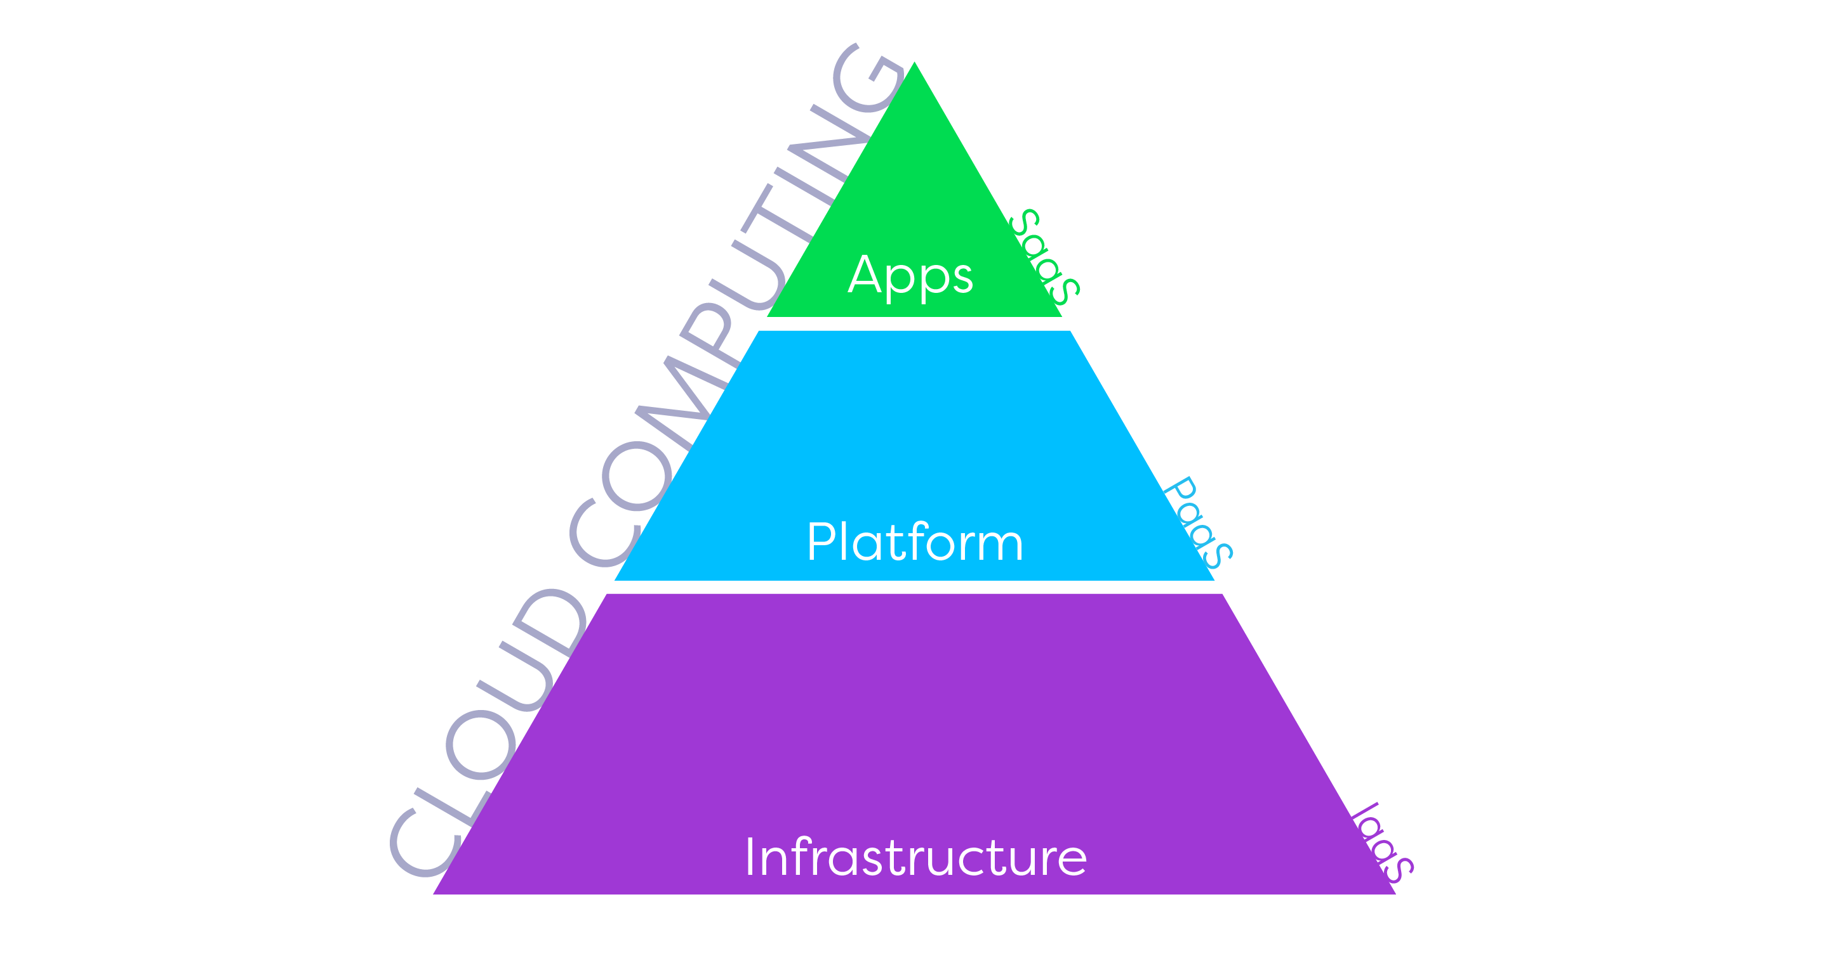

Slide 3
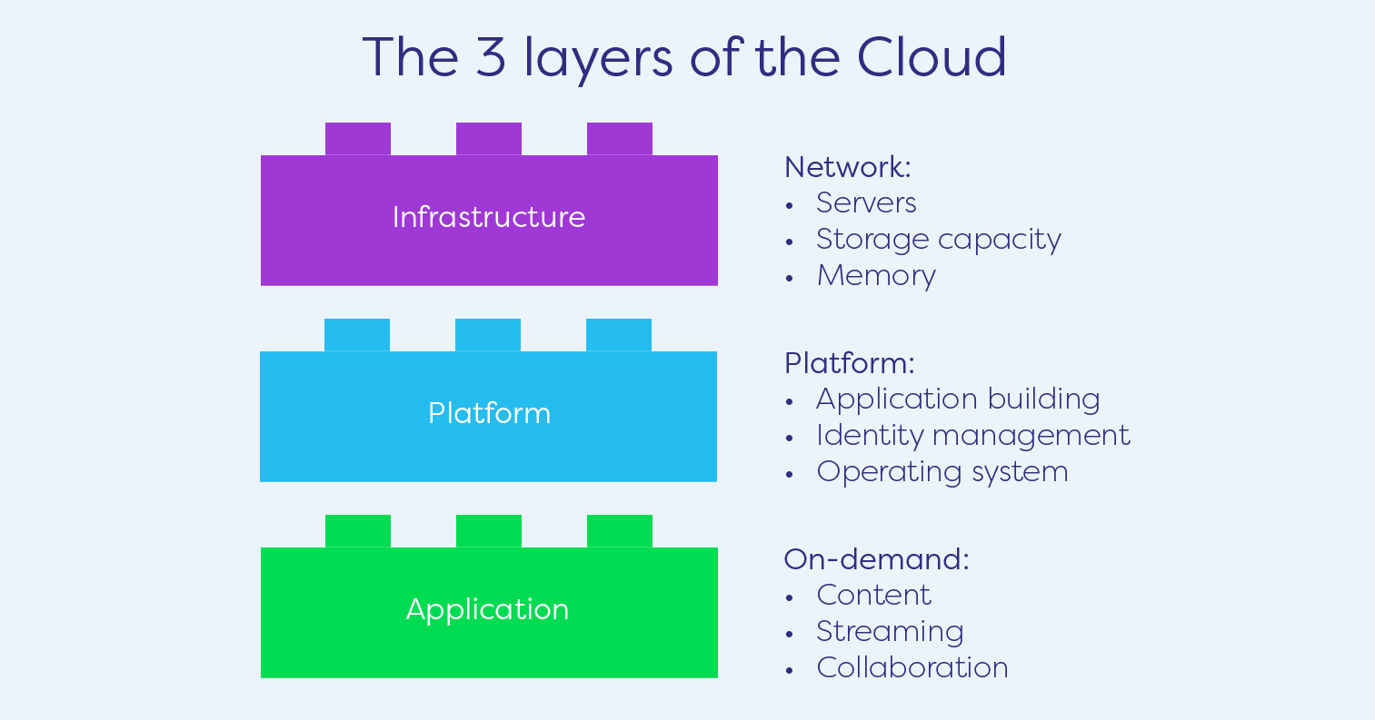

Slide 4


Slide 5
