Slide 1
CNF PORTAL
CNF Architecture
July 2026 · Confidential

Slide 2
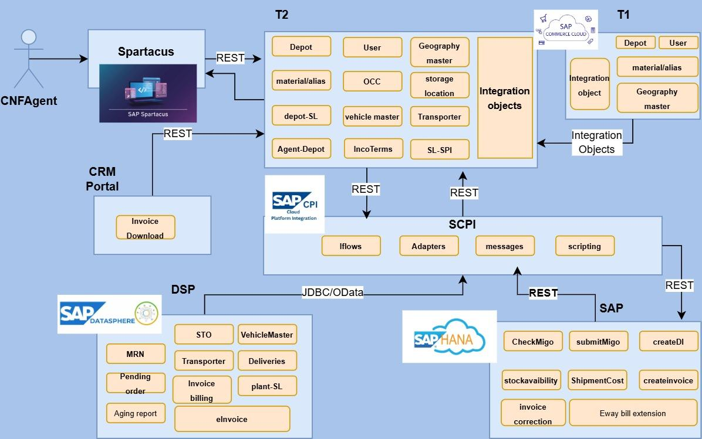

Slide 3
CNF PORTAL
DSP Data Integration — Architecture Options
Comparative Analysis of Two Integration Approaches
Shree Cement Limited · Technology Architecture
OPTION A
Real-Time DSP Query with OCC Caching
OPTION B
Hybris-Managed Data Store with Scheduled DSP Sync
July 2026 · Confidential

Slide 4
Option A — Real-Time DSP Query with OCC Caching (within session)
T2 queries DSP live on demand. OCC cache absorbs repeated requests.
CNF Agent
(Browser)
Hybris T2
OCC API Layer
OCC Cache
(Hybris Region)
SAP SCPI
Middleware
SAP Datasphere
OData API
✓ HIT
serve instantly
→ MISS
call SCPI live
TTL is matched to each object's DSP refresh cycle — no persistent copy of DSP data is kept in T2.
MASTER DATA
REAL-TIME OPERATIONAL (SLT)
Depot → Storage Location Mapping
Pending MRN
STO List
Synced from DSP · stored in T2.cached 23 hrs
DSP SLT CDC · OCC cache 4 min
DSP SLT CDC · OCC cache 4 min
Vehicle Master
Pending Orders
Synced from DSP · stored in T2. cached 23 hrs
DSP SLT CDC · OCC cache 4 min
Transporter Master
Deliveries
Synced from DSP ·stored in T2. cached 23 hrs
DSP SLT CDC · OCC cache 4 min
Stock Aging
Invoice Billing
DSP refresh once in a day
DSP SLT CDC · OCC cache 4 min
eInvoice
✓ Simpler to build
✓ Always current
✓ Low T2 storage
✗ DSP dependency
✗ SCPI bottleneck
✗ Cache tuning needed
Option A · Shree Cement CNF Portal · Architecture Decision
July 2026

Slide 5
Option B — Hybris-Managed Data Store with Scheduled DSP Sync
T2 maintains its own persistent data store. DSP sync runs in the background. Agents always read from T2.
BACKGROUND SYNC PATH · no agent involvement
Deliveries/Invoice Updates
Deliveries/Invoice Updates
Hybris
T2 Data Store
SCPI / Direct
Connection
DSP
JDBC connection
SAP S/4HANA
(via SCPI)
pushes delivery & invoice updates back to Hybris
AGENT RUNTIME PATH · zero DSP dependency
CNF Agent
(Browser)
Hybris T2
OCC API Layer
Hybris T2
Data Store (same as above)
Daily sync · master data 10–15 min sync · operational data
Created on write · transactional data, synced back via SCPI
MASTER DATA · DAILY BATCH
OPERATIONAL · 10–15 MIN
TRANSACTIONAL · CREATED IN T2 only after persisted in SAP
EVENT DRIVEN - Created in SAP , pushed from SAP to T2
Same as T1
Depot → Storage Location Mapping
Pending MRN
Deliveries
DSP daily batch → T2 persistent table
SCPI syncs from DSP to T2. Data stored in T2.
Created on DI confirm ·stored in T2
Deliveries
Vehicle Master
Pending Orders
Invoices
Create in SAP pushed to T2 via SCPI
DSP daily batch → T2 persistent table
SCPI syncs from DSP to T2. Data stored in T2.
Created on invoice post · stored persistently in T2
Invoices
Transporter Master
STO List
Invoice PDF Downloads
Create in SAP pushed to T2 via SCPI
DSP daily batch → T2 persistent table
SCPI syncs from DSP to T2. Data stored in T2.
First fetch via API · then persisted in T2 media
Stock Aging
SCPI syncs from DSP to T2. Data stored in T2.
eInvoice
SCPI syncs from DSP to T2. Data stored in T2.
✓ Portal resilience
✓ Fast agent screens
✓ Complex queries possible
✗ Higher dev effort
✗ Data duplication

Slide 6
CNF PORTAL
Option C - Direct T1 (CRM) Query with Scheduled DSP Sync (Hybrid)
July 2026 · Confidential

Slide 7
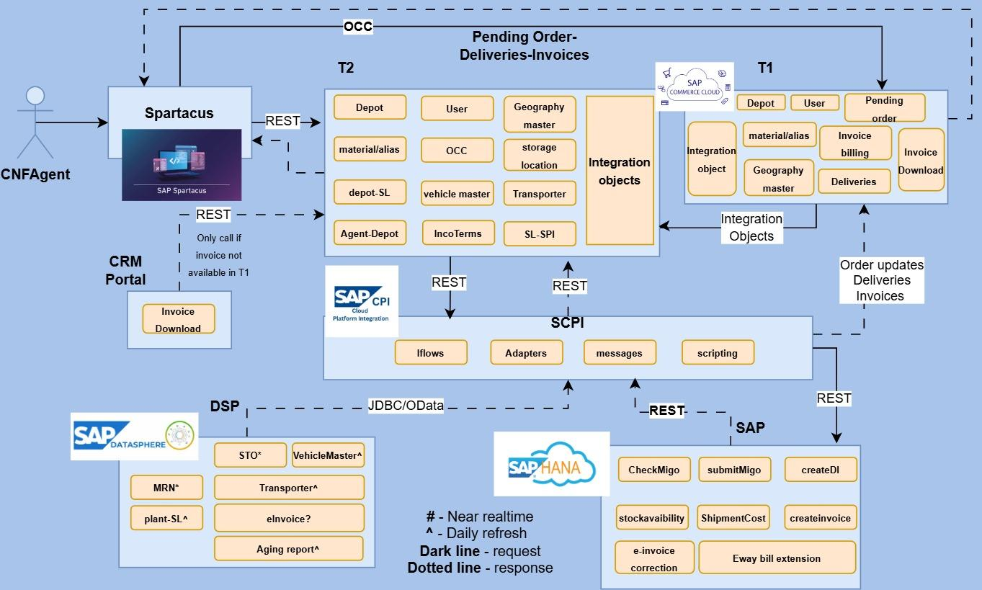

Slide 8
Option C — Direct T1 (CRM) Query with Scheduled DSP Sync
Orders, Deliveries & Invoices are served live from T1 (CRM) via OCC. MRN, STO List & Stock Aging sync from DSP to T2 on a fixed schedule.
DIRECT T1 (CRM) QUERY PATH · zero DSP / T2 dependency
CNF Agent
(Browser)
Hybris T1 (CRM)
OCC API Layer
Live OCC call for Orders, Deliveries & Invoices — served directly from T1, no T2 or DSP round-trip.
DIRECT T2 QUERY PATH · zero DSP / T2 dependency
CNF Agent
(Browser)
Hybris T2 (CNF/OMS)
OCC API Layer
Direct calls for Vehical master, transporter and stock Aging. No DSP round trip
DSP SYNC PATH · scheduled, no agent involvement,Fetch stock Aging , Depot-SL, Vehicle Master and Transporter master
Hybris
T2 Data Store
SCPI / Direct
Connection
DSP
JDBC connection
MASTER DATA · DAILY
OPERATIONAL · SCHEDULED/Realtime DSP SYNC
TRANSACTIONAL · REAL-TIME FROM T1
Depot → Storage Location Mapping
Synced from DSP · stored in T2 (daily)
Pending MRN
15 min sync
Orders
Live OCC query to T1 (CRM)
Vehicle Master
Synced from DSP · stored in T2 (daily)
STO List
15 min sync
Deliveries
Live OCC query to T1 (CRM)
Transporter Master
Synced from DSP · stored in T2 (daily)
Stock Aging
Dialy refresh from DSP
Invoices
Live OCC query to T1 (CRM)
Invoice Download
✓ Orders, Deliveries & Invoices always current — no DSP lag
OCC query to T1
✓ Fewer entities to sync via DSP — just Stock Aging, vehicle master.transporter master
✗ Two integration patterns to build and maintain
✓ Master data pattern stays consistent with Option A / B
Option C · Shree Cement CNF Portal · Architecture Decision
July 2026

Slide 9
