Slide 1
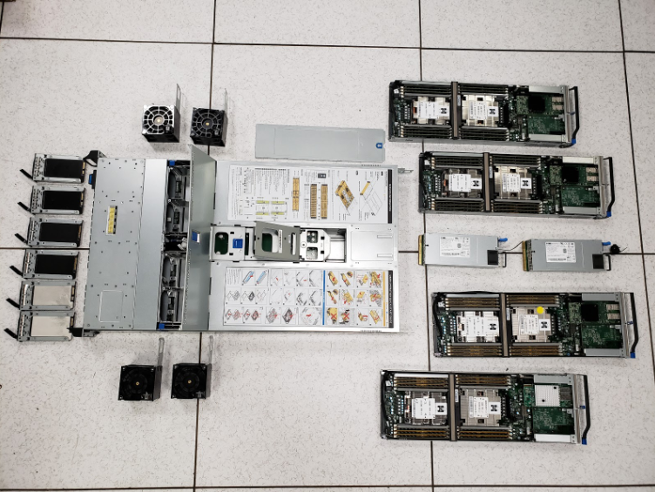
One faulty rule. A worldwide outage
JULY 2, 2019
Cloudflare sits between visitors and websites, delivering content and checking requests for threats.
A firewall update overloaded its servers. Visitors saw 502 errors even when the websites behind Cloudflare were healthy.
Cloudflare G9 hardware, 2018. Context photo, not the incident.
27 min
82%
100%
service disruption
worst traffic drop
CPU usage
CLOUDFLARE 2019
1 / 6
Notes:
Explain the setup as an intermediary: a visitor’s request passes through Cloudflare before reaching the site. A 502 error means that intermediary could not obtain the response it needed. The 82% figure describes Cloudflare’s traffic drop, not 82% of the Internet.
An everyday example: a visitor may be unable to open a store or complete an online task. This is an illustration of availability impact, not a measured financial-loss claim.
Sources: https://blog.cloudflare.com/cloudflare-outage/
https://blog.cloudflare.com/details-of-the-cloudflare-outage-on-july-2-2019/
Presentation detail:
Cloudflare sits between visitors and websites. Its servers deliver content and screen requests before they reach a website’s own server.
On July 2, a firewall rule update overloaded servers worldwide. Visitors saw “502 Bad Gateway” errors instead of web pages.
The outage lasted 27 minutes. CPU usage reached 100%, and Cloudflare’s traffic fell 82% at its worst.
Why it mattered: one shared provider’s failure interrupted many customers at once, even when their own websites were otherwise healthy.
Image: Cloudflare, A Tour Inside Cloudflare’s G9 Servers (October 10, 2018). https://blog.cloudflare.com/a-tour-inside-cloudflares-g9-servers/
Original asset: https://blog.cloudflare.com/_emdash/api/media/file/01KW46RPEYCEAKMS3YKZM20Z6N.png

Slide 2
Why a text-search rule consumed the CPU
THE SIMPLIFIED PATTERN
01 Inspect the request
.*.*=.*
The web application firewall (WAF) ran this rule to detect malicious JavaScript.
02 Retry possible matches
Each .* can match almost any amount of text. The overlapping sections create many possible ways to split the same input.
Backtracking tries alternative matches. Too many retries use up processing time.
03 Crowd out normal work
The check consumed CPU that servers needed to respond to visitors.
A regex is a pattern for searching text.
“Simulate” mode still runs the check. It only prevents the rule from blocking visitors.
CLOUDFLARE 2019
2 / 6
Notes:
Read the pattern aloud as: any text, followed by any text, followed by an equals sign, then any text. This is a simplified fragment, not the complete deployed expression.
Illustrative example: when a candidate input lacks an equals sign, a backtracking matcher can repeatedly redistribute characters between the wildcard sections before deciding there is no match. A check can be logically correct yet too expensive to run on every request. Avoid calling this an infinite loop: the problem is excessive repeated work.
Sources: https://blog.cloudflare.com/details-of-the-cloudflare-outage-on-july-2-2019/
https://blog.cloudflare.com/cloudflare-outage/
Presentation detail:
The web application firewall (WAF) checks requests for suspicious content. This update targeted malicious JavaScript.
A regular expression, or regex, is a text-search pattern. The simplified fragment .*.*=.* contains overlapping “match anything” sections.
Backtracking means retrying different ways to match the same text. Here, the repeated work consumed the CPU needed to serve requests.
“Simulate” mode only stopped the rule from blocking visitors. It still ran the expensive check on real traffic.

Slide 3
Four missing defenses amplified the failure
01
CPU protection
An earlier performance refactor accidentally removed a safeguard against costly regex processing.
02
Performance tests
Tests checked allow/block decisions, but did not catch runaway CPU use. Correct answers were not enough.
03
A limited rollout
The rule reached the world without a small trial first. One defect affected many locations together.
04
Independent recovery
The outage also blocked internal tools, making emergency access and recovery harder.
The rule triggered the incident. Existing weaknesses made it global and harder to stop.
CLOUDFLARE 2019
3 / 6
Notes:
Case analysis: several defenses failed together. A useful test plan asks both “Does this rule classify traffic correctly?” and “Can we afford to execute it under load?”
A staged rollout exposes a small traffic sample first. Teams watch errors and CPU before expanding it. That limits how many customers encounter an undetected defect.
The debt connection is the accumulated risk in testing, deployment, and recovery procedures. The new regex triggered the incident, while existing weaknesses increased its severity.
Source: https://blog.cloudflare.com/details-of-the-cloudflare-outage-on-july-2-2019/
Presentation detail:
Earlier refactoring accidentally removed a CPU safeguard. The effort to improve performance weakened a protection against costly rules.
Tests checked which requests to allow or block. They did not catch runaway CPU use, so passing tests gave incomplete reassurance.
The rollout sent the rule worldwide without a limited trial. A local defect therefore became a global availability problem.
Recovery also depended on affected systems. Engineers struggled to access internal tools, making an emergency change harder.

Slide 4

Service recovered before the firewall returned
CPU USAGE AT ONE CLOUDFLARE LOCATION
13:42
Rule deployed globally
14:00
WAF identified as cause
14:07
WAF disabled globally
14:09
Traffic and CPU recover
Original monitoring chart from Cloudflare’s postmortem
14:52
Disabling the WAF removed the immediate load. Other security protections stayed active.
WAF restored after testing
All times UTC, July 2, 2019
CLOUDFLARE 2019
4 / 6
Notes:
All times refer to July 2, 2019, in UTC. A rollback restores an earlier configuration or version. Disabling the affected component first removes the immediate load, giving the team room to investigate.
Make the two recovery milestones explicit: people could access websites again at 14:09, but the WAF returned at 14:52. Traffic recovery therefore does not mean every protection was already back. The detailed postmortem gives the 14:07 termination time and 14:00 diagnosis.
Sources: https://blog.cloudflare.com/cloudflare-outage/
https://blog.cloudflare.com/details-of-the-cloudflare-outage-on-july-2-2019/
Presentation detail:
13:42 UTC: the rule goes live. By 14:00, engineers identify the WAF as the source of CPU exhaustion.
14:07 UTC: they disable the WAF globally. By 14:09, CPU usage and traffic return to normal.
They roll back the faulty rule and test the fix. At 14:52 UTC, they restore the WAF worldwide.
The tradeoff: websites recover before WAF inspection returns. Other security protections remain active during that interval.
Image: original CPU chart, Cloudflare engineering postmortem. https://blog.cloudflare.com/_emdash/api/media/file/01KW44G5FHMGT7B6C2NGNFWVW7.png
The chart shows one location, not a separately measured global average.

Slide 5
The response addressed code and release process
COMPLETED BY JULY 12
ANNOUNCED NEXT STEPS
3,868
Measure processing cost
Profile rules for excessive CPU use, as well as checking whether they detect attacks.
managed rules inspected
Expand releases gradually
Cloudflare also restored the CPU safeguard removed during refactoring.
Start with limited traffic and inspect results before deploying worldwide.
Use a safer regex engine
RE2 or Rust regex can provide runtime guarantees. Compatibility still needs testing.
RE2: for a fixed pattern, matching time scales linearly with input length.
CLOUDFLARE 2019
5 / 6
Notes:
The first bullet describes work reported complete. The following actions were announced in the July 12 postmortem, so this slide does not claim they had all shipped by that date.
RE2 explanation: for a fixed pattern, work scales proportionally with input length instead of exploding through repeated retries. This does not mean every expression takes the same time. RE2 also restricts syntax: features such as backreferences and look-around are unsupported. A migration therefore needs compatibility tests.
Sources: https://blog.cloudflare.com/details-of-the-cloudflare-outage-on-july-2-2019/
https://github.com/google/re2
Presentation detail:
Completed by July 12: restored the CPU safeguard and inspected all 3,868 managed rules for similar problems.
Planned testing: profile each rule’s performance. That means measuring its processing cost, beyond whether it gives the right answer.
Planned rollout: release rules in stages. Planned engine change: use RE2 or Rust regex with runtime guarantees.
Why the engine matters: RE2 bounds matching time linearly in input length for a fixed pattern, avoiding unbounded backtracking.

Slide 6
What this case teaches engineering teams
Maintenance
Technical debt
Refactoring
Restore service first. Then improve the controls that keep the same failure from recurring.
Shortcuts in testing and deployment can turn today’s speed into tomorrow’s outage costs.
Preserve safety limits as well as feature behavior. Test resource use, not only correct answers.
Does “the same output” mean
“the same behavior” under load?
Test processing cost. Limit rollout exposure. Rehearse recovery without normal tools.
CLOUDFLARE 2019
6 / 6
Notes:
These are the presentation’s conclusions from the case. Corrective maintenance addresses an existing defect. Preventive maintenance reduces the likelihood of future failures.
Refactoring changes a program’s internal structure while preserving external behavior. The case shows why a team must identify the protections that need to survive a code change. A proposed regression test could run difficult inputs and fail when a rule exceeds an agreed processing budget. This is a recommendation, not a claim about Cloudflare’s exact implementation.
Discussion question: If a change returns the same answers but makes the service unavailable under load, has it preserved the behavior users need?
Concept source: https://refactoring.com/
Case evidence: https://blog.cloudflare.com/details-of-the-cloudflare-outage-on-july-2-2019/
Presentation detail:
Maintenance includes keeping changes safe. Fixing the broken rule restores service, while stronger tests help prevent another failure.
Technical debt can live in processes too. Saving time on rollout or testing can create larger debugging and outage costs later.
Refactoring should preserve behavior. Teams also need regression tests for safety limits that ordinary feature tests may miss.
Practical takeaway: test correctness and resource use, expand releases gradually, and rehearse recovery when normal tools are unavailable.

