Slide 1




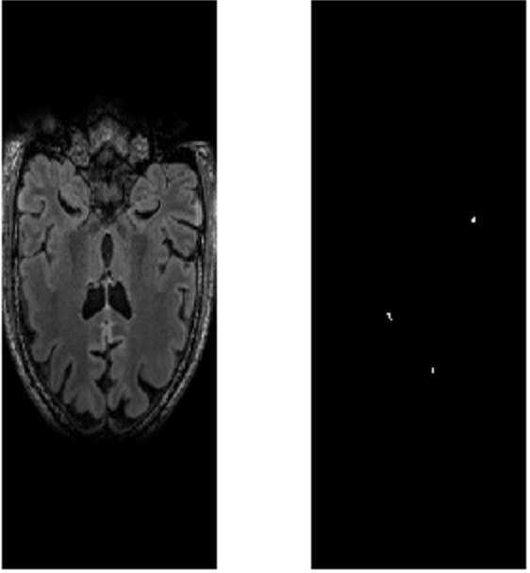
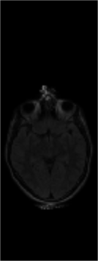
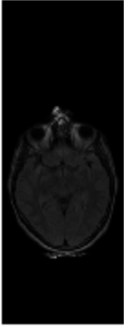

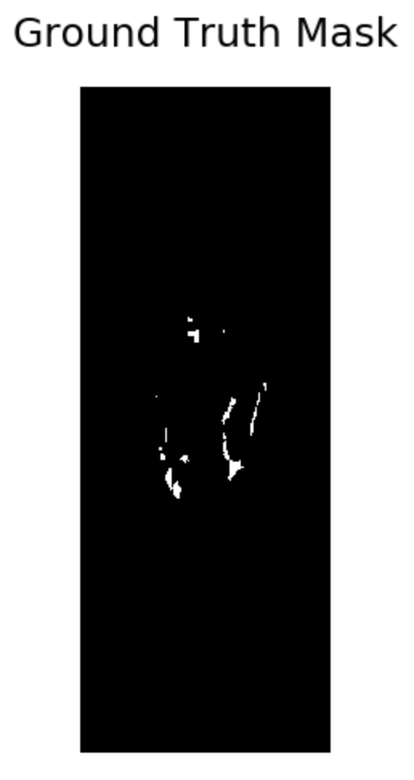
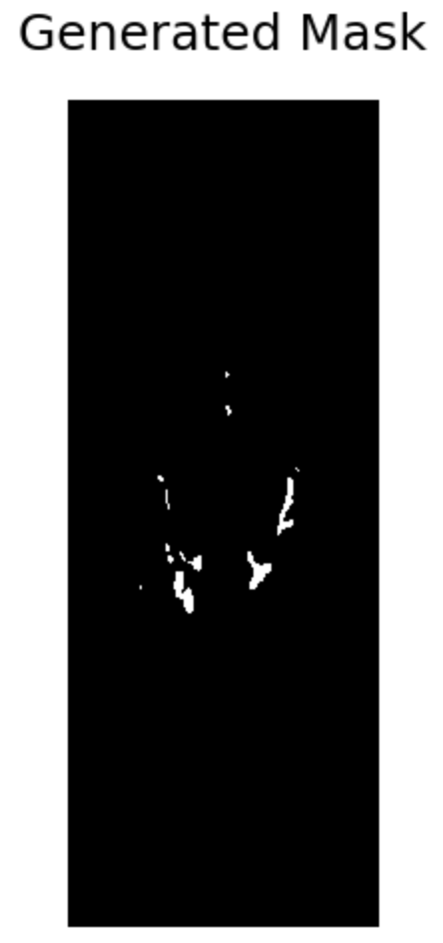
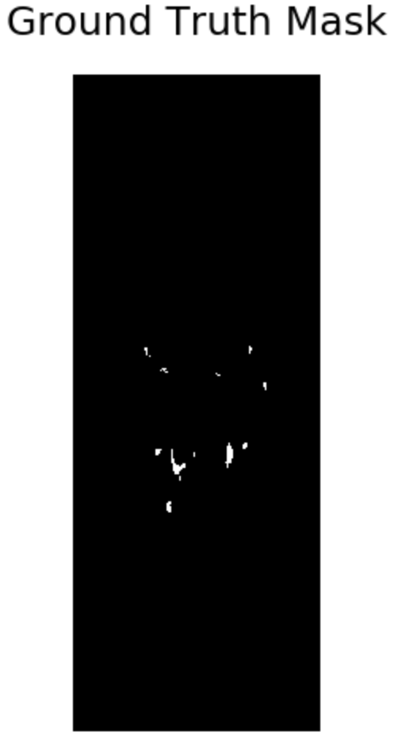

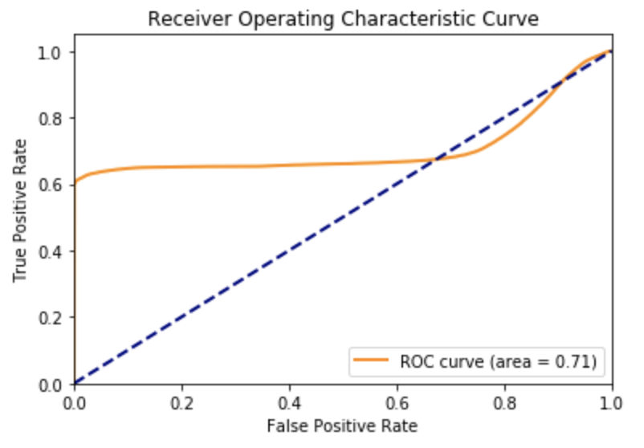
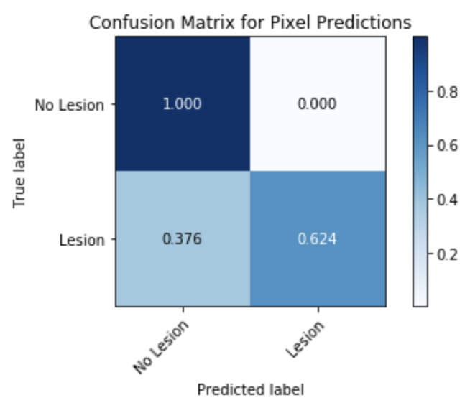
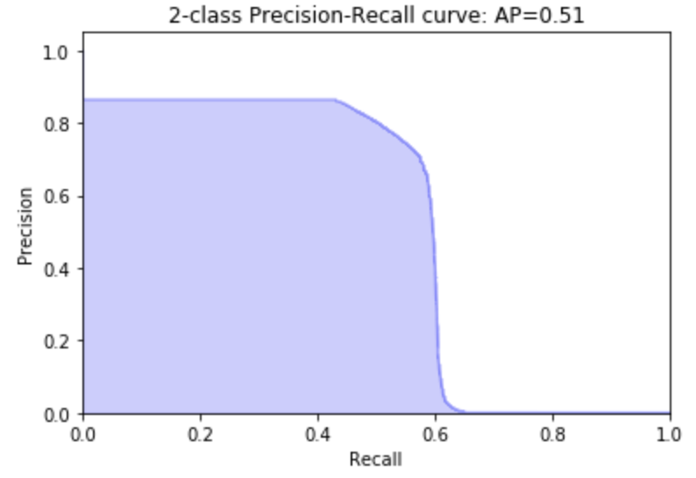
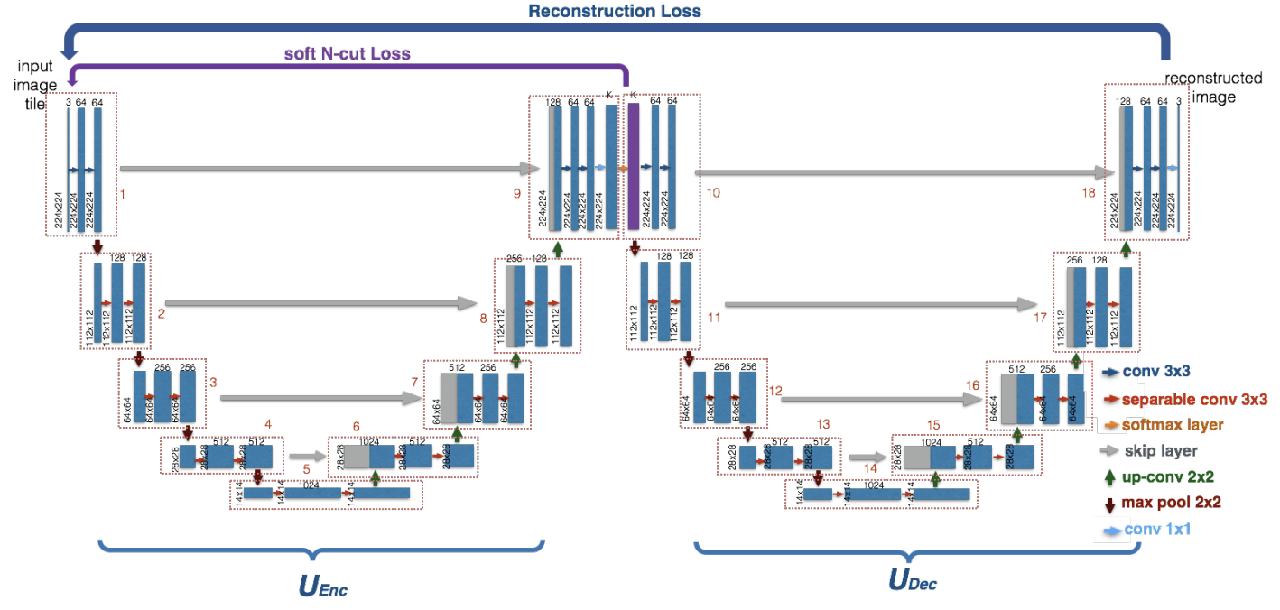
Longitudinal Multiple Sclerosis Segmentation and
Change Detection with Deep Learning
Siddarth Ijju, under Dr. Minh Hoai Nguyen
Simons Summer Research Program, Stony Brook University
Introduction
Approach (Change Detection)
Results
Multiple sclerosis (MS) is a chronic, autoimmune and demyelinating disease of the central nervous system causing lesions in the brain tissues, notably in white matter (WM) [1]. Precise segmentation of MS lesions is an important task for understanding and characterizing the progression of the disease [2].
The detection of new or enlarged white-matter lesions in multiple sclerosis is a vital task in the monitoring of patients. However, there are few algorithms and data resources built for this task. This project aims to develop algorithms to segment lesions from FLAIR-attenuated MRI images as well as to detect changes in lesion load over time.
Ultimately, the final approach to the change detection phase of the project consisted of a direct Siamese Network coupled with a U-Net architecture. Various initial approaches were experimented with before arriving at the final approach. Due to limited data availability, transfer learning was tested, but ultimately failed due to differences in the data, as shown below.
The primary metric used for model evaluation was the Dice coefficient, which is shown below. In addition, various other metrics such as precision-recall, and ROC-AUC were used to evaluate the success of the segmentation model.
Dataset 1
(lacks longitudinal data)
Dataset 2
(lacks individual segmentations)
The average Dice coefficient on the testing dataset was 0.61, compared to the state-of-the-art Dice coefficient of 0.76 [7]. Examples are shown below.
Approach (Segmentation)
For the segmentation phase of the project, a U-Net (shown below) was implemented [3]. Data consisted of 512 by 512 by 192 volumes from 30 patients [4]. Inputs to the U-Net consisted of the axial scans of the volumes (or the 512 by 192 slices).
In addition to the standard U-Net, a Spatial Transformer Network was implemented to improve generalizability for the network [5]. Spatial Transformer Networks learn affine transformations to improve performance in the networks they are used in.
Second, a Siamese network coupled with a Deconvolutional Encoder-Decoder was constructed. The network took as input the two MRI images, with the first input being the first timepoint and the second the later timepoint. The approach was ultimately set aside due to the little apparent correlation between the input data and the output.
Dice: 0.59
Dice: 0.73
In addition, the algorithm was able to achieve an ROC-AUC of 0.71 and an average precision of 0.51. In the future, further work will be done on the change detection segment of the project.
Siamese Network
Deconvolutional Encoder Decoder Network
Next, an unsupervised segmentation approach was tested, using an extension of the U-Net architecture called W-Net [6], as shown below.
References
[1]. Steinman, L., 1996. Multiple sclerosis: a coordinated immunological attack against myelin in the central nervous system. Cell 85 (3), 299–302.
[2]. Rolak, L. A., 2003. Multiple sclerosis: it is not the disease you thought it was. Clinical Medicine and Research 1 (1), 57–60.
[3]. Ronneberger, Olaf et al. “U-Net: Convolutional Networks for Biomedical Image Segmentation.” ArXiv abs/1505.04597 (2015): n. pag
[4]. Lesjak, Žiga, Franjo Pernuš, Boštjan Likar, and Žiga Špiclin. "A Novel Public MR Image Dataset of Multiple Sclerosis Patients With Lesion Segmentations Based on Multi-rater Consensus", Neuroinformatics (2017), DOI: 10.1007/s12021-017-9348-7
[5]. Jaderberg M, Simonyan K, Zisserman A, Kavukcuoglu K (2015) Spatial transformer networks. In: Cortes C, Lawrence ND, Lee DD, Sugiyama M, Garnett R (eds) Advances in neural information processing systems, vol 28. Curran Associates, Inc, Red Hook, pp 2017–2025
[6]. Xia, Xide and Brian Kulis. “W-Net: A Deep Model for Fully Unsupervised Image Segmentation.” ArXiv abs/1711.08506 (2017): n. pag.
[7]. Aslani, Shahab et al. “Multi-branch convolutional neural network for multiple sclerosis lesion segmentation.” NeuroImage 196 (2018): 1-15.
Acknowledgements. I would like to thank my P.I., Dr. Minh Hoai Nguyen, for his support and direction throughout the duration of the project. I would also like to thank Dr. Tim Duong of the Department of Radiology at the Stony Brook University Hospital for the idea and direction for the project.
However, the W-Net model could not generalize well on the datasets.

