Slide 1
Software Testing

Slide 2
Software Testing Introduction
What is Software?
Few Examples where Software is used:
Used in Computers
Used in Automobiles
Used in Aeroplanes
Used in Retail stores
Used in Ecommerce
What if Software is Defective?
China Airlines Airbus A300 crashed due to a software bug on April 26, 1994, killing 264 innocent lives
In 1985, A radiation therapy machine malfunctioned due to software bug and delivered lethal radiation doses to patients, leaving 3 people dead and critically injuring 3 others
In April of 1999, a software bug caused the failure of a $1.2 billion military satellite launch, the costliest accident in history
Nissan cars have to recall over 1 million cars from the market due to software failure in the airbag sensory detectors. There has been reported two accident due to this software failure

Slide 3
Software Testing Introduction
Cause of Software Defects: Few Causes
Miscommunicated Requirements
Enough time is not given for development
Poor Coding Skills
Poor Testing Skills
Human Factor
What is Software Testing?
To verify whether the software is developed as per the requirements
To Find Defects
To Deliver Quality Product
To save production cost

Slide 4
Software Company Models
Product Company
Services Company

Slide 5
Software Team Members
Product Owner/Business Analyst
Dev Team
QA Team
System Admins / Devops Team

Slide 6
Types of Software Applications
Desktop Applications
Client Server Applications
Web Applications

Slide 7
Types of Software Applications
Desktop Applications:
What Is a Desktop Application?
Examples:
Notepad, Media Player, Excel
Client Server Applications
What is a Client Server Application?
Examples:
Outlook, Skype

Slide 8
Types of Software Applications
Client Server Applications
What is a Client Server Application?
Examples:
Outlook, Skype

Slide 9
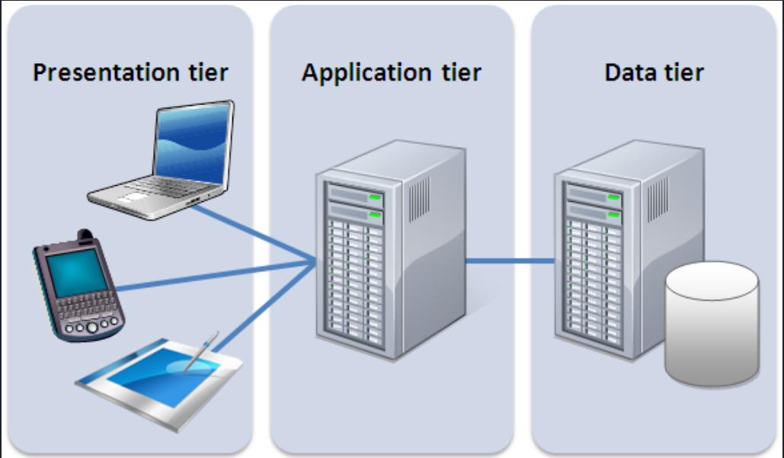
Types of Software Applications
Web Application
What Is a Web Application?
Examples:
facebook.com, Amazon.com
Web Application Architecture
3-Tier Architecture
Presentation Tier
Business Tier
Data Tier

Slide 10
Web Application Testing
Web Application testing Is done in all layers
Front End Testing
Presentation Tier
Back End Testing
Business Tier
Data Tier

Slide 11
Web Application Testing
Presentation Tier Components
Web Pages
Web Forms
Web Elements
Text Fields
Date Fields
Buttons
Radio Buttons
Drop downs
Check Boxes
Links
Images
Middle Tier Components
Servers
Logs
Date Tier Components
Data bases

Slide 12
Web Application Testing
Functional Testing
Non Functional Testing
Functional Testing
Testing the functionalities
Eg : Ecommerce Application
Registration
Login
Search
Cart
Checkout
Payment
Orders
Non Functional Testing
Usability Testing
Compatibility Testing
Performance Testing
Security Testing

Slide 13
Web Application Testing : Functional
Functional Testing : Realtime Examples?
Login Functionality
Cart Functionality

Slide 14
Web Application Testing : Functional
Functional Testing of Web Applications Involves following validations:
Text Field Validations
Date field validations
Select Box Validations
Radio Buttons Validations
Dropdown Validations
Check box Validations
Default values
Buttons validations
Test Outgoing links
Test Internal links
Test Links jumping on the same page
Test for broken links

Slide 15
Web Application Testing :Non Functional
Usability Testing
What is Usability Testing?
Testing to ensure that the website is easy to use
Usability Testing types:
Navigation Testing
Testing to ensure that a user can easily navigate through the website to perform intended action
Keyboard-only accessibility testing
Testing to ensure that an user can perform any action on website without using mouse
Content Testing
Testing to ensure that website visual content is user friendly
Font, Font Size, Font Colour
Image sizes, Image colours

Slide 16
Web Application Testing :Non Functional
Compatibility Testing
What is Compatibility Testing?
Testing to ensure the website works well in all OS, Browser and Device combinations
Compatibility Testing types
Browser Compatibility Testing
OS Compatibility Testing
Mobile Devices Compatibility Testing
Security Testing
Testing Validation Messages
Testing Internal URLs
SQL Injection
Cross Site Scripting

Slide 17
Web Application Testing :Non Functional
Performance Testing
What is Performance testing?
Testing for response times, number of requests being processed stability of application under various loads
Performance testing types:
Load Testing
Test the website by constantly and steadily increasing the load on the system to identify the breaking point
Stress testing
Test the website under extreme loads with reduced server resources to verify the behaviour of the application when it is stressed
Volume testing
Test the website with increasing volumes of data in the database to verify whether website can handle large amount of data

Slide 18
Software Development Life Cycle (SDLC)
What is Software Development Life Cycle (SDLC)?
Describes the life cycle of a software
SDLC Phases:
Requirements
Designing
Coding
Testing
Deployment
Maintenance

Slide 19
SDLC : Requirements Phase
SDLC : Requirements Phase
Who:
Business Analysts, Product Owners
Goal :
Document functional and non functional requirements from the Customer/Client
Process :
Documents, Discussions , Brainstorming sessions etc
Deliverables :
Identified Actors, Use Cases, Screen Prototypes, UX Designs , SRS/BRS

Slide 20
SDLC : Design Phase
Who:
System Architects and Senior Developers
Goal :
Requirements are actually transformed into a working system
Process :
Analysing the requirements, Referencing designs and architectures
Deliverables:
System Design :
Programming languages, Databases, Application Design, Database Design, API Design, Infrastructure Design
HLD :
High level modules and dependencies among them
LLD :
Detailed design of each module

Slide 21
SDLC : Coding Phase
Who:
Developers
Goal:
To develop the software
Process:
Coding
Deliverables:
Developed Product/Software

Slide 22
SDLC : Testing Phase
Who :
Testers
Goal:
To ensure quality of software
Process:
Analyse the requirements , Plan, Develop test cases, scripts. Manual and Automation Testing. Defect Logging, Retesting. Regression Testing
Deliverables:
Defect Free Software

Slide 23
SDLC : Deployment Phase
Who :
Lead Developers ,Devops
Goal:
To make the software available to the users in real time or production
Process:
Provisioning the infrastructure and deploying the software
Deliverables:
Running Software application available to the users

Slide 24
SDLC : Maintenance Phase
Who:
Users, QA, Developers
Goal:
To fix the bugs found in production
Process:
Users notify about the issues. Dev fix them and QA Test them. Updated software is deployed in production
Deliverables:
Software with fixed defects

Slide 25
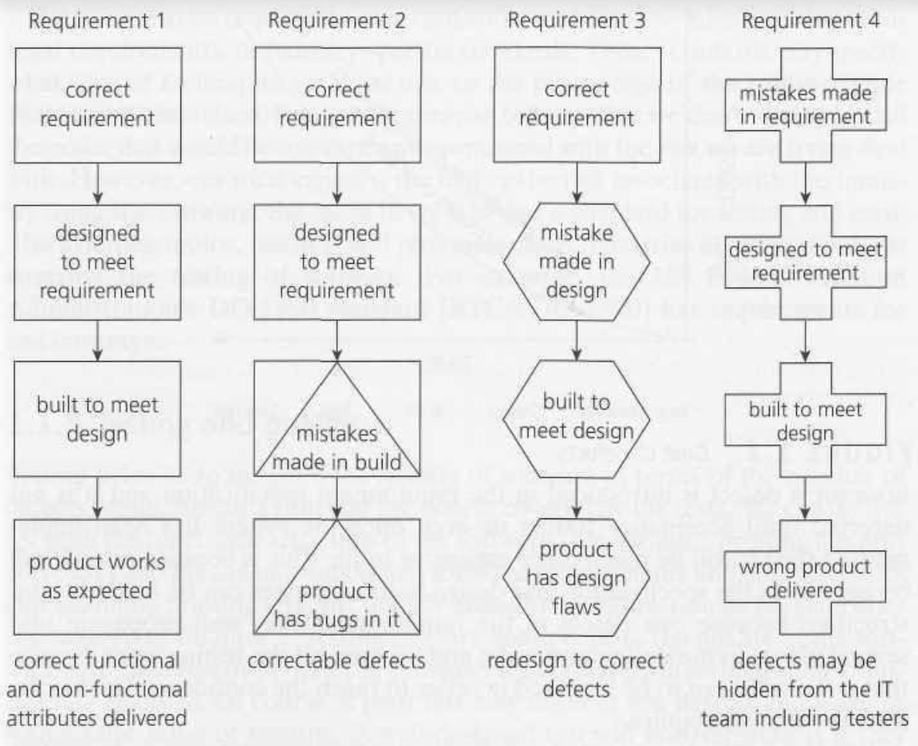
Impact of defects in various phases of SDLC

Slide 26
SDLC Models
Waterfall Model
V Model
Iterative Incremental Model

Slide 27
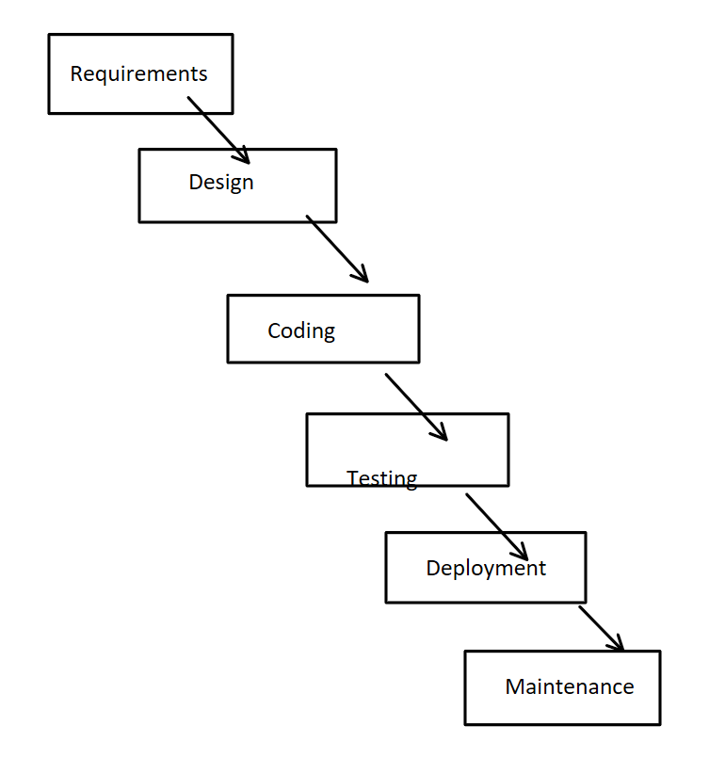
SDLC Models : Waterfall Model
Very first SDLC model
No two phases run in parallel
Advantages
Simple to Implement
Works well with small software where requirements are very clear well in advance
Disadvantages
Testing starts very late
Defects identified in later stages are costly to fix
Working software is only available at the end of SDLC
Not Suitable for big and complex projects where requirements are not clear

Slide 28
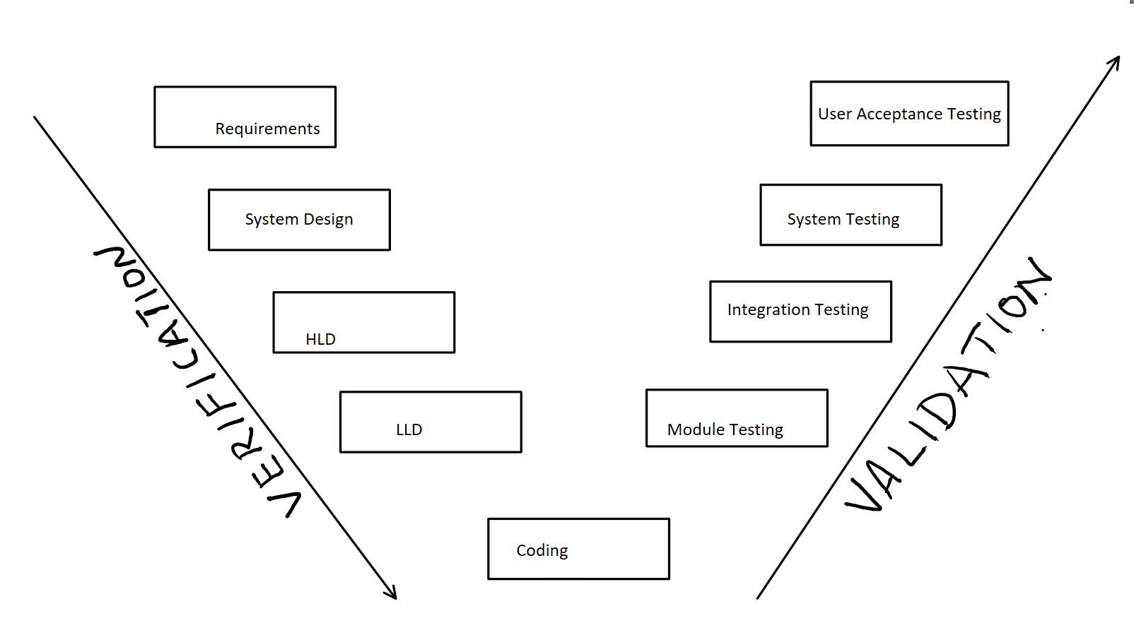
SDLC Models : V Model
Testing runs in parallel with other phases
Advantages
Early Testing
Simple to Implement
Works well with small software where requirements are very clear well in advance
Disadvantages
Working software is only available at the end of SDLC
Not Suitable for big and complex projects where requirements are not clear

Slide 29
SDLC Models : V Model
Verification
Also called as Static Testing
No running software to test
Verification is done using Reviews, Walkthroughs and Inspections
Verification helps prevent the bugs
Example
Validation
Also Called as Dynamic Testing
Testing is done on running software
Validation is done using actual testing
Validation helps to find bugs
Example

Slide 30
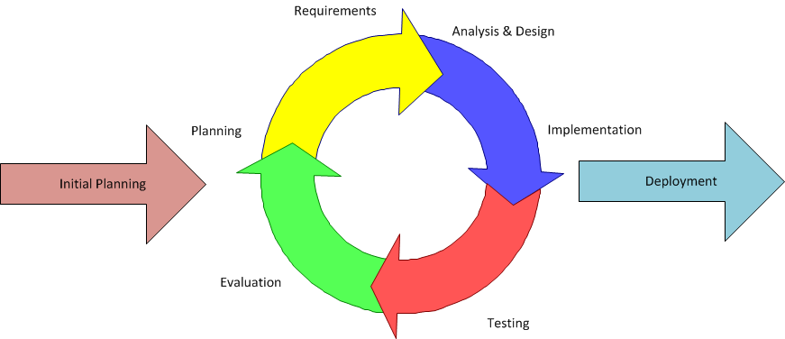
SDLC Models : Iterative Incremental Model
In this model, software development is split across multiple iterations
After each iteration, a subset of working software is developed. In Subsequent iteration, More functionalities are added to it and another partial working software is developed. After multiple iterations , final complete software is developed
Agile Methodology is an example of this model

Slide 31
SDLC Models : Iterative Incremental Model
Advantages:
Used to develop Complex software where requirements are not clear
Early testing
Customer Satisfaction
Flexibility and adaptability
Disadvantages
Training and skills to implement the process

Slide 32
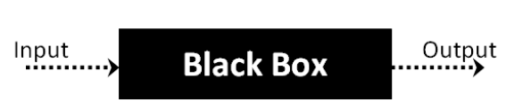
Testing Techniques
Whitebox testing
Also called as glass box testing
Internals of the software or software code is tested
Whitebox testing is done by developers
Blackbox Testing
Software is considered as black box.
Testing the functionality of the software ignoring Internals of the software
Blackbox testing is done by testers
Functional testing falls under block box testing

Slide 33
Blackbox Testing Techniques
Equivalence Class Partitioning
Inputs are divided into partitions and testing with a single value from each partition is sufficient
Boundary Value Analysis
Inputs are tested at boundaries.
Min-1, Min and Min+1
Max-1 and Max and Max+1
Decision Table technique

Slide 34
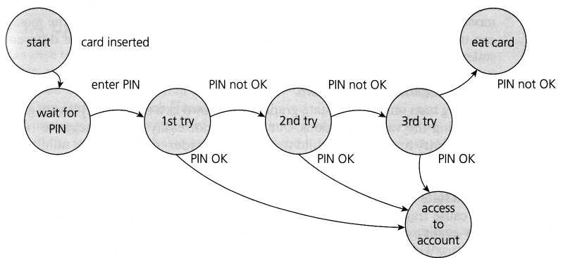
Blackbox Testing Techniques
State Transition Technique:
Sometimes functionality can be represented using state transition diagram. State transition diagram helps to understand and test the functionality thoroughly

Slide 35
Levels of Testing
Unit Testing
Module testing
Integration testing
System testing
User Acceptance Testing

Slide 36
Levels of Testing
Unit Testing:
Code units are tested
White box testing
Testing Performed by Developers
Module Testing
Functionality Individual modules are tested in detail
Blackbox testing
Testing performed by Testers
Integration Testing:
Integration between two modules is tested.
Blackbox testing
Functional Testing
Testing performed by Testers

Slide 37
Levels of Testing
System Testing:
System as a whole is tested.
Blackbox testing
Functional Testing
Testing performed by Testers
Also called as End to End testing

Slide 38
Levels of Testing
User Acceptance Testing
User Acceptance Testing (UAT), also known as End-user testing
Testing the software by the USER or CLIENT to determine whether it can be accepted or not.
Actual software users or Business users test the software to confirm whether the developed software is what the USER asked
Need of User Acceptance Testing
Miscommunicated requirements
Alpha Testing
UST performed by actual user at Development site
Beta Testing

Slide 39
Software Testing Life Cycle(STLC)
What is STLC?
STLC Phases:
Requirement Analysis
Test Planning
Test Cases Design
Test Environment setup
Test Execution
Test Closure

Slide 40
Software Testing Life Cycle(STLC)
Requirement Analysis:
What?
The QA team follows up with various stakeholders like Business Analyst, System Architecture, Client, Test Manager in case any query or clarification is required to understand the requirement.
Output
Scope of Testing
Automation Analysis

Slide 41
Software Testing Life Cycle(STLC)
Test Planning:
Attributes of Test Plan
Features To be tested
Features not to be tested
Test Strategy
Entry Criteria
Exit Criteria
Suspension Criteria
Resumption Criteria
Risks and Mitigations
Resource Allocation
Schedule
Training Needs
Test Environment
Test Deliverables

Slide 42
Software Testing Life Cycle(STLC)
Test Development:
Test Scenarios
Test Cases
Requirement Traceability Matrix(RTM)
Test Data Setup

Slide 43
Software Testing Life Cycle(STLC)
Test Environment setup
Hardware requirements
Software requirements
Tools setup
Need of multiple test environments

Slide 44
Software Testing Life Cycle(STLC)
Test Execution
Executing Test cases
What is Build?
What is Smoke Testing
What is Sanity Testing
What is Progression Testing?
Logging defect?
Retesting?
Regression Testing

Slide 45
Software Testing Life Cycle(STLC)
Test Closure
When can we say that testing is complete?
Test Deliverables

Slide 46
Defect
What is Defect?
Deviation from the actual behaviour
What is Bug?
When Developers accepts the defect, It is called as bug
What is Error?
Mistake done by developer in code because of which defect got introduced
Priority
The urgency with which a defect has to be fixed
Low, Medium, High, Urgent
Severity
Impact of the defect on business
Improvement, Minor, Major, Critical
Bug/defect Template
What is Bug/Defect triage meeting?
Examples

Slide 47
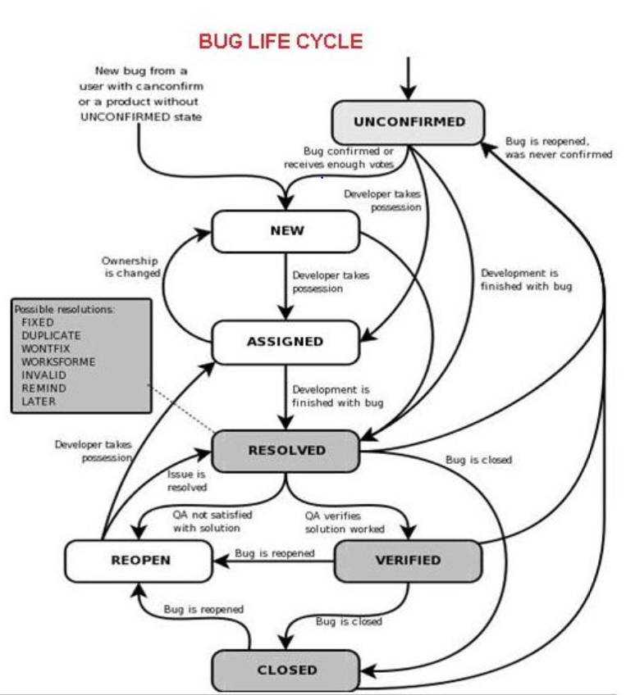
Defect
Defect Life Cycle

Slide 48
Test Scenarios and Test Cases
What is Test Scenario?
What to Test?
What is Test Case?
How to Test?
Test case template
Requirement Traceability matrix

Slide 49
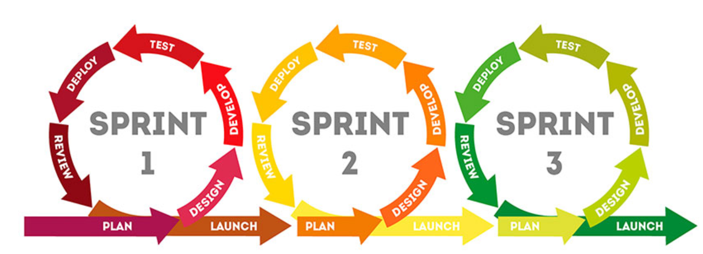
Agile
What is Agile?
Iterative Incremental Methodology
Different Implementations:
Scrum
Kanban
Extreme Programming
Lean Development
Crystal
What is Jira
Jira is ALM Tool
Jira Software is an agile project management tool that supports any agile methodology, be it scrum, Kanban, or your own unique flavour.
From agile boards to reports, you can plan, track, and manage all your agile software development projects from a single tool

Slide 50
Agile: Scrum
What is Scrum?
Scrum is framework which implements Agile methodology
What is Sprint?
Sprint Duration
1, 2 or 4 Weeks
Sprint Start
Wednesday
Sprint End
Zero Sprint

Slide 51
Agile : Three Amigos
Three Amigos
Product Owner
Developer
Tester

Slide 52
Agile : Scrum Master
Who is Scrum Master?
Role of Scrum master

Slide 53
Agile : Epics And User Stories
Epic
What is Epic?
Generally Feature.
Large work items , that can not be completed in a single sprint
Format of Epic
User Story
What is User Story?
Epics are divided into User stories
Small enough to be delivered in a single sprint
Have Business Importance
Format of User Story
As a <xyz user>, when I <do some action>, so that I should <achieve something>
As a customer , I should be able to login to my account, so that I can access my account
As a customer, I should be able to search for a product, so that I get list of relevant products
Examples of EPIC and User Story

Slide 54
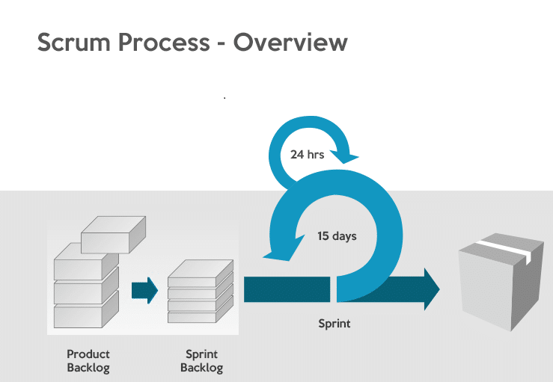
Agile : Product Backlog and Sprint Backlog
Product Backlog
Sprint Backlog

Slide 55
Agile : Backlog Refinement / Grooming
Backlog Refinement / Grooming
What is Backlog grooming
Define acceptance criteria
What is Acceptance Criteria?
Estimate the story
What are Story Points?
Planning poker technique
Create Sub tasks
Dev ,QA, Automation , Devops tasks
Goal of Backlog grooming
Good amount of user stories should be READY
When?
Participants

Slide 56
Agile : DOR and DOD
DOR => Definition of Ready
When an User Story is READY?
Acceptance Criteria is defined
Sub Tasks are created
Story points are provided
DOD=> Definition of Done
When is User Story DONE?
Coding is completed, Code comments, Code Review, Unit testing
Test cases are ready, Functional testing is completed
Non functional testing is completed
Documentation is completed
There is nothing left which stops from shipping product to client

Slide 57
Agile : Sprint Ceremonies/Meetings
Sprint Planning
Sprint Review
Sprint Retrospective
Daily Stand-up

Slide 58
Agile : Sprint Ceremonies
Sprint Planning meeting
What is Sprint Planning meeting
Creating Sprint Backlog
Adding User stories to sprint
Sprint Backlog
What is Sprint Backlog?
Who Creates Sprint Backlog?
What is Sprint Velocity?
Velocity is a measure of the amount of work a Team can tackle during a single Sprint
Sprint Goal
Participants
Duration
When during the sprint?

Slide 59
Agile : Sprint Ceremonies
Sprint Review meeting
What is Sprint Review meeting
When During the Sprint?
Participants
Duration

Slide 60
Agile : Sprint Ceremonies
Sprint Retrospective Meeting
What is Sprint Retrospective meeting
When During the Sprint?
Participants
Duration

Slide 61
Agile : Sprint Ceremonies
Sprint Daily Stand up Meeting
What is Daily Stand up Meeting
What was done yesterday
What is going to be done today
Blockers if any
When During the Sprint?
Participants
Duration

Slide 62
Agile : Charts
Burnup Chart
Burndown Chart

