Slide 1
Maven

Slide 2
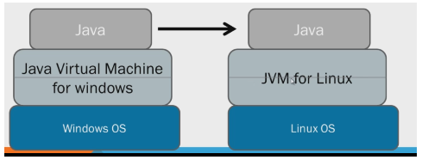
Java : Architecture
Source Code and (Binary code/bite code/executable code)
Compiler
JDK and JRE
JDK => Java Development Kit
JRE => Java Runtime Environment
JDK = Libraries needed for Development + JRE+ compiler

Slide 3
Java : Architecture
Source Code
Human readable code
Computers don’t understand source code
.java extension
Binary Code
Computer understandable code
Not Human readable
.class extension
Binary code gets generated after source code is compiled
JAR
Java Archive
All Java binary files are bundled into a single Jar file
The contents of a JAR file are extracted using any standard decompression software
We need a software management tool to build jar from source code
Maven, Ant, Gradle, SBT

Slide 4
Maven : Introduction
What is Maven?
Maven is a software management tool
Dependency Management
Build automation (Generating JAR)
Maven works on POM
Project Object Model
POM is the fundamental unit of work in Maven.
It is an XML file that contains information about the project and configuration details used by Maven to build the project.
What is a build tool?
Compile source code
Compile and run tests
Copy Resources
Package project
Deploy project
Maven Objectives:
Making build process easy

Slide 5
Maven : SetUp
Installing Maven:
Prerequisites:
JDK is installed
JAVA_HOME is set
Installing Maven in System:
Download Maven
https://maven.apache.org/download.cgi
Extract it
Set MVN_HOME environment variable
Set path variable
Used to run maven commands from command line
Installing Maven in eclipse
Already bundled with eclipse
Used to run maven commands from Eclipse

Slide 6
Maven : Creating First Maven Project
Creating First Maven project in Eclipse:
What is Archetype?
What is groupId?
What is artifactId?
What is Version?

Slide 7
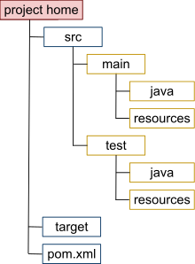
Maven : Folder Structure
Main code : src/main/java
Main resources : src/main/resources
Test code : src/test/java
Test Resources : src/test/resources
target directory : Contains all output of the build.
Pom.xml : Should be present in project’s in root folder

Slide 8
Maven : Lifecycle
Maven Life Cycles:
Build Life cycle:
Clean Life cycle
Maven Build Life cycle:
Build cycle consists of multiple phases which execute in a particular sequence:
Phases in build lifecycle are:
compile
test-compile
test
package
install
deploy
Build phases get executed in above order
When we run any particular phase ,then all the phases which come early in the order are first executed and then the selected phase gets executed.

Slide 9
Maven : Build Lifecycle
Maven build lifecycle
By default, maven check where all dependencies are present in local maven repository. If they are there, it just proceeds with phases in build cycle. If any dependency is missing, maven downloads it from central repository and adds them to local maven repository and proceeds with build life cycle phases
Mvn compile
Compile main code present in src/main/java
Generates target/classes
Mvn test-compile
Compile unit test code present in src/test/java
Generates target/test-classes
Mvn test
To run compile tests
All the methods with @Test annotation are executed in this phase
Generates surefire-reports folder
Mvn package
To generate jar or war
Mvn install
To copy jar/war into local maven repository
Mvn deploy
To deploy the jar

Slide 10
Maven : POM
A Project Object Model or POM is the fundamental unit of work in Maven
POM.XML
Minimal POM
Effective POM
Dependency management:
Project dependencies
Local repository
Transitive dependencies
Dependant jars of dependent jars are called as transitive dependencies.
Dependency hierarchy is found in pom.xml
Excluding transitive dependencies
To exclude one or more transitive dependencies.
Maven plugins and goals:
Plugin :Plugin is artifact which executes goals
Goal : Goal is a task in a phase
Plugin can execute goals from multiple phases

