Slide 1
Maven

Slide 2
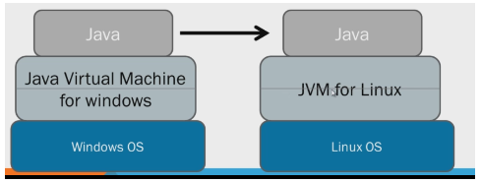
Java : Architecture
Source Code and (Binary code/bite code/executable code)
Compiler
JDK and JRE
JDK => Java Development Kit
JRE => Java Runtime Environment
JDK = Libraries needed for Development + JRE+ compiler

Slide 3
Java : Architecture
Source Code
Human readable code
Computers don’t understand source code
.java extension
Binary Code
Computer understandable code
Not Human readable
.class extension
Binary code gets generated after source code is compiled
JAR
Java Archive
All Java binary files are bundled into a single Jar file
The contents of a JAR file are extracted using any standard decompression software
We need a software management tool to build jar from source code
Maven, Ant, Gradle, SBT

Slide 4
Maven : Introduction
What is Maven?
Maven is a software management tool
Dependency Management
Build automation (Generating JAR)
Maven works on POM
Project Object Model
POM is the fundamental unit of work in Maven.
It is an XML file that contains information about the project and configuration details used by Maven to build the project.
What is a build tool?
Compile source code
Compile and run tests
Copy Resources
Package project
Deploy project
Maven Objectives:
Making build process easy

Slide 5
Maven : SetUp
Installing Maven:
Prerequisites:
JDK is installed
JAVA_HOME is set
Installing Maven in System:
Download Maven
https://maven.apache.org/download.cgi
Extract it
Set MVN_HOME environment variable
Set path variable
mvn -version
Used to run maven commands from command line
Installing Maven in eclipse
Already bundled with eclipse
Used to run maven commands from Eclipse

Slide 6
Maven : Creating First Maven Project
Creating First Maven project in Eclipse:
What is Archetype?
What is groupId?
Domain name=> com.google, com.learning
What is artifactId?
Project name
What is Version?
-SNAPSHOT => Its being developed

Slide 7
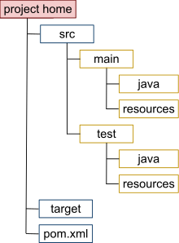
Maven : Folder Structure
Main code : src/main/java
Main resources : src/main/resources
Test code : src/test/java
Test Resources : src/test/resources
target directory : Contains all output of the build process.
Pom.xml : Should be present in project’s in root folder

Slide 8
Maven : Lifecycle
Maven Life Cycles:
Build Life cycle:
Clean Life cycle
Maven Build Life cycle:
Build cycle consists of multiple phases which execute in a particular sequence:
Phases in build lifecycle are:
compile
test-compile
test
package
install
deploy
Build phases get executed in above order
When we run any particular phase ,then all the phases which come early in the order are first executed and then the selected phase gets executed.

Slide 9
Maven : Build Lifecycle
Maven build lifecycle
By default, maven check where all dependencies are present in local maven repository. If they are there, it just proceeds with phases in build cycle. If any dependency is missing, maven downloads it from central repository and adds them to local maven repository and proceeds with build life cycle phases
Mvn compile
Compile main code present in src/main/java
Generates target/classes
Mvn test-compile
Compile unit test code present in src/test/java
Generates target/test-classes
Mvn test
To run compile tests
All the methods with @Test annotation are executed in this phase
Generates surefire-reports folder
Mvn package
To generate jar or war
Mvn install
To copy jar/war into local maven repository
Mvn deploy
To deploy the jar

Slide 10
Maven : POM
A Project Object Model or POM is the fundamental unit of work in Maven
POM.XML
Minimal POM
Effective POM
Dependency management:
Project dependencies
Local repository
C:\Users\Home\.m2\repository
Transitive dependencies
Dependant jars of dependent jars are called as transitive dependencies.
Dependency hierarchy is found in pom.xml
Excluding transitive dependencies
To exclude one or more transitive dependencies.
Scope of a dependency
If scope is compile=> Can be used in both src/main/java and src/test/java package classes
If scope is test=> Can be used only in src/test/java package classes
Default scope is ‘compile’

Slide 11
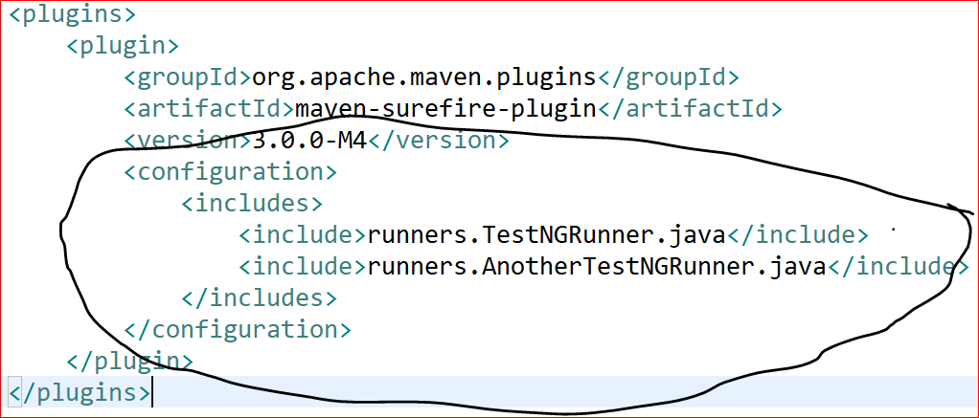
Maven : POM
How tests are being run In our framework?
We want our tests to be executed in ‘test’ phase of maven build life cycle
mvn clean test
How do we tell Maven which tests are to be run in test phase of build life cycle?
Test phase of maven is executed by a plugin called maven sure file plugin
In our pom.xml, we configures surefire plugin and we include all those runner classes which are to be run
When we execute mvn clean test, all these runner classes are picked and tests are executed

Slide 12
Git-GitHub

Slide 13
Git and GitHub
Git is a distributed version-control system for tracking changes in source code during software development.
Cloud Storage
Copy of source code is stored safely on cloud hosting service which can be accessed over the internet by any developer
Version Control:
Git takes snapshots of a project, and stores those snapshots as unique versions.
If you go off in a direction with your project that you decide was the wrong direction, you can just roll back to the last good version
Collaboration:
It is designed for coordinating work among programmers by providing means to make changes to code, sharing the changes across team members, merging the code written by multiple developers ,handling conflicts etc

Slide 14
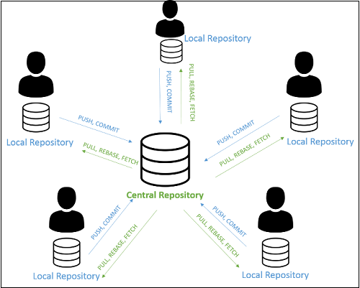
Git and GitHub
Git:
Is a version control system that lets you manage and keep track of your source code history
Git is a tool that is installed locally on a computer
There are a set of commands provided by Git for version control
GitHub:
Is a cloud based hosting service that lets you host and manage repositories over internet
GitHub is not a tool. It’s a Website where we need to create account for us
GitHub website gives GUI to view hosted code
GitHub doesn’t have any commands
There are many other Cloud based hosting services like GitHub:
GitLab
BitBucket

Slide 15
GIT and GitHub : Setup
Git Setup
Download and install
https://github.com/git-for-windows/git/releases/download/v2.27.0.windows.1/Git-2.27.0-64-bit.exe
git --version
GitHub Setup
Create account on GitHub

Slide 16
Git Repositories
Repository
Directory where your project lives
Types of Repositories
Local
Remote
What is .git folder?
Presents in git repository
Complete meta data about git repository

Slide 17
Git Commands
Git Commands
Creating Repositories
Linking Repositories
Snapshotting
Syncing Repositories
Branching

Slide 18















Git Commands : Creating repositories
Case 1: Remote repository is already there on GitHub
Creating Remote Repository:
No need to create a remote repository as its already there
Creating a local repository
Using git clone
The "clone" command downloads an existing remote Git repository to your local computer
Case 2: When a locally developed project has to be pushed for the first time
Creating a local repository
Create a Java Project and write your code
Execute git init command inside Maven project
Init command Initializes your Java project as local git repository
Creating remote Repository:
Create a repository on GitHub website whose name is same as your local repository/project

Slide 19
Git Commands : Linking remote and local repositories
Case 1: Remote repository is already there on GitHub
We clone remote repository to get a copy of already existing remote GitHub repository
If you clone a remote repository, Then they both are linked automatically
Case 2: When a locally developed project has to be pushed for the first time
They have to be linked by executing this command
git remote add origin <gitrepourl>
Here origin is the alias or short name of the remote repo URL
Where do we get gitrepourl?

Slide 20
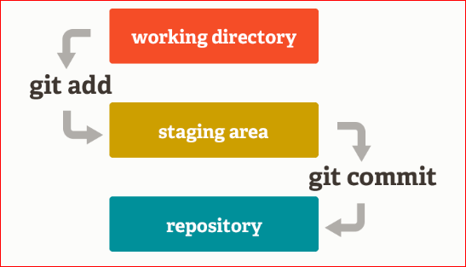



































Git Commands : Snapshot commands
Git Architecture
Working Directory
Staging Area:
This is an intermediate area where commits can be formatted and reviewed before completing the commit.
Local Repository

Slide 21









Git Commands : Snapshot commands
Listing modified files in your Local Repository
git status
Adding changes to staging area (Staging Changes)
git add .
git add file1 file2 file3
Resetting changes from staging area (Un-staging Changes)
git reset
Committing changes to local repository
git commit -m "commit message"

Slide 22
Git Commands : Syncing commands
To push local repository code to Remote repository
git push origin <branchname>
Pushes the committed code from local repository to remote repository
To pull remote repository code to local repository
git pull origin <branchname>
Pulls the latest code from remote repository and merges with local committed code

Slide 23
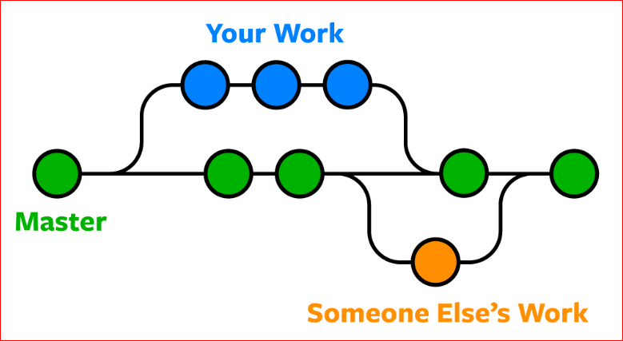
Git Commands : Branching Commands
Why do we need branching?
When you want to add a new feature or fix a bug—no matter how big or how small—you spawn a new branch to encapsulate your changes.
All your development code goes into branch . Once development of new feature is complete, and it is tested thoroughly, then the changes are merged to master branch
master branch also called default branch

Slide 24
Git Commands : Branching Commands
To list local branches
git branch
To list local and remote branches
git branch -a
To create a new branch
git branch branchname
To switch to newly created branch
git checkout branchname
To create a branch and switch to it
git checkout –b branchname
To push local branch code to remote branch code
Switch to your branch first
git push origin branchname
Merging Branches
First switch to the branch to which you want o merge into(master )
git merge branchname
Deleting a branch
git branch -D branchname

Slide 25
Git Commands : Branching Commands
Git ignore:
In git repository/project , a .gitignore file should be created under root directory
Add all those file paths that you don’t want to be tracked by git
When we run any git commands, git simply ignores all those files present in .gitignore file
But .gitignore file itself will get pushed to remote repository

Slide 26
Jenkins

Slide 27
Jenkins
Continuous Integration:
Automated way to build, package, and test applications
Continuous Delivery/Deployment:
Continuous delivery picks up where continuous integration ends.
CD automates the delivery of applications to selected infrastructure environments

Slide 28
Jenkins
Jenkins Installation
Download the war file from this link:
http://mirrors.jenkins.io/war-stable/latest/jenkins.war
Run the war file
java –jar Jenkins.war
Do initial setup
http://localhost:8080/

Slide 29
Jenkins
Create Jenkins Job

