Slide 1
Cucumber

Slide 2
Cucumber
Testing Frameworks:
TDD => Test Driven Development
BDD => Behavioural Driven Development
What is TDD?
What is BDD?
Tools for Implementing BDD:
Cucumber
SpecFlow
JBehave

Slide 3
Testing Frameworks
How Cucumber works?
Step 1 : Prepare Feature files
Document Tests in feature file using Gherkin language (A plain English language)
Each Test contains multiple test steps
Step 2 : Develop Step Definitions
Corresponding to each test step in feature files, create a method (In Java)
Write appropriate code in each method
Step 3: Execute Feature Files:
When a feature file is executed, All the java methods are executed in the same order as Test steps

Slide 4
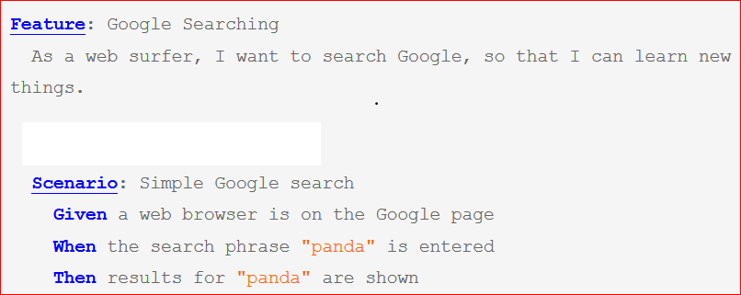
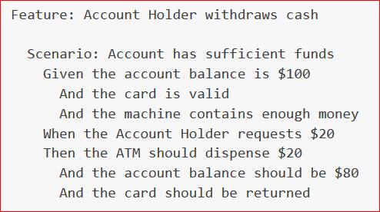
Cucumber
Feature Example:

Slide 5
Cucumber
What is Gherkin?
Gherkin is a set of grammar rules used to write features/Requirements
It is simply a set of keywords where each keyword has a specific purpose
Gherkin Keywords:
Feature
Scenario
Given
When
Then
And
But
Scenario Outline
Examples
Background

Slide 6
Cucumber
What is Feature file?
It’s a file where requirements are documented
It is a plain text file with .feature extension
Gherkin syntax is used to write feature file
Each feature file contains a group of scenarios
Each scenario in feature file is an acceptance test
Every step in Feature file is mapped to a step definition method in step definition file .
Feature File is an entry point to the Cucumber tests
Feature => Represents a requirement
Scenario 1 => Represent test case to be executed to test the requirement
Scenario 2
Scenario 3
Scenario n
Example feature file

Slide 7
Cucumber Set Up
Install Java JDK
Setup JAVA_HOME and PATH variables
Install IDE : Eclipse
Install Cucumber plugin in Eclipse
Help=> Eclipse Market place => Search for Cucumber => Install => Restart
Create a maven project in eclipse => Follow this video

Slide 8
Cucumber Set Up
Inside your project (ankitha-cucumber-learning)
Create a features folder under /src/test/resources
Inside features folder, create a new file with .feature extension
Write scenarios inside feature file
Right click on feature file => Run as Cucumber Feature
In console, you will find empty step definitions for all the missing steps
Create stepDefinitions package unuder /src/test/java/
Create a class inside stepDefinitions package => name it Steps.java
Copy empty step definitions from above and paste them in side the Steps.java class
Write your own code inside each step definition method
Right click on feature file => Run as Cucumber Feature

Slide 9
Cucumber : Gherkin Keywords
Feature:
High level Requirement
Eg : Search functionality in ecommerce website
Is a combination of Scenarios
Scenario
Is a Test case
Contains detailed test steps
Given
Pre conditions in a test case
When
Test steps in a test case
Then
Validation or comparison of Expected Vs Actual
And
To add multiple steps under any of Given/When/Then

Slide 10
Cucumber : Gherkin Keywords
But:
If you want add any step under Given/When/Then which you want to make sure to not to happen ,then that step can be added by giving a But
Background:
If there are same steps for all the scenarios present in feature file
All these steps should be the beginning steps in each scenario
When we run feature file, before each scenario the steps present in background are executed first
Scenario Outline
Examples

Slide 11
Cucumber : Parameterisation
What is Parameterisation?
A way of passing values from Feature file to Step definition
Following are different Parameterisation techniques
Technique 1 : Passing values directly within Scenario steps
Technique 2 : Parametrisation using Scenario Outline – Examples keywords
Technique 3 : Parameterisation using Data Table

Slide 12
Cucumber : Parameterisation
Technique 1 :
Passing values directly within Scenario steps
Passing String Values
Passing Numerical values

Slide 13
Cucumber : Parameterisation
Technique 2 :
Parametrisation using Scenario Outline – Examples
If we want to run the whole test scenario with different sets of data multiple times, we use this approach
The following two Gherkin keywords are used to implement this technique:
Scenario Outline
Examples
Scenario Outline : This represents a scenario which has to be run multiple times
Examples – All scenario outlines have to be followed with the Examples section. This contains multiple sets of data that has to be passed on to the scenario.
The first row under Examples section is a header row. Names of headers should match names of the parameters used in steps
All the parameters should be enclosed inside <>
String parameters should be passed inside double quotes
Numerical parameters should not be passed inside double quotes

Slide 14
Cucumber : Parameterisation
Technique 3 :
Parameterisation using Data Table
In this technique we don’t use any Gherkin keywords
We pass data using a table under a single step
All the data from the table will be passed to that step as DataTable object.
We need to explicitly write code to iterate through each row present in data table and read the values
The data present in Data Table is read in different ways:
List<List<String>> uses dataTable.asLists() method
List<Map<String,String>> => dataTable.asMaps() method
Header column names are keys in each map

Slide 15
Cucumber : Parameterisation
Difference between Technique 2 and Technique 3
IN Scenario outline, Whole scenario gets executed multiple times where as in DataTable, only particular step gets executed multiple times
In Data table, we need additional code to iterate through data present in Data table where as in Scenario Outline we don’t need to write any additional code and Cucumber takes care of running scenario multiple times

Slide 16
Cucumber : Hooks
Cucumber supports two hooks:
@Before
@After
Hooks are blocks of code that run either before or after each scenario.
You can define them
In Step Definition classes
In a separate class

Slide 17
Cucumber : Tags
What are tags in Cucumber?
We use @ followed by tag name to tag a scenario/Feature
Example tags
@SmokeTest
@RegressionTest
@SystemTest
@Search
@Cart
@SmokeTest @SystemTest
@Search @SystemTest
Tag names are not built in Cucumber keywords. You can use logical names based on your need
A feature/scenario can be tagged with multiple tags
If we tag a feature, then all the scenarios present in that feature file inherit that tag
Use of tags:
Tags are a way of grouping scenarios
When we execute scenarios, we can choose which tests to execute using tag names.
For Ex:
Only scenarios tagged as @SmokeTest
Scenarios tagged as both @IntegrationTest and @SystemTest

Slide 18
Cucumber : Tagged Hooks
Step 1: Create hooks
Step 2: Tag your features/scenarios
Step 3: Now tag your hooks
@Before("@acc")
@Before("@ecom")
@After("@ecom")
@After("@acc")
When you tag a hook, its gets hooked with scenarios tagged with given tag

Slide 19
Cucumber : Runner Class
Cucumber makes use of TestNG or Junit for running Cucumber tests
Along with cucumber jar, We need:
Cucumber-testng jar (If we want to go with testng)
Cucumber-junit jar (if we want to got with jnuit)

Slide 20
Cucumber : Runner Class
What is the Cucumber Test Runner class?
A mechanism/class used to run Cucumber tests
It’s a class using which we can configure Cucumber test runs
@CucumberOptions
Features
Folder location where feature files are present
Glue
Package locations where Step definitions and hooks are picked
Plugin
Html:<location> => Generates html report
Json:<location> => Geneartes .json file which contains test execution details
Pretty
Tags
Provide tag names => Only scenarios with these tags are executed
@SmokeTest
@SystemTest
@SmokeTest and @SystemTest
@SmokeTest or @SystemTest
@SmokeTest and not @SystemTest
Monochrome = true
Humn readable console output

