Slide 1
Java

Slide 2
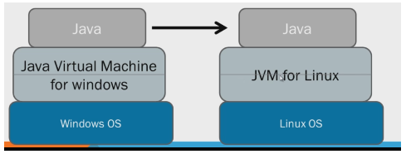
Java : Architecture
Source Code and (Binary code/bite code/executable code)
Compiler
JDK and JRE
JDK => Java Development Kit
JRE => Java Runtime Environment
JDK = Libraries needed for Development + JRE+ compiler

Slide 3
Java : Setup
Download Java
JDK and Not JRE
https://www.oracle.com/java/technologies/javase-jdk13-downloads.html
64bit/32bit
Set environment Variables
What is CMD?
JAVA_HOME variable(C:\Program Files\Java\jdk1.8.0_91)
Place where Java is installed
PATH variable(C:\Program Files\Java\jdk1.8.0_91\bin)
When location of all Java executable files, is added to path variable, Then we can run any executable file from anywhere (Not just from the location where executable file is present)
SET command => To view all the environment variables
IDE : Integrated Development Environment
Eclipse , Intellij, NetBeans
Download Eclipse for developers(MARS)
https://www.eclipse.org/downloads/download.php?file=/oomph/epp/2019-12/R/eclipse-inst-win64.exe

Slide 4
Java : Setup
First Java Project in eclipse
Create First Project
Create Package inside src folder
Create Class inside the package
Main method should be there in the class
Comments:
Comment:
Single line comment => //
Multiple line comments => Select multiple lines which you want comment => CONTROL+SHIFT+/
Uncomment:
=> Select multiple lines which you want comment => CONTROL+SHIFT+\
Auto Completion:
CONTROL+Space
Example :
Type main and CONTROL+Space
Type syso=> CONTROL+Space
Printing values to console:
System.out.println() => After printing value, Cursor goes to new line
System.out.print() => After printing value, Cursor will be on the same line

Slide 5
Java : Naming Conventions
Strictly no entity should have a space in its name
Except Class name, every thing else should start with small letter
Project name:
All small characters
package name
All small characters
Class name
Should always start with Capital letter
If there is a new word in the name, new word name should always start with capital letter
Variable name:
Should always start with small letter
If there is a new word in the name, new word name should always start with capital letter
Method names:
Should always start with small letter
If there is a new word in the name, new word name should always start with capital letter

Slide 6
Java : Variables
What is a variable?
A variable is a container that holds values that are used in a Java program
Type of variable
Data type of variables(Primitive data types)
Variable declaration
Variable initialization

Slide 7
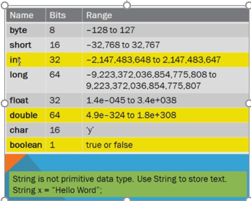
Java : Primitive data types
Primitive data types

Slide 8
Java : Operators
Java Operators:
Operators act on Variables. Generally for calculations and for applying logic
Operators are classified as :
Arithmetic
Relational
Logical

Slide 9
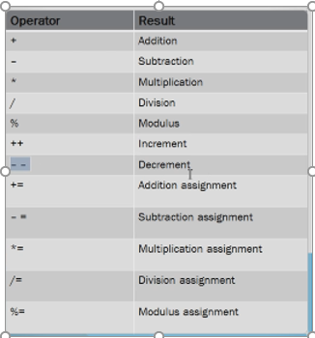
Java : Operators : Arithmetic
Arithmetic

Slide 10
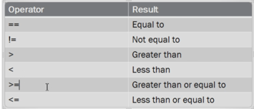
Java : Operators : Relational
Relational

Slide 11
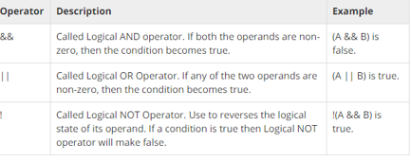
Java : Operators : Logical
Logical

Slide 12
Java : Operators- Examples
Incremental operator example
Decrement operator example
Even odd numbers example

Slide 13
Java : Conditional statements
If
If –else
If- else –if
Switch case
Examples:
Greater of given 2 numbers
Greater of given 3 numbers

Slide 14
Java : Loops
Loops
For loop
Nested for loop
While loop
Do While loop
Difference between while and do-while loops
Advanced for loop(For each loop)
Break statement
Continue statement
Loops examples
Listing Even and odd numbers
Factorial
Fibonacci series

Slide 15
Java : Arrays
Arrays:
What is an Array?
A group of values with similar data types and fixed size
How to declare array
How to Initialize array
Hard way
Using array constants
One dimensional array
Reading values from array using for loop
Reading values from array using for each loop
Two-dimensional array
Array examples:
Summing elements in array
Finding largest element from array
Reversing array

Slide 16
Java : Strings
What is a String?
String is a sequence of characters (Alphabets, Numbers, Special chars, Upper case , Lower case)
String Methods:
length()
Concatenation
Using concat()
Using +
String comparison
equals()
equalsIgnoreCase()
substring()
Splitting string using split()
trim()
toLowerCase() and toUpperCase()
String conversion using toString()

Slide 17
Java : Strings
String Examples
Convert String to Character Array
Reversing String
Palindrome

Slide 18
Java : Class and Object
What is a class?
Template or blueprint which provides specifications of its objects
What is an Object?
Instance of a class
To Instantiate means to create new object of class
Members of class:
State / Member Variables / Instance Variables
Behavior / Member Methods / Instance Methods
Constructors
Creating object of the class
Declaration
Giving a name and type to Object
Instantiation
Creating object using new keyword
Initialization
Giving initial values to Variables

Slide 19
Java : State (or) Member Variables (or) Instance variables
What are member variables
Declaring member variables
Initializing member variables
Direct initialization without using constructor
Disadvantage is every object will have same state
Using constructors
Hard coding the initialization
Disadvantage is every object will have same state
Parameterizing Initialization using parameterized constructors
Every object will have its own state
Accessing member variables
Are accessed via object of this class
Direct access => (Obj.VariableName)
Using getters and setters

Slide 20
Java : Behavior (or) Member Methods (or) Instance Methods
What are Methods?
Method syntax
Name of the method
Return type of Methods
Parameters of Methods
Method body
Accessing methods of a class

Slide 21
Java : Constructor
What is Constructor?
Constructor syntax
Name
No return type
parameters
Constructor without parameters
Constructor with parameters
Constructor overloading
Default constructor

Slide 22
Java : Variable types
Instance Variables
Local Variables
Static Variables

Slide 23
Java : Static Keyword
Static keyword can be used for:
Variables
Methods
Block of code
Static Variables:
Also called class variables
Once copy per class irrespective of number of objects created
Created when program starts and before first object of class is created
Destroyed when program ends
Can be accessed using class name as well as object
Static Methods
Also called as class level methods
Method which is declared with static keyword
Static method can access only static variables

Slide 24
Java : Main method
What is main method?
Why the name main?
Can we change the name of main method?
Why main method is public?
Why is main method static?
Why is main method return type void?
What are (String[] args)

Slide 25
Java : Exception Handling
What is exception?
What is the main purpose of exception handling?
Few examples of Exceptions
try - catch
try - catch - finally
multiple catch blocks
Handling exception in the method where exception occurred
Handling exception in calling program
throws
Exception object:
Name of exception
Description of exception
Location where exception occurred

Slide 26
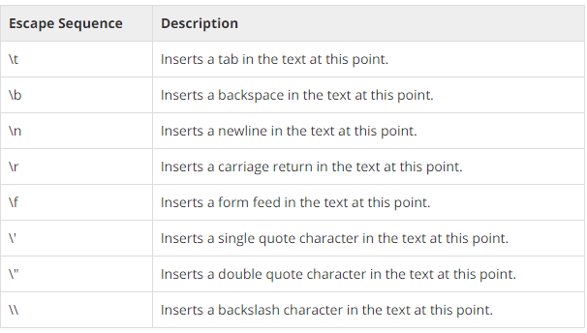
Java : Escape Sequences
What are Escape Sequences?

Slide 27
Java : OOPS
What is OOPS?
Objected Oriented programming language.
coding is done based on how an object behaves in real world.
OOPS features:
Class
Object
Inheritance
Encapsulation(Data hiding)
Abstraction
Polymorphism

Slide 28
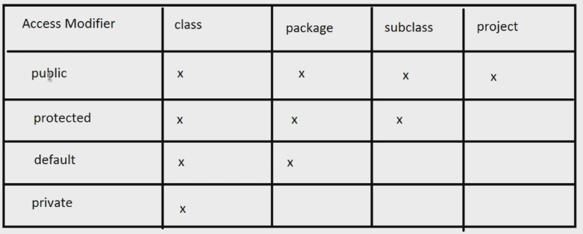
Java : OOPS
Inheritance
Inheriting or acquiring properties of a class by another class
Code reusability is the main purpose of inheritance
Encapsulation (Data hiding)
Binding data (variables) and behavior (methods) together into a single unit(class) is known as encapsulation.
Hiding members of class or making them not accessible from outside the class
Technically Its about protecting data from unwanted or accidental manipulation.
Data hiding is controlled in Java using access modifiers.
Access Modifiers:
public
protected
private
Default

Slide 29
Java : OOPS
Polymorphism
Method overloading
Method with same name, in same class with different parameters
Method Overriding
Method with same name, in sub class with same parameters
Abstraction
Abstraction means existing in thought or as an idea but not having a physical or concrete existence
Hiding internal implementation and highlighting the functionality/services being offered is called Abstraction.
In java, abstraction is achieved using:
Abstract class(Partial abstraction)
Interface(Full abstraction)

Slide 30
Java : OOPS
Abstract class
What is Abstract class?
A class with at least one abstract method.
What is Abstract method?
A method which is only declared and not implemented
What is concrete method?
A method which has implementation too
What is concrete class?
A derived class that implements all the missing functionality of abstract class is called a concrete class.
We can not create object of abstract class
Real world example of abstract class

Slide 31
Java : OOPS
Interface
What is Interface?
A class with all abstract methods and no concrete methods
An interface is implicitly abstract.
All the methods in interface are implicitly abstract.
We can not create object for Interface
implements keyword
An interface is not extended by a class. it is implemented by a class
When a class implements an interface, you can think of the class as signing a contract, agreeing to perform the specific behaviors of the interface.
Real world example of Interface

Slide 32
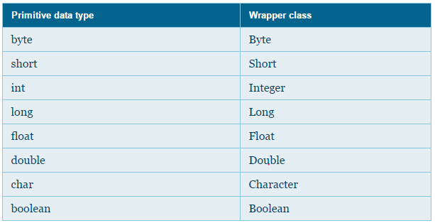
Java : Wrapper Classes
What are Wrapper classes?
Wraps (encloses) around primitive data type and gives it an object appearance.
Wrapper classes define several utility methods which act on primitive data.

Slide 33
Java : Wrapper Classes
Wrapping
Creating objects of the primitive data types
Unwrapping
Retrieving the value wrapped by a wrapper class object
Constructors of Wrapper classes
Major utility methods
valueOf()
To create wrapper object for a primitive(Equivalent to constructor)
xxxValue()
To unwrap primitive value from wrapper object
parsexxx()
To convert String to primitive
toString()
To convert object to string

Slide 34
Java : Collections
Limitation of Arrays
Arrays are of fixed length. We cannot add additional entries in it.
Readymade methods for actions like sort and search are not available. We need to write code explicitly
Arrays can hold only homogeneous data
What are collections?
Collections are Grow able in nature.
Readymade methods for operations like search and sort are available
Collections can hold both homogeneous and heterogeneous data.
Collections framework has 9 interfaces. These 9 interfaces can be grouped into 2 groups.
To one group of interfaces ‘Collection’ interface is root interface
To other group of interfaces ‘Map’ interface is the root interface.

Slide 35
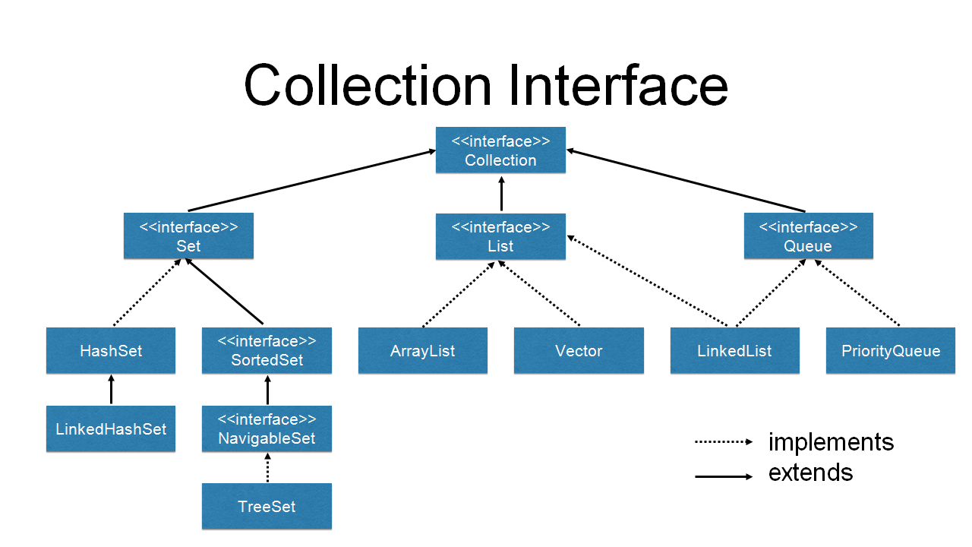
Java : Collections
Collection interface

Slide 36
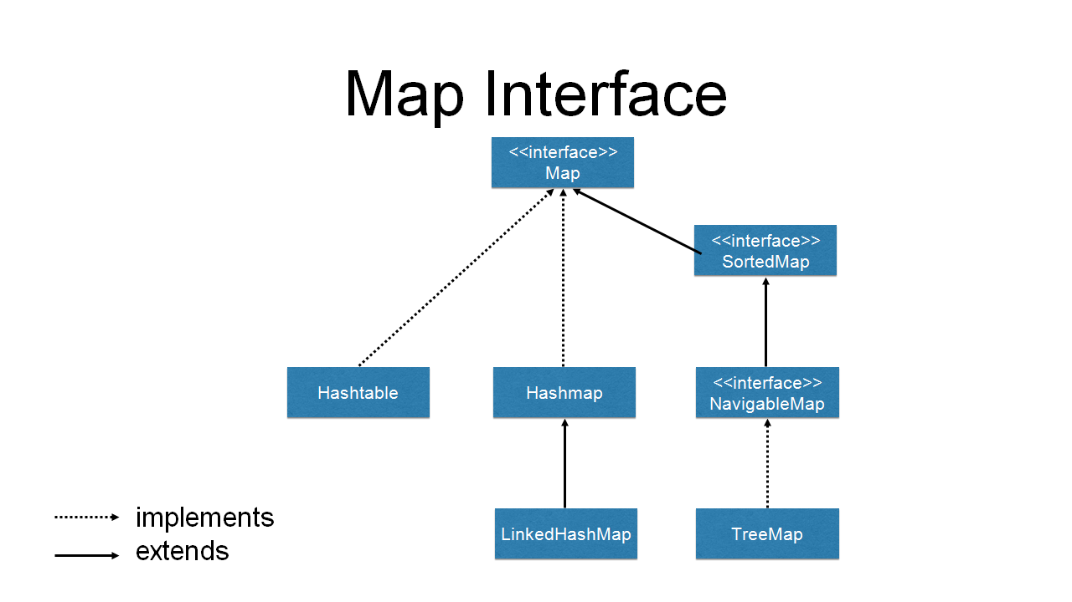
Java : Collections
Map Interface

Slide 37
Java : Collections
ArrayList
implements List interface
Various ArrayList Methods
add(value)
size()
isEmpty()
contains()
Collections.sort()
HashSet
implements Set interface
Very similar to ArrayList
Difference between List and Set:
List is an ordered collection it maintains the insertion order, Where as Set doesn't
List can have duplicates but Set can not
List can have any number of null values but Set can have only one null value

Slide 38
Java Collections
HashMap
Implements Map Interface
In map values can be stored as key value pairs
HashMap Methods
put(key,value)
get(key)
keySet()
containsKey()
Hashtable
Implements Map Interface
Difference between HashMap and Hashtable
HashMap is non synchronized and not thread safe whereas hashtable is synchronized
Hashmap allows one null key while Hashtable do not allow null keys and null values

Slide 39
Java : IO
Types of Files:
Text files
Files which contain plain text
Plain text includes numbers, lowercase alphabets, uppercase alphabets, special characters, language specific characters.
Binary files
A binary file is a computer file that is not a text file.
Image, audio, video etc.. Are examples of binary files
Microsoft word document is also a binary file even though it contains text because it has formatting, images etc. in it
How files are stored in computer?
Computers understand only bits (or numbers)
File is converted to bits and stored on hard disk
Both Text files and binary files are converted to bits and stored on hard disk
How Text files are stored in computer?
Encoding : Converting characters to numbers(or bytes)is called encoding
Decoding : Converting numbers(or bytes) to characters is called decoding

Slide 40
Java : IO
Encoding schemes:
There are multiple encoding schemes, which define how a character is mapped to corresponding number. ASCII,UNICODE etc.
ASCII
American Standard Code for Information Interchange
It is one of the early character-encoding standards
Because computers were invented by English speaking world, all the characters used in English language are identified which include numbers, lower case letters, upper case letters and special characters. There are 128 such characters.
Those 128 characters mapped to the numbers 0-127.
Drawbacks of ASCII
ASCII has only characters from English.
But when Internet became popular, people with different languages using different character sets started communicating with each other, Issues of not identifying characters from different languages started arising.
UNICODE
To solve the problem with ASCII, entered UNICODE consortium, where people from different countries speaking different languages came together and tried to standardize encoding by giving place to characters used in all languages using encoding schemes defined by Unicode.
Unicode is super set of ASCII. It has all ASCII characters plus characters from all the languages
There are many Unicode encoding schemes. Out of them UTF-32, UTF-16 and UTF-8 are famous.
Out of these three, UTF-8 encoding scheme stands out for various good reasons.

Slide 41
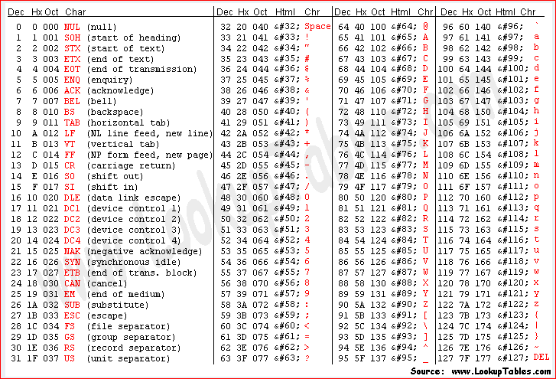
Java IO
ASCII encoding:

Slide 42
Java : IO
File
Creating a File
File class
createNewFile()
Creates a file if it doesn't exist
exists()
returns Boolean value if the file exists
getName()
Returns name of the file
getAbsolutePath()
Returns absolute path of the file

Slide 43
Java : IO
Input
Input to java program
Output
Output from java program
Stream
A stream is a continuous flow of data
We can either read from a stream or write to a stream
Types of Streams
Byte based streams
Byte based streams are read / write a raw byte at a time
The streams that are byte based are typically called something with "stream"
Character based streams
Character based streams can read / write characters
The streams that are character based are typically called something with "Reader" or "Writer"
Grouping of JAVA IO classes :
Grouping based on Input or Output
Grouping based on Byte based or character based

Slide 44
Java : IO
Here are the combinations
Character based - Input
Character based - output
Byte based - Input
Byte based – Output
Binary files :
byte by byte => Byte based classes
InputStream and OutputStream are used for bit
Text files :
character by character => Character based classes
Reader and Writer are used for character based /text files
Java IO classes we are going to discuss:
Character Based – Output => PrintWriter
Character Based – Input => BufferedReader
Byte based - Input => FileInputStream
Byte based - Output => FileOutputStream

Slide 45
Java : IO
Text files
PrintWriter
For writing to text files
Constructors
print() methods
println() methods
flush() method
close() method
BufferedReader
Reading data from text files
Constructors
readLine()
read()
close()

Slide 46
Java : IO
Binary Files
FileInputStream
To read binary files
Constructors
read()
close()
FileOutputStream
To write to Binary file
Constructors
write()
flush()
close()

Slide 47
Java : IO
Reading from console
System.in : Called as standard input stream
This is the input from keyboard
Scanner Class
Most advanced class to read data from console
nextLine()
This method always reads data input from console as String and returns String
nextXXX()
These methods read data as a particular data type like integer, long, float,double etc.
Reading multiple values using Scanner class
Use While loop to do this

Slide 48
Java : IO
Properties file
What is properties file
Properties class
How to read properties file
load() method
getProperty() method

Slide 49
Java: Dealing with Excel file using Apache POI
Difference between XLS and XLSX files
XLSX is the latest version of Microsoft Excel’s as compare to XLS.
XLSX is able to read the files in XLS but vice versa is not possible.
Entities in XLSX file
workbook
sheet
row
Cell
Workbook
Class
XSSFWorkbook is the class used create .xlsx workbook and
HSSFWorkbook is the class used create .xls workbook
Constructors
XSSFWorkbook() : For creating a new workbook
XSSFWorkbook(InputStream) : To work with already existing file
write() method
close() method

Slide 50
Java:Dealing with Excel file using Apache POI
Sheet
Class : XSSFSheet
createSheet(String sheetName)
This method creates a sheet with given sheet name
createSheet()
This method creates a sheet with name (“Sheet”+index)
getSheet(String sheetName)
Returns sheet object with given sheet name
getSheetAt(int sheetIndex)
Returns sheet object with given sheet index(index starts with 0)
Row
createRow(int rowNumber)
Creates a row whose row number is rowNumber
getRow(int rowNumber)
For reading a row
Returns row object with given row number

Slide 51
Java : Dealing with Excel file using Apache POI
Cell
createCell(int columnNumber)
Creates a cell in a given row whose column number is the given columnNumber.
setCellValue()
Assigns value to cell
getXXXCellValue()
Returns cell value
Cell style
workbookobject.createCellStyle
CellStyle class
Examples on Write and read from excel file

Slide 52
TestNG
TestNG is an open source automated testing framework.
NG means Next Generation.
TestNG is similar to JUnit but it is not a JUnit extension.
It's a testing framework which helps us manage the all aspects of a test suite. The aspects include:
Test Case management
Test case validations.
Test case grouping.
Test case dependency management.
Test data management
Test data supplied from excel, xml , database
Test data Parameterization
Parallel execution
Test results
Test reporting

Slide 53
TestNG : SetUp
TestNG setup:
Install TestNG plugin in eclipse
Download TestNG jar and add it to library
TestNG structure:
A suite is represented by one XML file. It can contain one or more tests and is defined by the <suite> tag.
A test is represented by <test> and can contain one or more TestNG classes.
A TestNG class is a Java class that contains at least one TestNG annotation. It is represented by the <class> tag and can contain one or more test methods.
A test method is a Java method annotated by @Test in your source.

Slide 54
TestNG : Annotations
TestNG annotations:
What is an annotation?
@Test
Marks a method as a test method.
TestNG Assertions.
Order of execution of test methods.
priority : The priority for this test method. Lower priorities will be scheduled first.
dependsOnMethods
Groups: (groups={“group_name1”,”group_name2”})
@BeforeMethod
The annotated method will be run before each test method annotated using @Test
@AfterMethod
The annotated method will be run after each test method annotated using @Test
@BeforeClass
The annotated method will be run before the first test method in the current class is invoked
@AfterClass
The annotated method will be run after all the test methods in the current class have been run.

Slide 55
TestNG : Annotations
@BeforeTest
The annotated method will be run before any test method belonging to the classes inside the <test> tag is run (not before test method annotated using @Test).
@AfterTest
The annotated method will be run after all the test methods belonging to the classes inside the <test> tag have run (not after test method annotated using @Test)..
@BeforeSuite
The annotated method will be run before all tests in this suite have run.
@AfterSuite
The annotated method will be run after all tests in this suite have run.

Slide 56
TestNG : suite xml
What is testng.xml?
To handle multiple test classes we need a xml configuration file.
Following are the few aspects of a test suite that can be configured using testng xml:
Tests present in the suite
TestNG classes present in each suite
Include or exclude test methods
Include or exclude test groups
Passing parameters
TestNG structure:
Suite has tests .Test has classes .Class has methods
<suite> tag
<test> tag
<classes> tag
Include/Exclude methods
<methods> <include name=“methodName"> </include></methods>
Include/Exclude groups
<groups> <run>
<include name=“group1”/>
<exclude name=“group2”/>
</run> </groups>
<class> tag

Slide 57
TestNG : Parameterization
Parameterization in TestNG:
Parameterization with testng.xml(Non-programmatic way)
Parameterization with DataProvider (programmatic way).
Parameterization with testng.xml
This method is used when number of parameters is very few.
This is non programmatic way of passing parameters to test.
Testng.xml parameterization steps:
Declare Parameter names and values in testng.xml
<parameter name="param2" value="param2_value"></parameter>
Declare test methods with parameters
Pass the parameters to test methods using @Parameters annotation
@Parameters({"param1","param2","param3"})
The XML parameters are mapped to the Java parameters in the same order as they are found in the annotation.
Parameters can be passed to any method that already has a @Test, @Before/After or @Factory annotations.
Parameters can be declared either under a <suite> tag or<tests> tag or <test> tag.
If two parameters have the same name, it's the one defined in <test> that has precedence.

Slide 58
TestNG : Parameterization
Parameterization with DataProvider:
Parameterization with testng.xml is not possible in following scenarios:
To test with multiple sets of data
Parameters that need to be created from Java (objects read from excel file or a database etc..)
We can achieve above shortcomings of testng.xml using DataProvider.
This is programmatic way of passing parameters to test.
DataProvider is a method which is annotated with @DataProvider.
DataProvider returns two dimensional array of objects.
The first dimension's size is the number of times the test method will be invoked
The second dimension contains an array of objects that are passed as parameters to test methods.
DataProvider parameterization steps :
Create a DataProvider method which return two dimensional array of objects. Annotate this method with @DataProvider.
@DataProvider(name=”dp1”)
Create a test method with parameters.
Specify the DataProvider of the test method using dataprovider attribute
@Test(dataProvider="dp1")
DataProvider can be in the same class or in different class of the test method
There can be multiple data providers in a class.

Slide 59
TestNG : Parallel execution
Parallel execution using TestNG:
Running suites in parallel
java org.testng.TestNG -suitethreadpoolsize 3 testng1.xml testng2.xml testng3.xml
Running tests in parallel
<suite name="My suite" parallel="tests" thread-count="5">
Running classes in parallel
<suite name="My suite" parallel="classes" thread-count="5">
Running test methods in parallel
<suite name="My suite" parallel="instances" thread-count="5">
Running DataProvider in parallel:
@DataProvider(name="dp1" ,parallel=true)

Slide 60
TestNG : HTML and XML reports
TestNG HTML and XML Reports:
TestNG comes with certain predefined listeners which are by default added to any test execution and generate different HTML and XML reports for any test execution.
The report is generated by default ,under the folder named test-output and can be changed to any other folder by configuring it.
Test-output folder contains files like
index.html
emailable-report.html,
testng-results.xml,
testng-failed.xml
This default report generation can be disabled while running the tests by setting the value of the property useDefaultListeners to false. This property can be set while using build tools like Ant or Maven.
TestNG logging:
TestNG has built in logger(We are not going to use log4j instead of this logger).
For advanced event based logging, we can make use of Listeners.

Slide 61
TestNG : Reporter class
TestNG Reporter:
Reporter is a class in TestNG which is used to log messages that will be included in the HTML reports generated by TestNG.
Using Reporter ,we can log messages to HTML reports or console only and not to log files.
Methods:
Reporter.log(s)
To log to HTML reports only
Reporter.log(s, logToStandardOut)
To log to HTML reports as well as console
Reporter class is not a Listener.

Slide 62
TestNG : Listeners
Listeners:
Listeners keep listening to TestNG execution events.
Using Listeners
We do some action like sending emails etc.
We can generate custom logs.
We can generate custom reports(Using IReporter)
All Listeners in TestNG are Interfaces. If we want to make use of any Interface then we need to implement all the unimplemented methods in our class
Few Listeners:
IExecutionListener
ISuiteListener
ITestListener
IInvokedMethodListener
IReporter
IReporter listener:
This interface can be implemented by clients to generate a report.
Its method generateReport() will be invoked after all the suite have run and the parameters give all the test results that happened during that run.

Slide 63
Selenium : Introduction
What is Automation testing?
Why do we need Automation?
Speed
Repetition
Human error
What do we need to Automate?
Types Of Testing
Functional
Non Functional
Types of Automation Tools
Functional and Non Functional
Commercial and Open source
Types of Applications:
Desktop Applications
Web Applications

Slide 64
Selenium : Introduction
Why Selenium?
It's Open source
Huge community supporting it
It supports multiple programming languages: java,perl,php,python,javascript,c#,ruby
It supports multiple OS: windows, mac, linux
Used to automate web application and mobile web.
Why The Name Selenium?
Differences between QTP and Selenium?
Selenium is an open source tool while QTP is not an open source tool.
Selenium supports scripting in many different languages like Java, .Net, Python, Ruby etc While in QTP only vb scripting is provided.
Selenium supports WINDOWS,MAC and UNIX platforms whereas QTP supports only WINDOWS platforms only.
Selenium supports all browsers whereas QTP supports IE and Firefox browsers only
Selenium is used to test only web based applications while QTP can be used to test client-server , web and Desktop applications.
Why Java?
It's Open source
Excellent support, lots of documentation and answers on web
Huge functionality implemented
Lots of supporting frameworks supporting java like junit,TestNG etc.
Platform independant

Slide 65
Selenium : Introduction
What is Selenium?
A Web Application functional tool
Web application functional testing includes
Testing Forms
Testing web elements (links,buttons,dropdowns,text fields)
Testing Cookies
Compatibility Testing(OS,Browser,Mobile)
Selenium Tools Suite:
Selenium IDE
Selenium RC(Selenium 1)
Selenium WebDriver(Selenium 2)
Browser’s Native Support for automation
Selenium Grid

Slide 66
Selenium : Introduction
Selenium IDE
Integrated Development environment
Record and playback tool
Its Firefox browser plugin.
Supports only Firefox browser.
Using IDE once can export the scripts into any preferred language and run using RC or WebDriver
Selenium RC
Selenium Remote Control and Selenium 1
Works on selenium Core. Selenium Core is a JavaScript library used to drive interactions with browsers.
RC Components:
Selenium server
Client libraries
Selenium Core
Due to several security restrictions browsers apply to JavaScript many things are not possible.
RC is now deprecated. It's only in maintenance mode.

Slide 67
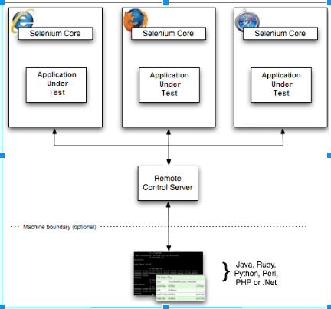
Selenium : Introduction
Selenium RC

Slide 68
Selenium : Introduction
WebDriver
It overcomes the limitations of Selenium RC
WebDriver directly speaks with browser using the ‘native’ support given by the browser engines for automation.
Selenium WebDriver:
Selenium RC and WebDriver are merged
After merge its called as Selenium WebDriver (or) Selenium 2.0.
Why Merger?
Selenium(RC) had massive community and commercial support
WebDriver has overcome the limitations of RC .
What features Selenium 2.0(Selenium WebDriver) got from Selenium RC and WebDriver?
WebDriver features from WebDriver
Selenium Server from Selenium RC.
When does Selenium WebDriver makes use of Selenium Server?
You are using Selenium-Grid
You want to run tests on remote machine
Selenium Grid:
For running tests against different browsers, operating systems, and machines all at the same time.
Save time in the execution of your test suites

Slide 69
Selenium : SetUp
Download Java
Download Eclipse
Set PATH variable
Download Selenium
Creating Selenium project in eclipse
Adding Selenium Jars to build path
Download TestNG
Adding TestNG library to build path of project
Download Chrome binary(chromedriver.exe)
Download Firefox binary(geckodriver.exe)
First program using Selenium WebDriver
Without TestNG annotations
With TestNG annotations
WebDriver interface

Slide 70
Selenium : Locators
Tools to identify elements / objects Firebug
Chrome Developer tools
Firefox : Firebug, FirePath
Locators:
Locating elements by ID
Locating elements by Name
Locating elements by Class name
Locating elements by Tag
Locating elements by Link Text
Locating elements by Partial Link Text
Locating elements by Xpath
Absolute xpath
Relative Xpath
Locating Elements by using CSS
Locating all elements

Slide 71
Selenium : Locators
XPATh Locators:
Absolute Xpath: It uses Complete path from the Root Element to the desire element.
Relative Xpath: You can simply start by referencing the element you want and go from there.
Using tagname+attribute | //a[@id]
Using tagname+attribute+attributevalue | //a[@id='elementid']
Using tagname+multiple(attribute+values) | //a[@id='xyz'][@name='lmn']
Without Using tagname | //*[@id='elementid']
Pattern matching
contains | //input[contains(@id,'em')]
starts with | //input[starts-with(@id,'em')]
Ends with | //input[ends-with(@id,'em')]

Slide 72
Selenium : Locators
Using CSS selectors
Using tagname | a
Using tagname+attribute | a[id]
Using tagname+attribute+attributevalue | a[id='xyz']
Using tagname+multiple attributes | a[id][name]
Using tagname+multiple(attribute+values) | a[id='xyz'][name='lmn']
Special attributes
Id | a#elementid
Classname | a.classname
Pattern matching
Contains | a[id*="somestring"]
Starts with | a[id^="somestring"]
Ends with | a[id$="somestring"]

Slide 73
Selenium : Locators
When to use CSS and xpath techniques?
When the elements don't have attributes like id ,name ,class
When the id,name,class attributes of web elements are dynamically changing
Disadvantages of Xpath:
Slower than CSS since it has to parse entire DOM.
IE browser doesn’t have native xpath engine. Selenium injects xpath engine in IE driver. Xpath works inconsistently in IE.
Relies on browser’s XPath implementation which is not always complete .So, not –recommended for cross-browser testing.
When a new element is added in page there is high possibility of breaking xpath
Disadvantages of CSS:
They tend to be more complex and require a steeper learning curve.

Slide 74
Selenium : Element Interactions
Working with Different Elements
Text box
Radio Buttons
Checkbox
Button
Link
Dropdown list
Select class
Select methods
selectByIndex(Index)
selectByValue(Value)
selectByVisibleText(Text)
(isDisplayed)
Whether a web element is visible or hidden
isEnbled()
Whether a web element is editables
isSelected()
Whether a web element is selected(check box,radio buttons etc)

Slide 75
Selenium : Dealing with Windows ,Tabs, Alerts and Iframes
Dealing with Windows and Tabs
getWindowHandle() method
getWindowHandles() method
Switching to new Window/Tab
Switching back to parent window
Difference between close() and Quit() methods
Dealing with Alerts
driver.switchTo().alert()
alert.getText()
alert.accept()
alert.dismiss()

Slide 76
Selenium : Dealing with Windows ,Tabs, Alerts and Iframes
Dealing with Iframes
Switching to Iframe:
driver.switchTo().frame(index)
driver.switchTo().frame(nameorId)
driver.switchTo().frame(webelement)
Switching back to parent page:
driver.switchTo().defaultContent()

Slide 77
Selenium : Actions
Mouse actions
click()
clickAndHold()
Release()
doubleClick()
moveToElement()
dragAndDrop(source, target)
actions.dragAndDrop(fromElement,toElement).build().perform()
Another way to achieve this:
actions.clickAndHold(fromElement).moveTo(ToElement).release().build().perform()
contextClick()
This method opens context menu corresponding web element passed to it.
Once the context menu got opened we need to press keyboard down arrow multiple times to go to the option we want to choose and click enter button.
action.moveToElement(el).contextClick().sendKeys(Keys.ARROW_DOWN).sendKeys(Keys.RETURN).build().perform()

Slide 78
Selenium : Actions
Keyboard actions
sendKeys()
keyDown()
keyUp()
Keys from keyboard can be distinguished into two categories:
Modifier keys
SHIFT,ALT,CONTROL
Non Modifier keys
All other keys
sendKeys() works on all keys
el1.sendKeys(Keys.CONTROL+"a")
el1.sendKeys("abc“)
keyDown() and keyUp() work only on modifier keys
Example on modifier keys

Slide 79
Selenium : Navigation
Navigation interface
driver.navigate().to()
driver.navigate().back()
driver.navigate().forward()
driver.navigate().refresh()

Slide 80
Selenium : Taking Screenshots
TakesScreenshot interface
Indicates a driver that can capture a screenshot and store it.
TakesScreenshot ts = ((TakesScreenshot)driver);
File screenshotFile = ts.getScreenshotAs(OutputType.FILE);
FileUtils.copyFile(screenshotFile, new File("test1.jpg"));
When to take screenshots?

Slide 81
Selenium : Executing JavaScript
JavascriptExecutor Interface
JavaScriptExecutor is an interface which provides mechanism to execute JavaScript through selenium driver
Sample JavaScript:
Scroll Page
js.executeScript("window.scrollBy(0,150)");
Get Title of a WebPage
string sText = js.executeScript("return document.title;").toString();
Click element
js.executeScript("arguments[0].click();", element);

Slide 82
Selenium : Waits
Why Waits?
Elements takes time to load in the web page
An element not being present at all in the DOM.
An element being present in the DOM but not visible.
An element being present in the DOM but not enabled. (i.e. clickable)
AJAX
Asynchronous JavaScript and XML
Ajax allows content on Web pages to update immediately without page load
Wait Interface
Wait interface
FluentWait implements Wait
WebDriverWait extends FluentWait

Slide 83
Selenium : Waits
Types of Waits:
Implicit Wait
Explicit wait
Thread.sleep()
Implicit wait:
The implicit wait will tell to the webdriver to wait for certain amount of time before it throws a "No Such Element Exception".
The default setting is 0 seconds.
Once we set the time, web driver will wait for that time before throwing an exception.
Implicit wait applies throughout driver instance
Poling interval is 250 ms
Explicit wait:
The explicit wait tells the Web Driver to wait for certain conditions
Explicit wait is a wait which explicitly waits for a certain condition called Expected Condition.
Poling interval is 500 ms
Few conditions:
presenceOfElementLocated()
visibilityOfElementLocated()
elementToBeClickable()
alertIsPresent()

Slide 84
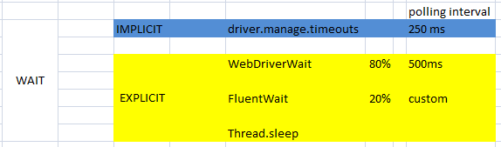
Selenium: Waits
FluentWait:
FluentWait is a wait in which we can set
Frequency with which FluentWait has to check the conditions defined.
Ignore specific types of exception such as NoSuchElementExceptions while searching for an element.
Maximum amount of time to wait for a condition

Slide 85
Maven : Introduction
What is Maven?
Maven is a software project management tool
Maven can manage a project's Build, reporting and documentation
Maven works on POM
Project Object Model
POM is the fundamental unit of work in Maven.
It is an XML file that contains information about the project and configuration details used by Maven to build the project.
What is a build tool?
Compile source code
Compile and run tests
Copy Resources
Package project
Deploy project
Maven Objectives:
Making build process easy

Slide 86
Maven : SetUp
Installing Maven:
Prerequisites:
JDK is installed
JAVA_HOME is set
Installing Maven in System:
Download Maven
https://maven.apache.org/download.cgi
Extract it
Set M2_HOME environment variable
Set path variable
Installing Maven in eclipse

Slide 87
Maven : Creating First Maven Project
Creating First Maven project:
Creating from eclipse
Creating from command line
mvn archetype:generate
-DgroupId=com.google
-DartifactId=ml2
-DarchetypeArtifactId=maven-archetype-quickstart
What is Archetype?
What is groupId?
What is artifactId?
What is Version?

Slide 88
Maven : Folder Structure
Main code : src/main/java
Main resources : src/main/resources
Test code : src/test/java
Test Resources : src/test/resources
target directory : Contains all output of the build.
Pom.xml : Should be present in project’s in root folder

Slide 89
Maven : Build Lifecycle
Maven Build Lifecycle:
It's a definition of process for building and distributing a project.
Build cycle consists of multiple phases which execute in a particular sequence:
Phases in build lifecycle are:
compile
test-compile
test
package
install
deploy
Build phases get executed in above order
When we run any particular phase ,then all the phases which come early in the order are first executed and then the selected phase gets executed.

Slide 90
Maven : Build Lifecycle
Maven build lifecycle
Mvn Compile
Compile main code present in src/main/java
Generates target/classes
Mvn Test-compile
Compile unit test code present in src/test/java
Generates test-classes
Mvn test
To run compile unit tests
Generates surefire-reports folder
Mvn package
To generate jar or war
Mvn install
To copy jar/war into local maven repository
Mvn deploy
To deploy the jar

Slide 91
Maven : POM
A Project Object Model or POM is the fundamental unit of work in Maven
POM.XML
Minimal POM
Effective POM
Dependency management:
Project dependencies
Local repository
Transitive dependencies
Dependant jars of dependent jars are called as transitive dependencies.
Dependency hierarchy is found in pom.xml
Excluding transitive dependencies
To exclude one or more transitive dependencies.
Maven plugins and goals:
Plugin :Plugin is artefact which executes goals
Goal : Goal is a task in a phase
Plugin can execute goals from multiple phases

Slide 92
Maven : Building runnable jars
Running a project having no dependencies.
Step1 : Add manifest entry to pom.xml
Running a project having dependencies.
Create all required folders
conf
drivers
Step1: Add manifest entry to pom.xml
Step2: Use assembly plugin
What is assembly?
Add assembly plugin to pom.xml
Create assembly.xml
Define formats
Add dependency sets
Add an entry for conf folder
Add an entry for drivers folder

Slide 93
Maven : Profiles
Maven Build Profiles:
A Build profile is a set of configuration values
Using a build profile, you can customize build for different environments such as Production , Development and QA environments.
Step1: Create a project and implement assembly as shown in previous slide
Step2: Add place holders in configuration files
Step3: Add a resource element to pom.xml
Set filtering to true
Define your custom configuration folder directory
Step4: Add profiles element in pom.xml
Step5: Build project with -P
Mvn clean install -Pqa

Slide 94
Selenium Grid
Ways of running selenium tests:
Local:
WebDriver is used to run tests locally
Remote:
RemoteWebDriver is used to run tests remotely
RemoteWebDriver runs tests on selenium grid
Why do we need selenium grid?
To run tests on multiple OS, Browser and device combinations.
To run tests in parallel to reduce execution time

Slide 95
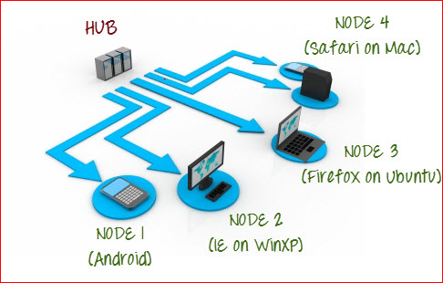
Selenium Grid
Selenium Grid Structure:
Selenium Grid components:
Grid HubSelenium Grid components:
Grid Hub
The Hub is the central point that will receive all the test request and distribute them the right nodes
Grid Nodes
Nodes need to be registered with hub
Tests are run on nodes

Slide 96
Selenium Grid
Selenium Grid Infrastructure:
Setup locally
We can setup selenium grid locally on our infrastructure
Cloud/online tools
There are 3rd party tools which are set up on cloud.
Browserstack.com
saucelabs.com
We need to purchase the subscription and use them directly.
Less maintenance overhead

Slide 97
Selenium Grid
Setting up selenium grid locally:
Start hub:
java -jar selenium-server-standalone-3.0.1.jar -role hub
Registering nodes with hub:
java -jar selenium-server-standalone-3.0.1.jar -role node
-hub "http://192.168.2.192:4444/grid/register"
-browser "browserName=firefox,firefox_binary=geckodriver.exe,maxInstances=1,platform=WINDOWS"
-browser "browserName=chrome,chrome_binary=chromedriver.exe,maxInstances=1,platform=WINDOWS"
Using grid to run tests:
After the grid is in-place, we need to access the grid from our test cases.
Grid URL : http://localhost:4444/wd/hub
We need DesiredCapabilities class to define which browser, version and platform you wish to use.
capability.setBrowserName(); capability.setPlatform(); capability.setVersion()
We need RemoteWebDriver class instead of WebDriver class as we need to run tests remotely
Pass grid url and capabilities object to RemoteWebDriver class

