Slide 1
DIGITAL MARKETING
Media-Mix optimization to maximize traffic
MGMT 6460 - Advanced Quantitative Methods For Business
Siddharth Jain
Tazein Fatma
Ankur Joshi

Slide 2

Problem: Online Advertising Optimization
Industry → Online Advertising Objective 1 → To increase traffic on an educational website/blog
Objective 2 → To advertise for possible future partners
Mammalsrus.com – ( http://mammalsrus.com/wordpress/ ) Our website aims to educate and entertain all those who are interested in mammals with lots of trivia on all the 5000 odd species that presently exist. Our mission is to promote knowledge of all these species so that conservation efforts are highlighted and can be funded by us and sister organizations.
Segregated into 3 sub category of mammals along with a blog
Maximize traffic corresponding to each of those Categories (Budget allocation)
We have separate Paid-Search campaigns running for each categories
Future Plans:
Merchandise Sales through online avenues

Slide 3
Optimization Techniques and Concepts:
Paid-Search campaign optimization utilizes:
Set Covering
Non-Linear Programming
(This optimization fully allocates the budget in the marketing channel)
Budget Allocation to Advertising Channels(Facebook, Email Marketing, Twitter) utilizes:
Mixed Integer Programming
(This optimization helps minimize weekly spend with maximum lead generation)

Slide 4
Data Collection
Google Analytics
Historical advertising performance data from paid search campaigns (1st Apr 2017 to 26th Nov 2017)
Metric included:
Total Cost
Visits
Day of the week
Other secondary Sources
https://adespresso.com/blog/facebook-ads-cost/
http://www.cypra.com/en/email_services/professional-pricing.php#
http://www.pennapowers.com/how-much-do-ads-on-twitter-cost/

Slide 5
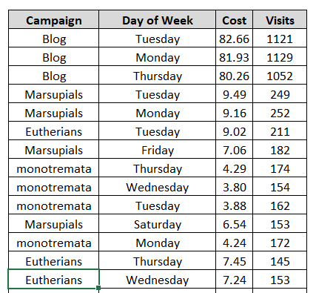
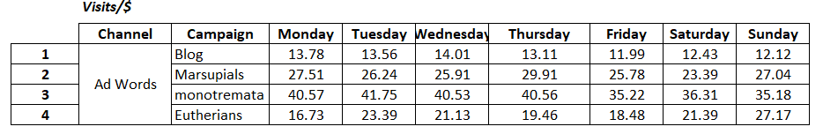
Data Snapshots – Paid Search Campaigns
Data Extracted from Campaigns
Data Manipulation
We derived daily visits for each dollar spent on individual campaigns
Visits for each dollar spent

Slide 6
Problem Formulation – Part1
Optimize weekly budget distribution to increase overall visits to the website while ensuring relatively
uniform spread of visitors across campaigns
Decision Variables – Daily budget spent on each campaign (formulated as matrix)
Xij – budget allocated to campaign i^{th} on j^{th} day of the week
Objective – To maximize total visitors to the website within a week for a given budget
Constraints –
Total weekly budget
Maximum allowed budget on each campaign (30%,30%,20%,20% of total weekly spend)
Each campaign should get at least 10% of its weekly budget everyday
Variation in daily campaign budgets should be relatively low
Each campaign should attain at least 500 visitors each day

Slide 7
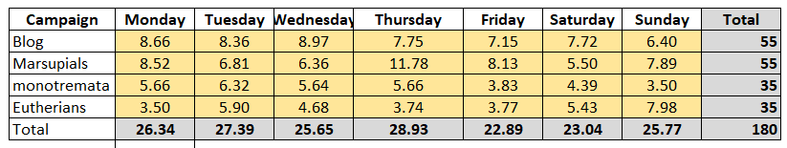
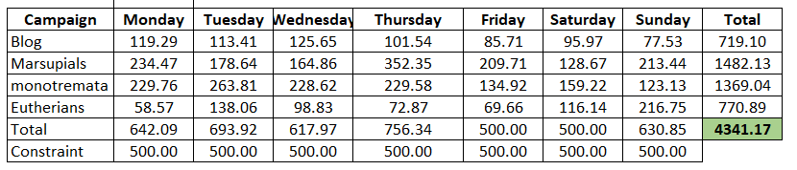
Problem Formulation
Visits for each dollar spent daily for each campaign
Decision Variables – Daily Budget for each campaign
Daily Visits for each campaign

Slide 8
Results/Recommendations
Website should allocate daily budget using our results which indicate highest visits for:
Blog-Campaign are on Wednesday
Marsupials-Campaign are on Thursday
Monotremata-Campaign are on Tuesday
Eutherians-Campaign are on Sunday
Optimization results in overall 4341.17 visits in a week with a weekly budget of $180.
Daily Budget for each campaign
Daily Visits for each campaign

Slide 9
Problem Formulation – Part 2
Budget Allocation to Advertising Channels( Facebook, Email Marketing, Twitter)
Decision Variables :
X1, X2, X3 – Weekly spend($) on Facebook, Email & Twitter respectively.
Y1, Y2, Y3 – Selection variable { 1- if channel is selected, 0- otherwise}
Y1, Y2 & Y3 are Binary Variables
Objective – To minimize the ad-spend allocated to the channels within a week. Min Cost = 250*Y1 + X1 + 150*Y2 +X2 +X3+0*Y3
Constraints –
X1 + X2 + X3 = 180 -- Total weekly operational budget
Total clicks obtained should be >= 500 -- Total clicks generated per week
X1 <= M *Y1 -- Fixed cost constraint for Facebook
X2 <= M*Y2 -- Fixed cost constraint for Email
X3 <= M*Y3 -- Fixed cost constraint for Twitter
Each campaign should attain at least 1000 visitors each day

Slide 10
Problem Formulation
Email(consultation) and Facebook(Social Media Marketer) have fixed costs
Binary variables used for first selecting a channel and then invest in it (Big-M Method)
Cost per click are assumed after research through secondary sources

Slide 11
Results/Recommendations
Website should focus on Facebook Advertising at the current budget constraints
Assuming a 2.5% lead conversion from lead generation advertising, we can say that atleast 16 leads could be generated
Any later cost for conversion of leads into partnerships is not considered for any formulation

Slide 12
THANK YOU
QUESTIONS?

