Slide 1
Conditioning LLMs with Emotion in Neural Machine Translation
Group: Human Intelligence
vvvvvvvvvvvvvvvvv

Slide 2
Problem Statement
Current Limitations
Bridging the Gap
Existing Neural Machine Translation (NMT) models have shown potential for integrating additional information, such as gender or politeness. However, there's a significant gap in incorporating emotional cues. While previous research suggests that adding emotion information, like arousal, can enhance translation performance, a publicly available code implementation remains elusive.
This project aims to address this gap by introducing a new MT pipeline that integrates emotion information extracted from a Speech Emotion Recognition (SER) model into Large Language Models (LLMs). By leveraging SER data, we aim to improve translation quality and contribute to advancements in this domain.
vvvvvvvvvvvvvvvvvv

Slide 3
Previous Work
Prompt Engineering and In-context Learning
Controlling Translation with Extra Information
Research has explored techniques like optimized prompting and in-context learning to improve translation quality over time. These methods aim to enhance LLM performance by providing tailored prompts and learning from past translations.
Previous works have demonstrated the possibility of controlling the translation by adding extra information, such as politeness, gender, or emotion, to the model. This approach leverages the notion that words can be categorized into emotion categories (affective word lists), allowing the model to select appropriate vocabulary for the target translation.
vvvvvvvvvvvvvvvvvv

Slide 4
Methodology
1
2
3
Metrics
We start by evaluating BLEU and COMET scores for various LLMs on the Libri-trans dataset for English-to-French text-to-text translation.
Speech Emotion Recognition
We convert the .wav files of our dataset to Audio Arrays
We then use HuBert Model to extract emotions from audio arrays.
The output given by the model is of the form - (emotion, confidence)
The emotions detected are - Anger,Fear,Happy,Neutral,Sad,Surprise
Finally, we compare translation performance with and without adding each emotional dimension as extra information to the input prompt.
vvvvvvvvvvvvvvvvv

Slide 5
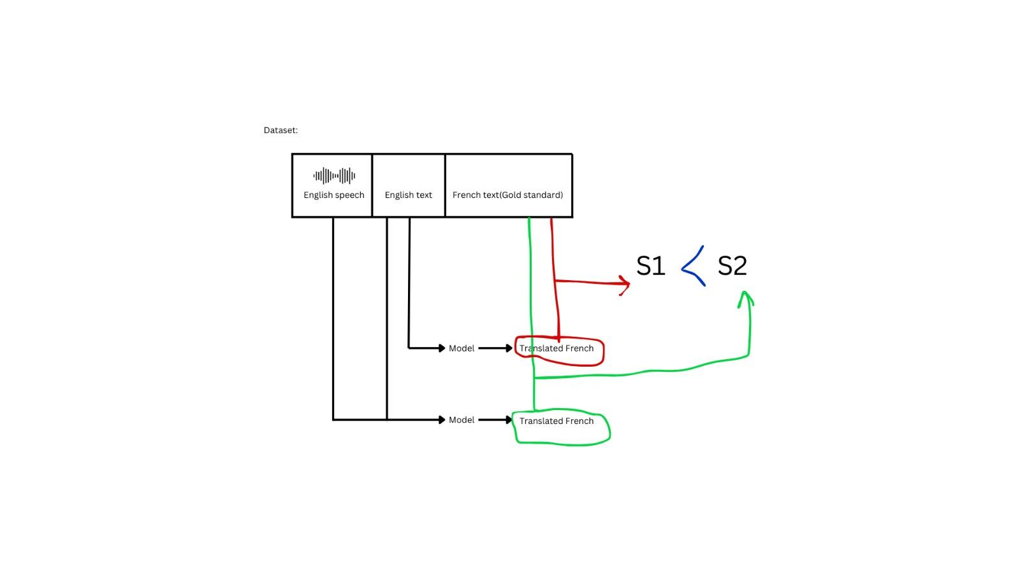
Experimental Settings And Results
1. Testing LLMs on Libri-Trans
To perform MT with LLMs, the task is converted into a language modeling problem using prompts. In this work, we perform zero-shot prompting with the template
"English: <src txt> \n French: <tgt txt>"
where and refer to the English source sentence and the French target sentence, respectively.
vvvvvvvvvvvvvvvvv

Slide 6
Experimental Settings And Results
2. Fine-Tuning LLMs with Emotion
Prompting with Emotion Information
The experiment aimed to observe the behavior of the model on English-to-French translation when emotion information is added to the prompt. We first estimated the emotion of each English recording in the Libri-trans dataset, computing dimensional emotion values for arousal, dominance, and valence using a trained SER model. Emotion values ranged between 0 and 1 and were balanced.
Specific prompts were created that included emotion information before the source sentence, using the template English <status> <emotion>: <src txt> \n French: <tgt txt>
where status is replaced by either "with" or "without" depending on whether the emotion value is higher or lower than 0.5, emotion is replaced by arousal, dominance, or valence, src txt represents the English source sentence, and tgt txt represents the French target translation.
vvvvvvvvvvvvvvvvv

Slide 7
RESULTS
 | Phi-3-mini-4k-instruct |  | Qwen2.5-1.5B-Instruct |  | Mistral-7B-Instruct-v0.3
 | BLEU | COMET | BLEU | COMET | BLEU | COMET
Without Emotions | 0.024 | -1.017 | 0.039 | -0.87 | 0.040 | -1.22
With Emotions | 0.04 | -0.98 | 0.034 | -1.06 | 0.057 | -1.15
Model used for COMET evaluation is Unlabel/wmt20-comet-da
vvvvvvvvvvvvvvvvvvv

Slide 8
Individual Contributions
Vedansh Sharma
Utkarsh Kumar
Siddharth Jain
Pipelining, translation tasks, research and documentation, Mistral Model evaluation
Research on COMET and BLEU metrics, evaluation code, experimentation.
Base models research, dataset research and extraction, QWEN Model evaluation, presentation
Shubham Yogesh Mahajan
Rishabh Sahu
Speech Emotion Recognition model, research, presentation
Translation tasks, Phi model, research, documentation
vvvvvvvvvvvvvvvvvvvv

