Slide 1
“Study of Strength & Weakness of Cashew Factory .”
Presenting by
MR. RUSHIKESH RAMESH MANCHEKAR
M.COM PART II SEMESTER III
Exam Seat No : 6545948
Under the Guidance of
PRO. MISS N. R. MANCHEKAR

Slide 2
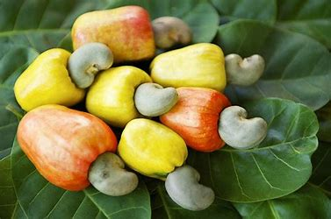
INTRODUCTION
Cashew (Anacardium occidentale) is a widely grown cash-crop across India. It covers a total area of 0.70 million hectares of land, producing over. 0.40 million M.T. of raw cashew nuts annually. Konkan is the main cashew - cultivation region of Maharashtra. Due to suitable climate, cashew has become the second important cash-crop next to mango.

Slide 3
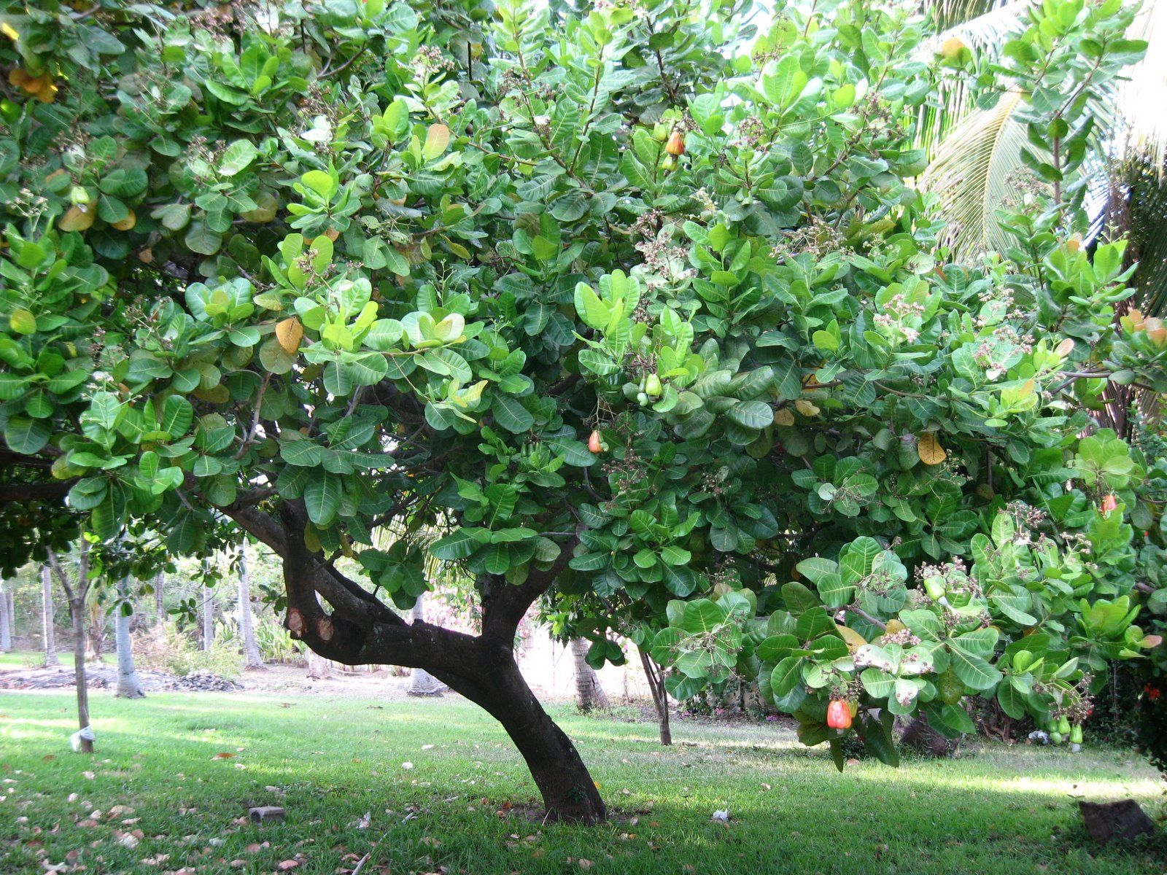
There are two main varieties of cashews in Konkan –
A local variety (Gavathi kaju ) and Vengura cashew (Vengurla Kaju).
Vengurla is a high-yielding improved variety which is recently grown by the farmers. The cashew nut harvesting season is from January to May.

Slide 4

ABOUT THE BUSINESSMAN
Name - DR. RAVINDRA DHAWALE.
Factory Name - Samarth Cashew Factory.
Running Age - 47
Education - MBBS
Address - A/P - Bandhawadi, Taluka - Vaibhavwadi, Dist - Sindhudurg, PIN - 416810
Contact No. 8459409653

Slide 5
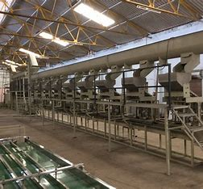
CASHEW NUT PROCESSING STEPS
High temperature cooking
Shelling
Automatic drying
Peeling
Grading and sorting
Cashew processed into delicious snacks

Slide 6
Market Potential
The demand for cashew nut is gradually increasing, whereas its supply is limited. India is leading producer, processor, consumer and exporter of cashew nuts in the world. It is one of the important agricultural commodities exported from India to many countries in the world. The market potential of cashew kernel is described as under:
Domestic Market
Export Market

Slide 7
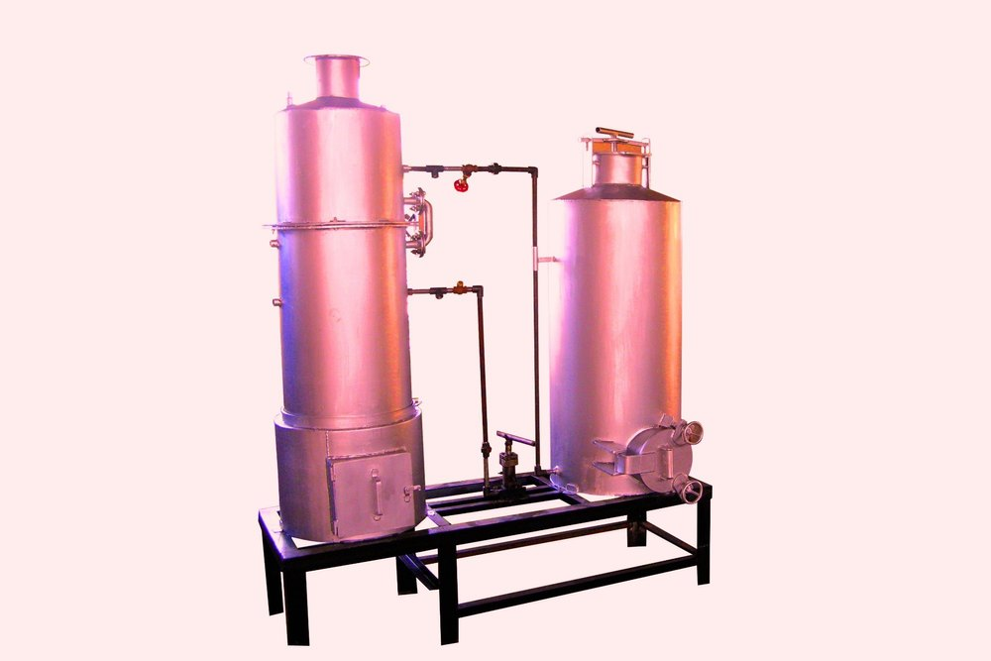
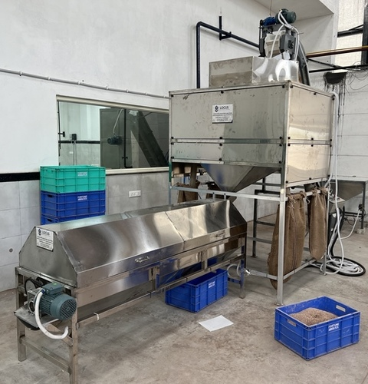
Plant & machinery and other equipments required by cashew processing units
Steam Boiler
Cashew Peeling Machine:

Slide 8
MANPOWER REQUIREMENT
Sr. No | Post | Number | Salary/ wages | Annual
1 | Manager cum supervisor | 1 | 12,000 | 84,000
2 | Skilled labour | 4 | 5,000 | 1,40,000
3 | Helper | 5 | 4,500 | 1,57,500
4 | Driver | 1 | 9,000 | 63,000
 | Total |  |  | 4,44,000
The cashew processing industry is highly labour intensive. The labour is required for each and every operation like loading and unloading of raw materials and finished products, drying of raw materials, processing and packing of cashew kernel.

Slide 9
ISSUES FACED BY CASHEW NUT PROCESSING UNITS
1. Inadequate supply of raw cashew
2. Lack of proper policy push for growing cashew
3. Shortage of skilled labour
4. Need for fine tuning the technology and mechanization
5. Outdated Shelling methods
6. Semi-Mechanization
7. Market issues
8. Poor working conditions

Slide 10

9.Other General issues of Cashew industry:
Shortage of finance of working capital by banks and
delay in sanction of loan.
Unfriendly government policies
Lack of infrastructure like industrial area / estate since 10 years.
Lack of uninterrupted power supply.
Marketing problem and Effects of recession in the market

Slide 11

CONCLUSION
To conclude, the industry is one of the most promising industries in the area of women employment and empowerment, sustainable rural development and economic development of the country. This needs further attention of the government and other related bodies to strengthen the building blocks of the industry to be a world leader in cashew nut processing.
Cashew processing is a profitable business in Konkan region. Above information shows that there is best profit in this business.
Easy availability of raw material, uncomplicated process, non-requirement of skilled labour, durability of final product, relatively inelastic demand are the advantages of this business.

Slide 12
SUGGESTIONS
Company should start to make their own cashew related products.
Company needs to spend a lot on advertising and promotion to create an better reputation among the public.
Businessman should take a look on increase his annual turn over, So that more employments opportunity will be create for the local people.

Slide 13
Thank You !

