Slide 1
Predictive Analytics and Predictive maintenance
By Sidharth Khatua
Jigsaw ID: Jig16647

Slide 2
Agenda
Project Synopsis.
Data Assessment
Data Exploration
Decision Tree Model- Analysis.
Rules from the decision Tree.
Recommendations
Ensemble Method-Random forest.
Important variables.

Slide 3
Project Synopsis
Problem Statement:- Predict breakdown (yes or no) and preventive maintenance to reduce downtime.
Dataset:- Data set provided has 9000 instances of maintenance work done across 1 year across machines.
Solution Identification :- Decision tree to set rules and establish framework for preventive maintenance and predict the breakdown.

Slide 4
Data Assesment

Slide 5
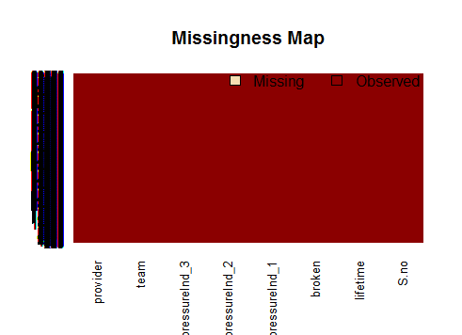
Analysis
Good quality of Data.
No Missing rows available.

Slide 6
Data Exploration
Bi-variate-Analysis

Slide 7
Lifetime in months by Breakdown
Machine without breakdown median lifetime value of 40 months.
Machine with breakdown have a median lifetime value of 80 months.
Higher chances for the machine to breakdown if their lifetime is >60 months.

Slide 8
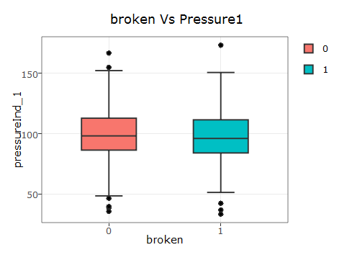
Pressure1 Vs Broken
machine without breakdown (0) have a median pressure of 98.23
machine with breakdown (1) have a median pressure of 96.11
no significant changes are observed.

Slide 9
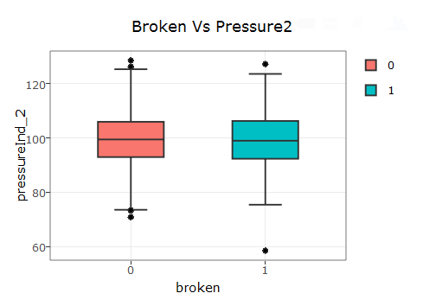
Pressure 2 by Breakdown
Machine without breakdown (0) have a median pressure at point 2 to be 99.52
Machine with breakdown (1) have a median pressure at point 2 to be 99.04
No significant changes.

Slide 10
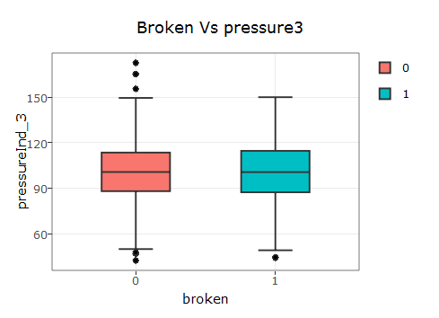
Pressure 3 by Breakdown
Machine without breakdwn have a median pressure at point 3 to be 100.62
Machine with breakdown have a median pressure at point 3 to be 100.56
No significant differences.

Slide 11
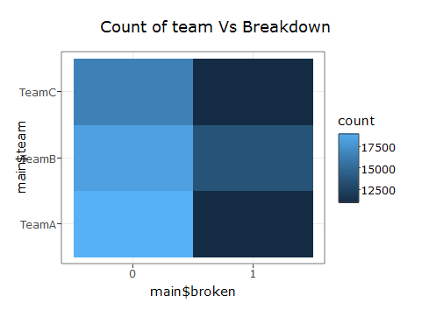
Team by Breakdown
Team B has highest no of breakdown compared to the other teams.

Slide 12
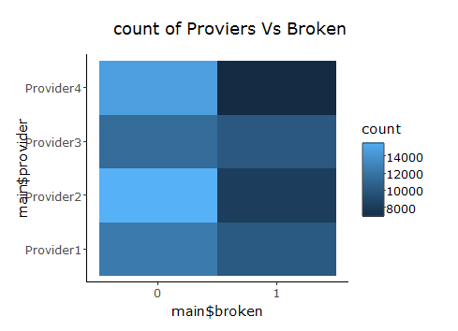
Providers by Breakdown
Providers 3 and Providers 1 have a highest no of breakdown compared to the other providers.

Slide 13
Decision Tree Model-Analysis
Rules for No Breakdown.
If lifetime in months <60 there is no breakdown.47% of the entire population.
If LT >=60 and LT <72 with Provider 1,2,4 There is no Breakdown.7% of the entire population.
If LT>= 76 and LT<78 with provider 1,2,4 and Team A,B .There is no breakdown which is 3 % of the entire Population.

Slide 14
Decision Tree Model-Analysis(contin.)
Rules for Breakdown.
If LT >= 78.Machine Breaks Down 28 % of the population.
If LT <78 with provider 3 Machine Breaks down 94 % of times which is 12% of the population.
If LT > 72 and LT < 76 with provider 1,2,4 and Team C Machine breaks down 97% of times which is 3% of the population.

Slide 15
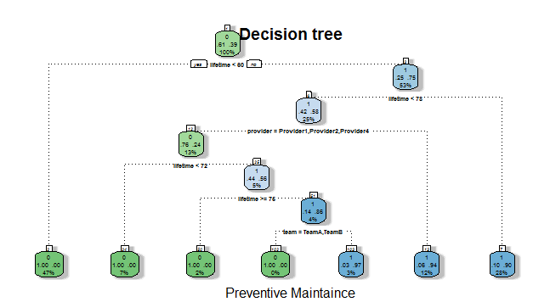
Decision Tree Model

Slide 16
Recommendation
Older machine have very high chances of breaking down compared to others especially lifetime >=78.efficient and specialized workforce has to be recruited to address the problem to reduce downtime and increase efficiency
Machine whose manufacturer is provider 3 breaks down hence its advisable to no to buy machine from provider 3.
Machine that belongs to the factory-Team c breaks down 97% of the times. Hence team c factory has to be constantly monitored by the supervisors and managers to reduce downtime.

Slide 17
Ensemble Method.
To Enhance Accuracy of the model .
Random forest algorithm of trees 250 is used.
Result : 100% accuracy.

Slide 18
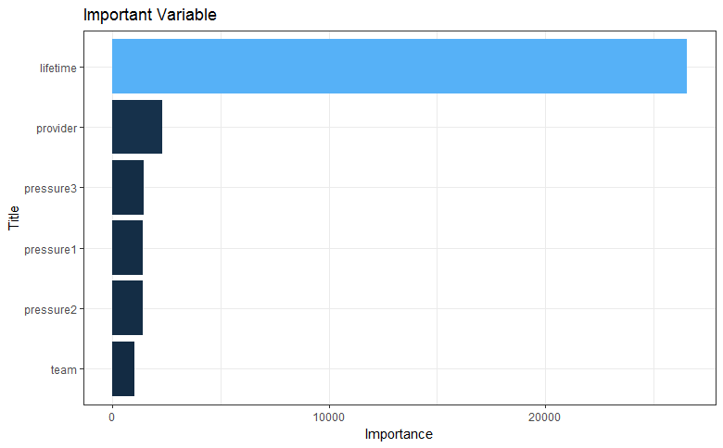
Important Variables.

