Slide 1
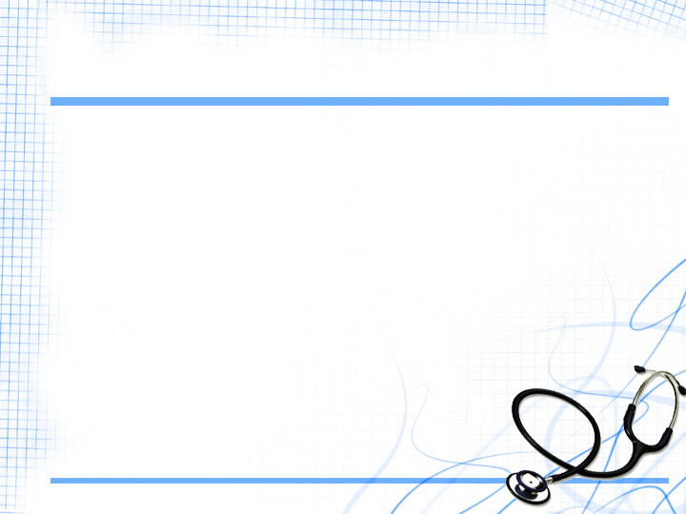

Team: RESPONSE200
Team Members:
1.Vatsal Agrawal
2.Siddharth Kathuria
3.Akshita Goel
4.Tushar Jajodia

Slide 2
PROBLEM STATEMENT
An initiative to enrich the lives of
people with disabilities , people to access and monitor health issues by developing an application for android operating system.

Slide 3

SOLUTION

Slide 4

- At your service, 24/7

Slide 5
WHAT IS MEDX ?
Know your Disease
Physical
disabilities
FEATURES
Pharmacy
Bed Availability
Blood Bank

Slide 6

PHYSICAL DISABILITY
BLIND: Implementation of morse code converter,speech to text converter for easy communication for blind people.
DEAF: speech to text converter for easy communication for deaf people.
MUTE: Text to speech converter for easy communication for mute people.

Slide 7
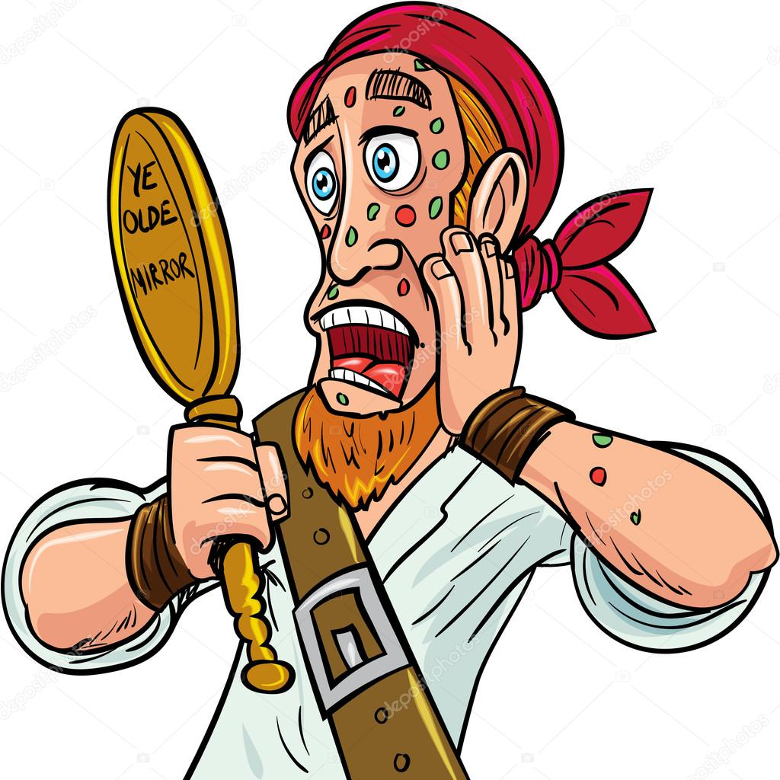
Know Your Disease
symptoms
Disease

Slide 8
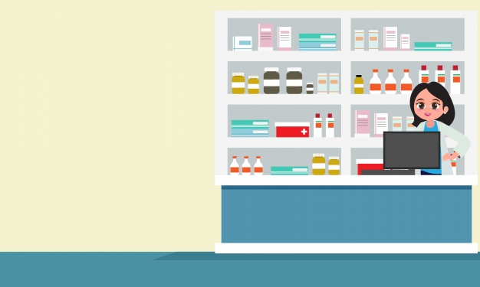
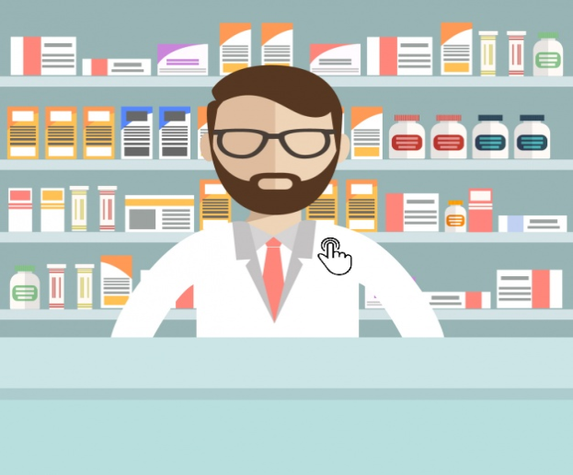
PHARMACY
Find the details like price(in rupee), manufacturer of your medicine.

Slide 9
FUTURE PROSPECTS:-
In future we’ll be focussing and implementing few features like-
1.Chatbot using Machine Learning
2.Nearest Ambulance call
3.Beds and blood availibility 24/7
4.Doctor consultation
5.Speech to text convertor for easy communication of mute and blind people.

Slide 10


