Slide 1
Anonymous Bank Customer Retention and Churn Analysis
Data Analytics Project – FI 8090 (Fall 2025)
CBS Finlytics | Team #8
Breanna Jones
Chidera Ebele
Siddhant Khatiwada

Slide 2
Contents
01
02
03
04
05
06
Purpose
Data Exploration
Hypotheses
Model Development
Results
Conclusions

Slide 3
Purpose
Objective
Identify key factors driving churn.
Build predictive models to classify customers.
Recommend retention strategies.
Investigation
Explore what customer behaviors and demographics influence churn.
Analysis
Which factors predict churn?
Low balances and overdrafts linked to churn rate?
Online users churn less?
Questions
Approach
LASSO Logistic Regression
Decision Tree
Gradient Boosting

Slide 4








Data Overview & Preparation
Dataset Snapshot
~47K records, 87 features
Cleaned, validated , no duplicates or missing values
Fields standardized for modeling
Loans, deposits, and account activity verified for internal consistency
Key Enhancements
Age handled separately for consumer vs. business
~57% identified as non-digital customers
Missing balances resolved → revealed activity patterns
️ Strong class imbalance (~1.5% churn)

Slide 5
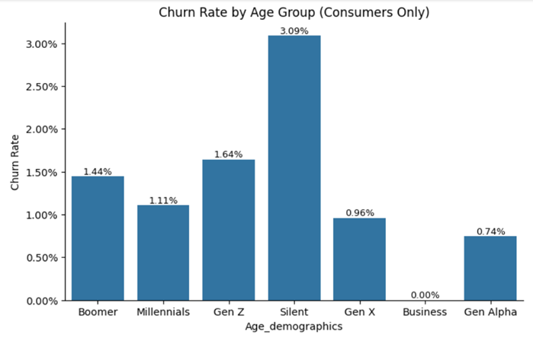
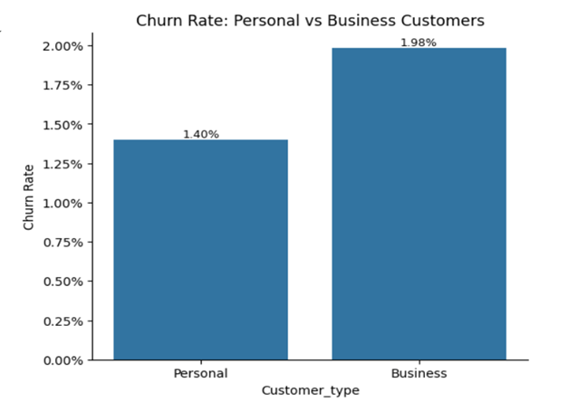
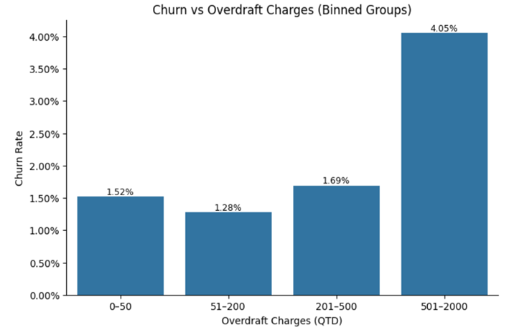
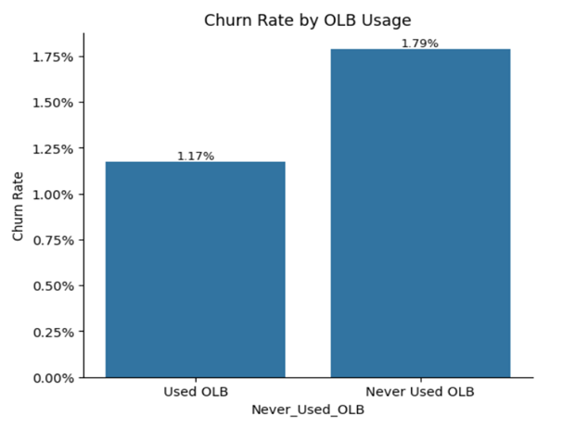
Key Findings
Silent Gen. shows the highest churn (~3.1%)
Business churn higher (1.98% vs 1.4%)
Heavy overdrafts drive churn (~4%)
Non-OLB users churn higher (1.79% )

Slide 6
Hypotheses Testing and Findings
Hypothesis | Key Results | Inference
H₁: Customers with low average balances and high overdraft or fee charges are more likely to churn. | Balance: OR=0.018, p<0.001 → significant Fees: OR=1.005, p=0.872 → not significant | Customers with low balances are far more likely to churn; fees have no measurable effect.
H₂: Customers inactive in online/mobile banking are more likely to churn. | OR=1.535, 95% CI [1.31, 1.79], p<0.001 | Inactive OLB users churn 1.79% vs 1.17% active → significant.
H₃: Younger generations exhibit different churn patterns than older cohorts. | χ²=90.2 (df=6), p<0.001, V=0.044 | Churn varies significantly by age; Silent Gen (3.1%) highest, Gen Alpha (0.7%) lowest.
H₄: Customers with fewer product holdings (loans, debit cards, savings) are more likely to churn. | OR=0.547 [0.49,0.61], p<0.001 | Each extra product reduces churn odds by ~45%; customers with 4–6 products churn only 0.35%.

Slide 7
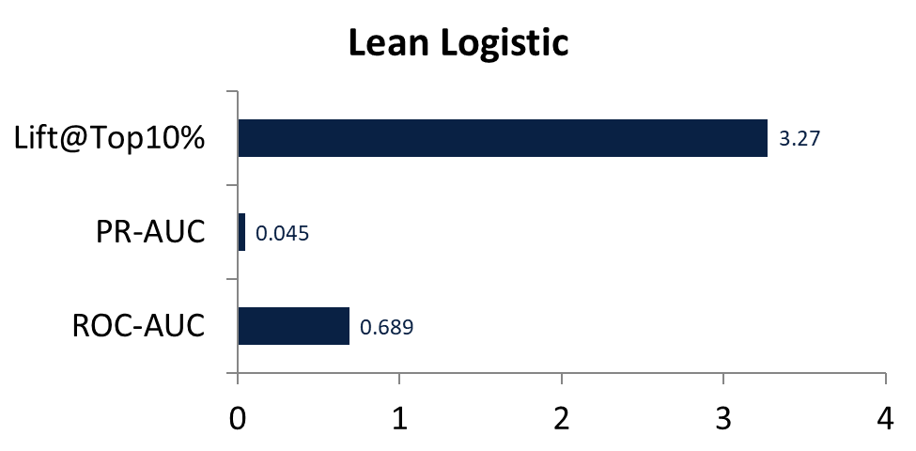
Model Development - Logistics Regression
Performance (Test Set)
Feature Selection
127 features – Initial encoded dataset
96 features – Lasso Selected​
86 features – One-SE Pruned
Key Predictors
• Balance - lower balances increase churn risk
• Product Count - more products reduce churn odds
• Digital Activity - OLB/App inactivity raises churn risk
• Age Group - older cohorts show higher churn
64 features – lean Logistics (final)

Slide 8
Gradient Boost Model – Summary
Phase | Business Approach | Outcomes
Data Preparation | Cleaned and structured ~47K customer records, handled severe class imbalance (~1.65), and split data into training, validation, and test sets. | Provided a reliable, balanced dataset for accurate model learning and prediction
Model Development | Developed a predictive analytics solution to anticipate customer churn. | Model trained on 60%, validated on 20%, and tested on 20%
Model Evaluation | Tested on unseen customer data to measure predictive performance and reliability. | Achieved ROC-AUC ≈ 0.74, PR-AUC ≈ 0.13
Customer Prioritization | Identified top 10% of customers most likely to churn for proactive engagement. | Captured ~42% of churners with ~4.2× targeting lift
Insights | Identified key churn drivers guiding retention strategy | Key factors: Overdraft charges, low balances, limited digital engagement, fewer product holdings.

Slide 9
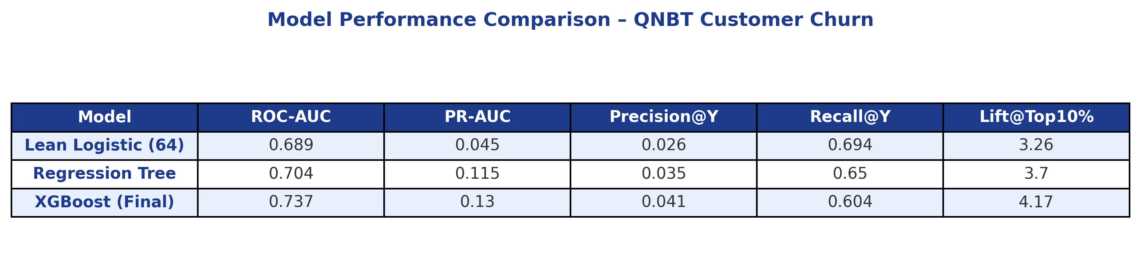
Model Comparison – Predicting Churn
XGBoost achieved the strongest predictive lift (4.17×) and best AUC (0.74).
Regression Tree provided interpretability with moderate performance (3.7× lift).
Lean Logistic confirmed core churn drivers (balances, digital activity, product count).
Lift@Top10%
Measures how many churners are captured in the top 10% of predicted risk compared to random targeting.

Slide 10
Model Comparison – Predicting Churn
Aspect | Logistic Regression | Regression Tree | XGBoost
Strengths | Interpretable, aligns with economic theory (balances, product count). | Transparent rules, visual interpretability. | Highest predictive power, handles complex nonlinear patterns.
Weaknesses | Limited recall for rare churn cases, linear assumptions. | Moderate lift (3.7×), risk of overfitting with deep splits. | Lower interpretability, requires tuning and computation.
Key Drivers / Coefficients | Balances ↓ churn; multiple products ↓ churn; inactivity ↑ churn. | Overdrafts, low balances, and high transaction drop-offs increase churn. | Customer Type, Branch, ACH Deposits, and Overdraft Charges most influential.
Calibration / Brier Score | 0.052 (moderate) | 0.041 (good) | 0.034 (strong, well-calibrated)
Training vs Test Error | Minimal gap; no overfitting. | Slight variance, mild bias toward train data. | Very stable; high generalization power.

Slide 11
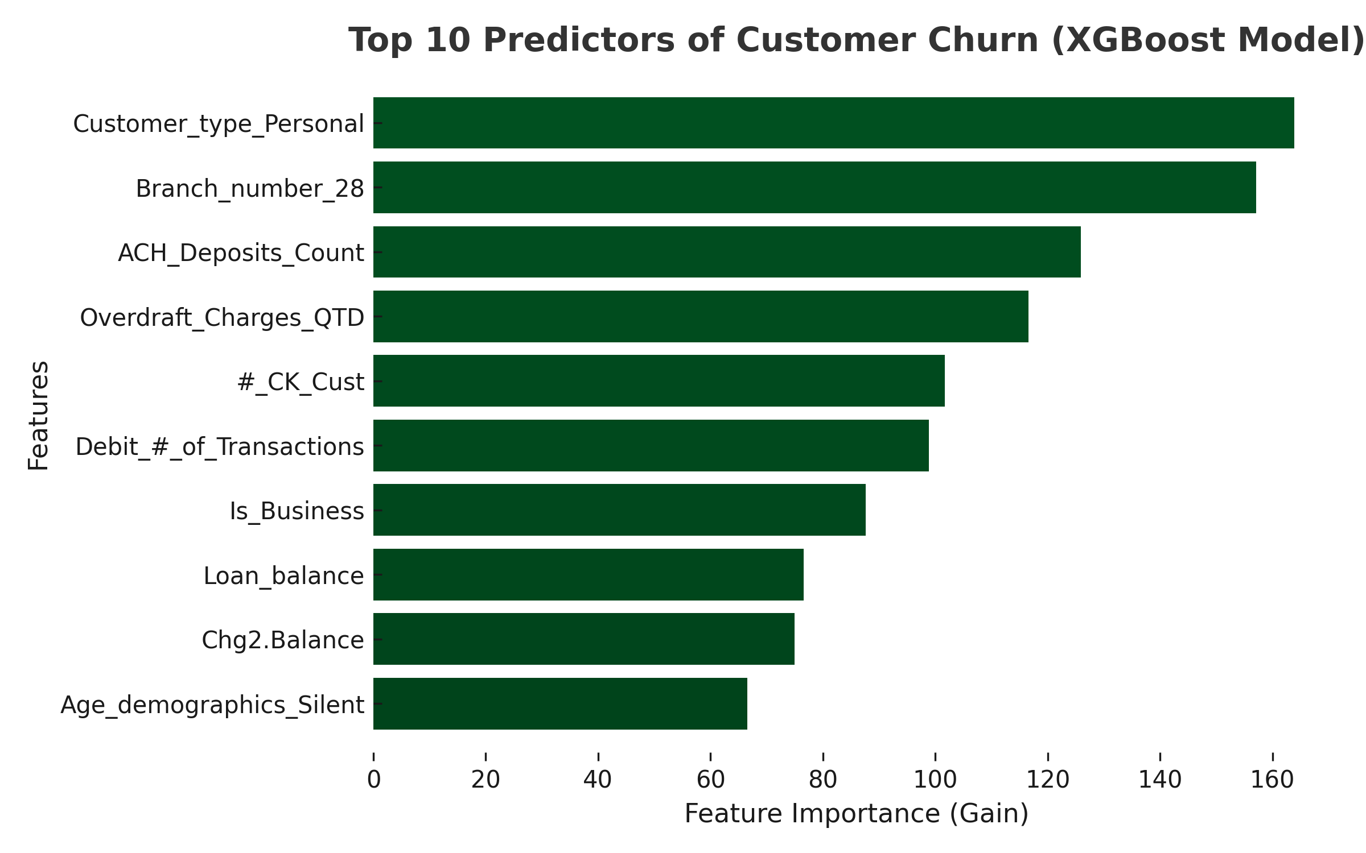
Key Churn Drivers and Economic Relevance
Liquidity risk indicator: declining balances often precede attrition.
Engagement metrics: low transaction frequency signals disengagement.
Digital adoption: inactive online users = 1.5× churn risk.
Cross-selling impact: each additional product cuts churn odds by ~50%.
Demographic insight: older, low-digital users show higher vulnerability.

Slide 12










Recommendations
Retention Focus
Build predictive churn models for proactive interventions
Drive digital adoption through targeted campaigns and easy onboarding
Prioritize retention programs for high-risk segments (business & older customers)
Offer overdraft alerts, fee relief, or budgeting tools to reduce dissatisfaction
Expand cross-selling to increase product depth and loyalty
Growth Strategy
Optimize fee structures with tiered pricing based on customer value
Enhance mobile and online banking experience to attract Gen Z
Launch loyalty rewards and tiered benefit programs to boost retention
Personalize offers and communication using behavioral and demographic insights
Leverage transaction patterns to design early-warning churn triggers

Slide 13

Thanks!
Do you have any questions?

