Slide 1
Comprehensive framework for pre-trained machine learning algorithms
By : siddharth Madupathi
Gowtham Alasakani
Sowmya Medabalimi

Slide 2
Problem scope : Fragmented ML Workflows Across Data Types
Machine learning solutions are often siloed by data type: images, text, or numerical data
Most existing frameworks are:
Task-specific (e.g., image-only or text-only)
Non-modular (code tied to a dataset or platform)
Not easily reusable across domains (agriculture, healthcare, finance, etc.)

Slide 3
This leads to:
Redundant development work
Inefficient experimentation
Slower deployment in real-world projects

Slide 4
Motivation: One Framework for Every Dataset
We wanted to create a dataset-agnostic ML framework that allows:
Seamless switching between data modalities
Rapid integration of pretrained models
Minimal code changes between domains

Slide 5
Our vision:
Provide a plug-and-play ML backbone/framework that supports both experimentation and deployment.
Let developers focus on solving the problem, not setting up the pipeline every time.

Slide 6
System Architecture
Our framework includes the following core components:
Input Handler – accepts image, text, or tabular data
Preprocessor Layer – standardizes inputs (resizing, tokenization, normalization)
Model Router – detects input type & selects appropriate pretrained model
Model Wrappers – contain reusable training and inference logic for each model

Slide 7
Trainer & Evaluator – allows user-defined training, testing, saving
Output Interpreter – formats prediction output and provides feature insights
Notebook Integration – supports model testing and data exploration
Deployment-Ready – portable across web, mobile, and cloud environments

Slide 8
Supported Pretrained Models
Model | Type | Learning | Input Type | Use Case | Libraries | Quantitative | Data Cleaning | Feature Selection | Platforms
MobileNetV2 | CNN | Supervised | Image | Plant disease detection | TensorFlow, TFLite | No | Resizing, normalization | CNN filters, PCA | Android, Edge
DistilBERT | Transformer | Supervised | Text | Symptom classification | HuggingFace | No | Tokenization, stopwords | Attention scores | Web, NLP platforms
Random Forest | Ensemble | Supervised | Tabular | Crop recommendation | scikit-learn | Yes | Outlier removal, imputation | Feature importance ranking | Desktop, Cloud
XGBoost | Boosting | Supervised | Tabular | Yield prediction | XGBoost | Yes | Missing value handling | SHAP, gain-based | Cloud, Desktop
VGG16 | CNN | Supervised | Image | Simple image classification | Keras, TensorFlow | No | Resize, pixel scaling | CNN filters | Web, Mobile

Slide 9
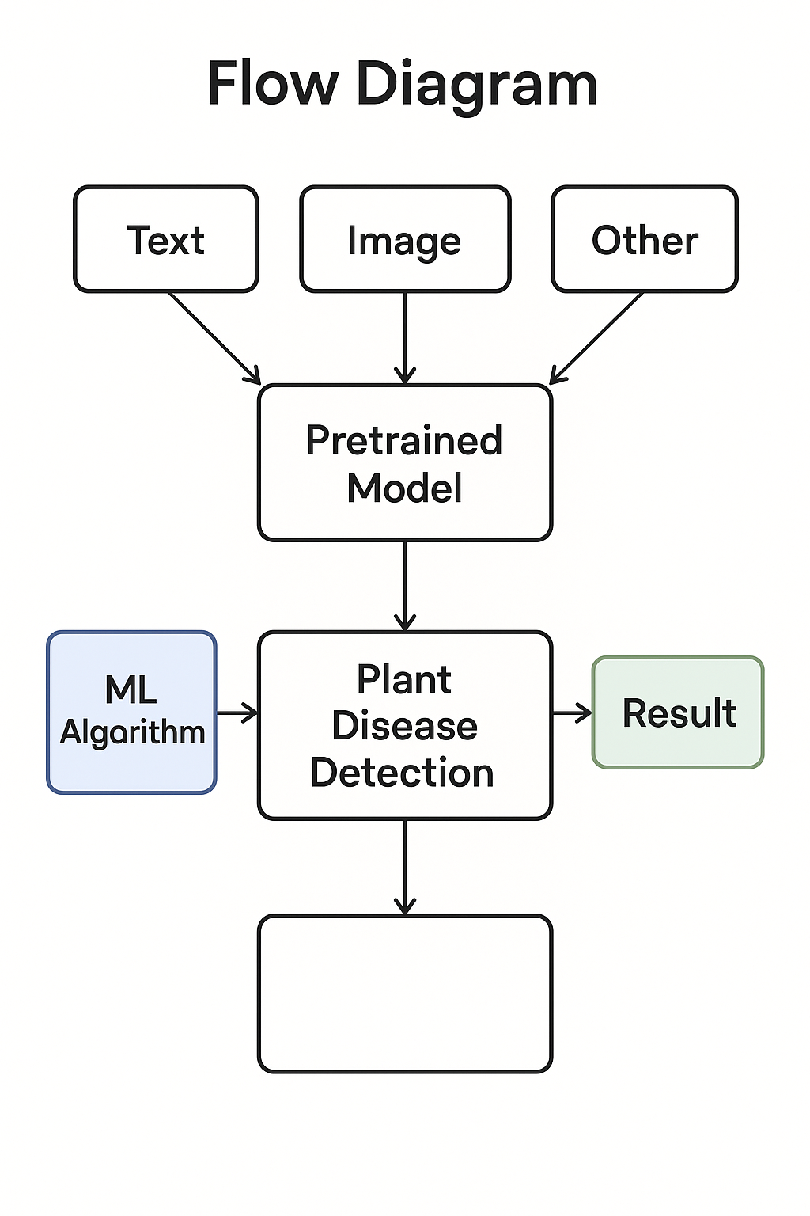
Flow Diagram
Output interpreter

Slide 10
Progress so far :
Data cleaning and feature selection for
Images data set
csv data set

Slide 11
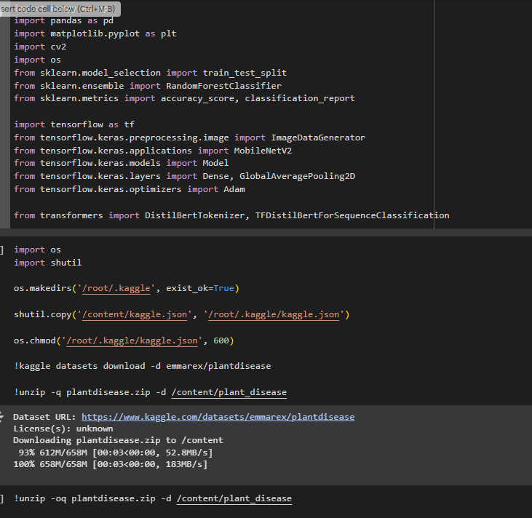

Slide 12
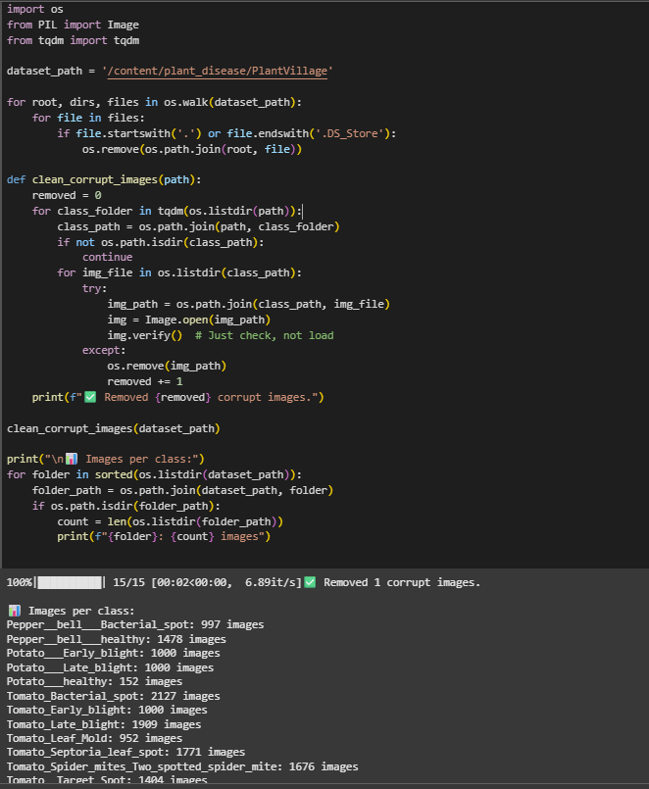

Slide 13
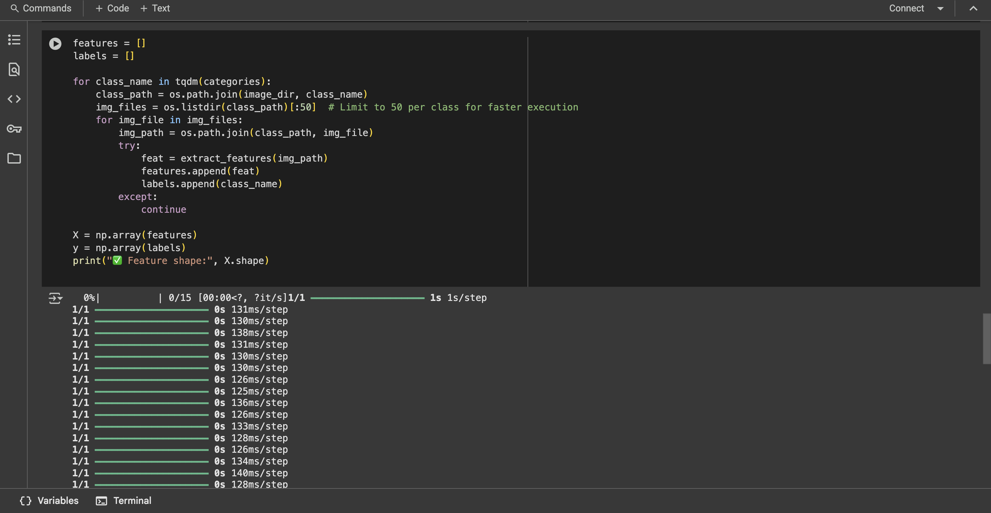

Slide 14
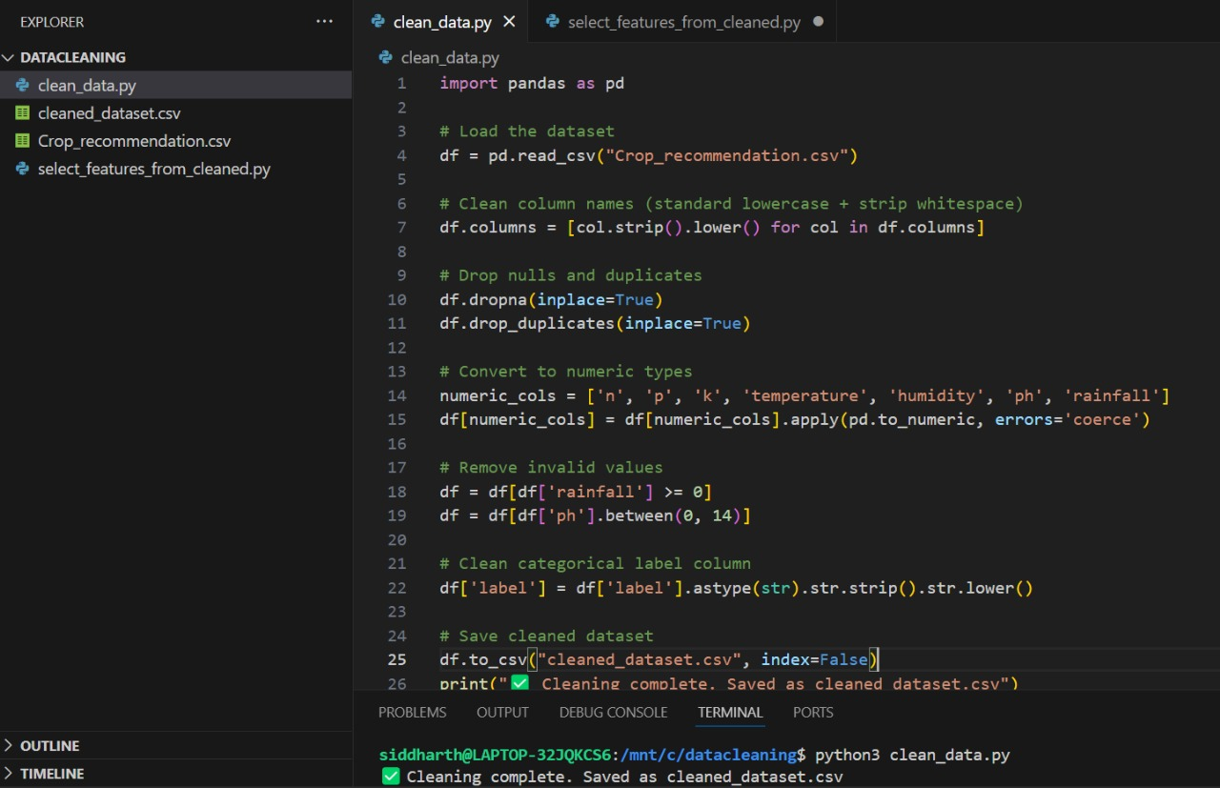

Slide 15
