Slide 1


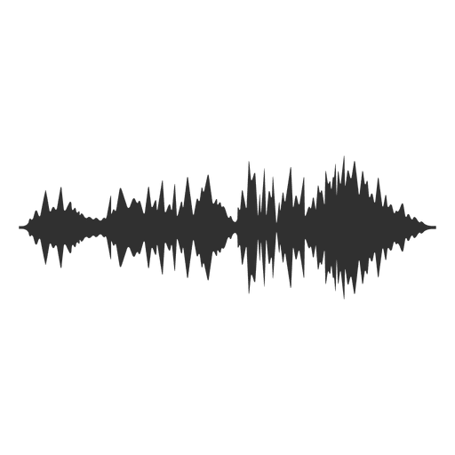

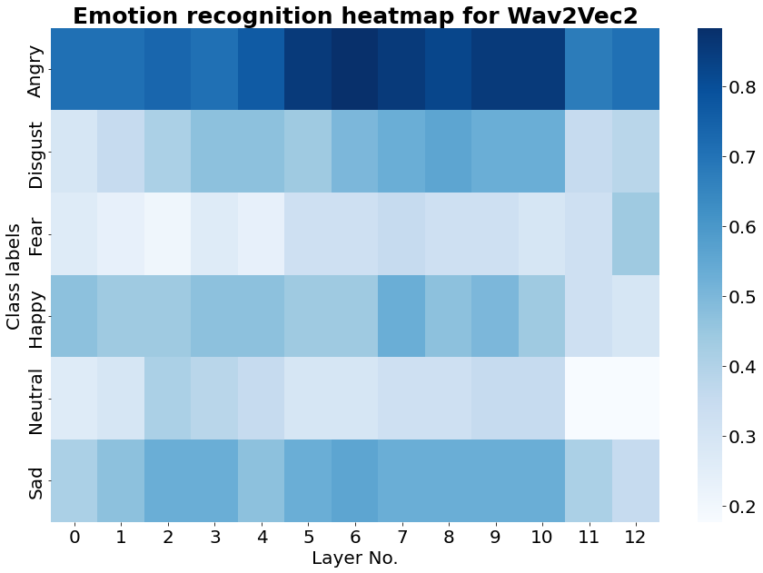
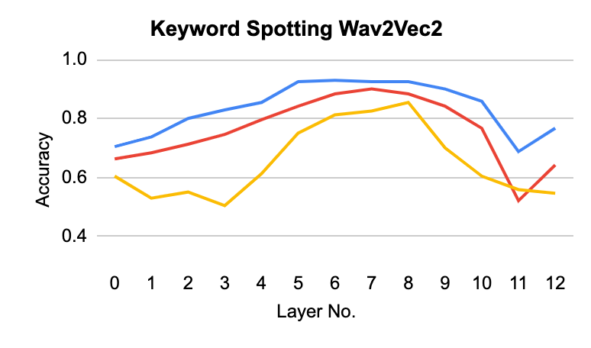
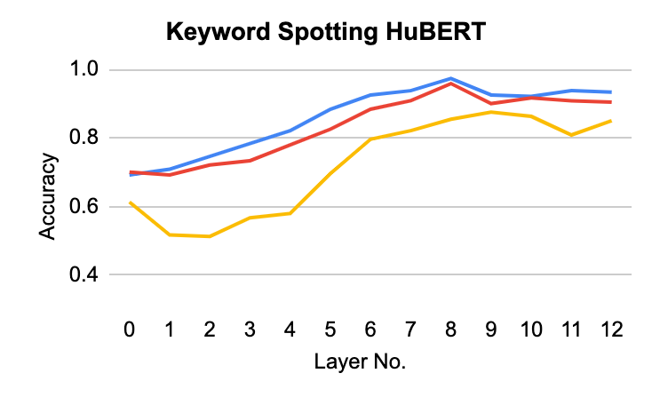
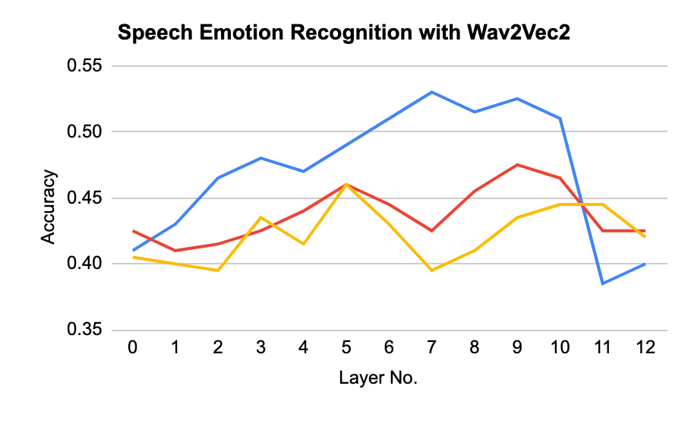
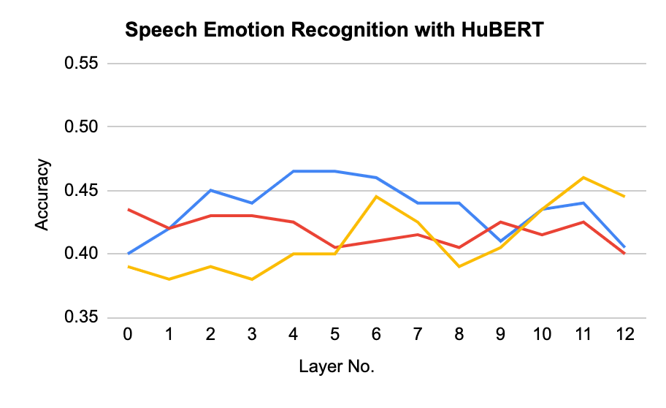
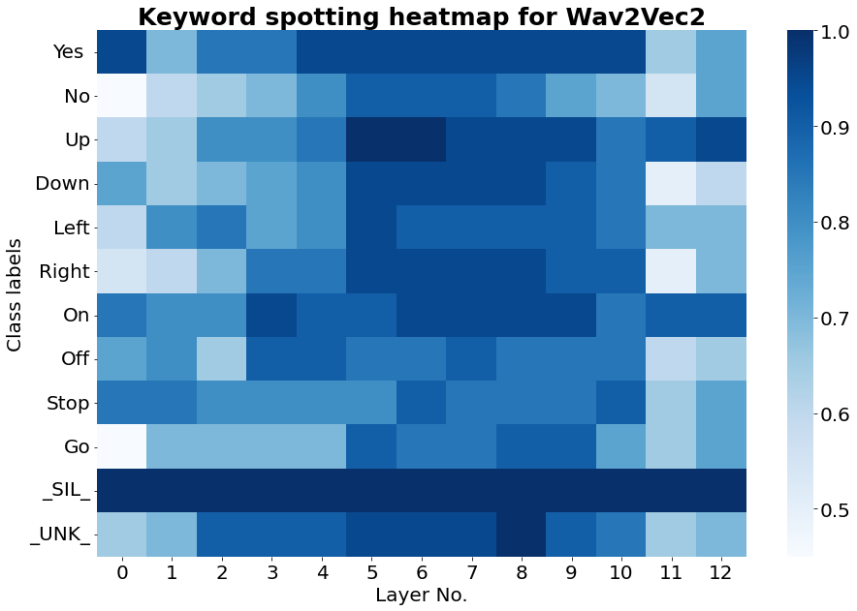
Interpreting Transformer-Based Models for Speech-Related Task
Mridul Gupta, Siddhant Kumar, Siddhant Mahurkar, Angad Nandwani, Eubin Park, Akshat Gupta (JPMC), Dr. Sining Chen
Objective
To interpret and understand the information captured by Wav2Vec2.0 & HuBERT models for Speech Emotion Recognition (SER) and Keyword Spotting (KS). We extract hidden states from each layer and train classification models to analyze the information gain across the 12 layers of transformer models.
Speech Emotion Recognition (SER)
To determine the emotion conveyed by speaker
7742 clips including 91 actors
Train-Test-Validation = [90-5-5]
Keyword Spotting (KS)
To detect when the certain keyword is spoken
60,793 audio samples, each of 1 second
Train-Test-Validation = [ 84-11-5]
Wav2Vec2.0/HuBERT
TASK | Model | Epochs | Accuracy
KS | Wav2Vec2.0 | 5 | 98.23
 | HuBERT | 5 | 98.19
SER | Wav2Vec2.0 | 10 | 78.00
 | HuBERT | 5 | 77.14
Wav2Vec is a speech encoder that employs semi-supervised training to improve supervised speech recognition. Uses CNN based network to convert the audio signal to a contextualized representation which can be used for down-stream tasks.
Hidden-Unit BERT (HuBERT) approach for self-supervised speech representation learning, which utilizes an offline clustering step to provide aligned target labels for a BERT-like prediction loss.
Table 1: Transformer Based Models Training Accuracy
Framework
6
Speech Emotion [ angry, happy, fear]
Train/Test Split
Load Sequence Classification layer from hugging face
Model Training/Evaluation
16000
Sampling Rate
Load Wav2Vec2 & HuBERT from hugging face library
Audio.wav
Sampling the dataset; Using 100 samples for each class
Pass dataset though model and extract layer wise hidden states
Training Classification Models
12
Keyword spotter [ up, go, down, left, on]
Conclusion
For most classes in Keyword Spotting and Speech Emotion Recognition, middle layers are performing better than initial layers.
Change in accuracy across layers was substantial for Keyword Spotting in comparison to Speech Emotion Recognition.
“Silence” (_SIL_) keyword and "angry” emotion are accurately classified across all 12 layers
“Fear” & “Neutral” emotions and “Stop” & “Go” keywords are not correctly classified across all layers.
Result : Layer wise Probing Accuracies
Logistic Regression
SVC
Random Forest
References
Acknowledgement
Tenney, I., Das, D., & Pavlick, E. (2019). BERT rediscovers the classical NLP pipeline. arXiv preprint arXiv:1905.05950.
Wang, Y., Boumadane, A., & Heba, A. (2021). A fine-tuned wav2vec 2.0/hubert benchmark for speech emotion recognition, speaker verification and spoken language understanding. arXiv preprint arXiv:2111.02735.
Sincere thanks to Akshat Gupta, Prof. Sining Chen, and Dr. Eleni Drinea for their constant support, expert guidance with the project and resources.
Fig 1 : Layer Wise #True Positive/Class

