Slide 1
The Typewriter
Invented by Christopher Latham Scholes (with Carlos Glidden and Samuel Soule)
Please excuse the obvious anachronisms. Thank you!

Slide 2
What Is it?
The typewriter is revolutionary!
It prints letters onto paper, so you don’t have to write!

Slide 3
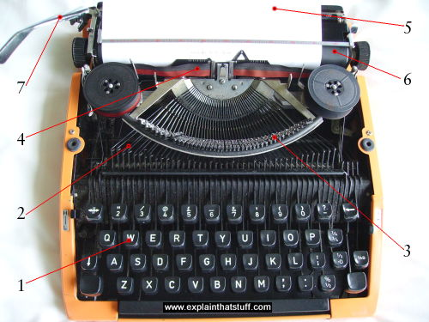
How does it work?
Keys (1), levers (2), type hammers (3), ribbons (4), paper (5), carriages (6), and carriage return levers (7) are all involved in making the typewriter work.
But what if you made a mistake? (IGNORE THE ANACHRONISM)

Slide 4
How will it make life better?
You can use it to “type” better letters and books!
No more writing by hand!
By: Sidney Pham

