Slide 1
Sidney Rodrigues
HTML title and alt Attributes

Slide 2
The <title> tag is required in all HTML documents and it defines the title of the document.
The <title> element:
Defines a title in the browser toolbar.
Provides a title for the page when it is added to favorites
Displays a title for the page in search-engine results
Tag <title>

Slide 3
<!DOCTYPE html>
<html> <head> <title>HTML Reference</title> </head> <body> The content of the document...... </body> </html>
Tag <title>

Slide 4

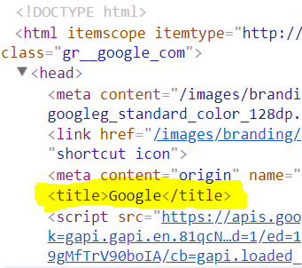
Examples

Slide 5
The title attribute specifies extra information about an element.
The information is most often shown as a tooltip text when the mouse moves over the element.
HTML title Attibute

Slide 6


<p><abbr title="World Health Organization">WHO</abbr> was founded in 1948.</p>
<p title="Free Web tutorials">W3Schools.com</p>
Example

Slide 7
The alt attribute provides alternative information for an image if a user for some reason cannot view it or if the user uses a screen reader.
Note: The alt attribute is required for the <img> element.
HTML alt Attibute

Slide 8
It Applies to:
<img>
<area>
<input>
Note: For <input> elements, the alt attribute can only be used with <input type="image">.
HTML alt Attibute

Slide 9


<img src="smiley.gif" alt="Smiley face">
Example <img>
Working:
Not Working:

Slide 10
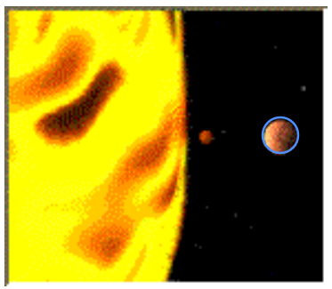
<map name="planetmap">
<area shape="rect" coords="0,0,82,126" alt="Sun" href="sun.htm">
<area shape="circle" coords="90,58,3" alt="Mercury" href="mercur.htm">
<area shape="circle" coords="124,58,8" alt="Venus" href="venus.htm">
</map>
Example <area>

Slide 11
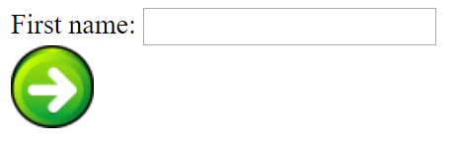

<input type="image" src="submit.gif" alt="Submit" width="48"height="48">
Example <input>
Working:
Not Working:

Slide 12
Thank you!
sidneyluiz.github.io
sidneyrodrigues.com

