Slide 1
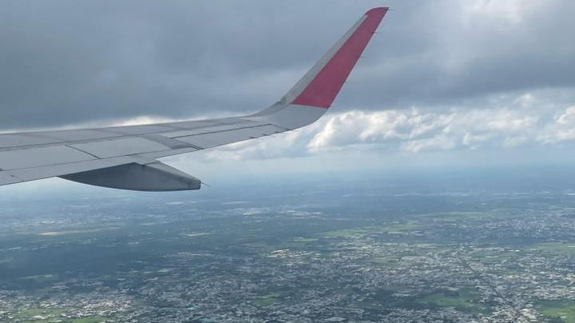
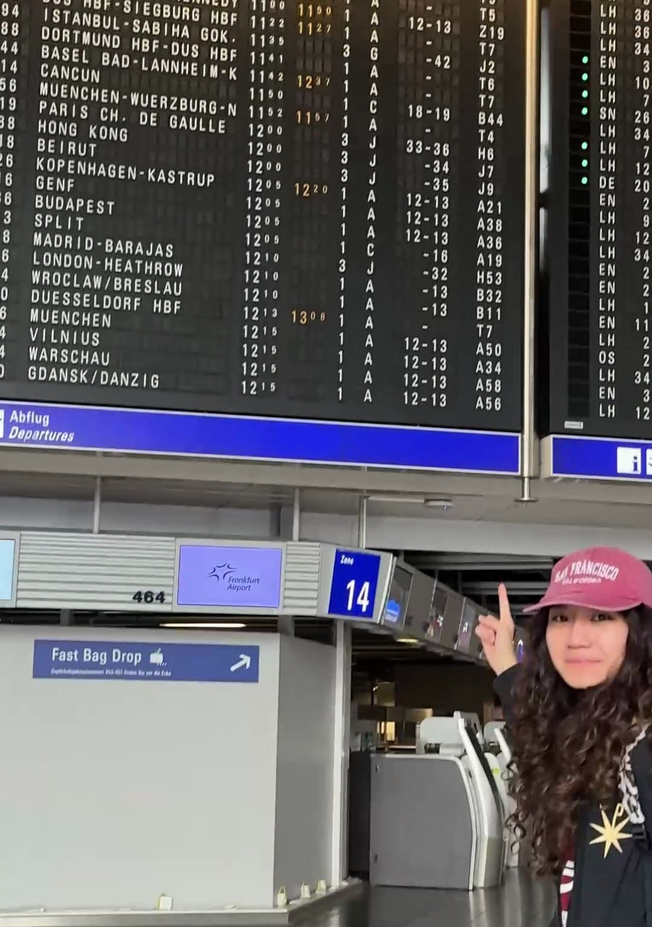
AIRPORT DISRUPTION IN GERMANY
INTRODUCTION TO DATA ANALYTICS · FRANKFURT SCHOOL
Forecasting daily ATFM arrival delays at 12 German airports, 2014–2025
Siddharth Jain · Manasvi Japi · Rong Qin
Terminal 1, Frankfurt. Orange on the board means delayed.

Slide 2
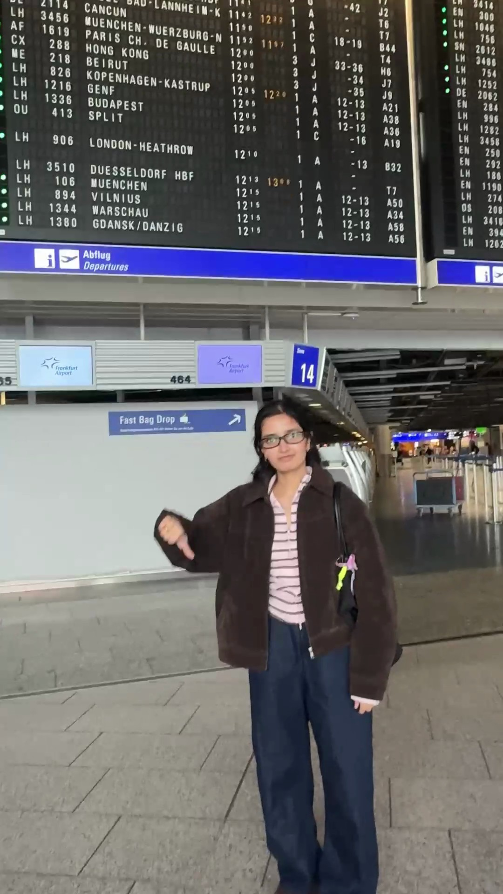
YOUR FLIGHT IS LATE AGAIN. WHO DO YOU BLAME?
BEFORE WE TAKE OFF
A
The weather
B
Air traffic control
C
The airport itself
D
Ich weiß es nicht
Keep your answer. We check it on slide 10.

Slide 3
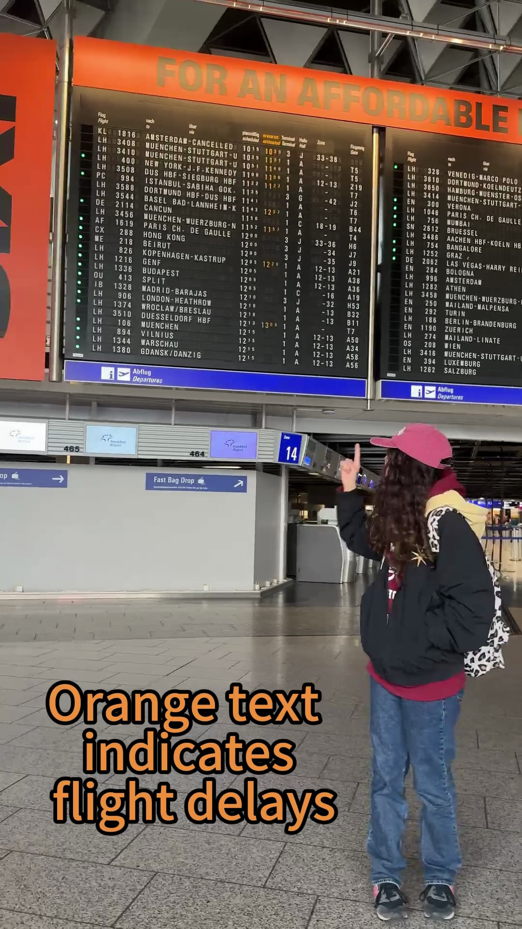
WE LEARNED „VERSPÄTUNG“ BEFORE „DANKE“
OUR STORY · FRANKFURT AM MAIN
1
We arrived at FRA as new international students. The board was orange.
2
Long waits, missed connections, and the same announcement every time.
3
As data science students at Frankfurt School, we asked: could the data have seen it coming?
„Wir bitten um Ihr Verständnis.“

Slide 4
ZEIT IST GELD · THE BUSINESS CASE
7.8 YEARS
of waiting. That is how much ATFM arrival delay piled up at just 12 German airports between 2014 and 2025. Every minute of it idles crews, gates and passengers.
4.09 million
55%
1 in 16
delay minutes in total
of them at Frankfurt alone
airport-days is disrupted

Slide 5
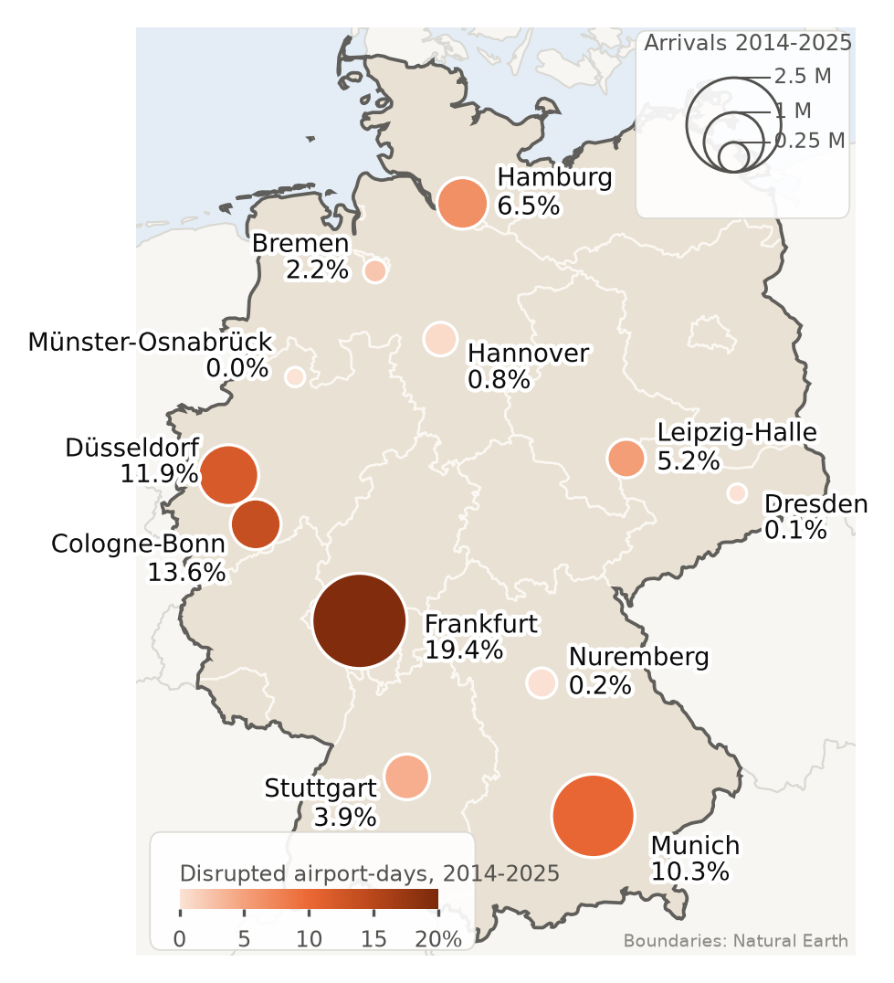
CAN PUBLIC DATA PREDICT A DISRUPTED DAY?
THE PROJECT
A day counts as disrupted when at least 2% of its arrivals get more than 15 minutes of ATFM delay. That is 6.2% of all days, and 19.4% at Frankfurt.
RISK
Will today be disrupted? yes or no
SEVERITY
How many delay minutes per arrival?
12 airports · 2014–2025 · 52,596 airport-days · EUROCONTROL and DWD open data

Slide 6
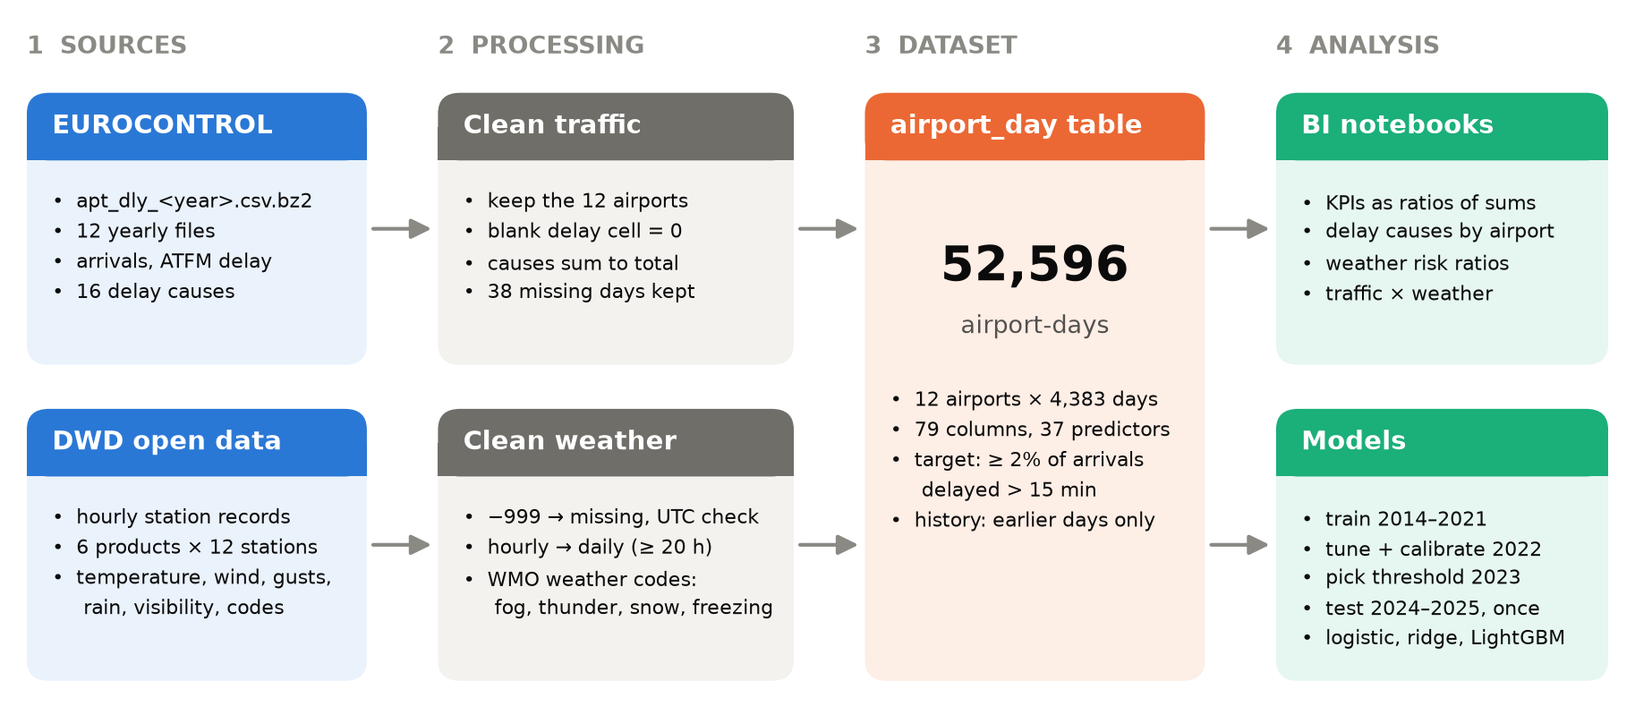
TWO PUBLIC SOURCES BECOME ONE TABLE
DATA SOURCES
84 raw files, each logged with a SHA-256 hash · a rebuild from raw gives an identical dataset · the 2025 file even had Umlaut trouble: two text encodings in one file

Slide 7
ONE ROW PER AIRPORT PER DAY, 79 COLUMNS
FRANKFURT · NOVEMBER 2024
Date | Arrivals | Delay, min | Over 15 min | Share | Max gust | Disrupted
17 Nov | 588 | 0 | 0 | 0.0% | 13.1 m/s | no
18 Nov | 597 | 0 | 0 | 0.0% | 11.9 m/s | no
19 Nov | 522 | 19,266 | 293 | 56.1% | 20.1 m/s | yes
20 Nov | 593 | 276 | 4 | 0.7% | 13.3 m/s | no
21 Nov | 588 | 0 | 0 | 0.0% | 12.4 m/s | no
22 Nov | 589 | 1,160 | 31 | 5.3% | 14.1 m/s | yes
19 November 2024 was the worst day of the test years: more than half of all arrivals were delayed, coded as aerodrome capacity.
Share = arrivals delayed over 15 minutes ÷ arrivals · a day is disrupted from 2% · 16 delay causes, 20 weather and 10 history features per row

Slide 8
TWO LINEAR MODELS, TWO TREE MODELS, ONE HONEST SPLIT
MODEL CHOICE
SIMPLE AND LINEAR
GRADIENT-BOOSTED TREES
RISK
Logistic regression
LightGBM classifier
disrupted, yes or no
One readable weight per input. Fast and easy to explain.
Learns thresholds and combinations, like storms that only hurt busy hubs.
SEVERITY
Ridge regression
LightGBM, Tweedie
delay minutes per arrival
Linear with a penalty, so overlapping history features stay calm.
Made for targets that are mostly zero with a long tail.
Train 2014–2021
Tune + calibrate 2022
Pick threshold 2023
Test 2024–25, scored once
Split by time, never shuffled. Each model has to beat a simple rule: the last 28 days.

Slide 9
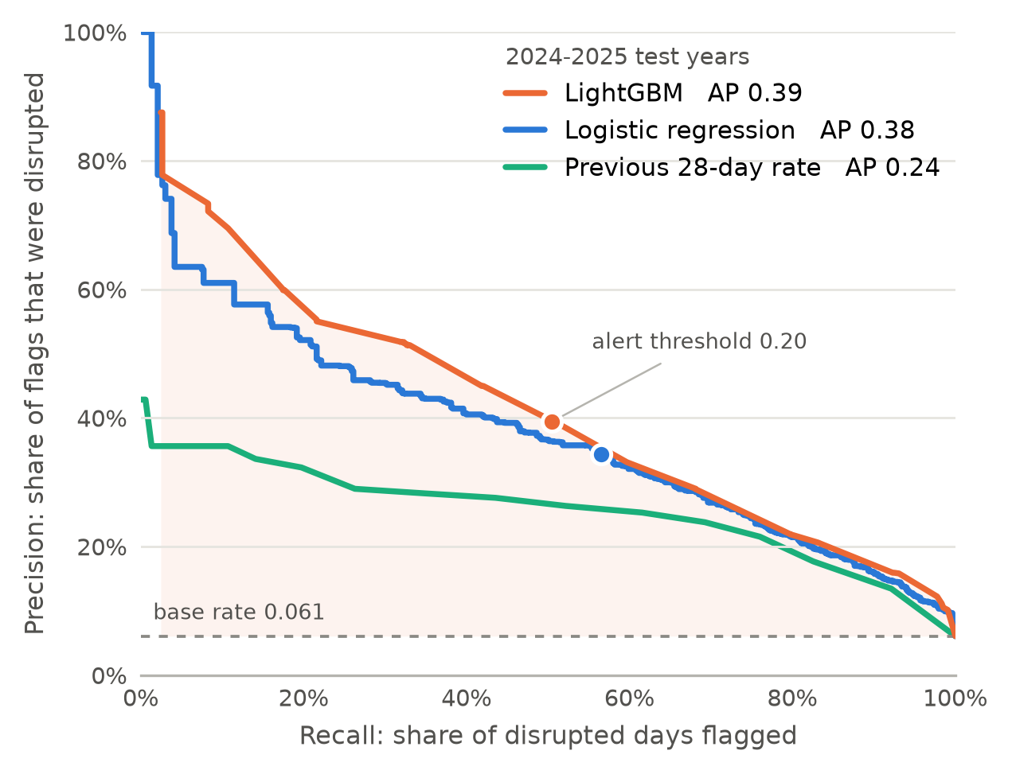
LIGHTGBM BEATS THE 28-DAY RULE
RESULTS · TEST YEARS 2024–25
Average precision 0.39 against 0.24, on 8,771 airport-days scored once.
50%
of disrupted days caught at the 0.20 alert threshold
0.63
AP at Frankfurt, against 0.30 for the 28-day rule
3 / 52
disrupted days caught at Stuttgart. Still homework.
Ehrlich gesagt: 89% of days have no delay, so “nothing happens” is hard to beat. Our delay-minutes model won by only 0.007 MAE.
Settings fixed on 2022–2023 before the test years · observed weather stands in for a forecast

Slide 10
THE SCOREBOARD
RESULTS · ALL MODELS, TEST YEARS 2024–25
DISRUPTED DAY? · CLASSIFIERS
DELAY MIN PER ARRIVAL · REGRESSORS
AP
ROC-AUC
Brier
Prec.
Recall
MAE
RMSE
R²
LightGBM
0.389
0.895
0.045
0.39
0.50
LightGBM (Tweedie)
0.200
0.947
0.16
Logistic regression
0.376
0.889
0.046
0.34
0.56
Ridge regression
0.290
0.957
0.14
28-day rate
0.242
0.848
0.050
0.25
0.62
Always zero
0.207
1.054
−0.04
Constant rate
0.061
0.500
0.057
–
–
28-day average
0.298
0.989
0.08
8,771 airport-days scored once · bold: best per column · grey rows: baselines · lower is better for Brier, MAE, RMSE · precision and recall at the 0.20 alert threshold chosen on 2023

Slide 11
WEATHER CAUSES TWO THIRDS OF ALL DELAY MINUTES
BI · NETWORK KPIS, 2014–2025
TOTAL ARRIVALS
DELAY MIN PER 1,000 ARRIVALS
DISRUPTION RATE
WEATHER SHARE OF DELAY
8.93 M
6.2%
458
67.3%
How much traffic are we analysing?
How often do airport disruptions occur?
How severe is delay relative to traffic?
How much ATFM delay is weather-related?
Slide 2, solved: the answer is mostly A, the weather. Sorry, air traffic control.
Ratios of sums over all 52,596 airport-days, so each airport counts by its traffic

Slide 12
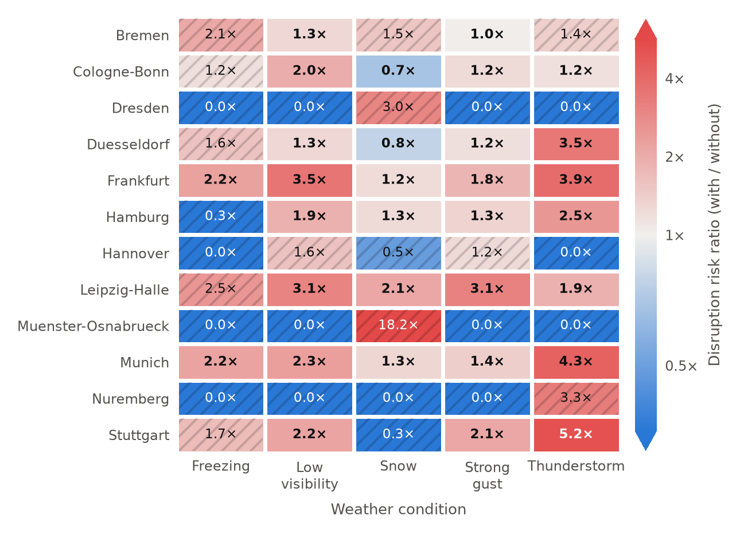
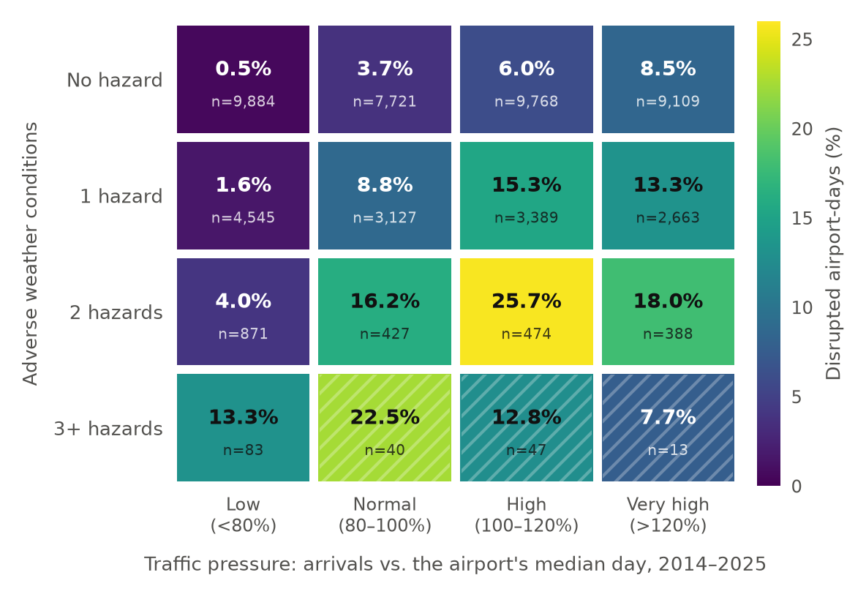
STORMS AND BUSY DAYS DRIVE DISRUPTION
BI · WHERE AND WHEN IT HITS
Thunderstorms make a day 3.9 to 5.2 times as likely to be disrupted at Frankfurt, Munich and Stuttgart.
A busy day with two hazards is disrupted 25.7% of the time. A quiet, calm day: 0.5%.

Slide 13
WHO DID WHAT
CREW
CREW 01
CREW 02
CREW 03
Siddharth Jain
Manasvi Japi
Rong Qin
Data engineering: sources, pipeline, airport-day table
LightGBM classifier and LightGBM regressor
Logistic regression and Ridge regression
Presentation
BI analysis and KPIs
Micropublication
Presentation
Code, data and paper: github.com/sidnov6/german-airport-disruption
MSc AI & Data Science · Frankfurt School of Finance & Management

Slide 14
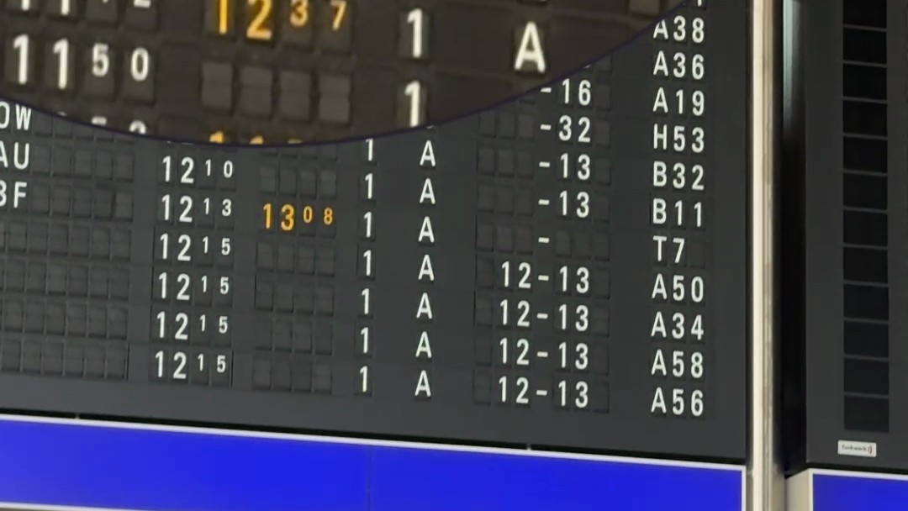
DANKE & PROST!
LANDED · ON TIME, FOR ONCE
Thank you and cheers. Please stay seated until the Q&A sign is switched off.
FRAGEN?
github.com/sidnov6/german-airport-disruption

