Slide 1
Multilingual Chatbot
Group no. :- 12
Under the Guidance of Prof. Rohini Deshapande
Name | Roll Number
Neel Patel | 1713043
Siddhant Kulkarni | 1823011

Slide 2
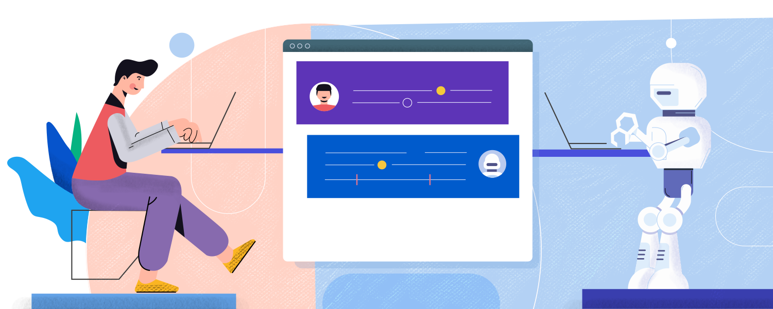
Problem Statement
To Develop natural language processing (NLP) and Machine learning based multilingual text to text chatbot which understands two languages during a conversation.

Slide 3
Objectives
To create Chatbot which provide information based on our college website
To build a text to text Chatbot that is used to provide support.
To create Training and Testing phase after creating Dataset.

Slide 4
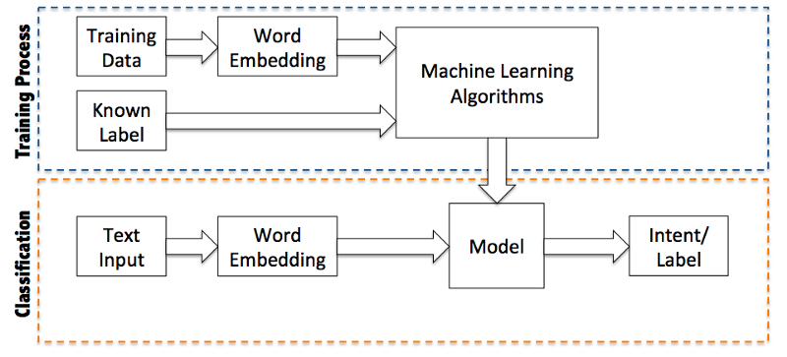
Proposed Architecture

Slide 5
Dataset
Chatbot is designed for two languages( English, Hindi).
To create Dataset based on our college website.
Language is converted via Google Translator.

Slide 6
Software Used
Programming language – Python(For Developing API)
Libraries – tkinter, Python
Tool – Python IDLE
Other - JSON

Slide 7
Work done
Created Initial Dataset in English (Intent).
Created Graphical User Interface (Label or Chat window).

Slide 8
Future Work To be Done
To create Training and Testing phase after creating Dataset.(Training Process and Classification)
Language is converted via Google Translator.(Hindi)

