Slide 1

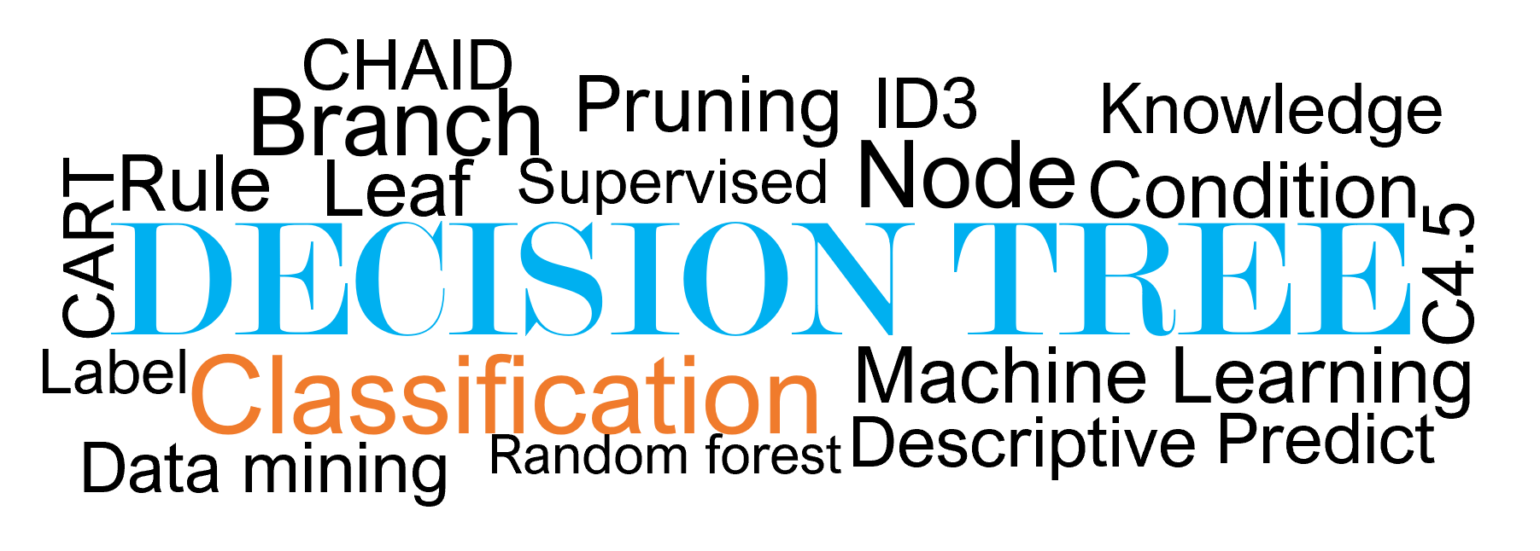
INTRODUCTION TO ARTIFICIAL INTELLIGENCE AND MACHINE LEARNING
CHAID
Pruning
Branch
ID3
Knowledge
Rule
Leaf
Supervised
Node
Condition
DECISION TREE
CART
C4.5
Label
Classification
Machine Learning
Data mining
Random forest
Descriptive
Predict
Submitted by
AKPA Céphas
DAKO Sidoine
ESSETCHEOU Merveille
MITCHOZOUNNOU Firmin
Lecturer
PhD Ratheil V. HOUNDJI
March 2022

Slide 2

OUTLINE
General introduction to decision tree (DT)
Classification DT as a ML technique
Advantages and limitations
Fields of application
Algorithms to perform classification DT
Performance metrics
Take home message
For this session
Application on real data: Bank marketing dataset

Slide 3
GENERAL INTRODUCTION TO DECISION TREE

Slide 4
GENERAL INTRODUCTION TO DECISION TREE
Every time, we make a decision:
Coming to school or not
Taking an exam or not
Go out and chill or not
Decide whether to have sexual intercourse or not
Convince the prof to make a presentation or not
In fact, each decision is underpinned by some conditions/rule:
Presence of the professor
The mark will count for an exam
Prof’s level of empathy

Slide 5
GENERAL INTRODUCTION TO DECISION TREE
For instance, let’s ask the following question:
What to do when different situation occur in weather ?

Slide 6
GENERAL INTRODUCTION TO DECISION TREE
Work to do ?
Stay at home
Outlook ?
sunny, overcast, rainy
Friend busy ?
Go to beach
Go running
Stay in
Go to movie

Slide 7

CLASSIFICATION DECISION TREE AS A ML TECHNIQUE
What is classification decision tree?
Non-parametric form of supervised machine learning technique
Flow chart like a tree structure
Same structure as in normal tree which includes root node, branches and leaf node.
A decision tree is a tree in which each node represents an attribute, each link (branch) represents a decision (rule), and each leaf represents a result.

Slide 8
CLASSIFICATION DECISION TREE AS A ML TECHNIQUE
Aim of classification decision tree
The most important feature of decision tree classifiers is the capability of capturing, descriptive, decisions making knowledge from the supplied data

Slide 9
CLASSIFICATION DECISION TREE AS A ML TECHNIQUE
Aim of classification decision tree
It is used to create a training model that can use to predict the class or value of the target variable by learning simple decision rules inferred from prior data (training data)
It is also used to categorize or make predictions based on how a previous set of questions were answered

Slide 10


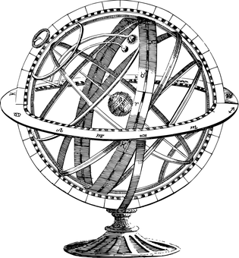



FIELDS OF APPLICATION
ETC.

Slide 11

ADVANTAGES AND LIMITATIONS
Advantages
Very easy to understand and to visualize
Handle both numerical and categorical data
Handle missing data
Non-parametric machine learning algorithm and make no asumptions regarding space distribution and classifier structures
White-box model
Inexpensive to construct.
Extremely fast at classifying unknown records

Slide 12

ADVANTAGES AND LIMITATIONS
Limitations
Tend to overfit data very easily, and use of pruning to prevent overfitting of the model
Not recommended for imbalanced data (use random forest instead of)
Biased when dealing with features that have a large number of levels
A slight change in the training set can highly affect the decision logic

Slide 13
ALGORITHMS TO PERFORM CLASSIFICATION DT
The decision tree algorithms are used to split the attributes to test at any node to determine whether splitting is “Best” in individual classes. Among those algorithms, we distinguish:

Slide 14
ALGORITHMS TO PERFORM CLASSIFICATION DT
DT Algorithm
ID3
C4.5
CART
CHAID
MARS

Slide 15
ALGORITHMS TO PERFORM CLASSIFICATION DT
ITERATIVE DICHOTOMISER 3
ID3 is a simple decision tree learning algorithm introduced in 1986 by Quinlan Ross.
It is based on Hunt's algorithm and is serially implemented.
The ID3 algorithm's main idea is to build a decision tree by doing a top-down, greedy search across the given sets to test each characteristic at each node.
Uses Entropy function and Information gain as metrics

Slide 16
ALGORITHMS TO PERFORM CLASSIFICATION DT
C4.5
C4.5 is an algorithm used to generate a decision tree developed by Ross Quinlan.
It introduces a number of improvements over the original ID3 algorithm
It’s an extension of Quinlan’s earlier ID3 algorithm.
As splitting criteria, C4.5 algorithm uses information gain.
C4.5 can accept data with categorical or numerical values (continuous data).
C4.5 algorithm can easily handle missing values, as missing attribute values are not utilized in gain calculations by C4.5.

Slide 17
ALGORITHMS TO PERFORM CLASSIFICATION DT
CART ALGORITHM
It stands for Classification And Regression Trees
Similar to C4.5, it can handle the continuous attributes
It was introduced by Breiman in 1984.
The classification tree construction by CART is based on binary splitting of the attributes.
CART also based on Hunt‟s algorithm and can be implemented serially.
Gini index is used as splitting measure in selecting the splitting attribute

Slide 18
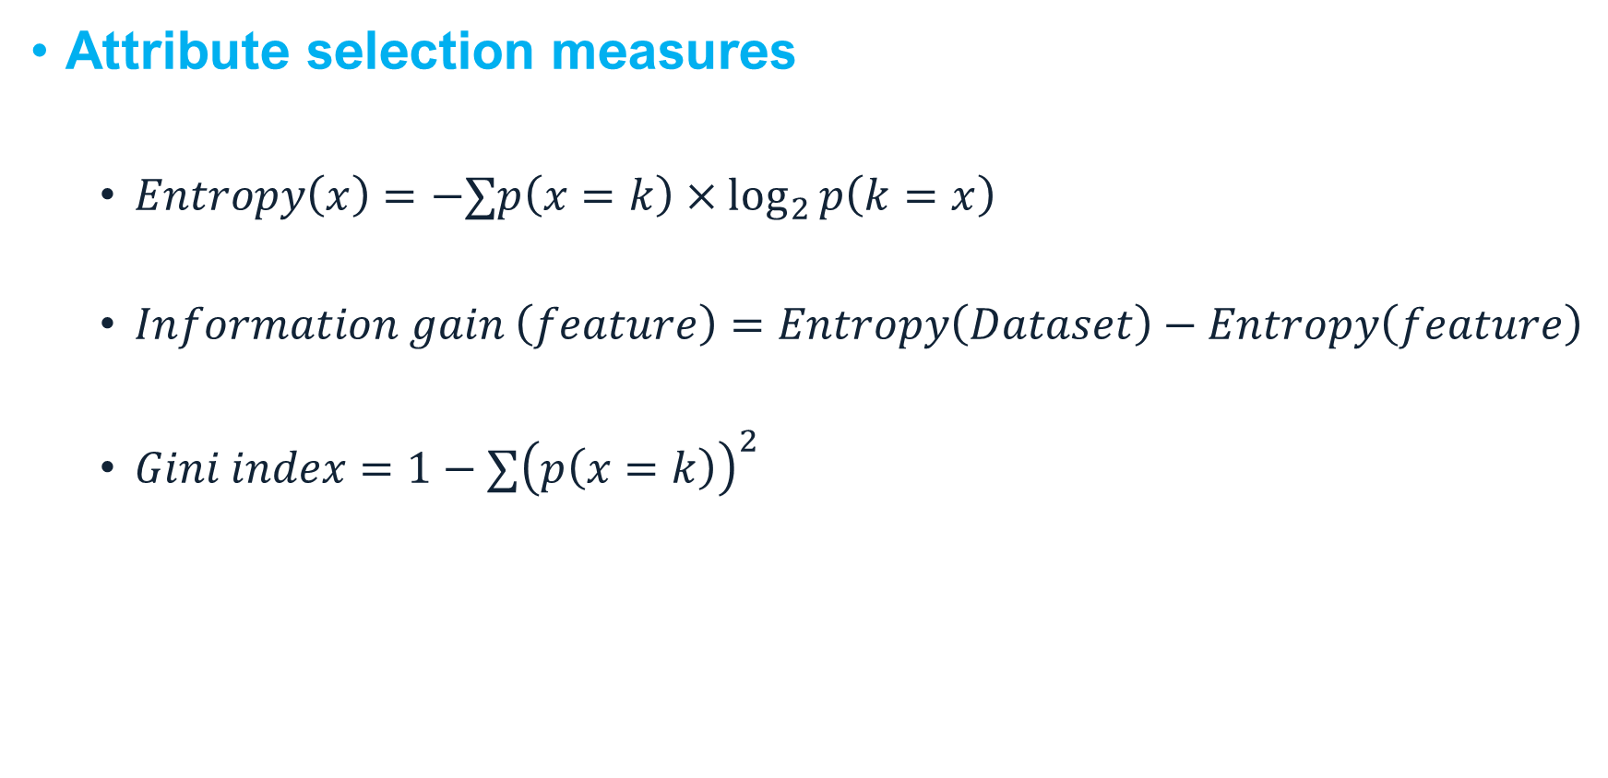
ALGORITHMS TO PERFORM CLASSIFICATION DT
Attribute selection measures
$Entropy\left(x\right)=−∑p\left(x=k\right)×\log_{2}{p\left(k=x\right)}$
$Information gain \left(feature\right)=Entropy\left(Dataset\right)−Entropy\left(feature\right)$
$Gini index=1−∑{\left(p\left(x=k\right)\right)}^{2}$

Slide 19
EXERCISE OF APPLICATION
The example considered in this section is based on the construction of a decision tree to predict whether a loan given to a person would result in a write-off or not.
Our entire population consists of 30 instances where there are 16 write-offs and 14 non-write-offs.
We have two features: “Balance” that can take one of the two values: “<50K” or “>50K” and “Residence” that has 3 modalities: “OWN”, “RENT” or “OTHER”.
The goal of this exercise is to demonstrate how, using the ID3 technique, a decision tree algorithm would determine which attribute to split on first and which feature gives more information or removes more uncertainty regarding our target variable.

Slide 20
EXERCISE OF APPLICATION
Let’s take the first feature Balance
N=30 instances
Class write-offs
(14)
(16)
Class non write-offs
P( ) =14/30=0.47
P( ) =16/30=0.53
Balance<50k
Balance>50k
(1)
(12)
(13)
(4)
P( ) =1/13=0.08
P( ) =12/13=0.92
P( ) =13/17=0.76
P( ) =4/17=0.24

Slide 21
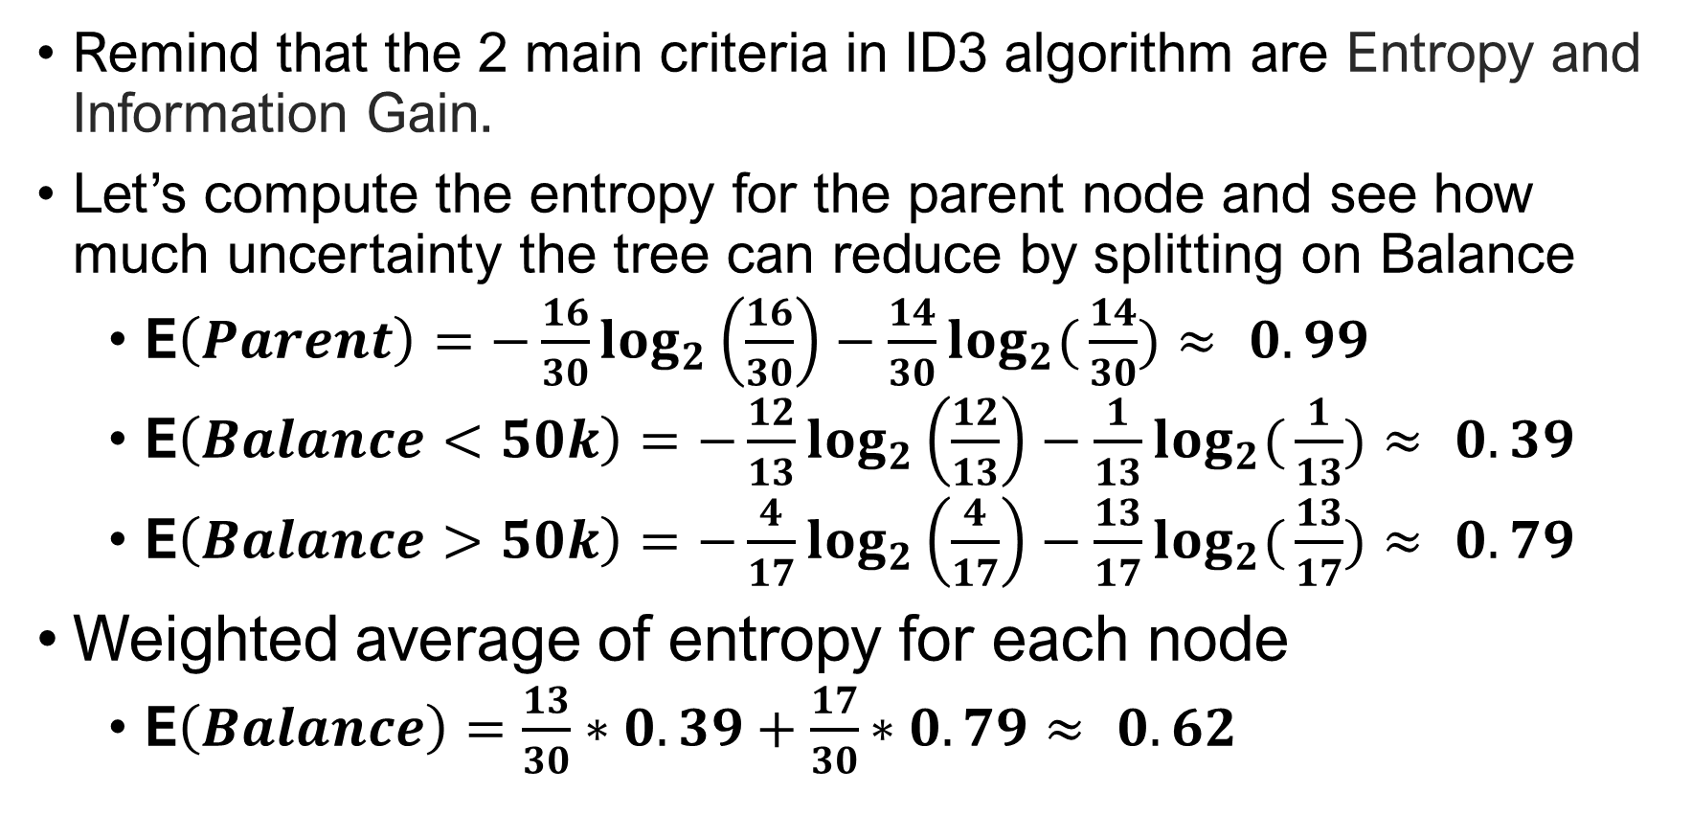
EXERCISE OF APPLICATION
Remind that the 2 main criteria in ID3 algorithm are Entropy and Information Gain.
Let’s compute the entropy for the parent node and see how much uncertainty the tree can reduce by splitting on Balance
E$\left(Parent\right)=−\frac{16}{30}\log_{2}\left(\frac{16}{30}\right)−\frac{14}{30}\log_{2}({\frac{14}{30})≈ 0.99}$
E$\left(Balance<50k\right)=−\frac{12}{13}\log_{2}\left(\frac{12}{13}\right)−\frac{1}{13}\log_{2}({\frac{1}{13})≈ 0.39}$
E$\left(Balance>50k\right)=−\frac{4}{17}\log_{2}\left(\frac{4}{17}\right)−\frac{13}{17}\log_{2}({\frac{13}{17})≈ 0.79}$
Weighted average of entropy for each node
E$\left(Balance\right)=\frac{13}{30}∗0.39+\frac{17}{30}∗0.79{≈ 0.62}$

Slide 22

EXERCISE OF APPLICATION
Information Gain
IG$\left(Parent, Balance\right)$= E$\left(Parent\right)$- E$\left(Balance\right)$ = $0.99$- $0.62$
$=0.37$
Conclusion: Splitting on feature ,“Balance” leads to an information gain of 0.37 on our target variable.

Slide 23
EXERCISE OF APPLICATION
Let’s do the same thing for feature, “Residence”.
N=30 instances
P( ) =14/30=0.47
P( ) =16/30=0.53
Class write-offs
(14)
(16)
Class non write-offs
Residence= OWN Residence= RENT Residence= OTHER
(1)
(7)
(6)
(4)
(7)
(5)
P( ) =1/8=0.12
P( ) =7/8=0.92
P( ) =6/10=0.6
P( ) =4/17=0.4
P( ) =7/12=0.58
P( ) =5/12=0.42

Slide 24
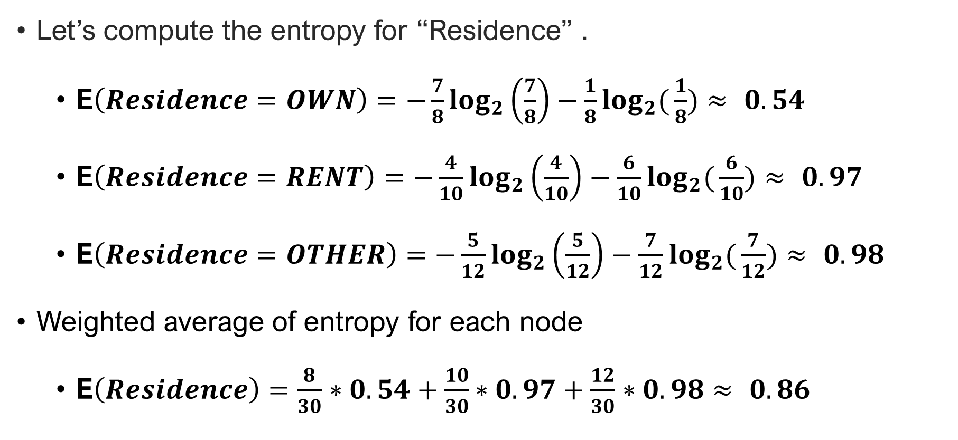
EXERCISE OF APPLICATION
Let’s compute the entropy for “Residence” .
E$\left(Residence=OWN\right)=−\frac{7}{8}\log_{2}\left(\frac{7}{8}\right)−\frac{1}{8}\log_{2}({\frac{1}{8})≈ 0.54}$
E$\left(Residence=RENT\right)=−\frac{4}{10}\log_{2}\left(\frac{4}{10}\right)−\frac{6}{10}\log_{2}({\frac{6}{10})≈ 0.97}$
E$\left(Residence=OTHER\right)=−\frac{5}{12}\log_{2}\left(\frac{5}{12}\right)−\frac{7}{12}\log_{2}({\frac{7}{12})≈ 0.98}$
Weighted average of entropy for each node
E$\left(Residence\right)=\frac{8}{30}∗0.54+\frac{10}{30}∗0.97+\frac{12}{30}∗0.98{≈ 0.86}$

Slide 25
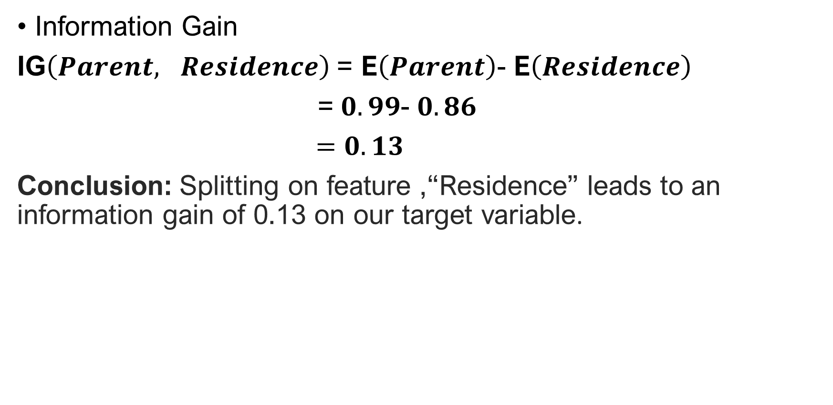
EXERCISE OF APPLICATION
Information Gain
IG$\left(Parent, Residence\right)$= E$\left(Parent\right)$- E$\left(Residence\right)$
= $0.99$- $0.86$
$=0.13$
Conclusion: Splitting on feature ,“Residence” leads to an information gain of 0.13 on our target variable.

Slide 26
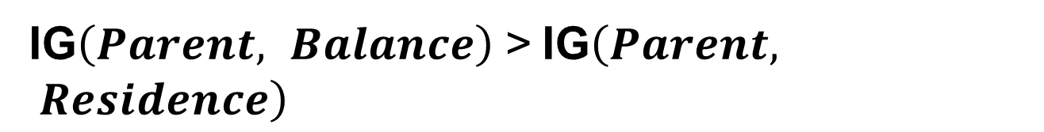
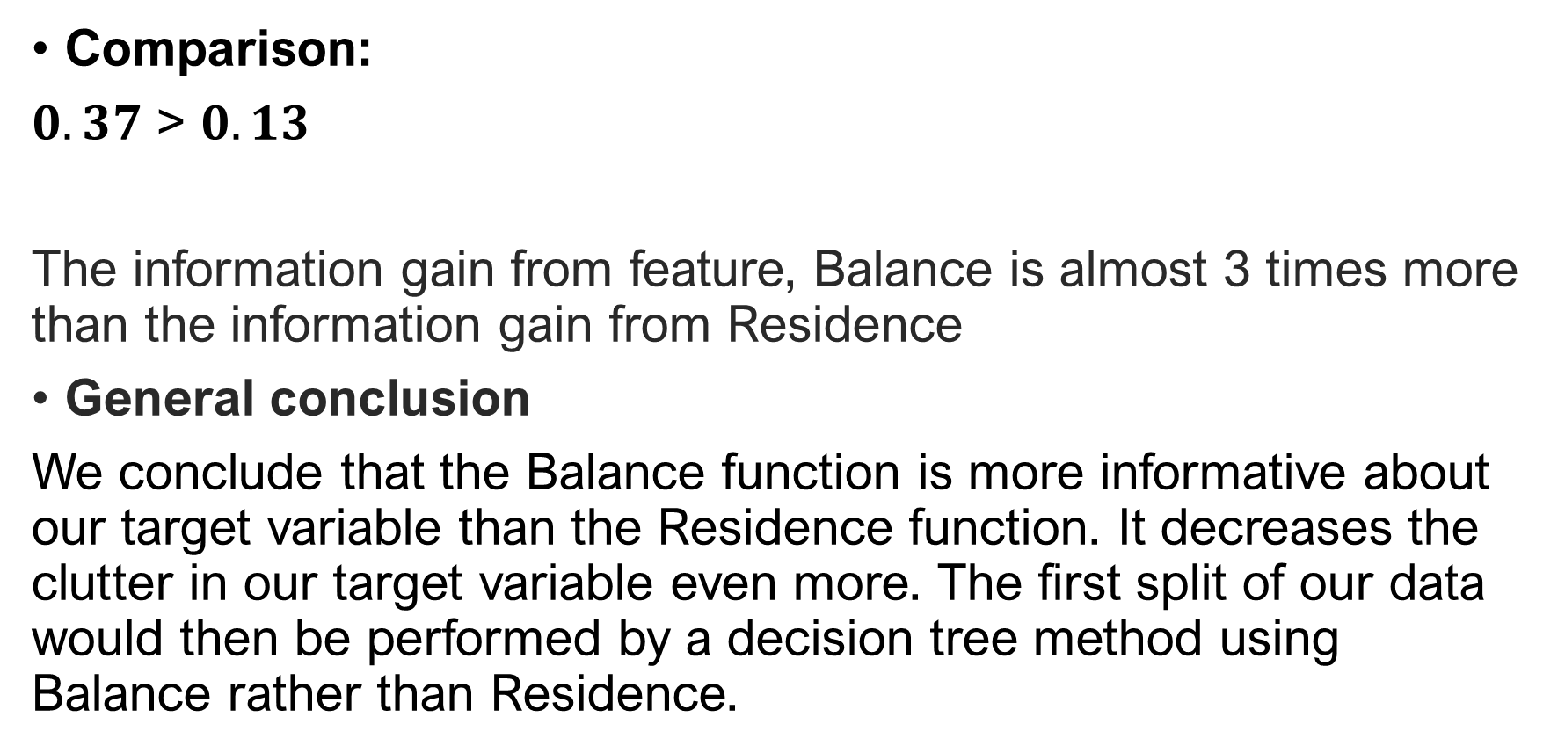
EXERCISE OF APPLICATION
Comparison:
$0.37$ > $0.13$
The information gain from feature, Balance is almost 3 times more than the information gain from Residence
General conclusion
We conclude that the Balance function is more informative about our target variable than the Residence function. It decreases the clutter in our target variable even more. The first split of our data would then be performed by a decision tree method using Balance rather than Residence.
IG$\left(Parent, Balance\right) \text{>}$IG$\left(Parent, Residence\right)$

Slide 27
EXERCISE OF APPLICATION
A decision tree would repeat this process as it goes deeper and deeper until it either reaches a pre-defined depth or no more splits may result in a higher information gain beyond a specific threshold, which is commonly set as a hyper-parameter!

Slide 28
EXERCISE OF APPLICATION
Decision tree N=30 instances
Class write-offs
(14)
(16)
Class non write-offs
Balance<50k
Balance>50k
(1)
(12)
(14)
(16)
Residence= OWN Residence= RENT Residence= OTHER
(1)
(4)
(6)
(0)
(6)
(0)

Slide 29
PERFORMANCE METRICS
Confusion matrix
 | Predicted labels
TRUE LABELS | TP | FN
 | FP | TN

Slide 30

PERFORMANCE METRICS
Accuracy score
$$Accuracy score=\frac{TP+TN}{TP+FP+TN+FN}$$
Precision score
$$Precision score=\frac{TP}{FP+TP}$$

Slide 31

PERFORMANCE METRICS
Recall score
$$Recall score=\frac{TP}{TP+FN}$$
F1 score
$$F1 score=2×\frac{Precision×Recall}{Precision+Recall}$$

Slide 32
APPLICATION FOR NEXT TIME
Dataset: Bank marketing
Source: OpenML website
Bibliography: S. Moro, R. Laureano and P. Cortez. Using Data Mining for Bank Direct Marketing: An Application of the CRISP-DM Methodology. In P. Novais et al. (Eds.), Proceedings of the European Simulation and Modelling Conference - ESM’2011, pp. 117-121, Guimarães, Portugal, October, 2011. EUROSIS
Number of observations: 45 211
Number of features: 16

Slide 33


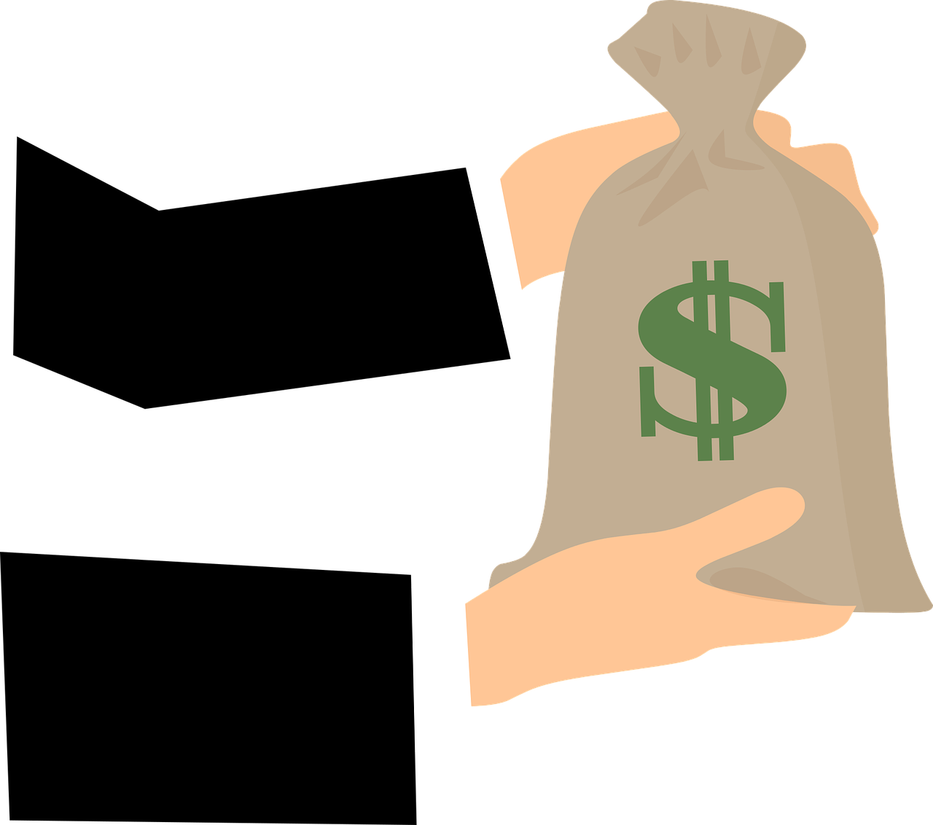

APPLICATION FOR NEXT TIME

Slide 34


APPLICATION FOR NEXT TIME

Slide 35




APPLICATION FOR NEXT TIME
The aim here is to build a model using a decision tree algorithm to predict if a client will subscribe to a bank term deposit or not with the historical data.

Slide 36
Let’s make our analysis !

Slide 37
TAKE HOME MESSAGE
Classification Decision tree is a machine learning algorithm used as a data mining approach to either characterize or predict a persona.
Easy interpretable, it’s frequently employed in many domains, classification DT is not very expensive in cost performance and have a good prediction accuracy.

Slide 38
Any questions, remarks, improvements ?
Fill free to share it with us !

