Slide 1
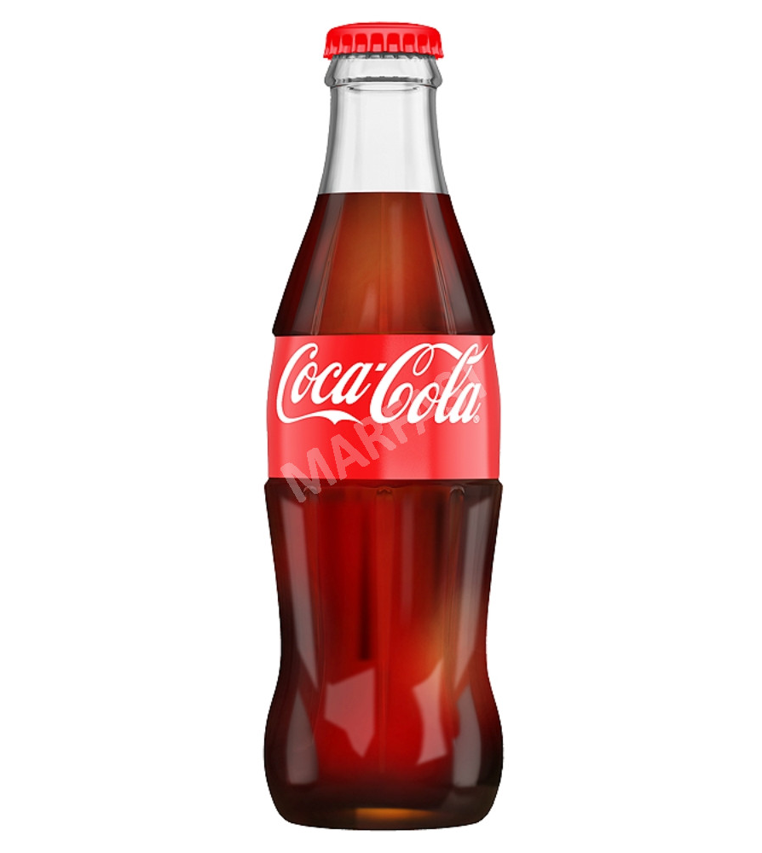
Bottle Filling Station

Slide 2
Agenda
Scenario Overview
Solution
Demo

Slide 3
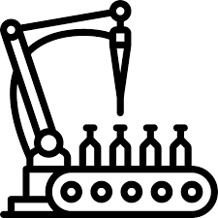
Scenario
Final phase of beverage manufacturing procedure
Demo simulates 20 cycles of 1 batch
100 bottles gets filled in every cycle
Objective
Measure productivity of every batch

Slide 4
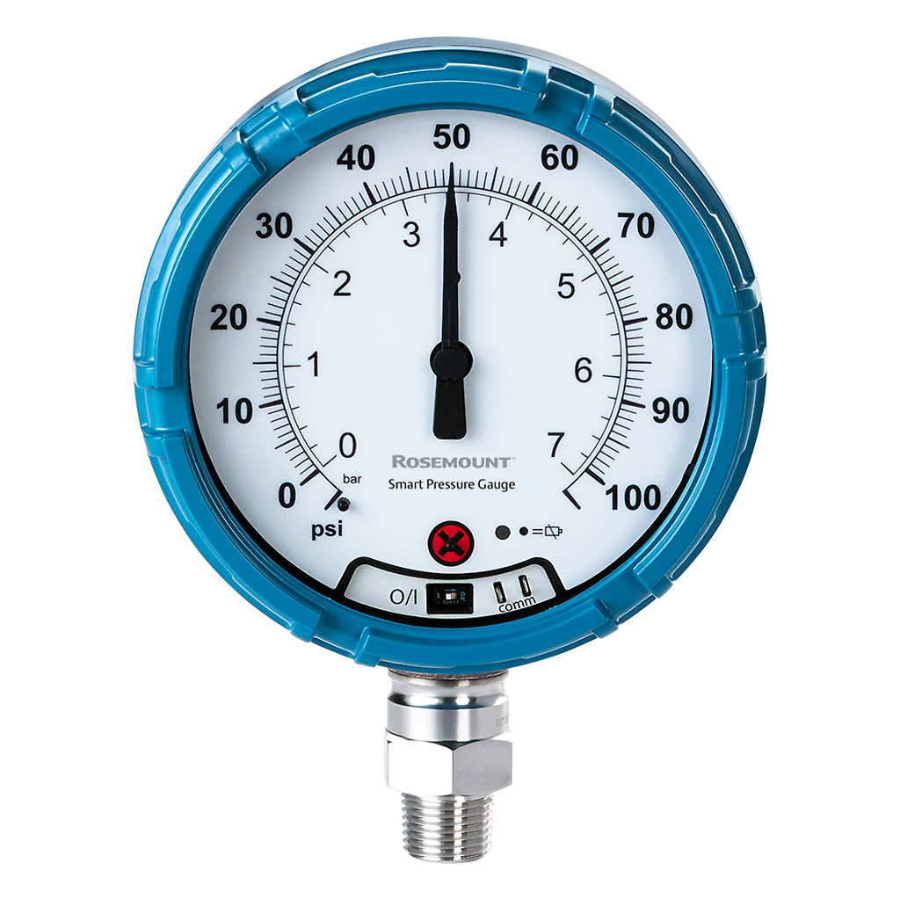
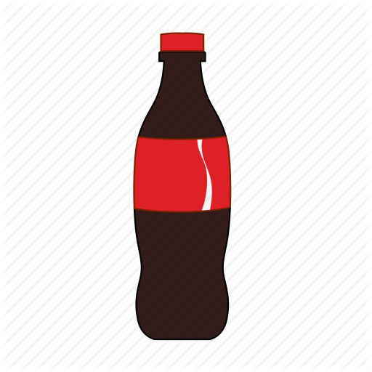

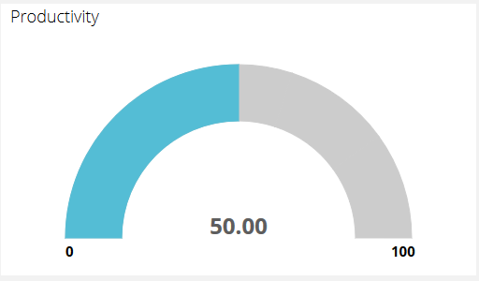
Solution
Check Metrics
In Limit?
Fill Bottles
Log Results
Monitor
Smart Sensors
( Pressure Gauge / Flowmeter )
Ubidots
Dashboards
Notes:
Smart Sensors

Slide 5
