Slide 1

Adding A Database Layer
Module 4
2

Slide 2

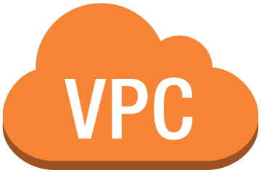





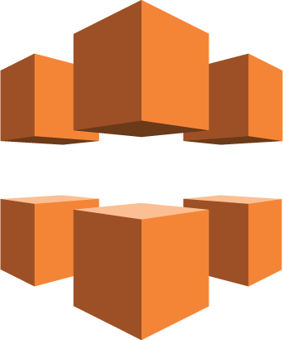







Dedicated Database Layer
Region
Amazon EC2
Instance
Amazon RDS Standby Replica
Amazon EFS Mount Target
NAT Gateway
Memcached
Amazon CloudFront
Availability Zone
Internet Gateway
Public Subnet
App Subnet
Data Subnet
Application Load Balancer
Auto Scaling
Amazon EFS
Amazon Route 53
Public Subnet
App Subnet
Data Subnet
Availability Zone
Static Assets
Amazon EC2
Instance
Amazon RDS Primary
Amazon EFS Mount Target
NAT Gateway
Memcached
Notes:
By the end of class, you will be able to understand all of the components of this architectural diagram. You will also be able to construct your own architectural solutions that are just as large and robust.

Slide 3
Module 4
The architectural need
You need a database that is highly available and easy to scale that is separate from your application servers.
Module Overview
Comparing database types
Managed vs. unmanaged services
Amazon Relational Database Service (Amazon RDS) and Amazon DynamoDB

Slide 4
Database Layer Considerations

Slide 5
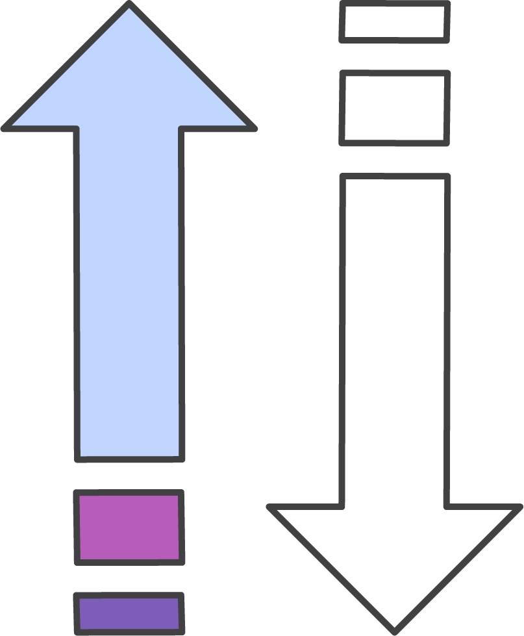

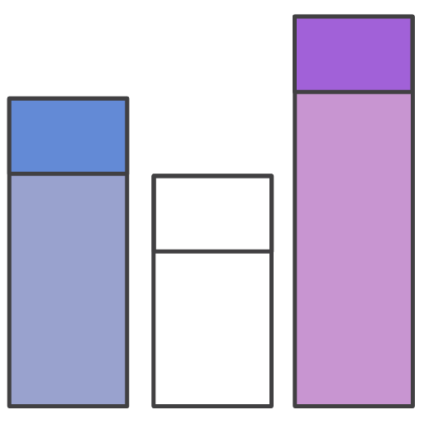

What Should You Consider?
Scalability
How much throughput do we need?
Will the solution we choose be able to scale up later if needed?
Total storage requirements
Object size and type
Durability

Slide 6
What Should You Consider?
Scalability
How large does our database need to be?
Will we have GB, TB, or PB of data?
Total storage requirements
Object size and type
Durability

Slide 7
What Should You Consider?
Scalability
Do we need to store simple data structures, large data objects, or both?
Total storage requirements
Object size and type
Durability

Slide 8
What Should You Consider?
Scalability
What level of data durability, data availability, and recoverability do you require?
Do you have a related regulatory obligation?
Total storage requirements
Object size and type
Durability

Slide 9
Database Types
Two types of database options are available for your architectures.
Traditional examples:
Relational
Nonrelational
Traditional examples:
Microsoft SQL Server
Oracle Database,
MySQL
MongoDB
Cassandra
Redis

Slide 10
Database Type: Relational
ISBN | Title | Author | Format
9182932465265 | Cloud Computing Concepts | Wilson, Joe | Paperback
Sales | Revenue | Author
1143 | 10503 | Wilson, Joe
Author | AccountNumber
Wilson, Joe | 8017330011
Notes:
A SQL database stores data in rows and columns. Rows contain all the information about one entry, and columns are the attributes that separate the data points. A SQL database schema is fixed: columns must be locked before data entry. Schemas can be amended if the database is altered entirely and taken offline. Data in SQL databases is queried using SQL (Structure Query Language), which can allow for complex queries. SQL databases scale vertically by increasing hardware power.

Slide 11
Database Type: Relational
When to choose a relational database:
You require strict schema rules and data quality enforcement
Your database doesn’t need extreme read/write capacity
If you have a relational dataset that does not require extreme performance, an RDBMS can be the best, lowest effort solution.

Slide 12
Database Type: Non-Relational
Key-Value
Document
{
ISBN: 9182932465265,
Title: “Cloud Computing Concepts”,
Author: “Wilson, Joe”,
Format: “Paperback”
}
Notes:
A NoSQL database stores data using one of many storage models, including key-value pairs, documents, and graphs. NoSQL schemas are dynamic. A row doesn’t have to contain data for each column. Data in NoSQL databases is queried by focusing on collections of documents. NoSQL databases scale horizontally by increasing servers.

Slide 13
Database Type: Non-Relational
When to choose a non-relational database:
You need your database to scale horizontally
Your data does not lend itself well to traditional schemas
Your read/write rates exceed those that can be economically supported through traditional SQL DB

Slide 14
Compare and Contrast Structured Data Storage
 | Relational | Nonrelational
Data Storage | Rows and columns | Key value, documents, and graphs
Schemas | Fixed | Dynamic
Querying | SQL-based querying | Focused on collection of documents
Scalability | Vertical | Horizontal

Slide 15
Unmanaged Databases
App optimization
Scaling
High availability
Database backups
DB s/w patches
You
DB s/w installs
OS patches
OS installation
Server maintenance
Rack and stack
Power, HVAC, net
If you host your databases on-premises
Notes:
In general: you are responsible for all security backups, DB tuning and replication.
You might be required by compliance obligations to create a self-managed DB solution for your application.

Slide 16

Unmanaged Databases
App optimization
Scaling
High availability
Database backups
DB s/w patches
You
DB s/w installs
OS patches
OS installation
OS installation
Server maintenance
Server maintenance
Rack and stack
Rack and stack
Power, HVAC, net
Power, HVAC, net
If you host your databases on-premises
If you host your databases in Amazon EC2

Slide 17
Unmanaged Databases
App optimization
App optimization
Scaling
Scaling
High availability
High availability
Database backups
You
Database backups
DB s/w patches
DB s/w patches
You
DB s/w installs
DB s/w installs
OS patches
OS patches
OS installation
OS installation
Server maintenance
Server maintenance
Rack and stack
Rack and stack
Power, HVAC, net
Power, HVAC, net
If you host your databases on-premises
If you host your databases in Amazon EC2

Slide 18
Managed Databases
You
App optimization
Scaling
High availability
Database backups
DB s/w patches
DB s/w installs
OS patches
OS installation
Server maintenance
Rack and stack
Power, HVAC, net
If you host your databases in a managed AWS database service
Notes:
AWS-Managed Databases
These provide systems for high availability scalability and backups. Packages that you can opt into. Choose to use
scaling, high availability, database backups, database software patches, database software installs, OS patches
Handing over the repetitive heavy lifting
OS installation, server maintenance, rack and stack, Power,hvac,net
In general: You are responsible only for app optimization “making sure the database layer works as well as possible with your application”

Slide 19
Amazon RDS and Amazon DynamoDB

Slide 20




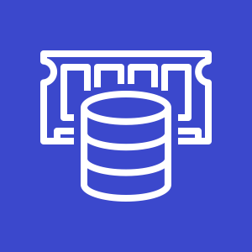
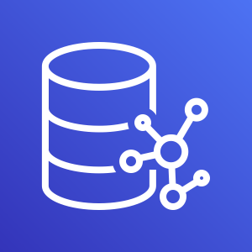
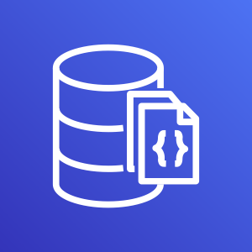
Amazon Database Options
Relational Databases
Non-Relational Databases
Amazon RDS
Amazon Redshift
Amazon Aurora
Amazon DynamoDB
Amazon ElastiCache
Amazon Neptune
Amazon DocumentDB (with MongoDB compatibility)
There are more databases – these are just common examples
Notes:
Amazon Relational Database Service (RDS) for Oracle supports Read Replicas with Active Data Guard. Amazon RDS for Oracle makes it easy to create the replicas in the same AWS Region as the primary DB instance by fully managing the configuration of Active Data Guard, and maintaining secure network connections between a primary DB instance and its replicas.
For more information, see: https://aws.amazon.com/rds/oracle/

Slide 21


Our Focus
Relational
Non-Relational
Amazon RDS
Amazon DynamoDB

Slide 22


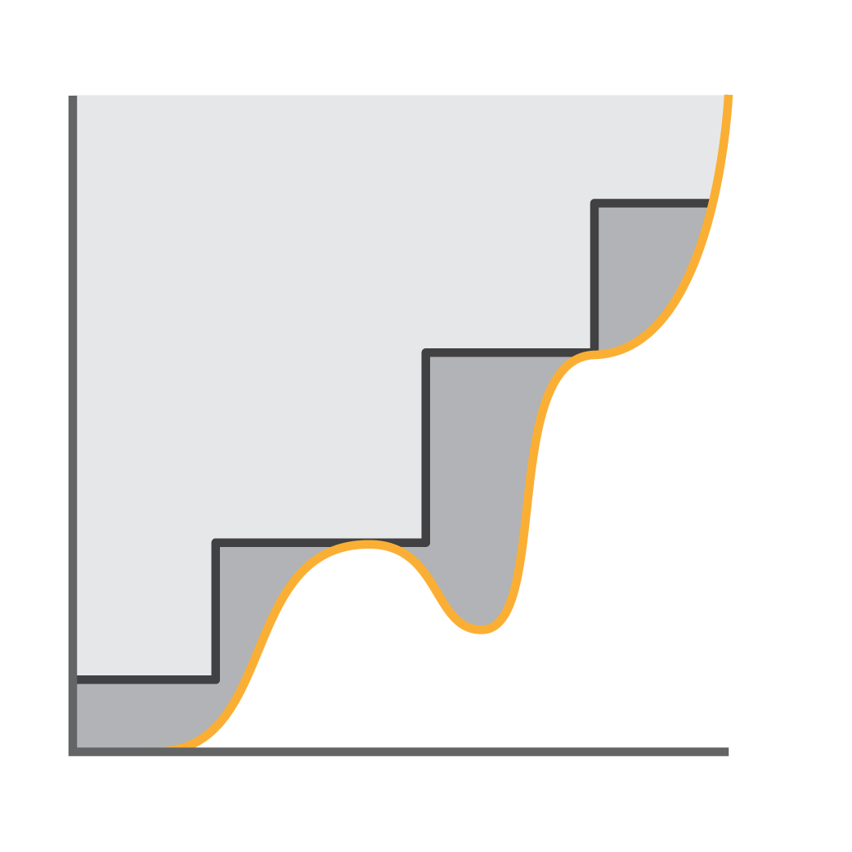
Amazon RDS
Relational
Fully managed relational database service
Provisions new instances in a few minutes
Amazon RDS
Scaling vertically with a few mouse clicks

Slide 23



Amazon RDS in General
Works well for applications that:
Relational
Amazon RDS
Have more complex data
Need to combine and join data sets
Require enforced syntax rules
Notes:
To protect against accidental deletion of data, Amazon Relational Database Service (RDS) supports the retention of automated backups after database deletion. In situations where accidental data loss occurs, your Amazon RDS instance can be restored to any point in time defined by the retained backups. Any retained automatic backups will adhere to the lifecycle policy specified for the deleted database. The automated backups will be deleted after the specified retention period passes, removing the need for manually clearing any stale backups. This is available for MySQL, MariaDB, PostgreSQL, Oracle, and Microsoft SQL Server database engines.

Slide 24
Amazon RDS Storage is Fully Managed
Relational
MySQL, MariaDB, PostgreSQL, Oracle – 16TB max
Aurora for MySQL and PostgreSQL – 64TB max
Amazon RDS

Slide 25
Amazon RDS and Amazon Aurora
Amazon Aurora is a fully managed, MySQL- and PostgreSQL-compatible, relational database engine.
Up to five times the throughput of MySQL
Up to three times the throughput of PostgreSQL
Replicates data six ways across three Availability Zones
Requires very little change to your existing application
Aurora global database support

Slide 26


Amazon RDS Use Case
Analytics
New Data
Data
Users
Data Analytics
Data Transformation

Slide 27
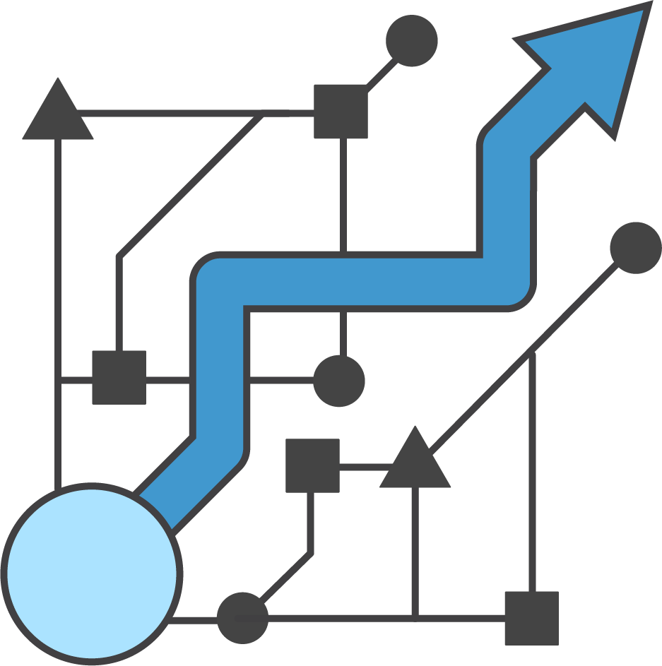

Amazon DynamoDB
Non-Relational
Fully managed non-relational database service
Event-driven programming (serverless computing)
Amazon DynamoDB
Extreme horizontal scaling capability
Notes:
Amazon DynamoDB is a fast, NoSQL database service that makes it simple and cost-effective to store data. Its throughput and single-digit millisecond latency make it a great fit for gaming, ad tech, mobile, and many other applications. DynamoDB delivers seamless throughput and storage scaling via API and an easy-to-use management console, so you can easily scale up or down to meet your needs. Many AWS customers have, with the click of a button, created DynamoDB deployments in a matter of minutes that are able to serve trillions of database requests per year.
DynamoDB tables do not have fixed schemas, and each item may have a different number of attributes. You can add secondary indexes to increase flexibility in the queries you can perform, without affecting performance. Performance, reliability, and security are built in, with SSD (solid state drive) storage and automatic three-way replication. DynamoDB uses proven cryptographic methods to securely authenticate users and prevent unauthorized data access.
Amazon DynamoDB transactions simplify the developer experience of making coordinated, all-or-nothing changes to multiple items both within and across tables. Transactions provide atomicity, consistency, isolation, and durability (ACID) in DynamoDB, enabling you to maintain data correctness in your applications easily.
You can use the DynamoDB transactional read and write APIs to manage complex business workflows that require adding, updating, or deleting multiple items as a single, all-or-nothing operation. For more information see: https://docs.aws.amazon.com/amazondynamodb/latest/developerguide/transactions.html

Slide 28


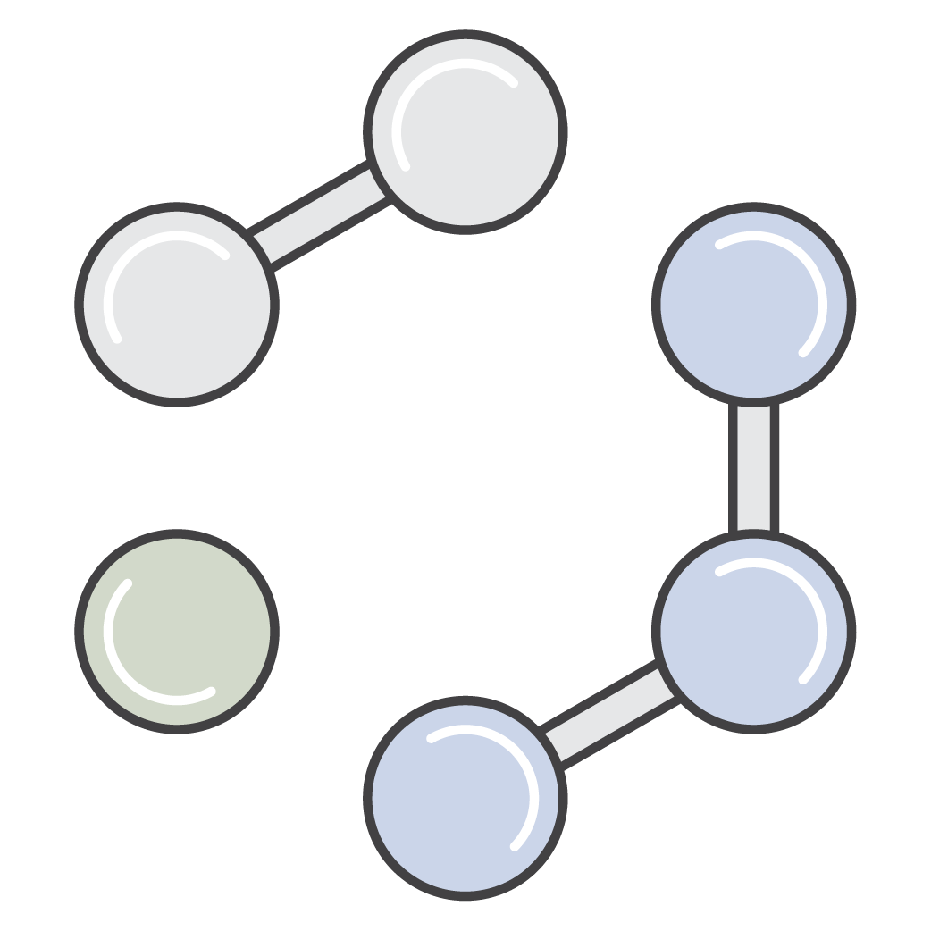
Amazon DynamoDB
Works well for applications that:
Non-Relational
Amazon DynamoDB
Have simple high-volume data
Need to scale quickly and with ease
Don’t need complex joins
Notes:
DynamoDB transactions provides ACID across one or more tables within a single AWS account and region. Can be used with applications that require coordinated inserts, deletes, or updates to multiple items.
https://aws.amazon.com/blogs/aws/new-amazon-dynamodb-transactions/

Slide 29


Amazon DynamoDB Data Model
Table = collection of data elements
Data elements stored as attributes
Data partitioned by the partition (hash) key
User
ID
Order
ID
Item = a collection of attributes
Partition1..N
Partition (hash) keys
Sort (range) keys
Notes:
In the world of DynamoDB, there is no schema. In a table, you have items. An item has variable attributes that have key-value pairs (similar to associative array or hash). In DynamoDB, they are called key and attribute.
DynamoDB supports key-value GET/PUT operations using a user-defined primary key (partition key, also known as a hash key). The primary key is the only required attribute for items in a table and it uniquely identifies each item. You specify the primary key when you create a table. In addition, DynamoDB provides flexible querying by allowing queries on non-primary key attributes using Global Secondary Indexes and Local Secondary Indexes.
A primary key can be a single-attribute partition key or a composite partition-sort key. A composite partition-sort key is indexed as a partition key element and sort (also known as range) key element. This multi-part key could be a combination of “UserID” (partition) and “Timestamp” (sort). Holding the partition key element constant, you can search across the sort key element to retrieve items. For example, you can retrieve all items for a single UserID across a range of timestamps.
Auto-partitioning occurs with data set size growth and as provisioned capacity increases.

Slide 30
Data Distribution: Partition Key and Sort Key
{
“AnimalType”:“Dog”,
“Name”:“Fido”,
<…other attributes…>
}
F(X)
Hash
function
{
“AnimalType”:“Bird”,
“Name”:“Polly”,
<…other attributes…>
}
{
“AnimalType”:“Dog”,
“Name”:“Bowser”,
<…other attributes…>
}
{
“AnimalType”:“Fish”,
“Name”:“Blub”,
<…other attributes…>
}
{
“AnimalType”:“Cat”,
“Name”:“Fluffy”,
<…other attributes…>
}
{
“AnimalType”:“Dog”,
“Name”:“Fido”,
<…other attributes…>
}
{
“AnimalType”:“Lizard”,
“Name”:“Lizzy”,
<…other attributes…>
}
{
“AnimalType”:“Turtle”,
“Name”:“Shelly”,
<…other attributes…>
}
{
“AnimalType”:“Dog”,
“Name”:“Rover”,
<…other attributes…>
}
Partition
Partition
Partition
Notes:
If the table has a composite primary key (partition key and sort key), DynamoDB calculates the hash value of the partition key in the same way as described in Data Distribution: Partition Key—but it stores all of the items with the same partition key value physically close together, ordered by sort key value.
To write an item to the table, DynamoDB calculates the hash value of the partition key to determine which partition should contain the item. In that partition, there could be several items with the same partition key value, so DynamoDB stores the item among the others with the same partition key, in ascending order by sort key.
To read an item from the table, you must specify its partition key value and sort key value. DynamoDB calculates the partition key's hash value, yielding the partition in which the item can be found.
You can read multiple items from the table in a single operation (Query), provided that the items you want have the same partition key value. DynamoDB returns all of the items with that partition key value. Optionally, you can apply a condition to the sort key so that it returns only the items within a certain range of values.
Suppose that the Pets table has a composite primary key consisting of AnimalType (partition key) and Name (sort key). The following diagram shows DynamoDB writing an item with a partition key value of Dog and a sort key value of Fido.
To read that same item from the Pets table, DynamoDB calculates the hash value of Dog, yielding the partition in which these items are stored. DynamoDB then scans the sort key attribute values until it finds Fido.
To read all of the items with an AnimalType of Dog, you can issue a Query operation without specifying a sort key condition. By default, the items are returned in the order that they are stored (that is, in ascending order by sort key). Optionally, you can request descending order instead.

Slide 31

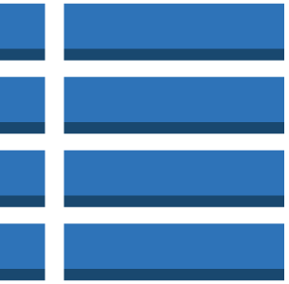
Amazon DynamoDB Has Global Tables
Global table
Non-Relational
Replica
us-west-2
Replica
us-east-1
Replica
eu-central-1
Amazon DynamoDB
Notes:
A global table is a collection of one or more DynamoDB tables, all owned by a single AWS account, identified as replica tables. A replica table (or replica, for short) is a single DynamoDB table that functions as a part of a global table. Each replica stores the same set of data items. Any given global table can only have one replica table per region, and every replica has the same table name and the same primary key schema.
Amazon DynamoDB global tables provide a fully managed solution for deploying a multi-region, multi-master database, without having to build and maintain your own replication solution. When you create a global table, you specify the AWS regions where you want the table to be available. DynamoDB performs all of the necessary tasks to create identical tables in these regions, and propagate ongoing data changes to all of them.

Slide 32

Amazon DynamoDB Use Cases
Leaderboards and Scoring
Players
Game servers
Leaderboard

Slide 33

Amazon DynamoDB Use Cases
Temporary Data (Online Cart)
Web store
Shopping cart
Order processing
Users

Slide 34

Amazon DynamoDB Consistency Options
Eventually Consistent
Strongly Consistent
Replica
Replica
Replica
Replica
Replica
Replica
Uses .5x Read Capacity Unit
Uses 1x Read Capacity Unit
Notes:
Read consistency represents the manner and timing in which the successful write or update of a data item is reflected in a subsequent read operation of that same item. Amazon DynamoDB exposes logic that enables you to specify the consistency characteristics you desire for each read request within your application.
Eventually Consistent Reads
When you read data from a DynamoDB table, the response might not reflect the results of a recently completed write operation. The response might include some stale data. If you repeat your read request after a short time, the response should return the latest data.
Strongly Consistent Reads
When you request a strongly consistent read, DynamoDB returns a response with the most up-to-date data, reflecting the updates from all prior write operations that were successful. A strongly consistent read might not be available if there is a network delay or outage.
DynamoDB uses eventually consistent reads, unless you specify otherwise. Read operations (such as GetItem, Query, and Scan) provide a ConsistentRead parameter. If you set this parameter to true, DynamoDB uses strongly consistent reads during the operation.

Slide 35
Security Controls for Amazon RDS and DynamoDB

Slide 36
Security Controls for Amazon RDS
A few things to think about:

Slide 37
Security Controls for Amazon RDS
A few things to think about:
Access to the DB itself – Who has visibility and can run actions on the database?
Notes:
Access Control When you first create a DB instance within Amazon RDS, you create a master user account, which is used only within the context of Amazon RDS to control access to your DB instances. The master user account is a native database user account that allows you to log on to your DB instance with all database privileges. You can specify the master user name and password you want associated with each DB instance when you create the DB instance. After you create your DB instance, you can connect to the database using the master user credentials. Subsequently, you can create additional user accounts so that you can restrict who can access your DB instance.
You can control Amazon RDS DB instance access via DB security groups, which are similar to Amazon EC2 security groups but not interchangeable. DB security groups act like a firewall that controls network access to your DB instance. Database security groups default to a “deny all” access mode, and customers must specifically authorize network ingress. There are two ways to do this: authorize a network IP range, or authorize an existing Amazon EC2 security group. DB security groups only allow access to the database server port (all others are blocked) and can be updated without restarting the Amazon RDS DB instance, which gives a customer seamless control of their database access. Using AWS IAM, you can further control access to your RDS DB instances. AWS IAM enables you to control which RDS operations each individual AWS IAM user has permission to call.

Slide 38
Security Controls for Amazon RDS
A few things to think about:
Access to the DB itself – Who has visibility and can run actions on the database?
Encryption at rest – Data that is encrypted at rest includes the underlying storage for a DB instance, its automated backups, read replicas, and snapshots.
Notes:
Encryption at Rest Amazon RDS DB instances and snapshots at rest can be encrypted. When encryption has been enabled, the instance’s automated backups, Read Replicas, and snapshots are encrypted using AES-256. Amazon RDS then handles authentication of access and decryption of this data with a minimal impact on performance, and with no need to modify your database client applications. This encryption is available for Amazon RDS with MySQL, PostgreSQL, Oracle, and SQL Server DB instances; however, it is not available for DB instances in the AWS GovCloud (us-gov-west-1) Region.

Slide 39
Security Controls for Amazon RDS
A few things to think about:
Access to the DB itself – Who has visibility and can run actions on the database?
Encryption at rest – Data that is encrypted at rest includes the underlying storage for a DB instance, its automated backups, read replicas, and snapshots.
Encryption in transit – Encryption in transit can be accomplished with SSL.
Notes:
Encryption in Transit
You can use SSL to encrypt connections between your application and your DB instance. For MySQL and SQL Server, RDS creates an SSL certificate and installs the certificate on the DB instance when the instance is provisioned. For MySQL, launch the MySQL client using the --ssl_ca parameter to reference the public key in order to encrypt connections. For SQL Server, download the public key and import the certificate into your Windows operating system. Oracle RDS uses Oracle native network encryption with a DB instance. You simply add the native network encryption option to an option group and associate that option group with the DB instance. When an encrypted connection is established, data transferred between the DB instance and your application will be encrypted during transfer. You can also require your DB instance to only accept encrypted connections. Note that SSL support within Amazon RDS is for encrypting the connection between your application and your DB instance; it should not be relied on for authenticating the DB instance itself. Although SSL offers security benefits, be aware that SSL encryption is a compute-intensive operation and will increase the latency of your database connection.

Slide 40
Security Controls for Amazon RDS
A few things to think about:
Access to the DB itself – Who has visibility and can run actions on the database?
Encryption at rest – Data that is encrypted at rest includes the underlying storage for a DB instance, its automated backups, read replicas, and snapshots.
Encryption in transit – Encryption in transit can be accomplished with SSL.
Event notifications – You can receive notifications of a variety of important events that can occur on your Amazon RDS instance.
Notes:
Event Notification You can receive notifications of a variety of important events that can occur on your RDS instance, such as whether the instance was shut down, a backup was started, a failover occurred, the security group was changed, or your storage space is low. Amazon RDS groups events into categories that you can subscribe to so that you can be notified when an event in that category occurs. You can subscribe to an event category for a DB instance, DB snapshot, DB security group, or DB parameter group. Amazon RDS events are published via Amazon SNS and sent to you as an email or text message.

Slide 41
Security Controls for DynamoDB
A few things to think about:

Slide 42
Security Controls for DynamoDB
A few things to think about:
Definable access permissions – With DynamoDB, you can grant access to everything from the table to the item to even the attributes of your database.

Slide 43
Security Controls for DynamoDB
A few things to think about:
Definable access permissions – With DynamoDB, you can grant access to everything from the table to the item to even the attributes of your database.
Encryption at rest – DynamoDB offers fully managed encryption at rest.

Slide 44
Security Controls for DynamoDB
A few things to think about:
Definable access permissions – With DynamoDB, you can grant access to everything from the table to the item to even the attributes of your database.
Encryption at rest – DynamoDB offers fully managed encryption at rest.
SSL/TLS – By default, communications to and from DynamoDB use the HTTPS protocol, which protects network traffic by using SSL/TLS encryption.

Slide 45
Security Controls for DynamoDB
A few things to think about:
Definable access permissions – With DynamoDB, you can grant access to everything from the table to the item to even the attributes of your database.
Encryption at rest – DynamoDB offers fully managed encryption at rest.
SSL/TLS – By default, communications to and from DynamoDB use the HTTPS protocol, which protects network traffic by using SSL/TLS encryption.
Customer managed keys – You can have full control over how you encrypt and manage the security of your DynamoDB data.

Slide 46
Migrating Data into Your AWS Databases

Slide 47

AWS Database Migration Service (AWS DMS)
Supports migration to and from most commercial and open source databases
Can be used to migrate between databases on Amazon EC2, Amazon RDS, Amazon S3, and on-premises
AWS Database Migration Service
Notes:
AWS DMS supports migration between the most widely used databases (Oracle, PostgreSQL, Microsoft SQL Server, Amazon Redshift, Amazon Aurora, MariaDB, and MySQL). It also supports homogenous (same engine) and heterogeneous (different engines) migrations.
The service can be used to migrate between databases on Amazon EC2, Amazon RDS and on-premises.
This includes migrating from Amazon EC2 or RDS databases to on-premises.
Either the target or the source database must be located in Amazon EC2 (cannot migrate between two on-premises databases).
It automatically handles formatting of the source data for consumption by the target database.
It does not perform schema or code conversion.
For homogenous migrations, you can use native tools to perform these conversions.
For heterogeneous migrations, you can use the AWS Schema Conversion Tool.
For more information, see http://docs.aws.amazon.com/dms/latest/userguide/Welcome.html.

Slide 48


Migration Options
One-time migration
AWS Database Migration Service
Ongoing migration

Slide 49

Using AWS Snowball Edge with AWS DMS
When migrating data is unfeasible:
Database is too large
Connection is too slow
Privacy and security concerns
We recommend AWS Snowball Edge
AWS Database Migration Service

Slide 50
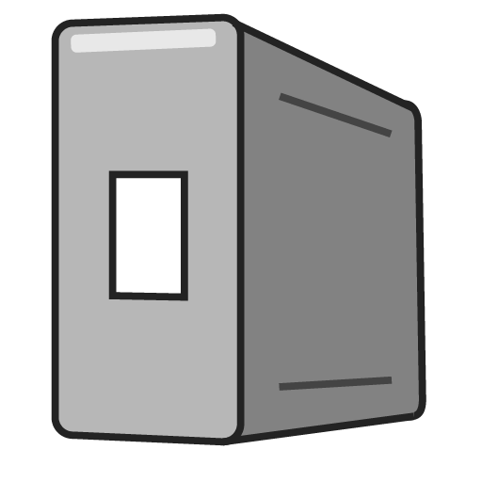
Using AWS Snowball Edge with AWS DMS
AWS DMS has a Snowball Edge integration point.
You can migrate one or more databases using the Snowball Edge device.
Multi-terabyte storage
Without using internet or DX bandwidth
AWS DMS
Snowball Edge
Notes:
You get the ability to physically attach a secure, hardened device directly inside your data center rather than opening ports from the outside.
You can now move very large databases from on-premises to AWS Cloud.
This integration provides a “push” model to migrate databases instead of a “pull” model.
You can migrate one or more databases using the same AWS Snowball Edge device without a need to upgrade your network infrastructure and consume dedicated bandwidth.
While migrating these multi-terabyte and multi-petabyte databases to AWS, your on-premises databases remain online. They can be decommissioned when the AWS Snowball Edge appliance is shipped back to AWS and is automatically loaded onto your target Amazon RDS– or Amazon EC2–based database.
You can migrate existing data (one time) or optionally perform ongoing data replication to the target database.
A few notes about working with AWS Snowball Edge and AWS DMS:
The version of AWS Snowball required for integration with AWS DMS is AWS Snowball Edge.
Currently, you need a Linux host to run the AWS DMS Snowball agent.
The AWS Snowball Edge must be on the same network as your source database.

Slide 51
AWS Schema Conversion Tool
A standalone application that enables you to convert your existing database schema from one database engine to another.
Source Database | Target Database
Microsoft SQL Server | Amazon Aurora, MySQL, PostgreSQL
MySQL | PostgreSQL
Oracle | Amazon Aurora, MySQL, PostgreSQL
Oracle Data Warehouse | Amazon Redshift
PostgreSQL | Amazon Aurora, MySQL
Teradata | Amazon Redshift
Notes:
For more on the AWS Schema Conversion Tool, go here: http://docs.aws.amazon.com/SchemaConversionTool/latest/userguide/Welcome.html

Slide 52
Lab 2: Deploying a Web Application on AWS

Slide 53
Lab 2: Deploying a Web Application on AWS
”I want to host a web application and database.”
Technologies used:
Amazon EC2
Amazon RDS
Security groups

Slide 54
Lab 2: Deploying a Web Application on AWS
Provided at start of lab:
VPC across two Availability Zones
2 x public subnets
2 x private subnets
Public Subnet 1
10.0.0.0/24
Public Subnet 2
10.0.1.0/24
Private Subnet 1
10.0.2.0/23
Private Subnet 2
10.0.4.0/23
Availability Zone
Availability Zone
Lab VPC

Slide 55


Lab 2: Deploying a Web Application on AWS
Security Configuration
App Security Group: Permit access from the internet
DB Security Group: Permit access from App Security Group
Allow HTTP traffic
Allow MySQL traffic
App server
Amazon RDS MySQL DB instance
Internet
App Security Group
DB Security Group
“Build the fence, then put resources inside the fence.”

Slide 56
Lab 2: Deploying a Web Application on AWS
You will then:
Deploy a database server
Deploy an application server
Test the application
App server
Public Subnet 1
10.0.0.0/24
Public Subnet 2
10.0.1.0/24
Amazon RDS DB instance
Private Subnet 1
10.0.2.0/23
Private Subnet 2
10.0.4.0/23
Duration: 30 min
Availability Zone
Availability Zone
Lab VPC

Slide 57
Thank You

