Slide 1
File I/O

Slide 2
Read the first line of a file
file = open("students.txt", "r")
line = file.readline()
file.close()
print(line)
FirstName, Surname, Math, English, IT, Biology, PE
FirstName, Surname, Math, English, IT, Biology, PE
Alfalfa, Aloysius, 40.0, 90.0, 100.0, 83.0, 49.0
Alfred, Smith, 41.0, 97.0, 96.0, 97.0, 48.0

Slide 3

Read every line of a file into memory
file = open("students.txt", "r")
lines = file.readlines()
file.close()
for line in lines:
print(line)
FirstName, Surname, Math, English, IT, Biology, PE
Alfalfa, Aloysius, 40.0, 90.0, 100.0, 83.0, 49.0
Alfred, Smith, 41.0, 97.0, 96.0, 97.0, 48.0

Slide 4

Read every line of a file into memory…
file = open("students.txt", "r")
header = file.readline()
lines = file.readlines()
file.close()
for line in lines:
print(line)
FirstName, Surname, Math, English, IT, Biology, PE
Alfalfa, Aloysius, 40.0, 90.0, 100.0, 83.0, 49.0
Alfred, Smith, 41.0, 97.0, 96.0, 97.0, 48.0

Slide 5
Read a file line by line
file = open("students.txt", "r")
for line in file:
print(line.strip())
file.close()
FirstName, Surname, Math, English, IT, Biology, PE
Alfalfa, Aloysius, 40.0, 90.0, 100.0, 83.0, 49.0
Alfred, Smith, 41.0, 97.0, 96.0, 97.0, 48.0
Press any key to continue . . .
spaces
FirstName, Surname, Math, English, IT, Biology, PE
Alfalfa, Aloysius, 40.0, 90.0, 100.0, 83.0, 49.0
Alfred, Smith, 41.0, 97.0, 96.0, 97.0, 48.0

Slide 6
Read all lines into memory – Using with
with open("students.txt") as file:
lines = file.readlines()
for line in lines:
print(line)
FirstName, Surname, Math, English, IT, Biology, PE
Alfalfa, Aloysius, 40.0, 90.0, 100.0, 83.0, 49.0
Alfred, Smith, 41.0, 97.0, 96.0, 97.0, 48.0

Slide 7
Read a file line by line – Using with
with open("students.txt") as file:
for line in file:
print(line)
FirstName, Surname, Math, English, IT, Biology, PE
Alfalfa, Aloysius, 40.0, 90.0, 100.0, 83.0, 49.0
Alfred, Smith, 41.0, 97.0, 96.0, 97.0, 48.0

Slide 8
Append to a file – Using with
with open("students.txt", "a") as file:
file.write("Bob, Smith, 30, 80, 70, 60\n")
file.write("Rob, Jones, 20, 60, 80, 90\n")
FirstName, Surname, Math, English, IT, Biology, PE
Alfalfa, Aloysius, 40.0, 90.0, 100.0, 83.0, 49.0
Alfred, Smith, 41.0, 97.0, 96.0, 97.0, 48.0
Bob, Smith, 30, 80, 70, 60
Rob, Jones, 20, 60, 80, 90

Slide 9
Write to a file
with open(r"c:\qa\students.txt", "w") as file:
file.write("Bob, Smith, 30, 80, 70, 60")
Bob, Smith, 30, 80, 70, 60
The only line in the file!

Slide 10
File path in Windows
✗
file = open('C:\Users\Admin\source\repos\AWS\students.txt', "r")
✓
file = open('C:/Users/Admin/source/repos/AWS/students.txt', "r")
✓
file = open('C:\\Users\\Admin\\source\\repos\\AWS\\students.txt', "r")
✓
file = open(r'C:\Users\Admin\source\repos\AWS\students.txt', "r")

Slide 11

Any Questions?

Slide 12
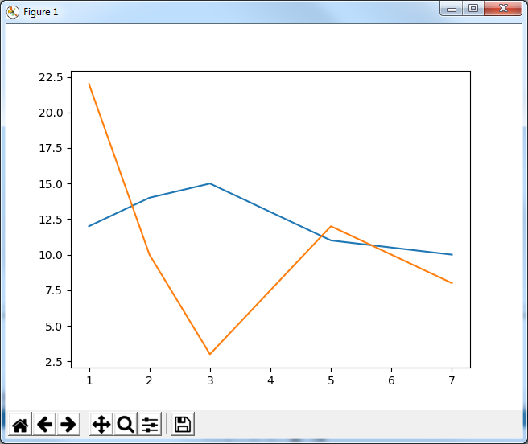
Plotting values read from a file
import matplotlib.pyplot as plt
plt.plot([1, 2, 3, 5, 7], [12, 14, 15, 11, 10])
plt.plot([1, 2, 3, 5, 7], [22, 10, 3, 12, 8])
plt.show()

Slide 13
Practical example of graph from a file
import matplotlib.pyplot as plt
with open("students.txt") as file:
for line in file:
grades = line.replace(' ', '').split(', ')
grades = list(map(float, grades[2:7]))
plt.plot([1, 2, 3, 4, 5, ], grades)
plt.show()

