Slide 1
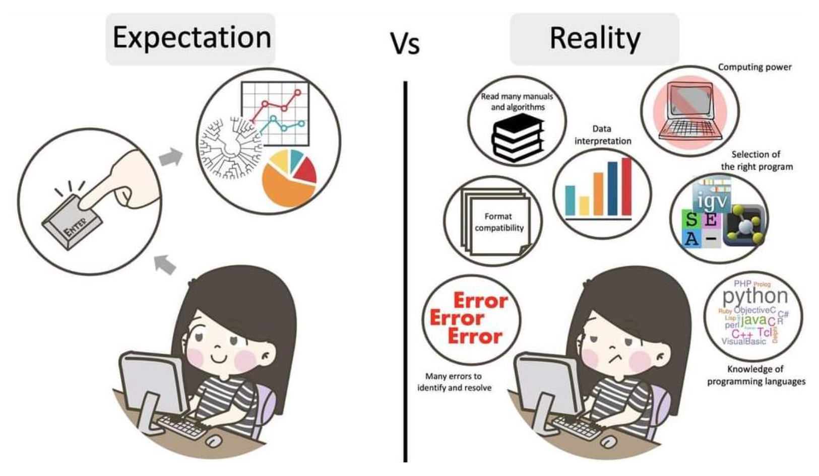
Linux basics
But don’t panic, it will be fun ☺
© Adapted from Galaxy Training Network, Cormier, Leroi et al., 2023, licensed under Creative Commons Attribution 4.0 International License

Slide 2
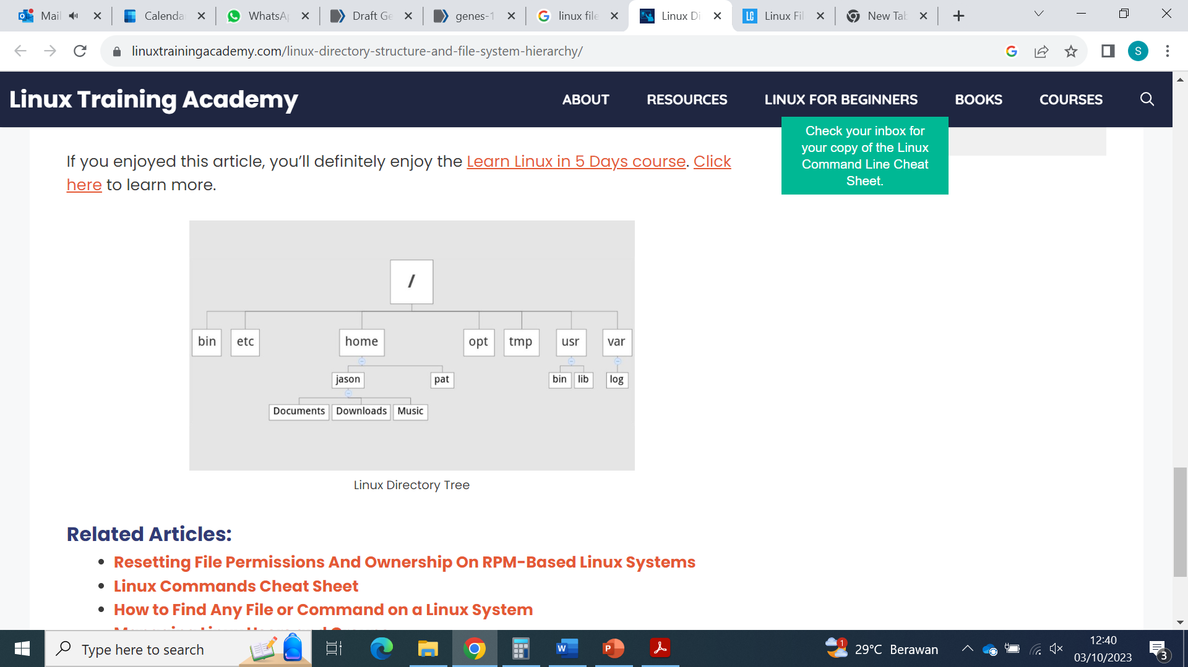

Linux environment, how to know where you are and how to move around
The environment is made of directories, themselves containing directories and files. This can be represented as a tree
How does your environment look like?

Slide 3
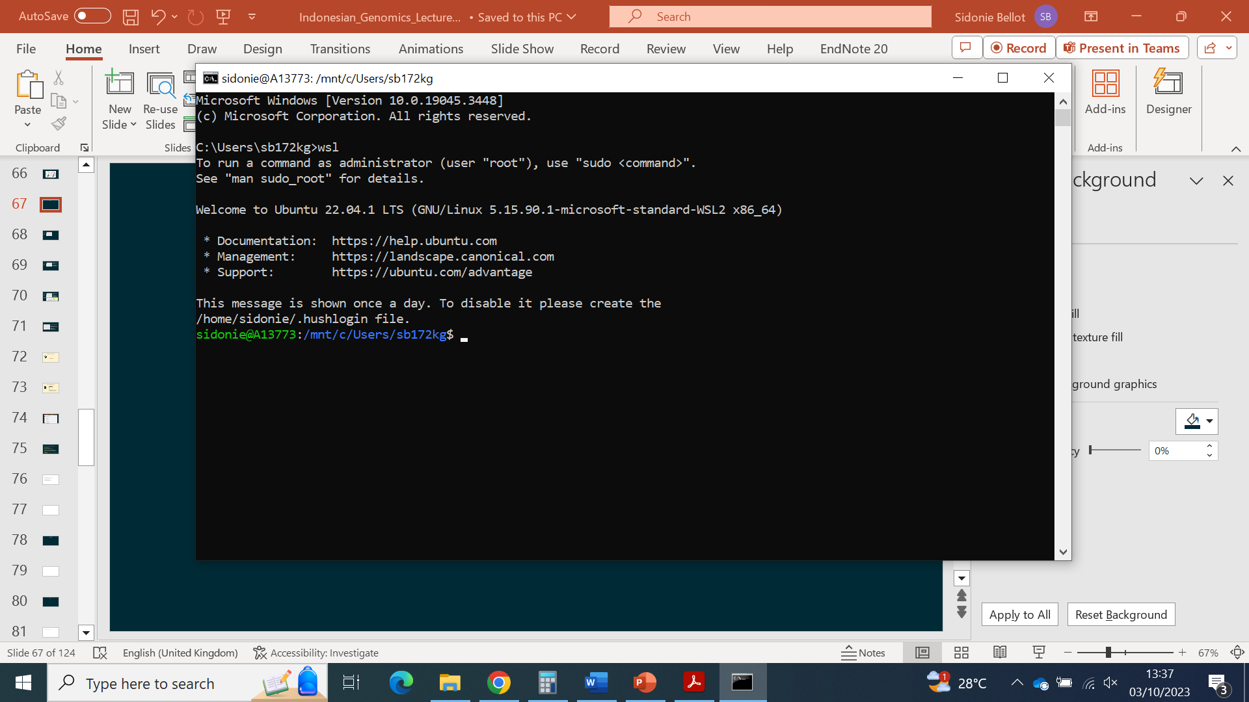

The Terminal
You can use a linux computer without the terminal just as you do with an Apple or Windows computer.
However, using the terminal can be much more powerful and efficient. Moreover, if you use cloud computing or high-performance computers, you will likely need to connect to them using the terminal and work through a non-graphical interface. This is why we teach how to use linux commands when we teach bioinformatics.
In the next slides, the following format indicates commands that need to be typed in the terminal: mycommand
Case and spaces matter! Spaces separate command arguments. It is best to never use space in file names in linux!
File extensions do not matter but it is convenient to use them to know what type of file you are dealing with.
Open your terminal…

Slide 4
Linux environment, how to know where you are and how to move around
The environment is made of directories, themselves containing directories and files. This can be represented as a tree
How does your environment look like?

Slide 5
Linux environment, how to know where you are and how to move around
How does your environment look like?
The directory that contains every other directory is called the “root” and understood by the computer as “/”
So to go to the root directory, you need to tell the computer cd / (see cd command below)
Useful website with explanations:
https://www.linuxtrainingacademy.com/linux-directory-structure-and-file-system-hierarchy/
The environment is made of directories, themselves containing directories and files. This can be represented as a tree

Slide 6
Linux environment, how to know where you are and how to move around
How does your environment look like?
The directory that contains every other directory is called the “root” and understood by the computer as “/”
So to go to the root directory, you need to tell the computer cd / (see cd command below)
Useful website with explanations:
https://www.linuxtrainingacademy.com/linux-directory-structure-and-file-system-hierarchy/
The environment is made of directories, themselves containing directories and files. This can be represented as a tree
Useful commands to move through the linux system
Command | Explanation | Examples
pwd | Find out where you are in the system | pwd
ls | Find out what is in a directory | ls, ls -hr, ls /
cd | Move to a directory | cd,cd /home/jason,cd ../pat
TAB key | Find out what is in the directory and prevents you to type full directory names | cd /home/p + TAB

Slide 7
Absolute vs relative paths
For the computer to find a directory or to bring you to this directory, you need to provide the path to that directory
You can do it
In relation to where you are. This is called a relative path.
Or
In relation to the root. This is called an absolute path.
For instance, if you are in home and want to go to Music, you can type:
cd jason/Music (relative path)
Or
cd /home/jason/Music (absolute path)

Slide 8
Exercise: move around your computer
Go to three different directories in your environment
Each time you arrive to a directory,
list the content of the directory
find out the path to where you are
Come back to where you started

Slide 9

Solutions: move around your computer
Go to three different directories in your environment
cd path/to/directory
Each time you arrive to a directory,
list the content of the directory
ls
find out the path to where you are
pwd
Come back to where you started
cd ../relative/path/to/original/directory
or
cd /absolute/path/to/original/directory

Slide 10
Most useful linux commands for our purpose
Command | Explanation | Examples
cat (6)
cd (2) | Move to a directory | cd, cd /home/dir1, cd ../dir1
cp (7)
echo (3)
grep (10)
head (13)
less (4)
ls (8)
man (11)
mkdir (1) | Make directory | mkdir dir1
mv (9)
pwd (0) | Find out where you are in the system | pwd
q (5)
rm (15)
tail (14)
wc (12)

Slide 11
Most useful linux commands for our purpose
Command | Explanation | Examples
cat (6)
cd (2) | Move to a directory | cd, cd /home/dir1, cd ../dir1
cp (7)
echo (3) | Print something | echo “Hello!”, echo “Hello!” > file1.txt
grep (10)
head (13)
less (4)
ls (8)
man (11)
mkdir (1) | Make directory | mkdir dir1
mv (9)
pwd (0) | Find out where you are in the system | pwd
q (5)
rm (15)
tail (14)
wc (12)

Slide 12
Most useful linux commands for our purpose
Command | Explanation | Examples
cat (6)
cd (2) | Move to a directory | cd, cd /home/dir1, cd ../dir1
cp (7)
echo (3) | Print something | echo “Hello!”, echo “Hello!” > file1.txt
grep (10)
head (13)
less (4) | Show file content | less file.txt (use arrow keys to scroll up/down)
ls (8)
man (11)
mkdir (1) | Make directory | mkdir dir1
mv (9)
pwd (0) | Find out where you are in the system | pwd
q (5)
rm (15)
tail (14)
wc (12)

Slide 13
Most useful linux commands for our purpose
Command | Explanation | Examples
cat (6)
cd (2) | Move to a directory | cd, cd /home/dir1, cd ../dir1
cp (7)
echo (3) | Print something | echo “Hello!”, echo “Hello!” > file1.txt
grep (10)
head (13)
less (4) | Show file content | less file.txt (use arrow keys to scroll up/down)
ls (8)
man (11)
mkdir (1) | Make directory | mkdir dir1
mv (9)
pwd (0) | Find out where you are in the system | pwd
q (5) | Quit when you are in a file | q
rm (15)
tail (14)
wc (12)

Slide 14
Most useful linux commands for our purpose
Command | Explanation | Examples
cat (6) | Concatenate files and print the output | cat file1 file2 > file12.txt
cd (2) | Move to a directory | cd, cd /home/dir1, cd ../dir1
cp (7)
echo (3) | Print something | echo “Hello!”, echo “Hello!” > file1.txt
grep (10)
head (13)
less (4) | Show file content | less file.txt (use arrow keys to scroll up/down)
ls (8)
man (11)
mkdir (1) | Make directory | mkdir dir1
mv (9)
pwd (0) | Find out where you are in the system | pwd
q (5) | Quit when you are in a file | q
rm (15)
tail (14)
wc (12)

Slide 15
Most useful linux commands for our purpose
Command | Explanation | Examples
cat (6) | Concatenate files and print the output | cat file1 file2 > file12.txt
cd (2) | Move to a directory | cd, cd /home/dir1, cd ../dir1
cp (7) | Copy file/directory | cp dir1/file2.txt dir1/file2_copy.txt
echo (3) | Print something | echo “Hello!”, echo “Hello!” > file1.txt
grep (10)
head (13)
less (4) | Show file content | less file.txt (use arrow keys to scroll up/down)
ls (8)
man (11)
mkdir (1) | Make directory | mkdir dir1
mv (9)
pwd (0) | Find out where you are in the system | pwd
q (5) | Quit when you are in a file | q
rm (15)
tail (14)
wc (12)

Slide 16
Most useful linux commands for our purpose
Command | Explanation | Examples
cat (6) | Concatenate files and print the output | cat file1 file2 > file12.txt
cd (2) | Move to a directory | cd, cd /home/dir1, cd ../dir1
cp (7) | Copy file/directory | cp dir1/file2.txt dir1/file2_copy.txt
echo (3) | Print something | echo “Hello!”, echo “Hello!” > file1.txt
grep (10)
head (13)
less (4) | Show file content | less file.txt (use arrow keys to scroll up/down)
ls (8) | Find out what is in a directory | ls, ls –hr, ls /
man (11)
mkdir (1) | Make directory | mkdir dir1
mv (9)
pwd (0) | Find out where you are in the system | pwd
q (5) | Quit when you are in a file | q
rm (15)
tail (14)
wc (12)

Slide 17
Most useful linux commands for our purpose
Command | Explanation | Examples
cat (6) | Concatenate files and print the output | cat file1 file2 > file12.txt
cd (2) | Move to a directory | cd, cd /home/dir1, cd ../dir1
cp (7) | Copy file/directory | cp dir1/file2.txt dir1/file2_copy.txt
echo (3) | Print something | echo “Hello!”, echo “Hello!” > file1.txt
grep (10)
head (13)
less (4) | Show file content | less file.txt (use arrow keys to scroll up/down)
ls (8) | Find out what is in a directory | ls, ls –hr, ls /
man (11)
mkdir (1) | Make directory | mkdir dir1
mv (9) | Move file or directory | mv file1.txt dir1, mv file1.txt renamed_file1.txt
pwd (0) | Find out where you are in the system | pwd
q (5) | Quit when you are in a file | q
rm (15)
tail (14)
wc (12)

Slide 18
Most useful linux commands for our purpose
Command | Explanation | Examples
cat (6) | Concatenate files and print the output | cat file1 file2 > file12.txt
cd (2) | Move to a directory | cd, cd /home/dir1, cd ../dir1
cp (7) | Copy file/directory | cp dir1/file2.txt dir1/file2_copy.txt
echo (3) | Print something | echo “Hello!”, echo “Hello!” > file1.txt
grep (10) | Print file lines containing pattern | grep “pattern” file.txt
head (13)
less (4) | Show file content | less file.txt (use arrow keys to scroll up/down)
ls (8) | Find out what is in a directory | ls, ls –hr, ls /
man (11)
mkdir (1) | Make directory | mkdir dir1
mv (9) | Move file or directory | mv file1.txt dir1, mv file1.txt renamed_file1.txt
pwd (0) | Find out where you are in the system | pwd
q (5) | Quit when you are in a file | q
rm (15)
tail (14)
wc (12)

Slide 19
Most useful linux commands for our purpose
Command | Explanation | Examples
cat (6) | Concatenate files and print the output | cat file1 file2 > file12.txt
cd (2) | Move to a directory | cd, cd /home/dir1, cd ../dir1
cp (7) | Copy file/directory | cp dir1/file2.txt dir1/file2_copy.txt
echo (3) | Print something | echo “Hello!”, echo “Hello!” > file1.txt
grep (10) | Print file lines containing pattern | grep “pattern” file.txt
head (13)
less (4) | Show file content | less file.txt (use arrow keys to scroll up/down)
ls (8) | Find out what is in a directory | ls, ls –hr, ls /
man (11) | Show usage and options for a command | man grep
mkdir (1) | Make directory | mkdir dir1
mv (9) | Move file or directory | mv file1.txt dir1, mv file1.txt renamed_file1.txt
pwd (0) | Find out where you are in the system | pwd
q (5) | Quit when you are in a file | q
rm (15)
tail (14)
wc (12)

Slide 20
Most useful linux commands for our purpose
Command | Explanation | Examples
cat (6) | Concatenate files and print the output | cat file1 file2 > file12.txt
cd (2) | Move to a directory | cd, cd /home/dir1, cd ../dir1
cp (7) | Copy file/directory | cp dir1/file2.txt dir1/file2_copy.txt
echo (3) | Print something | echo “Hello!”, echo “Hello!” > file1.txt
grep (10) | Print file lines containing pattern | grep “pattern” file.txt
head (13)
less (4) | Show file content | less file.txt (use arrow keys to scroll up/down)
ls (8) | Find out what is in a directory | ls, ls –hr, ls /
man (11) | Show usage and options for a command | man grep
mkdir (1) | Make directory | mkdir dir1
mv (9) | Move file or directory | mv file1.txt dir1, mv file1.txt renamed_file1.txt
pwd (0) | Find out where you are in the system | pwd
q (5) | Quit when you are in a file | q
rm (15)
tail (14)
wc (12) | Count words or lines in file | wc -l file1.txt

Slide 21
Most useful linux commands for our purpose
Command | Explanation | Examples
cat (6) | Concatenate files and print the output | cat file1 file2 > file12.txt
cd (2) | Move to a directory | cd, cd /home/dir1, cd ../dir1
cp (7) | Copy file/directory | cp dir1/file2.txt dir1/file2_copy.txt
echo (3) | Print something | echo “Hello!”, echo “Hello!” > file1.txt
grep (10) | Print file lines containing pattern | grep “pattern” file.txt
head (13) | Print beginning of file | head file.txt, head -n 12 file.txt
less (4) | Show file content | less file.txt (use arrow keys to scroll up/down)
ls (8) | Find out what is in a directory | ls, ls –hr, ls /
man (11) | Show usage and options for a command | man grep
mkdir (1) | Make directory | mkdir dir1
mv (9) | Move file or directory | mv file1.txt dir1, mv file1.txt renamed_file1.txt
pwd (0) | Find out where you are in the system | pwd
q (5) | Quit when you are in a file | q
rm (15)
tail (14)
wc (12) | Count words or lines in file | wc -l file1.txt

Slide 22
Most useful linux commands for our purpose
Command | Explanation | Examples
cat (6) | Concatenate files and print the output | cat file1 file2 > file12.txt
cd (2) | Move to a directory | cd, cd /home/dir1, cd ../dir1
cp (7) | Copy file/directory | cp dir1/file2.txt dir1/file2_copy.txt
echo (3) | Print something | echo “Hello!”, echo “Hello!” > file1.txt
grep (10) | Print file lines containing pattern | grep “pattern” file.txt
head (13) | Print beginning of file | head file.txt, head -n 12 file.txt
less (4) | Show file content | less file.txt (use arrow keys to scroll up/down)
ls (8) | Find out what is in a directory | ls, ls –hr, ls /
man (11) | Show usage and options for a command | man grep
mkdir (1) | Make directory | mkdir dir1
mv (9) | Move file or directory | mv file1.txt dir1, mv file1.txt renamed_file1.txt
pwd (0) | Find out where you are in the system | pwd
q (5) | Quit when you are in a file | q
rm (15)
tail (14) | Print end of file | tail file.txt, tail -n 12 file.txt
wc (12) | Count words or lines in file | wc -l file1.txt

Slide 23
Most useful linux commands for our purpose
Command | Explanation | Examples
cat (6) | Concatenate files and print the output | cat file1 file2 > file12.txt
cd (2) | Move to a directory | cd, cd /home/dir1, cd ../dir1
cp (7) | Copy file/directory | cp dir1/file2.txt dir1/file2_copy.txt
echo (3) | Print something | echo “Hello!”, echo “Hello!” > file1.txt
grep (10) | Print file lines containing pattern | grep “pattern” file.txt
head (13) | Print beginning of file | head file.txt, head -n 12 file.txt
less (4) | Show file content | less file.txt (use arrow keys to scroll up/down)
ls (8) | Find out what is in a directory | ls, ls –hr, ls /
man (11) | Show usage and options for a command | man grep
mkdir (1) | Make directory | mkdir dir1
mv (9) | Move file or directory | mv file1.txt dir1, mv file1.txt renamed_file1.txt
pwd (0) | Find out where you are in the system | pwd
q (5) | Quit when you are in a file | q
rm (15) | Remove file or directory (NO WAY BACK!) | rm file1.txt, rm -r dir1
tail (14) | Print end of file | tail file.txt, tail -n 12 file.txt
wc (12) | Count words or lines in file | wc -l file1.txt

Slide 24
Useful tips
The man command can help you find out more about how to use a command.

Slide 25
Useful tips
The man command can help you find out more about how to use a command.
If you do not know how to do something, ask Google, there is a high chance that people have written about your problem on the Internet

Slide 26
Useful tips
The man command can help you find out more about how to use a command.
If you do not know how to do something, ask Google, there is a high chance that people have written about your problem on the Internet
You can call back a previous command using the upper arrow key

Slide 27
Useful tips
The man command can help you find out more about how to use a command.
If you do not know how to do something, ask Google, there is a high chance that people have written about your problem on the Internet
You can call back a previous command using the upper arrow key
You can see the history of all commands you used using the command history

Slide 28
Useful tips
The man command can help you find out more about how to use a command.
If you do not know how to do something, ask Google, there is a high chance that people have written about your problem on the Internet
You can call back a previous command using the upper arrow key
You can see the history of all commands you used using the command history
Notepad++ (Windows) and Gedit (Linux) are powerful text editors that you can use to write your own commands and scripts without having formatting issues generated by Word or equivalent.

Slide 29
Useful tips
The man command can help you find out more about how to use a command.
If you do not know how to do something, ask Google, there is a high chance that people have written about your problem on the Internet
You can call back a previous command using the upper arrow key
You can see the history of all commands you used using the command history
Notepad++ (Windows) and Gedit (Linux) are powerful text editors that you can use to write your own commands and scripts without having formatting issues generated by Word or equivalent.
It is a good habit to write all the commands you use, so that you can more easily debug errors and remember next time.

Slide 30
Useful tips
The man command can help you find out more about how to use a command.
If you do not know how to do something, ask Google, there is a high chance that people have written about your problem on the Internet
You can call back a previous command using the upper arrow key
You can see the history of all commands you used using the command history
Notepad++ (Windows) and Gedit (Linux) are powerful text editors that you can use to write your own commands and scripts without having formatting issues generated by Word or equivalent.
It is a good habit to write all the commands you use, so that you can more easily debug errors and remember next time.
If you want to create a file or edit a text file, you can use vi or nano, directly from the terminal. This is useful when you are working remotely on a high-performance computing facility to which you do not have graphical interface access.

