Slide 1
What sequencing approach to select?

Slide 2
What regions of the genome are we most interested in?
Intergenic spacers: More variable
Genes:
Less variable

Slide 3
What regions of the genome are we most interested in?
Intergenic spacers: More variable
Genes:
Less variable
In a plant cell, we usually find…

Slide 4
What regions of the genome are we most interested in?
Intergenic spacers: More variable
Genes:
Less variable
In a plant cell, we usually find…
Two to dozens of nuclear genome copies in the nucleus (diploid vs polyploid)
Hundreds of chloroplast genome copies in the chloroplasts
One genome copy divided in 4 chromosomes
Hundreds of mitochondrial genome copies in the mitochondria

Slide 5
What regions of the genome are we most interested in?
Intergenic spacers: More variable
Genes:
Less variable
In a plant cell, we usually find…
Two to dozens of nuclear genome copies in the nucleus (diploid vs polyploid)
Hundreds of chloroplast genome copies in the chloroplasts
Very variable
A lot of data
Difficult to very difficult to assemble
Less copies: less chances to be sequenced by chance… except for repeated regions (eg ITS)
One genome copy divided in 4 chromosomes
Hundreds of mitochondrial genome copies in the mitochondria

Slide 6
What regions of the genome are we most interested in?
Intergenic spacers: More variable
Genes:
Less variable
In a plant cell, we usually find…
Two to dozens of nuclear genome copies in the nucleus (diploid vs polyploid)
Hundreds of chloroplast genome copies in the chloroplasts
Very variable
A lot of data
Difficult to very difficult to assemble
Less copies: less chances to be sequenced by chance… except for repeated regions (eg ITS)
Variable
Less data
Easy to assemble
One genome copy divided in 4 chromosomes
Hundreds of mitochondrial genome copies in the mitochondria

Slide 7
What regions of the genome are we most interested in?
Intergenic spacers: More variable
Genes:
Less variable
In a plant cell, we usually find…
Two to dozens of nuclear genome copies in the nucleus (diploid vs polyploid)
Hundreds of chloroplast genome copies in the chloroplasts
Very variable
A lot of data
Difficult to very difficult to assemble
Less copies: less chances to be sequenced by chance… except for repeated regions (eg ITS)
Variable
Less data
Easy to assemble
One genome copy divided in 4 chromosomes
Less variable
Less data
Easy to very difficult to assemble
Hundreds of mitochondrial genome copies in the mitochondria

Slide 8
What regions of the genome are we most interested in?
Intergenic spacers: More variable
Genes:
Less variable
In a plant cell, we usually find…
Two to dozens of nuclear genome copies in the nucleus (diploid vs polyploid)
Hundreds of chloroplast genome copies in the chloroplasts
Very variable
A lot of data
Difficult to very difficult to assemble
Less copies: less chances to be sequenced by chance… except for repeated regions (eg ITS)
Variable
Less data
Easy to assemble
One genome copy divided in 4 chromosomes
More copies: more chances to be sequenced by chance
Less variable
Less data
Easy to very difficult to assemble
Hundreds of mitochondrial genome copies in the mitochondria

Slide 9
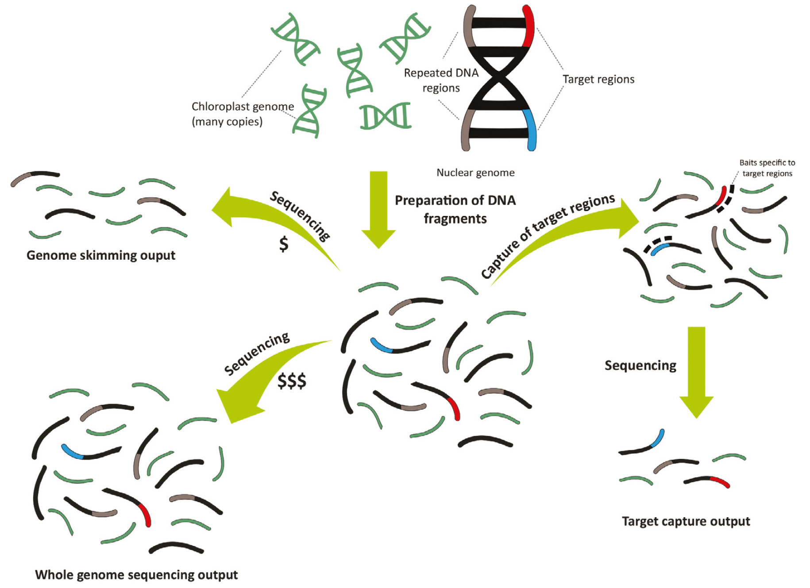
Different research questions can be addressed with different methods
Bellot, Odufuwa et al., 2020

Slide 10
Rough guidance – best ask/read what other people do in your field!
Method | Cost | Type of data obtained | Need a reference genome? | Need initial optimisation in the lab or computer? | Species Identification (DNA barcoding) | Phylogenetics (taxonomic level) | Adaptation detection | Gene evolution and function
Restriction site associated DNA markers sequencing (RADseq, GBS) | $ | Single Nucleotide Polymorphisms (SNPs), isolated | No but it can help | Yes in the lab | Yes | Not optimal Population level | Yes | No
Target capture sequencing | $$ | Many isolated nuclear regions Full or partial chloroplast and mitochondrial genomes | Yes, reference regions | Yes, designing a kit to capture custom targets requires reference data and bioinformatics | Yes | Yes, performance at desired taxonomic level depending on variability of target regions and flanking regions | Yes if target regions numerous and variable | Yes if focus genes are targeted
Genome skimming | $ | Few isolated nuclear regions Full or partial chloroplast and mitochondrial genomes | No but it can help | No | Yes if species distant enough | Yes if species distant enough | No except chloro/mito genes or repeated nuclear genes | No except chloro/mito genes or repeated nuclear genes
Whole genome resequencing | $$ | Partial nuclear genome, full chloroplast and mitochondrial genomes | Yes, reference genome | No | Yes | Yes Population level or close species | Yes | Yes
Whole genome sequencing | $$$ | Full nuclear, chloroplast and mitochondrial genomes | No but it can help | No | Yes | Yes but not optimal as $$$ | Yes | Yes

