Slide 1
DTDL Talent Hack
AI Experiment Copilot & Decision Intelligence
Universal A/B Testing & Decision Platform

Slide 2
Problem Statement
A/B experiments require manual setup, statistical expertise, and constant monitoring — leading to inconsistent quality and slow decisions.
How might we help?
Guide teams through the full experiment lifecycle
Generate hypotheses from business goals
Recommend metrics, audiences & configurations
Validate setup before launch
Monitor performance in real time
Explain why variants win or underperform
Summarize results in business-friendly language
Recommend next actions: Scale / Continue / Stop / Rollback
Reduce manual effort across the lifecycle
Deliver explainable, data-driven decisions
Success: faster experiment creation · high-quality configs · accurate insights · reliable recommendations · measurable eval metrics (creation time, acceptance rate, analysis time)
AI Experiment Copilot

Slide 3
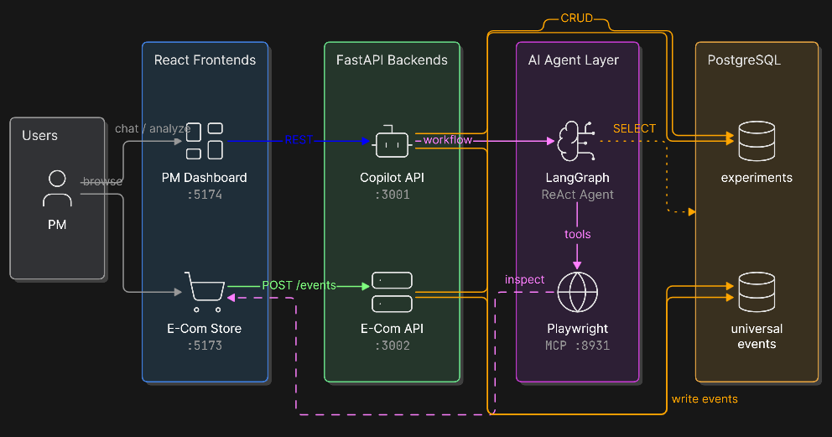
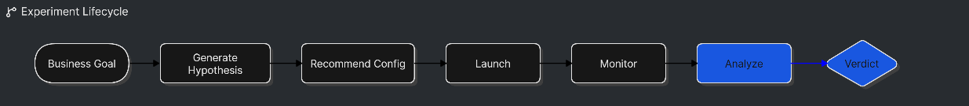
Solution Architecture
Six microservices · shared Postgres · LangGraph agent with Playwright + SQL tools

Slide 4
Thank You

