Slide 1


Enhancing Solar Panel Efficiency using Thermoelectric Module
Solar panels are a promising source of renewable energy. Learn how the integration of thermoelectric modules can enhance their efficiency and revolutionize sustainable power generation.

Slide 2

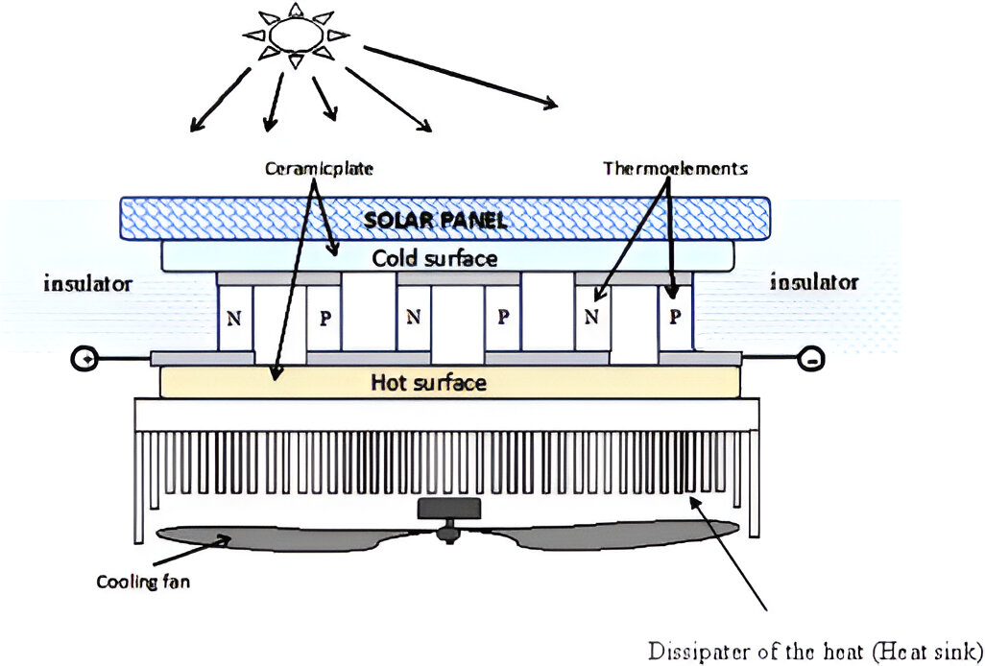
Introduction
Thermoelectric modules offer a revolutionary way to improve the efficiency of solar panels. By harnessing the wasted heat energy and converting it into usable electricity, we can maximize the power output of solar systems.

Slide 3

Explanation of Thermoelectric Module
What is it?
Working Principle
Efficiency Factors
A thermoelectric module is a solid-state device that can generate electricity from a temperature gradient.
It utilizes the Seebeck effect, where a voltage is produced when there is a temperature difference across two different materials.
The efficiency of a thermoelectric module depends on factors such as the thermoelectric material, temperature difference, and electrical resistance.

Slide 4

Factors Affecting Solar Panel Efficiency
1
Dust and Dirt
Accumulation of dust and dirt on solar panels reduces their ability to absorb sunlight, resulting in decreased efficiency.
2
Shading
Even partial shading on solar panels can significantly impact their overall performance and efficiency.
3
Temperature
High temperatures can cause solar panels to lose efficiency, as their electrical output decreases with rising temperatures.

Slide 5
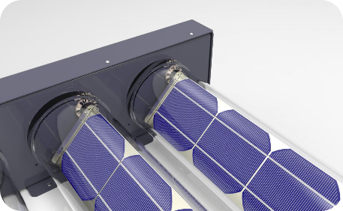
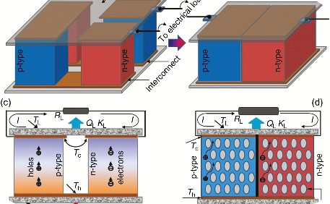
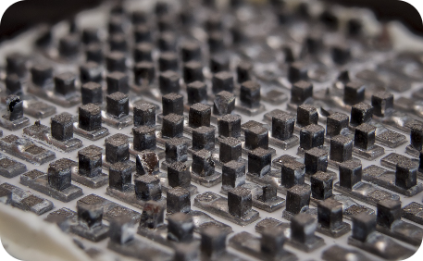
Integration of Thermoelectric Module with Solar Panel
Direct Integration
Heat Recovery
Advanced Materials
The thermoelectric module is integrated directly into the solar panel, allowing for simultaneous power generation and improved efficiency.
The thermoelectric module captures and converts waste heat from the solar panel, increasing its overall energy output.
New thermoelectric materials with higher energy conversion efficiency provide greater potential for integration with solar panels.

Slide 6
Benefits of Increased Solar Panel Efficiency
Higher Energy Output
Improved efficiency means increased power generation, leading to a higher energy output from solar panel installations.
Cost Savings
Enhanced solar panel efficiency reduces the number of panels required, resulting in lower installation and maintenance costs.
Environmental Impact
Maximizing solar panel efficiency helps reduce the carbon footprint and promotes a more sustainable future.

Slide 7

Case Studies of Successful Applications
1
Residential Rooftop Systems
Thermoelectric integration has increased the efficiency of solar panels, making residential rooftop systems more cost-effective and energy-efficient.
2
Commercial Installations
Many businesses have adopted thermoelectric modules to boost the efficiency of their large-scale solar installations, enhancing their sustainability efforts.
3
Off-Grid Solutions
In remote areas with limited access to the power grid, solar panels with thermoelectric integration have enabled efficient off-grid electricity generation.

Slide 8
Conclusion and Future Possibilities
The integration of thermoelectric modules with solar panels unlocks immense potential for enhancing renewable energy systems. As technology advances, we can expect further breakthroughs in efficiency and cost-effectiveness, paving the way for a greener and more sustainable future.

