Slide 1


Welcome
We make email delivery easy
Isaac Saldana, Jose Lopez, Tim Jenkins, Kyle Kermgard

Slide 2





Email Categories
Personal
Marketing
Transactional

Slide 3
Transactional Emails
Examples of transactional emails…

Slide 4
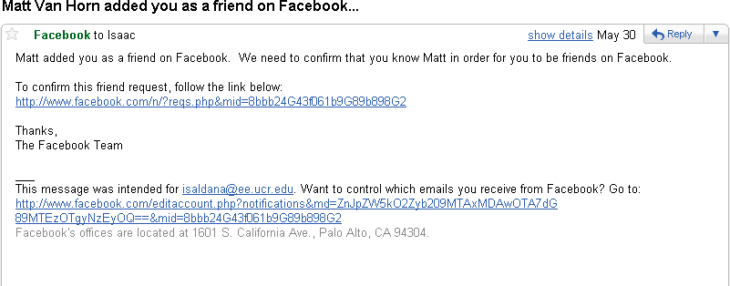

Friend Requests

Slide 5
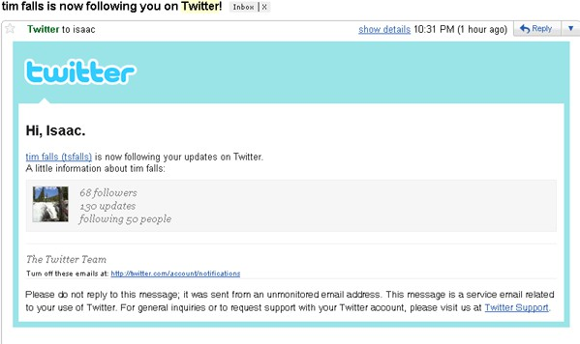
Twitter Followers

Slide 6
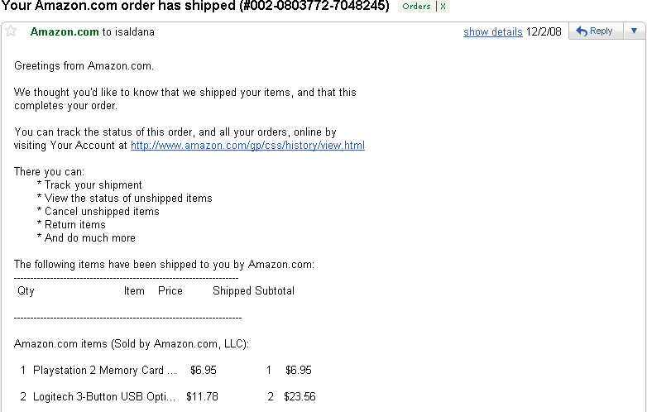

Shipping Alerts

Slide 7

Transactional Email Problems
Deliverability
Scalability
Lack of insight
Time consuming

Slide 8





Email Delivery Made Easy
Easy integration | Hosted service | Zero coding

Slide 9
Deliverability
20% non-delivery is typical
Costly – missed opportunities
– If 1% of Ebay’s yearly email is missing they lose $14 million dollars

Slide 10
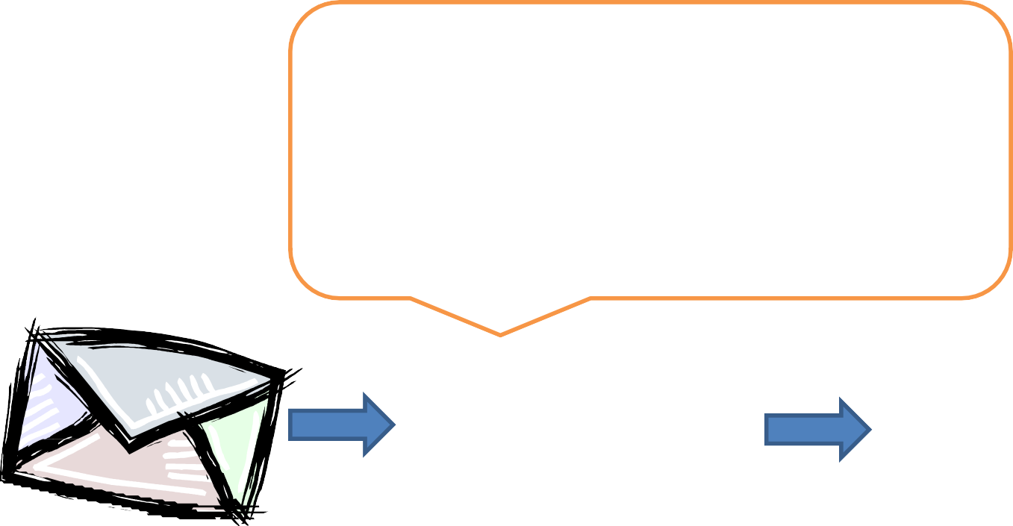

Deliverability (solved)
Delivery Monitoring SPF
DKIM
DomainKeys Unsubscribes
Soft/Hard Bounces RDNS CAN-SPAM
Feedback Loop ISP Rate Limits
Expert system in transactional email to solve problems. On average users increase 20% deliverability by using SendGrid

Slide 11






Scalability
The more email sent the more hardware needed, more software to configure, and more servers to maintain.

Slide 12

Scalability (solved)
SendGrid is a cloud-based service that scales on demand

Slide 13

Lack of Insight after delivery

Slide 14
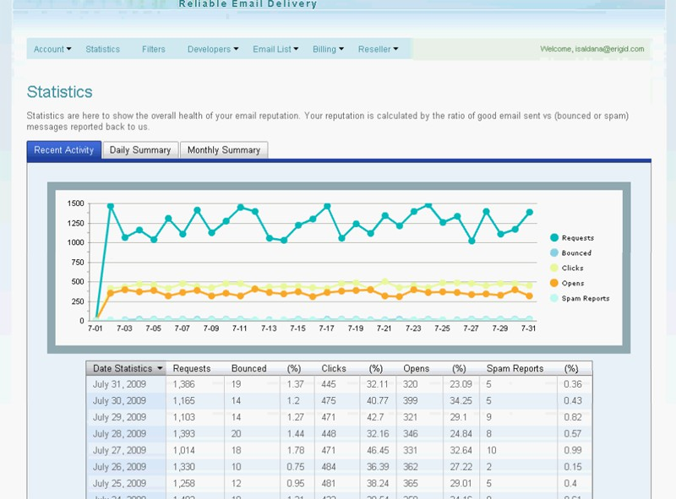
Metrics Provided by SendGrid

Slide 15
Time Consuming
Comply with CAN-SPAM
Manage unsubscribes
Add corporate branding

Slide 16
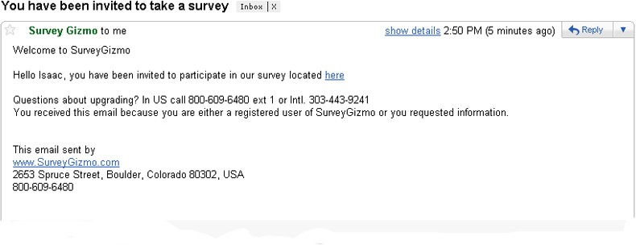
Before SendGrid

Slide 17
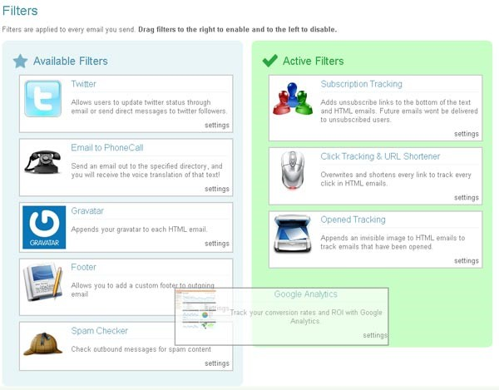
Apply Filters

Slide 18
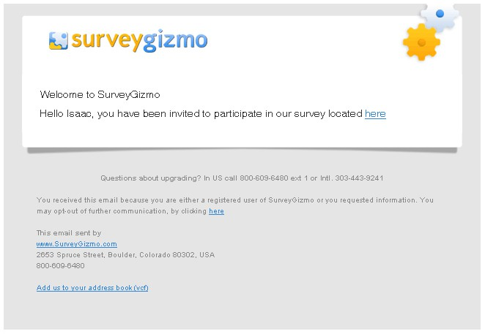
After Enhancement

Slide 19


Market Size
Transactional
600 million/day
Marketing
100 million/day

Slide 20
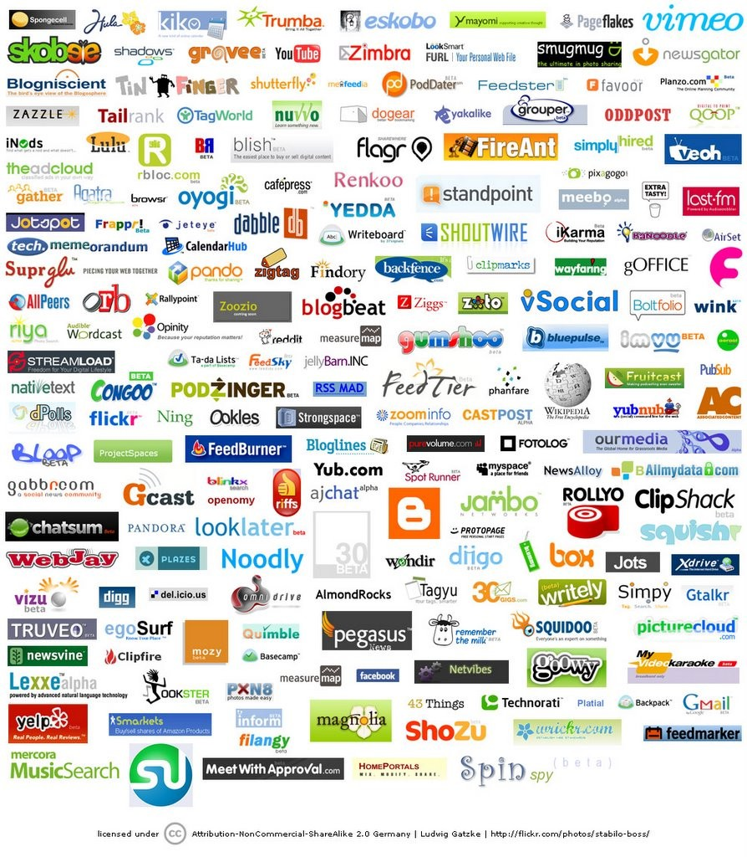
Many others sending emails

Slide 21





Competition
 | Services | Products | SendGrid
Deliverability
Scalability
Metrics
Enhancement |  | ---
Integration
Administration
Affordability
Flexibility | --- | ---

Slide 22
















Revenue Model
 | Basic | Silver | Gold | Platinum
Monthly Price | $9.95 | $79.95 | $199.95 | $799.95
Price per email | $0.001 | $0.00075 | $0.00050 | $0.00045
Custom IP
Click Tracking
Open Tracking
White label
Reseller Panel
Priority Support

Slide 23

Customer Acquisition
Direct
Ad campaigns
Social media marketing
Open source integration
Distribution channels
Hosting companies
Systems administrators
Web development firms

Slide 24

Progress
Nearly 100 paying customers
Over 150 million emails sent
3 million emails per day

Slide 25

Goals
Raise $300k
Solid Sales & Marketing
400 customers
$60k monthly recurring revenue
Investors
Email experience
Contacts with hosting providers
Mentorship

Slide 26
Thank You
Isaac Saldana, CEO
Email: isaac@sendgrid.com Twitter: @isaldana

