Slide 1



Lending Club Case Study
IIITB
Author:
Sidharth Pani

Slide 2

Abstract
Lending club is the largest online loan marketplace, facilitating personal loans,
business loans, and financing of medical procedures.
Borrowers can easily access lower interest rate loans through a fast online interface.
The objective of analysis is to use the information about past loan applicants and find whether they ‘defaulted’ or not.

Slide 3
Problem solving method:
Data cleaning : Remove nulls ,unwanted variables ,Null percentage and remove the rows
Data Understanding : Working with data dictionary and getting knowledge of all columns and domain level uses
Univariate analysis : Analysis of each column and plotting for each distributions
Bivariate analysis: Analysis of two variables and plotting for distributions
Observation: Writing the summery what we found in the analysis

Slide 4

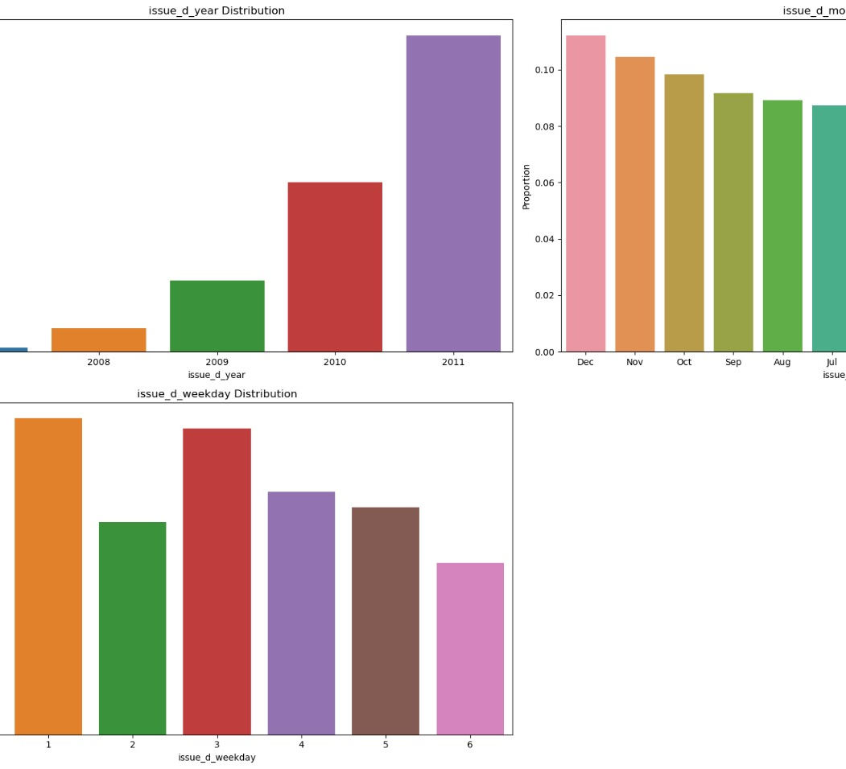
Analysis :
Lending club has really expanded year by year, the number of loan issued are doubled every year.
Also, the issued month of loans is also increasing from January to December. In the final quarter of year there are more loans issued this could be because of vacation and christmas.
Also, on Monday the number of applied loans are greater and high.

Slide 5
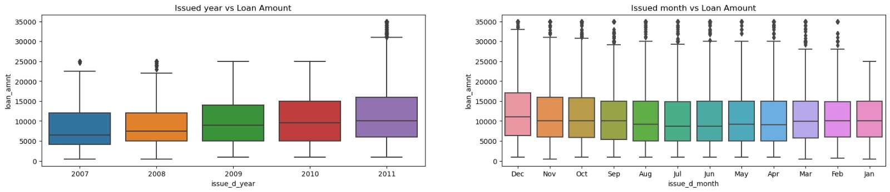
Analysis:
Observations- The median loan amount each year did not change significantly, but the distribution became more spread over the years. This indicates that people took varying loan amounts each year.
A few loan borrowers took higher loan amounts in 2008 and 2011, which are plotted as outliers.
Loan borrowers generally took similar amounts throughout the year, except in December, where higher amounts were taken, as indicated by a distribution higher above the median.

Slide 6
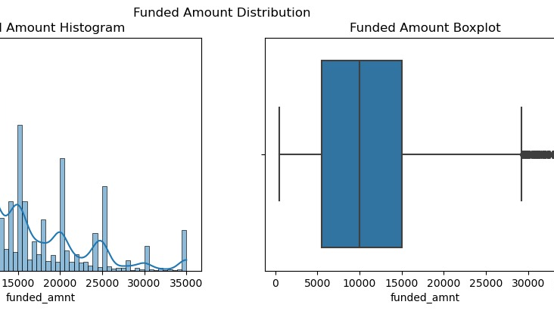
Analysis: Funded amount
The funded amount data behaves similarly to the loan amount data, which indicates that Lending Club approved most of the applied loan amounts.
The histogram shows a peak at 10,000, suggesting that a significant number of people took loans of this amount.
The median loan amount is also 10,000, as seen in the box plot.4. Very few people took loan amounts greater than 30,000, which is evident from the sparsity of data points in this range in the

Slide 7
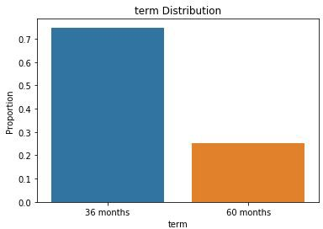
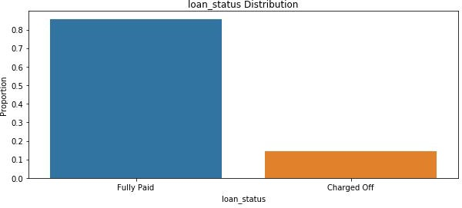
Analysis
There are only two loan terms 36 and 60 months. Around 75% borrowers took loans with 36 months term.
The charged off borrowers are around 15% and fully paid is around 85% in the given data set.

Slide 8
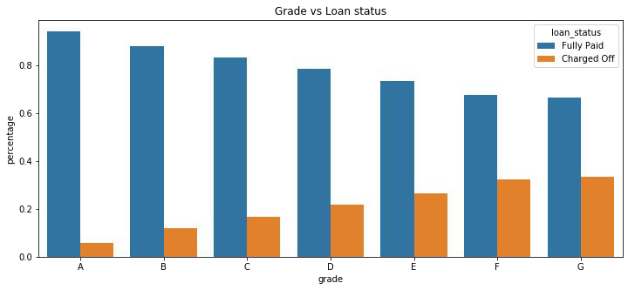
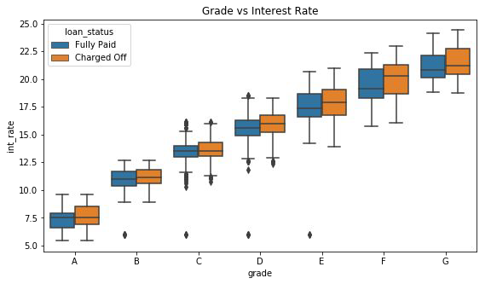
Analysis
Grades are very good category to tell the borrower probability of defaulting the loan.
The Lower grades(E,F,G) have higher chances of defaulting the loan than Higher ones(A,B)
Also the Lower grades are getting loans for higher interest rates which might be the cause for loan default.

Slide 9
Analysis:
Observations- The median loan amount each year did not change significantly, but the distribution became more spread over the years. This indicates that people took varying loan amounts each year.- A few loan borrowers took higher loan amounts in 2008 and 2011, which are plotted as outliers.- Loan borrowers generally took similar amounts throughout the year, except in December, where higher amounts were taken, as indicated by a distribution higher above the median.

Slide 10
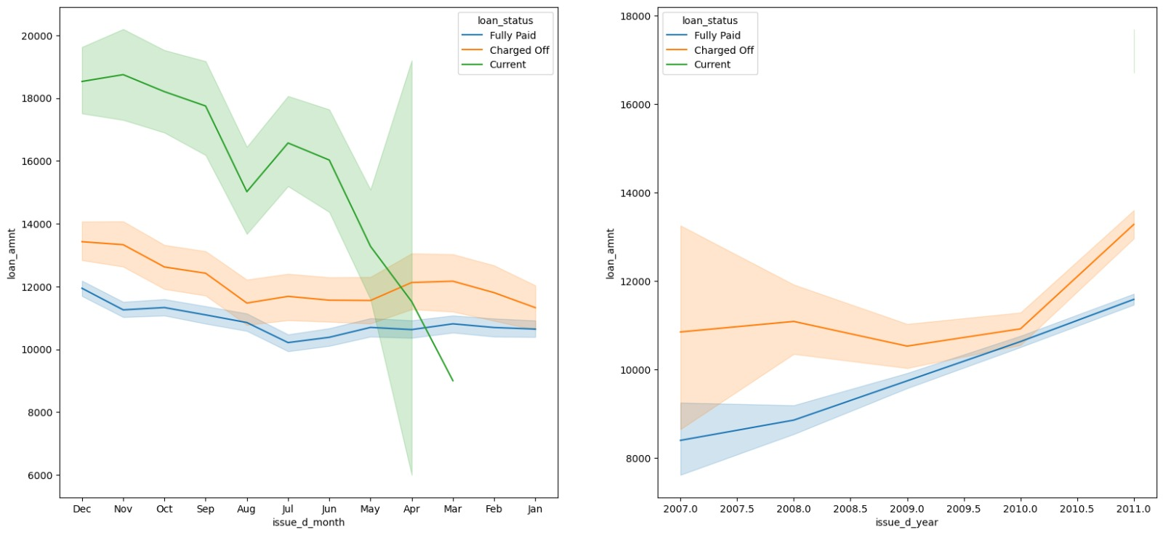
Analysis
Observations- From above line plot we can say that, higher the loam amount, more is the charged off frequency.- And the borrower who took the loan in the month of november and december are having highest charged off ratio with highest loan amount.

Slide 11
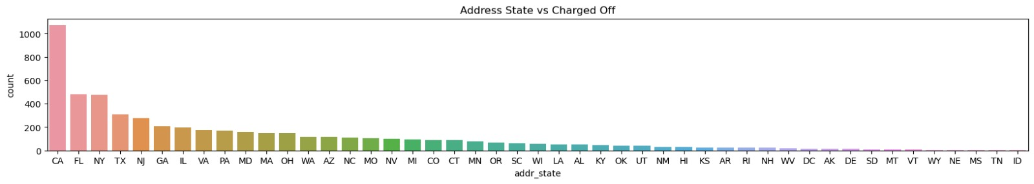
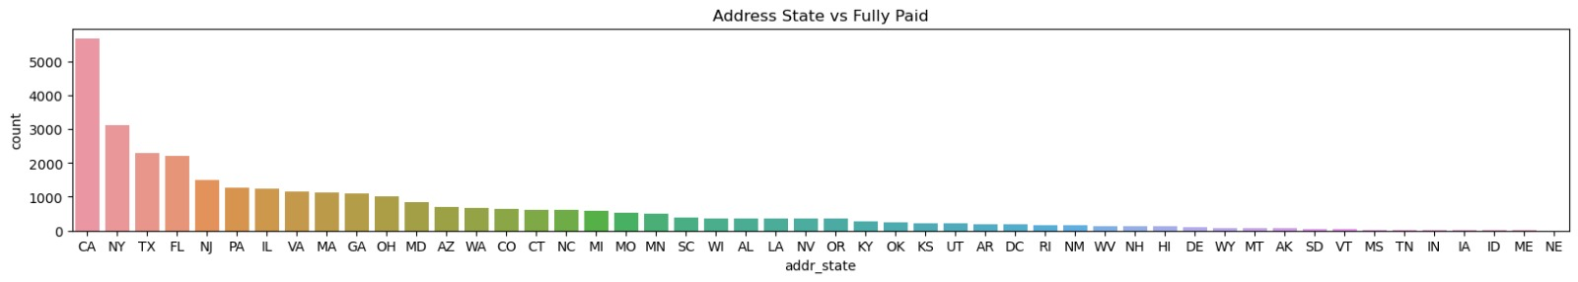
Analysis
The loans which are given for CA, FL and TX state borrowers are defaulted more than other states.

Slide 12
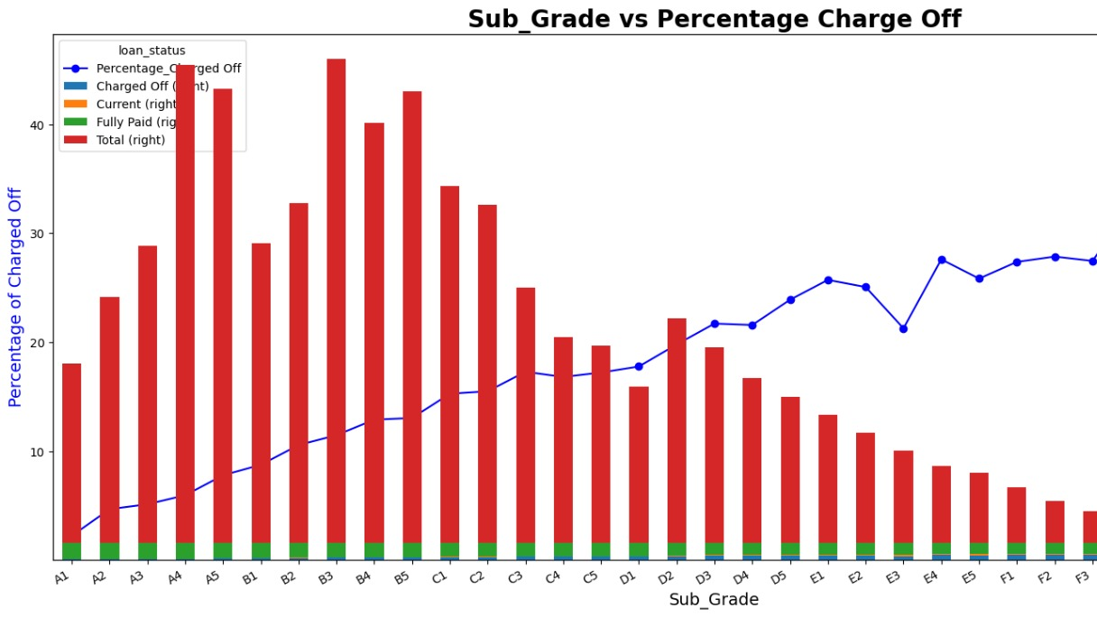
Analysis
Observation
Grade A and B loans are safe. Within these the sub-grades A4 and B3 have the highest number of loan applicants.> Grade E, F, G loans are less safe as compared to others.

Slide 13
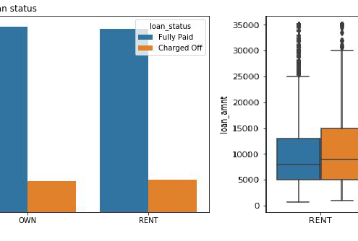
Analysis
There is around 20% chance of loan default in each home ownership category.
From the 2nd plot we can see the people with higher loan amounts in mortgage home ownership has high default rate than others.

Slide 14
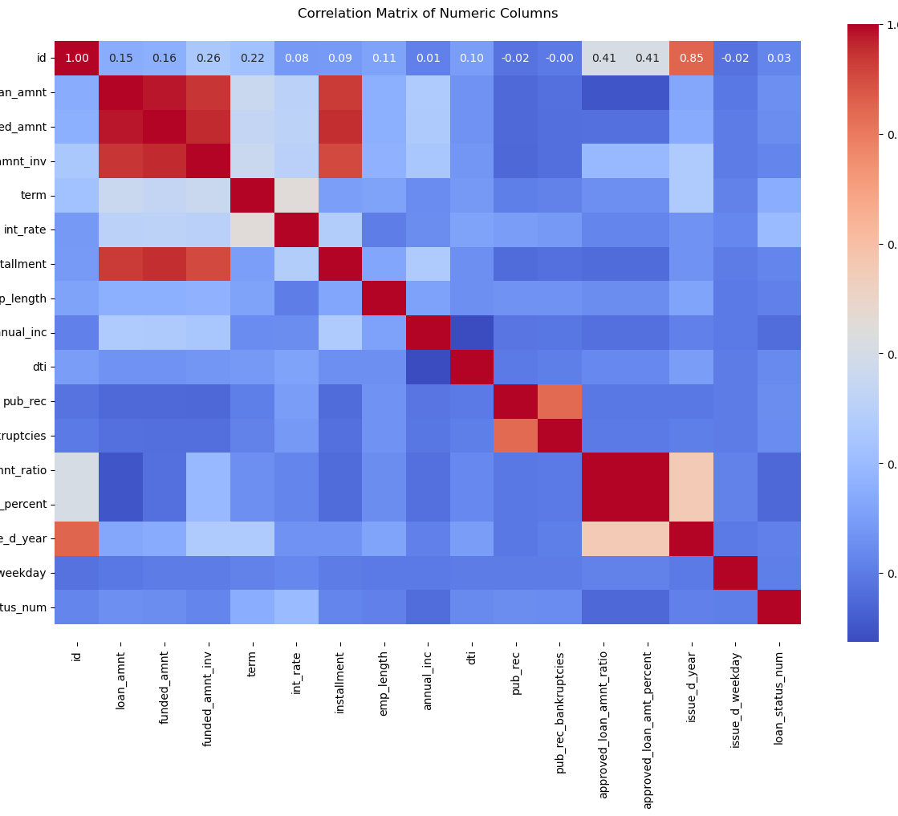
Analysis
Observations:
The public derogatory records columns shows a strong positive corelation with public bankruptcy records.Additionly interest rates tend to be higher for the individuals with high resolving credit utilization

Slide 15
Conclusions
Lending club should reduce the high interest loans for 60 months tenure, they are prone to loan default.
1
Grades are good metric for detecting defaulters. Lending club should examine more information from borrowers before issuing loans to Low grade (G to A).
2
Lending Club should control their number of loan issues to borrowers who are from CA, FL and NY to make profits.
3
Small business loans are defaulted more. Lending club should stop/reduce issuing the loans to them.
4
People with more number of public derogatory records are having more chance of filing a bankruptcy. Lending club should make sure there are no public derogatory records for borrower.
5

