Slide 1
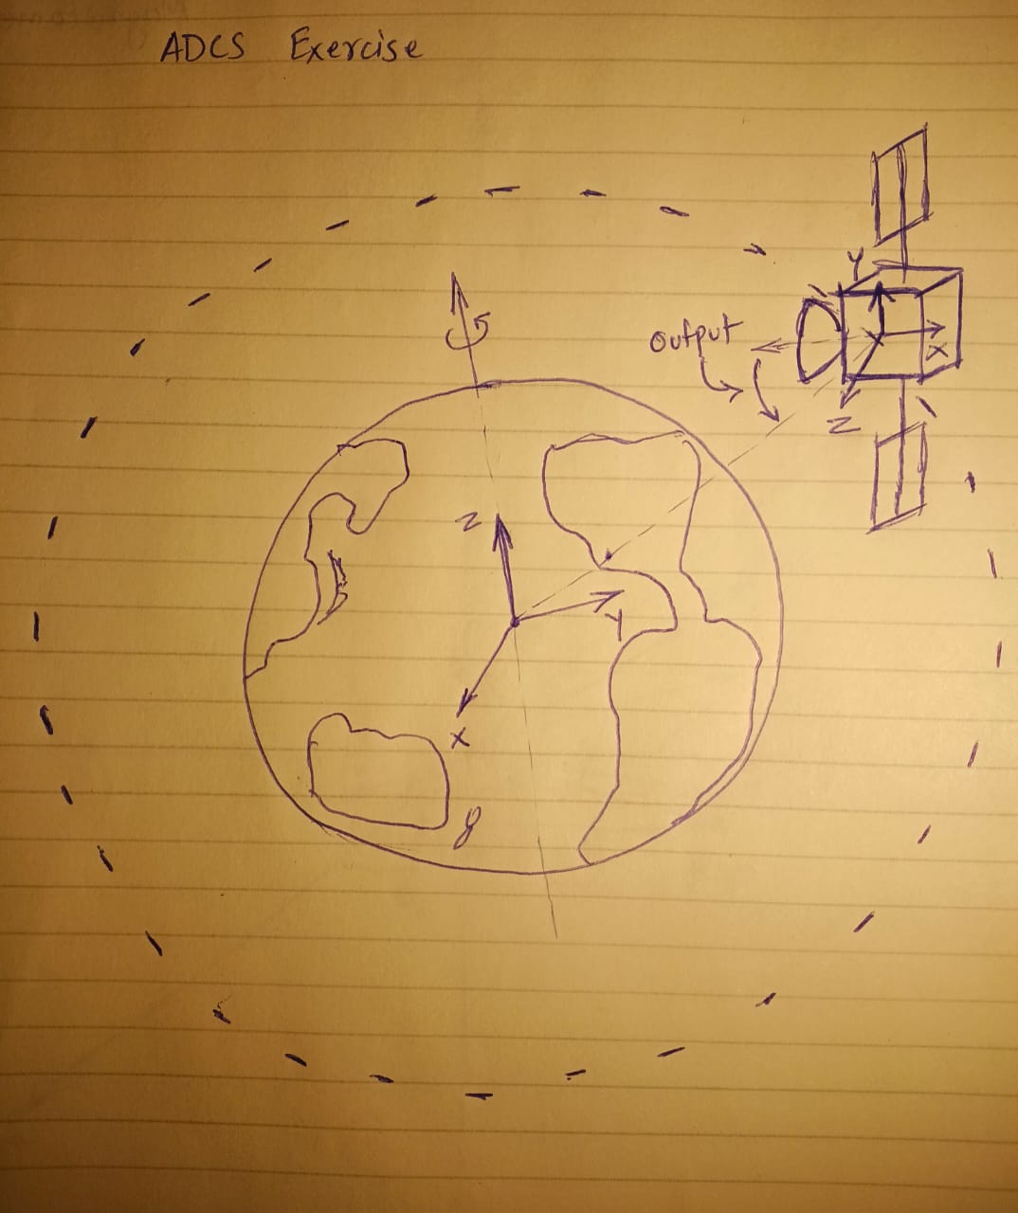
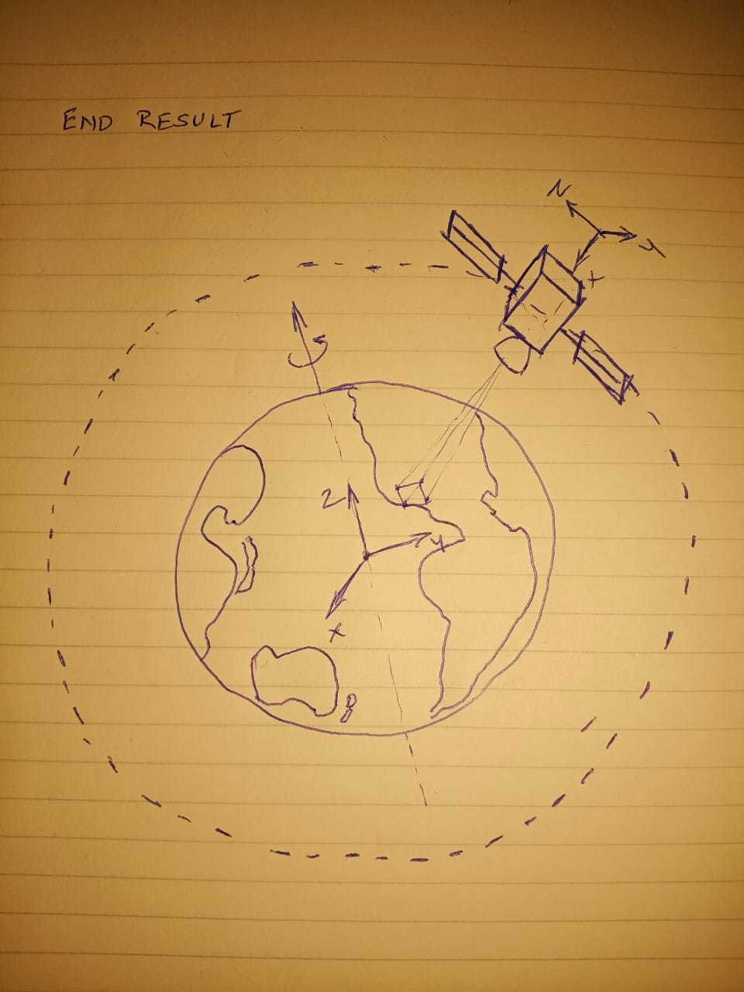
* Initial Motivation
* Problem Statement
Pacific Palisades
Pacific Palisades

Slide 2
Why are maneuvers performed
Types of maneuvers
Maintaining Orbit and Altitude – to keep the satellite at a desired altitude and speed, ensuring consistent data collection.
Maintaining a consistent ground track – For polar-orbiting satellites like Landsat, these maneuvers keep the satellite’s ground track and timing of its equatorial crossings consistent over time.
Counteracting Orbital Perturbations - The gravitational forces of the Sun and Moon, along with factors like solar radiation pressure and the weak effects of Earth’s non-uniform gravity, can alter a satellite’s orbit, requiring adjustments to stay on course.
Drag make-up (DMU) or Delta-Velocity (Delta-V) maneuvers – To increase the satellites orbital velocity to raise its altitude, counteracting the effects of atmospheric drag that would otherwise lower the orbit time.
Inclination Adjustment (IAM) or Delta-Inclination (Delta-I) maneuvers – These burns are performed to adjust the angle of orbit relative to the Earth’s equator, which is necessary for maintaining a consistent ground track for land-observing satellites and for managing the change in inclination caused by gravitational forces from the Sun and Moon.
Station-Keeping maneuvers – These are small adjustments to the satellite's orbit and position to counteract gradual orbital perturbations caused by the gravitational pull of the Moon and the Sun.
Longitudinal Shift Maneuvers – These maneuvers change the satellite’s sub-satellite point on the Earth’s equator, often by adjusting the satellite’s orbital period to match the Earth’s rotation for geostationary or geosynchronous orbits.

