Slide 1
Why are maneuvers performed
Types of maneuvers
Maintaining Orbit and Altitude – to keep the satellite at a desired altitude and speed, ensuring consistent data collection.
Maintaining a consistent ground track – For polar-orbiting satellites like Landsat, these maneuvers keep the satellite’s ground track and timing of its equatorial crossings consistent over time.
Counteracting Orbital Perturbations - The gravitational forces of the Sun and Moon, along with factors like solar radiation pressure and the weak effects of Earth’s non-uniform gravity, can alter a satellite’s orbit, requiring adjustments to stay on course.
Drag make-up (DMU) or Delta-Velocity (Delta-V) maneuvers – To increase the satellites orbital velocity to raise its altitude, counteracting the effects of atmospheric drag that would otherwise lower the orbit time.
Inclination Adjustment (IAM) or Delta-Inclination (Delta-I) maneuvers – These burns are performed to adjust the angle of orbit relative to the Earth’s equator, which is necessary for maintaining a consistent ground track for land-observing satellites and for managing the change in inclination caused by gravitational forces from the Sun and Moon.
Station-Keeping maneuvers – These are small adjustments to the satellite's orbit and position to counteract gradual orbital perturbations caused by the gravitational pull of the Moon and the Sun.
Longitudinal Shift Maneuvers – These maneuvers change the satellite’s sub-satellite point on the Earth’s equator, often by adjusting the satellite’s orbital period to match the Earth’s rotation for geostationary or geosynchronous orbits.

Slide 2
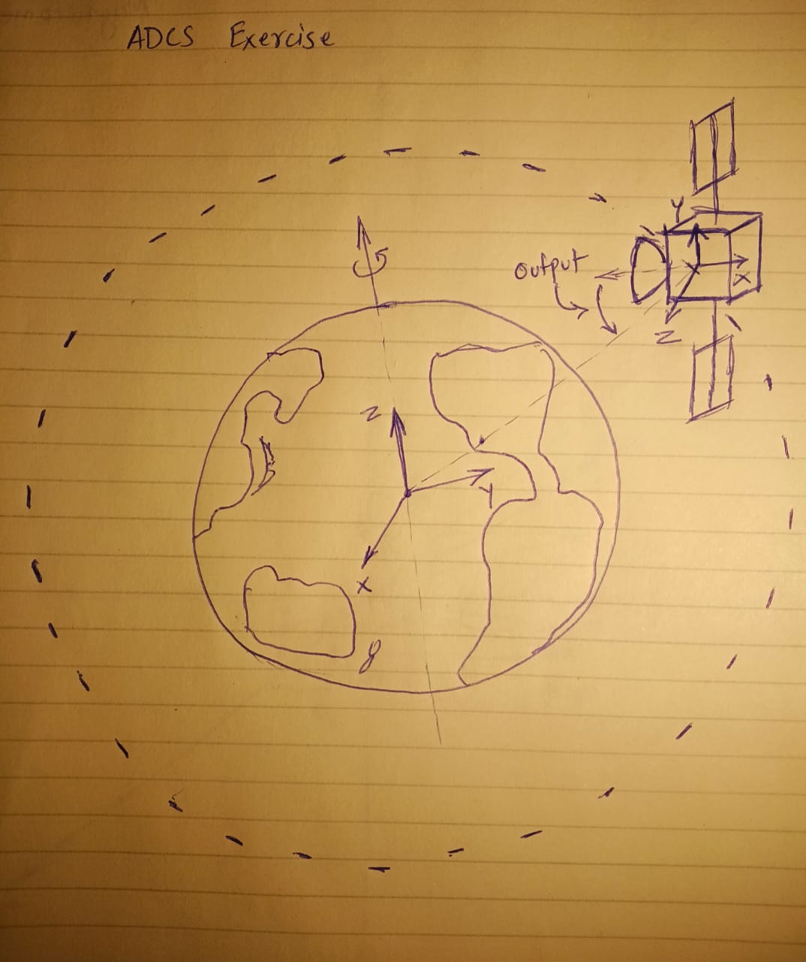
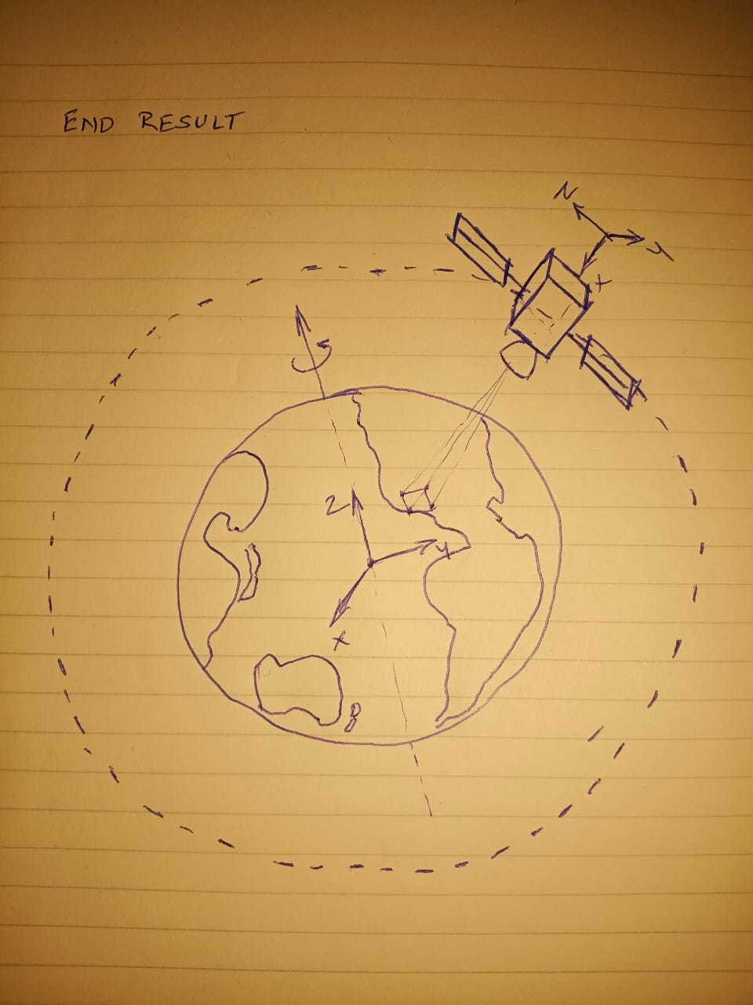
* Initial Motivation
* Problem Statement
Pacific Palisades
Pacific Palisades

Slide 3
Project Steps
Problem
Proposed Solution
Testing / Charts for error metrics
Solution Implementation

Slide 4
Problem
Proposed solution
Build an algorithm to point the satellite camera towards a location provided by the user.
1. Depending on the latitude-longitude data provided by the user, create the sequence of maneuvers required to:
Move the satellite from its current location in the xyz orbit directly above the location of interest. i.e. trajectory determination, optimum thrust calculation based on rotation of the Earth.
Once directly above the location of interest, attitude estimation & Euler rotation sequence calculation to point the camera directly towards the location of interest. (demonstrate usage of sensor data)
Euler sequence to maintain the attitude required to keep the antennas pointed towards the ground station.
Thrust calculations to account for perturbations due to gravity created by the moon and the sun. (implementation of methods used to mitigate attitude deltas due to various perturbations)
2. Animation of the algorithm steps.

