Slide 1



GIT
Internal
GIT Team, SAP / Aug 02, 2016

Slide 2
Table of contents
What is Git?
Git installation.
Validate installation.
Working locally
What you have to do?
Next Session?
How to access Lynda site?
Notes:
2

Slide 3
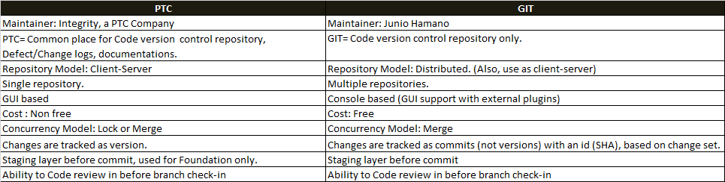
What is GIT?
Notes:
3
Git is a distributed version control system
Multiple repositories exist
Changes are tracked as commits (not versions) with an id (SHA)
Commits can be applied or not applied to a repository based on need
There is no concept of a required master or central repository only a set of repositories with potentially different commits applied
However for release purposes we will designate an "Authoritative Repository" for release branches and official builds, etc.
Because of this distributed nature:
There is no single point of failure
We can work disconnected against our local repository and still do commits

Slide 4
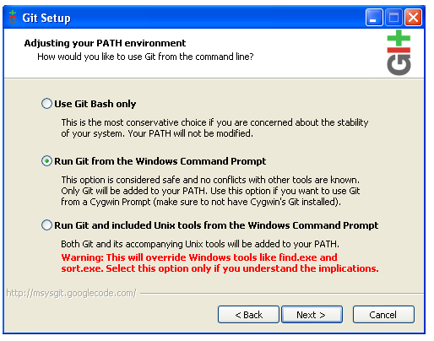
GIT Installation?
Go to site https://git-scm.com/
Click on “Download for windows”. Make sure you are downloading 64 bits version.
"Adjusting Your Path Environment"
Select "Git bash only" (Windows shell
has environment variable substitution problem)
Check out Windows style, Commit Unix style
Note: Need to configure IDE to
UTF-8 (eclipse defaults to platform default)
Do not have the installer launch git bash shell
If you have issues with a lock on or cannot find gitconfig,
close the shell and re-open the git bash shell
Notes:
4

Slide 5
Validate install?
Launch git bash
which git
git –version (2.9.0.windows.1)
Notes:
5

Slide 6
Working Locally
Create Git account
git config --global user.name “User Name”
git config --global user.email “User emailId” (This will create user account.)
Create a blank directory c:\gitPractice
cd gitPractice\
Notes:
6

Slide 7
Working Locally
Create a local repository:
Create a blank directory c:\gitPractice
cd gitPractice
git init
Look at ".git" folder to see what happened
Everything in this directory is now being tracked by git
If you remove the .git directory you have also removed your repository
Notes:
7

Slide 8
Working Locally
Adding and committing files
Create some directories and text files with a little content. Code, poetry, TODO list, the content doesn't matter
git status
git add <file name> ( “.” To add all files from directory.)
Your files are now "staged" for a commit
git status
git commit <file name> -m "initial commit"
Notes:
8

Slide 9
Working Locally
Delete/Remove files:
Manually remove files from folder
git rm <file name> (remove file names.)
Rename and move files:
Manually rename file
git add <renamed file name>
git rm <old file name>
OR
git mv <new file name> <old file name>
git mv <new file name> <folder name /old file name> (This will rename along with moving file to new package)
Notes:
9

Slide 10
Working Locally
Status and log
git status
git log
Git help
git help
git help --topic
Notes:
10

Slide 11
What you have to do?
“GIT essential training” from Lynda.
"Up and Running with Git and Git Hub".
Practice locally.
Once you read Chapter 13, we will have another training session.
Deadline :
Before 16th August 2016
Notes:
11

Slide 12
Next session?
Set up SSH keys to interact with the FG repository on BitBucket.
Cloning a repository.
Interacting with the remote repository.
Notes:
12

Slide 13
How to access Lynda?
Desktop
How to access training videos?
Open Lynda site in Chrome or Safari using below link
http://www.lynda.com/
Click on “Login” link.
Select “Organization Login” tab.
Enter “www.sap.com” in last textbox which asks for company URL. Click on the button to move on.
You will be redirected to the page where it will ask for an account. Click on “I haven’t account” button.
Notes:
13

Slide 14
How to access Lynda?
How to download training videos?
Go to any online training video.
Go to “view offline” tab
Click on download button
Download Windows 7 version app.
Install the app.
Go Back to the web app.
Again click on download video, popup will come.
Click on “Launch Application” button, download will start.
Notes:
14

Slide 15
How to access Lynda?
2. Mobile
How to access training videos?
Go to Playstore and download Lynda app
Select “Organization Login” tab.
In Web portal section, enter “www.sap.com” in last textbox which asks for company URL.
Click on the button to move on. It will redirect to Success Map screen on browser.
Enter your I id and laptop password.
You can access all training videos.
How to download training videos?
Open any training video
Download view as we do for YouTube.
Notes:
15

Slide 16
Thank you

