Slide 1
SmartPay : An ML-Based Salary Prediction System
CAPSTONE PROJECT
Presented By:
Student Name- SIDDHARTH KUMAR
AICTE ID- STU6830ff3f38b5c1748041535
College Name- PRESIDECY UNIVERSITY
Department- CSE

Slide 2
OUTLINE
Problem Statement
About The Project
System Approach
Algorithm & Deployment
Result
Conclusion
Future Scope
References

Slide 3
Problem Statement
Organizations often struggle to evaluate employee compensation fairly due to inconsistent data and subjective judgment.
There is a need for a system that can analyze multiple employee attributes to support evidence-based decision-making.
Traditional methods of salary benchmarking are time-consuming and often fail to account for dynamic factors like education and role.
Data-driven systems can help standardize the evaluation process across diverse roles and industries.
Employers and analysts require tools that can process employee data efficiently to uncover meaningful trends.
This project focuses on building an intelligent system that uses employee attributes to drive informed analysis using machine learning.

Slide 4
About the Project
The Employee Salary Predictor is a machine learning-based web application developed using Python and Streamlit.
It predicts the exact salary of an employee based on inputs like Age, Experience, Gender, Education, and Occupation.
The core model used is XGBoost Regressor, trained and deployed with a complete preprocessing pipeline.
The app supports both manual predictions via form inputs and batch predictions via uploaded CSV files.
With a dark-themed, user-friendly UI, the system also displays evaluation metrics such as R² Score and RMSE, along with visual insights.
This project helps HR teams, analysts, and career advisors estimate salary expectations more accurately using data-driven insights.

Slide 5
System Approach
System requirements
Hardware Requirements:
Processor: Intel Core i3 or higher
RAM: Minimum 4 GB (8 GB recommended)
Storage: At least 500 MB of free disk space
Operating System: Windows, macOS, or Linux
Software Requirements:
Python 3.8 or above
Streamlit framework
Git (for version control and deployment)
Web browser (Chrome/Firefox for app access)

Slide 6
System Approach
Library required to build the model
The following Python libraries were used throughout the project for data preprocessing , model training, evaluation, and app deployment:
pandas – For data manipulation and loading
numpy – For numerical computations
scikit-learn – For model training, preprocessing pipelines, and evaluation metrics
xgboost – Core regression model used for salary prediction
joblib – To serialize (save/load) the trained model
streamlit – To build the interactive web application
matplotlib & seaborn – For creating visualizations and evaluation plots

Slide 7
Algorithm & Deployment
Step-by-Step Procedure
Data Collection & Understanding
Gathered a dataset containing employee features like age, experience, gender, education, and occupation.
Explored data types, missing values, and overall structure for compatibility with ML algorithms.
Data Preprocessing
Categorical features were encoded using OneHotEncoder.
Numerical features were scaled as required.
Combined preprocessing steps using a Scikit-learn ColumnTransformer inside a pipeline.
Model Building
Used the XGBoost Regressor as the core algorithm for salary prediction.
Tuned hyperparameters and trained the model using training data.
Evaluated the model using metrics like R² Score, MAE, and RMSE.

Slide 8
Algorithm & Deployment
Step-by-Step Procedure
4.Model Saving
Saved the trained pipeline (including preprocessing + model) using joblib for deployment.
5.Streamlit App Development
Created an interactive web UI using Streamlit for input, prediction, CSV batch processing, and visual insights.
Integrated plots (e.g., actual vs predicted, feature importance) and evaluation tables into the app.
6.Deployment
Added requirements.txt and .streamlit/config.toml (for dark theme) to the project.
Pushed the project to GitHub and deployed the app on Streamlit Cloud.
Ensured compatibility by resolving dependency issues (e.g., using use_container_width for images).

Slide 9
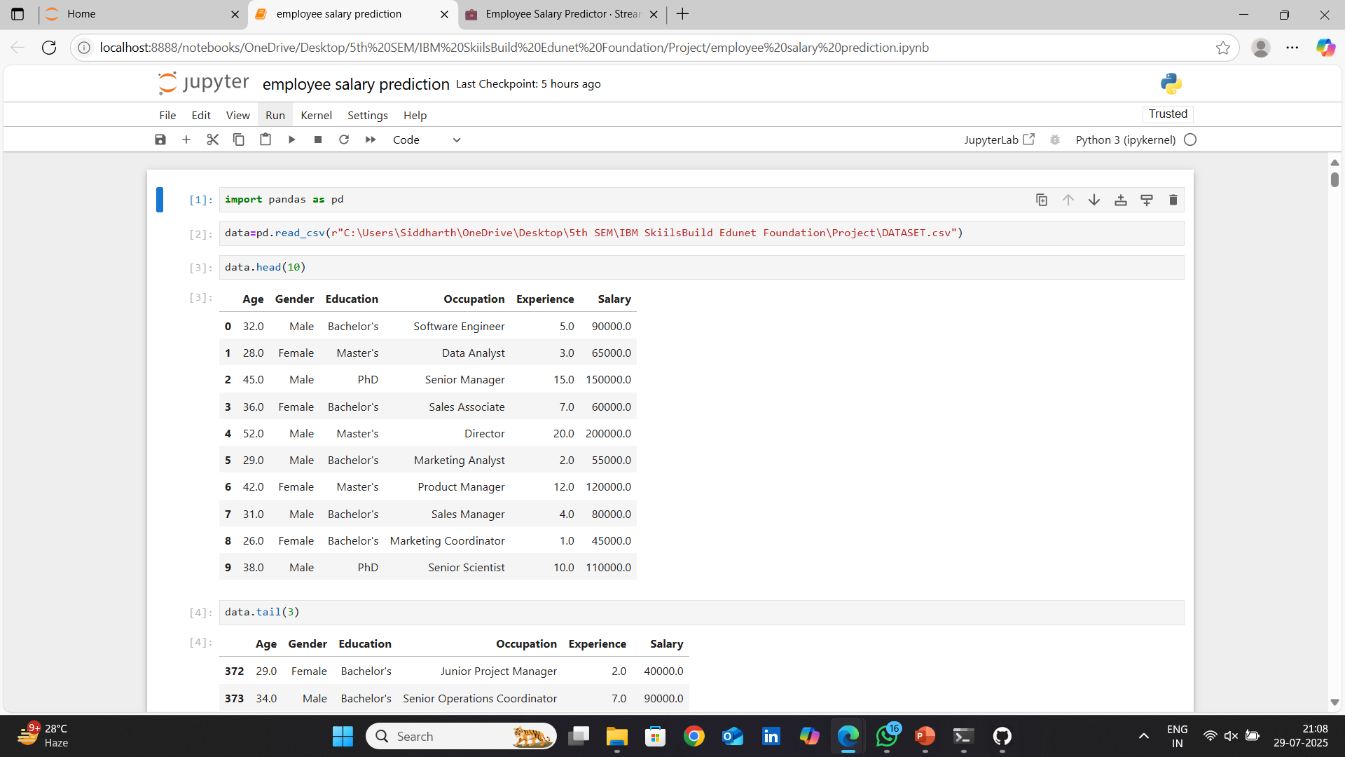
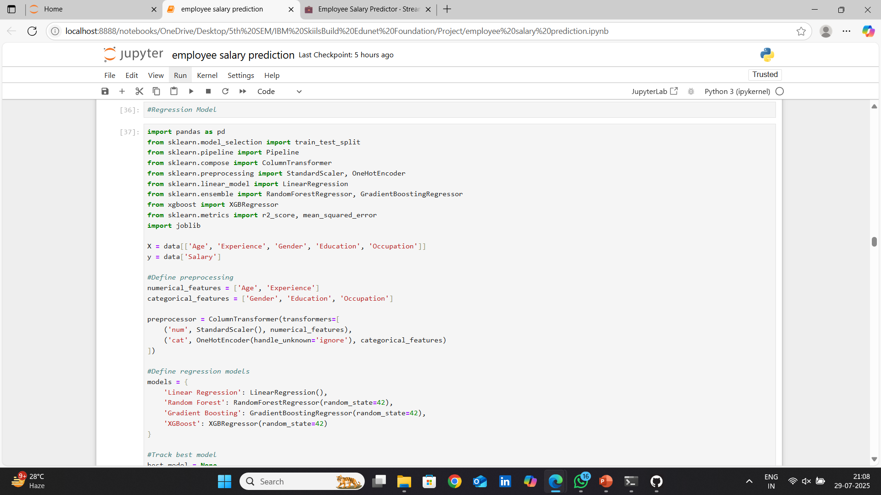
Result
Github link : https://github.com/SID-CSE/Internship-Project---IBM-Skillsbuild-Edunet-Foundation-AICTE
Data Collection & Understanding
Data Preprocessing

Slide 10
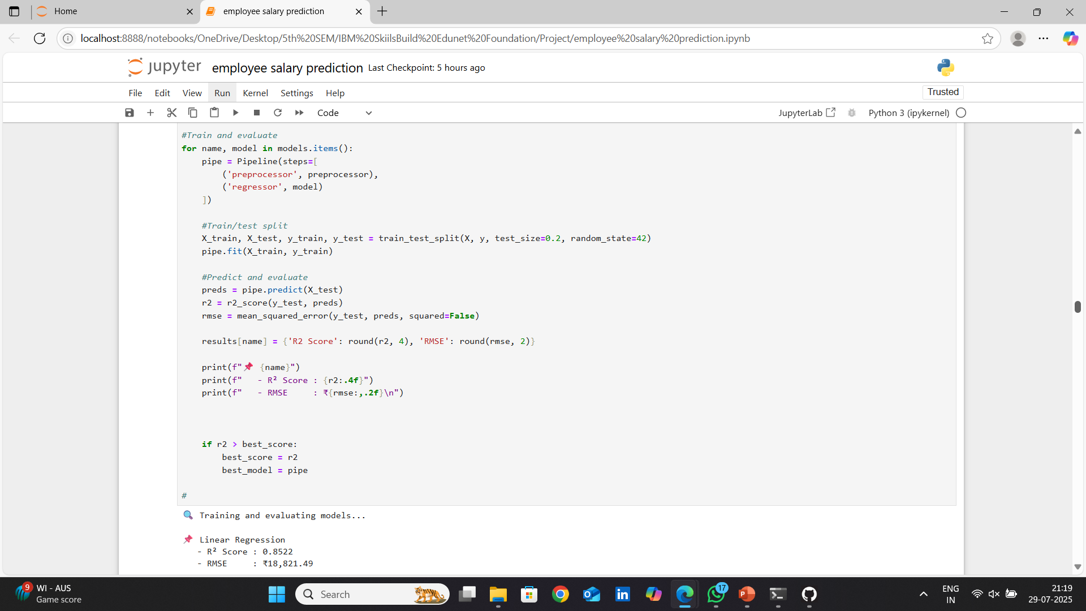
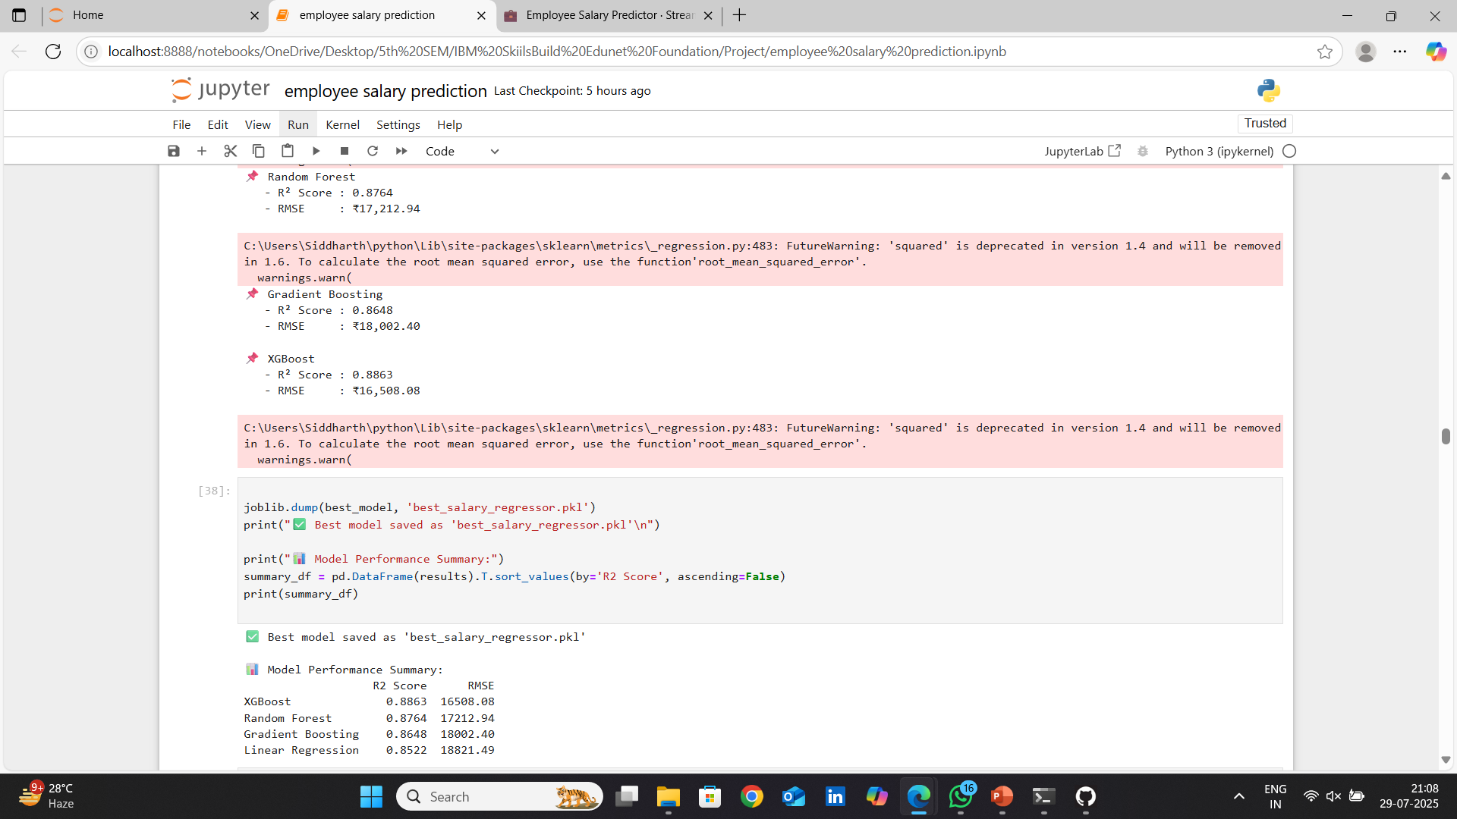
Result
Github link : https://github.com/SID-CSE/Internship-Project---IBM-Skillsbuild-Edunet-Foundation-AICTE
Model Building
Model Saving

Slide 11
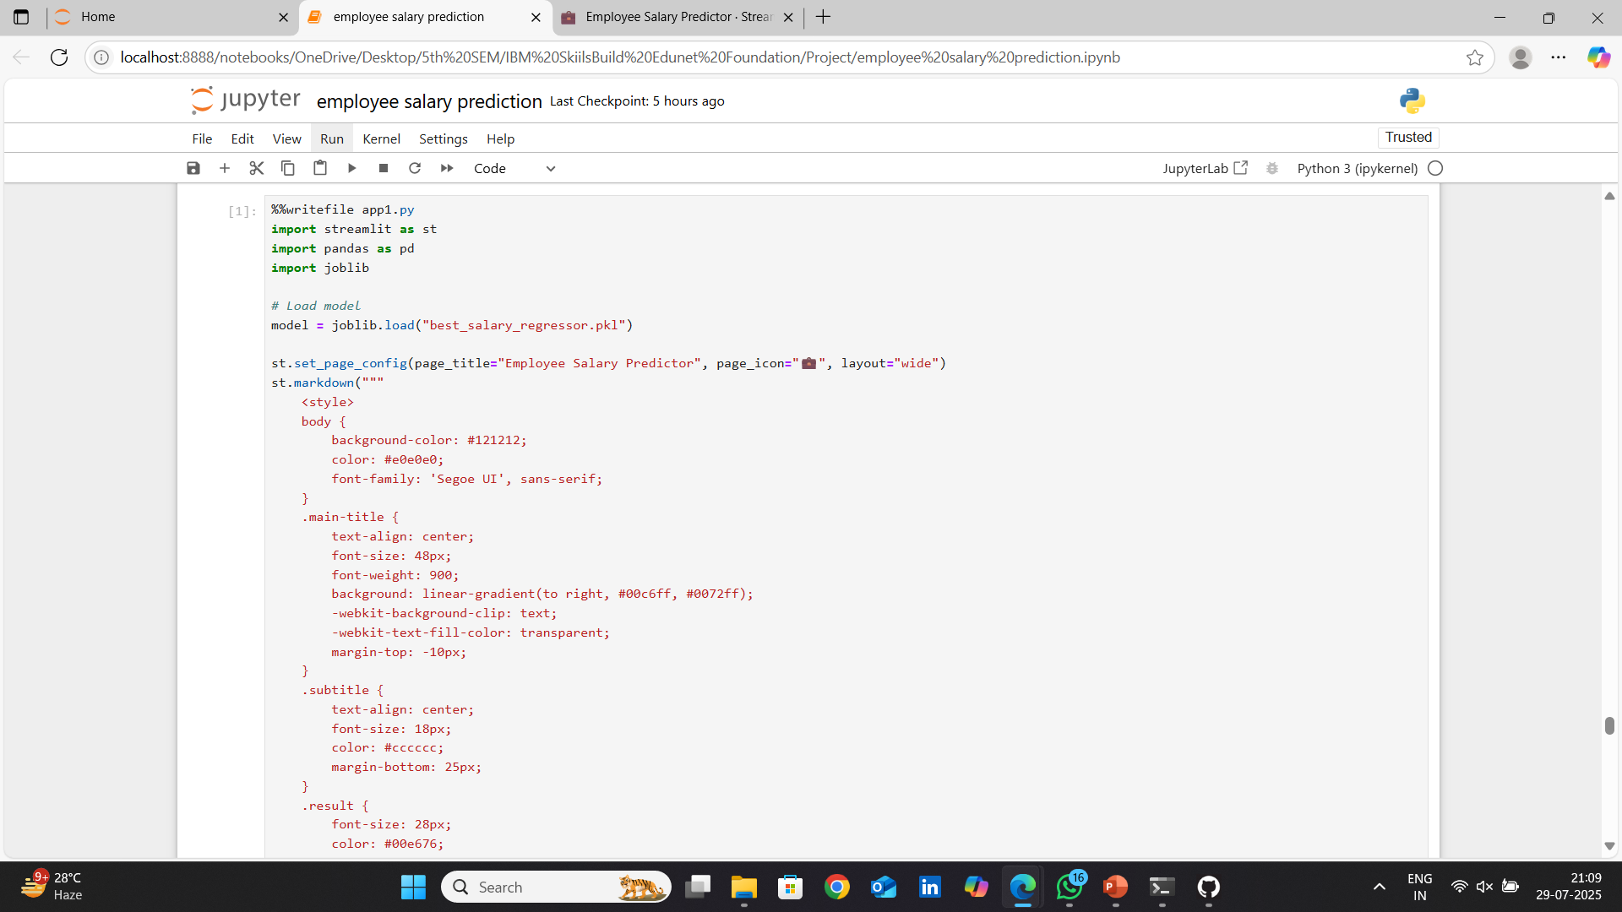
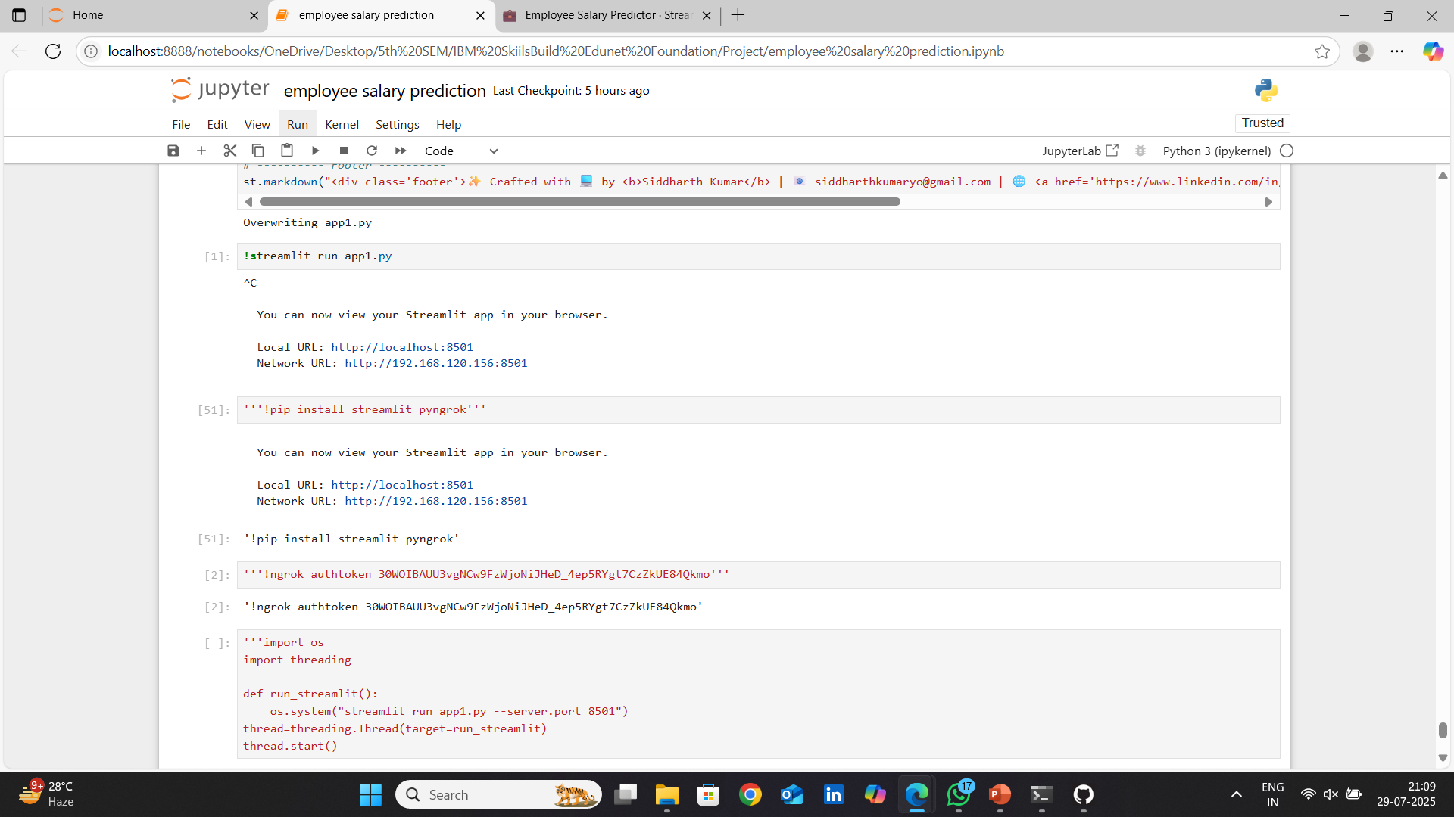
Result
Github link : https://github.com/SID-CSE/Internship-Project---IBM-Skillsbuild-Edunet-Foundation-AICTE
Streamlit App Development
Deployment

Slide 12
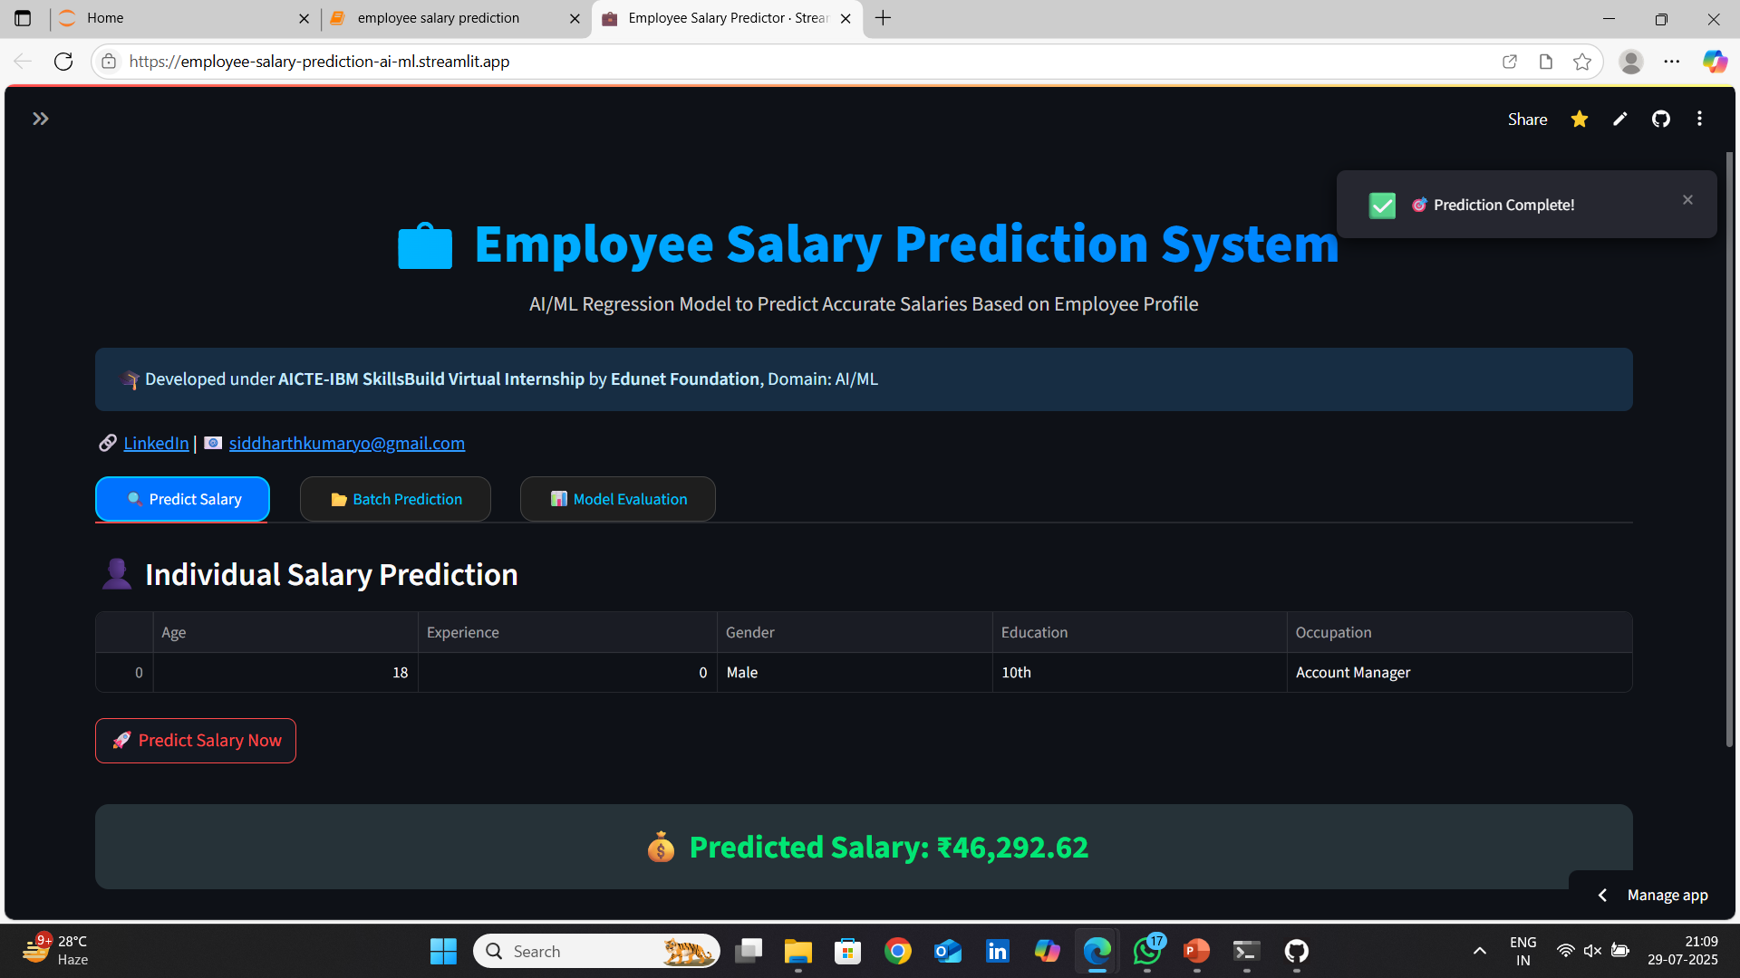
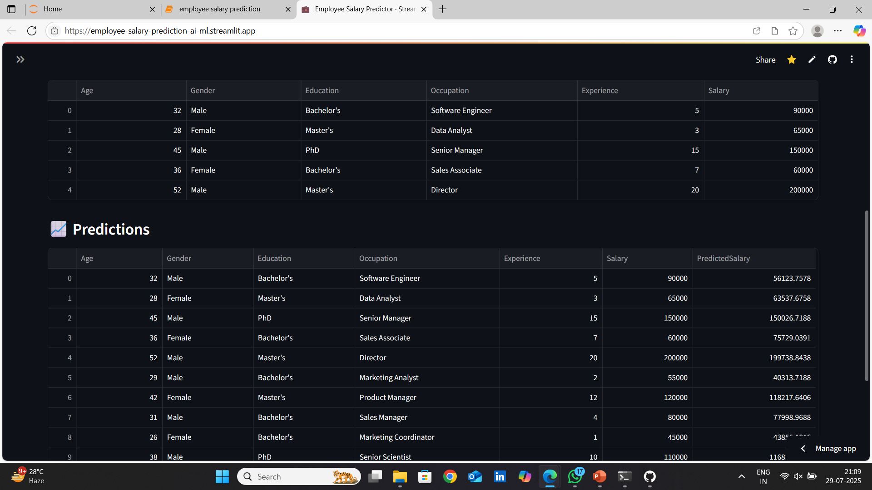
Result
Github link : https://github.com/SID-CSE/Internship-Project---IBM-Skillsbuild-Edunet-Foundation-AICTE
Individual Salary Prediction
Batch Salary Prediction

Slide 13
Conclusion
The project successfully demonstrates how machine learning can be applied to predict employee salaries using features like age, experience, education, occupation, and gender.
The XGBoost regression model, combined with a preprocessing pipeline, provided accurate and reliable results with strong evaluation metrics such as high R² score and low RMSE.
The Streamlit-based web app offers a user-friendly interface, supporting both single and batch predictions, making it practical for real-world usage by HR and analytics teams.
Challenges included handling categorical data effectively, optimizing model performance, and ensuring smooth deployment on Streamlit Cloud (e.g., library compatibility, theme customization).
Future improvements could include integrating more features (like location or industry), using real-time APIs for dynamic data input, and deploying on scalable platforms like AWS or Azure.
Overall, the project showcases the effectiveness of an end-to-end ML solution from model training to web deployment, emphasizing automation, accessibility, and decision-making support.

Slide 14
Future scope
Feature Expansion: Include additional factors like location, company size, department, and skills to improve prediction accuracy.
Real-Time Prediction API: Integrate REST APIs to accept real-time data from external systems like HR portals or job platforms.
Interactive Dashboard: Add a full-fledged analytics dashboard with salary trends, comparative graphs, and filtering options for insights.
Model Optimization: Experiment with ensemble methods, AutoML frameworks, or deep learning models for enhanced performance.
User Authentication & Role Management: Secure the app for multi-user access (e.g., HR, Admin) with login credentials and personalized usage.
Cloud Deployment & Scaling: Deploy the system on platforms like AWS, Azure, or Heroku for better scalability, uptime, and performance monitoring.
Mobile-Responsive Version: Build a mobile-friendly version or native app to allow access on smartphones and tablets.

Slide 15
References
Scikit-learn: Machine Learning in Python Pedregosa et al., Journal of Machine Learning Research, 2011 https://scikit-learn.org/stable/
XGBoost : A Scalable Tree Boosting System Tianqi Chen, Carlos Guestrin, Proceedings of the 22nd ACM SIGKDD, 2016 https://arxiv.org/abs/1603.02754
Streamlit: The Fastest Way to Build Data Apps Streamlit Inc., Official Documentation https://docs.streamlit.io/
UCI Machine Learning Repository: Adult Income Dataset Ronny Kohavi and Barry Becker, 1996 https://archive.ics.uci.edu/ml/datasets/adult
Python Data Science Handbook Jake VanderPlas, O’Reilly Media, 2016
Machine Learning for Predicting Salaries: A Review and Case Study Journal of Artificial Intelligence Research, 2020

Slide 16
THANK YOU

