Slide 1

Python

Slide 2

Agenda
Introduction
A problem-solving app
Specification
Implementation
Future plans
conclusion

Slide 3
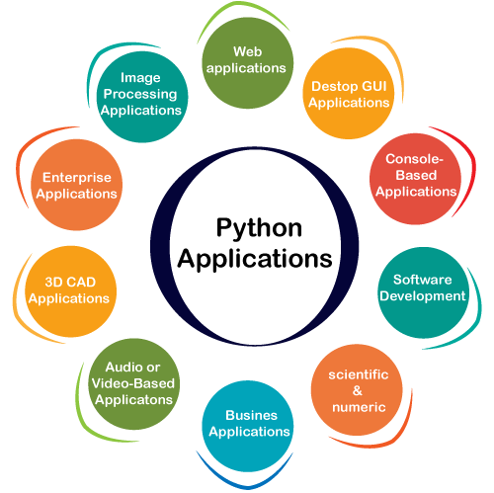
Introduction
Python
a versatile, high-level programming language.
Dynamically typed and automatic memory management.
supports web development, data analysis,
artificial intelligence, and automation.
cross-platform compatibility.

Slide 4
Problem-solving
Accessibility: Our app eliminates the need for a PC or laptop.
Cost-Effectiveness: By eliminating the need for an Internet Connection
and expensive hardware.
Lightweight: No need for heavy Installations of python and IDEs
consumes minimal system resources, ensuring smooth performance.
AnyTime, AnyWhere

Slide 5
Specifications:
Syntax and Keywords highlighting
Auto closing of Opened Parenthesis, Brackets, Braces and Angular brackets
Interpretation of Code on a single click
Auto Increment and Decrement In No. of Lines while editing the Code

Slide 6



Implementation
+
=
(android Sdk33 ) (python 3.11) (chaquopy 14.0)

Slide 7
chaquopy
An API
provides everything you need to include Python
components in an Android app
Simple APIs for calling Python code from Java/Kotlin,
and vice versa.

Slide 8
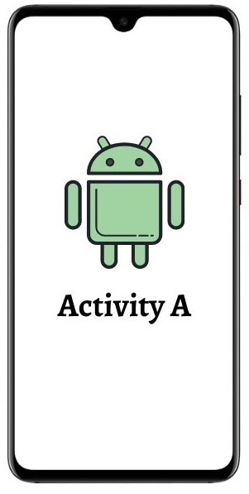


Slide 9









Plan for future
Auto Suggestions
Auto Code Completion
Formatting The Code (Proper Indentation)
Read And Write the python files In local Storage
Include new languages ( C, C++, Java, Rust, C#.....)

Slide 10
conclusion
In conclusion, our problem-solving app provides an accessible and versatile solution for students without PCs or laptops.Its mobile convenience, interactive learning features, and cost-effectiveness make it a valuable tool.
With successful implementation, including collaborative problem-solving, offline access, and gamified learning, our app empowers students to enhance their problem-solving skills.

Slide 11

Thank you

Slide 12
Questions

